Slide 1
ABNORMAL LABOUR
LECTURE NOTES

Slide 2
Introduction
Labor is a physiological process during which a fetus is expelled.
The mainly labor force is uterine contracion.
In the labor process, cervical effacement and dilation and fetal delivery occur.

Slide 3
Normal labor
Normal labor is divided into 3 stages by Fredman.
The first stage, the second stage and the third stage.
The first stage is subdivided into the latent phase and the active phase.

Slide 4
Normal labor staging

Slide 5
Abnormal labor
Abnormal labor refers to difficult labor.
Another name is dystocia.
Clinical presentation is slow labor process.

Slide 6
Causes of abnormal labor
Abnormalities of expulsive forces
Abnormalities of birth canal
Abnormalities of presentation & position of fetus

Slide 7
The diagnostic criteria of abnormal labor

Slide 8
Abnormalities of birth canal
The morphology and capacity are primary causes of dystocia.
Pelvic structure: pubis, sacrum and ischium.
Pelvic plane: inlet, midpelvic and outlet
Bony marker: ischial spine

Slide 9
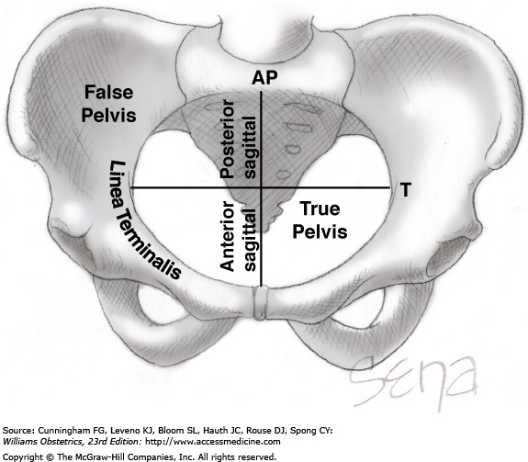

Slide 10
Ischial spine
The Ischial spine is halfway of birth canal.
Station of fetal presentation is discribed in relationship with the ischial spine.
the axis of birth canal above and below the ischial spine is divided into fifth respectively.
As the presenting part reaches the ischial spine, the designation is 0 station.

Slide 11
Classification of abnormalities of pelvis
Contracted pelvis
contracted inlet plane
contracted midpelvis
contracted outlet plane
Pelvic malformation

Slide 12
Mechanism
For Contracted pelvis , the fetus has difficulty in passing through birth canal.
The labor is protracted or arrested.
Secondary uterine inertia occurs.

Slide 13
Contracted inlet plane
Ctriteria: sacral-pubic diameter<18cm
Clinical findings: fetal head palpable above
the inlet plane.
prolonged latent phase

Slide 14
Management
To assess cephalopelvic relationship by a series of examination.
Mild cephalopelvic disproportion: trial labor
Obvious cephalopelvic disproportion: cesarean section.

Slide 15
Abnormalities of fetus
Abnormalities of fetal position
Macrosomia
Fetal malformation

Slide 16
Fetal status
Fetal lie:The relation of the fetal long axis to that of the mother is termed fetal lie and is either longitudinal or transverse
Fetal presentation: the foremost part in birth canal.
Cephalic, breech and should presentation.

Slide 17
Cephalic presentation
According to degree of fetal head flex, cephalic presentation is divided into vertex, brow and face presentation.
Brow and face presentation result in dystocia.

Slide 18
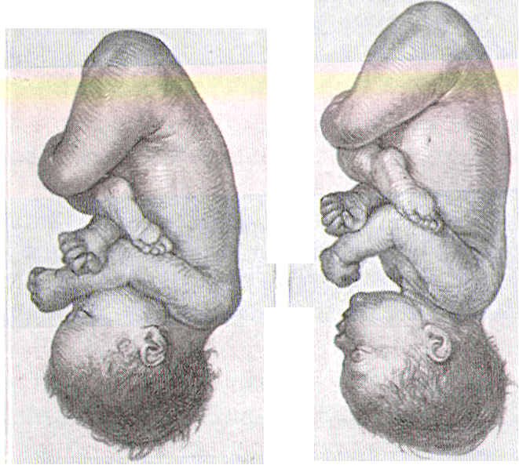
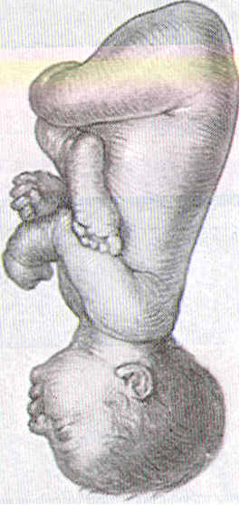
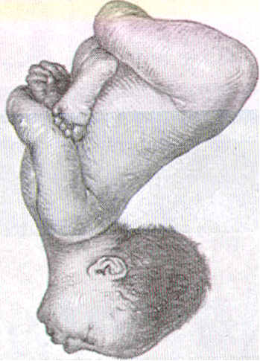
Longitudinal lie. Ce­phalic presentation. Differences in attitude of fetal body, Note changes in fetal attitude in relation to fetal vertex as the fetal head becomes less flexed
(A) vertex
(B) sinciput
(C) brow
(D) face

Slide 19
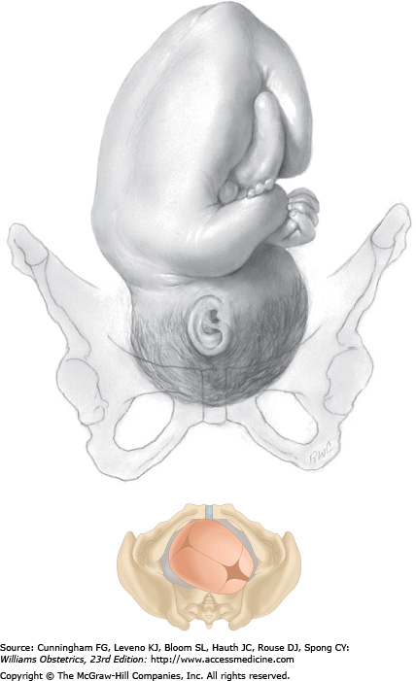

Slide 20
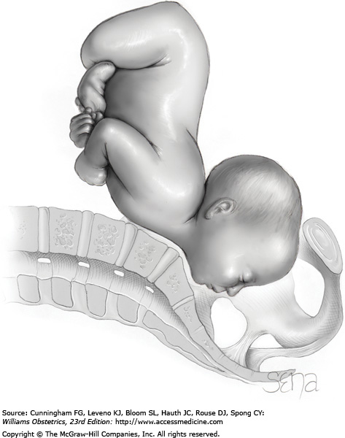

Slide 21
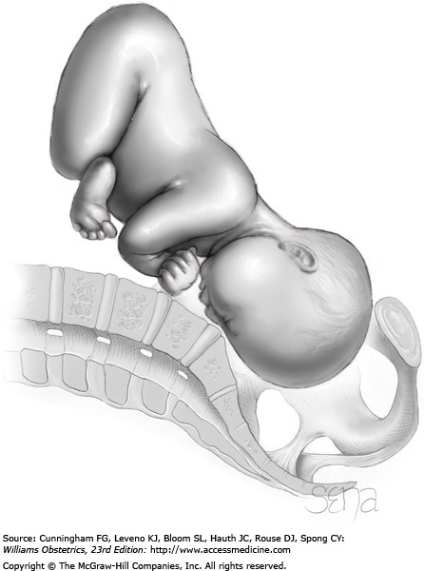

Slide 22
Fetal head diameter
Bi-parietal dimension: 9.5cm
Suboccipitobregmatic dimension: 9.5cm
Occipitofrontal dimension:11.5cm
Occipitomental dimension: 13cm

Slide 23
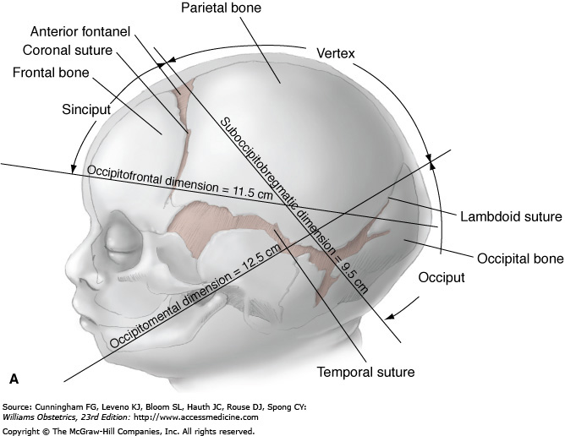

Slide 24
Cont…
Any presentation other than vertex presentation.
Many types:
1.Face presentation.
2.Brow presentation.
3.Breech presentation.
4.Shoulder ===.
5.Compound ===.

Slide 25
Causes of malpresentations
1.Prematurity.
2.Multiple pregnancy.
3.Abnormal baby.
4.Polyhydramnios or oligohydramnios.
5.Congenital malformation of the uterus.
6.Placenta previa.
7.Contracted pelvis

Slide 26
Face presentation
In this condition the head is fully extended and the face is the presenting part.
Incidence: about once in 500 labours.
Causes:
1.Abnormal baby e.g.anancephaly.
2.Congenital tumors of the neck causes extended head.
3.Contracted pelvis.
4.Prematurity.
5.Multiple pregnancy.
6.Presence of several loops of cord around the neck.
7. Most face presentations are secondary occurs during labour as a result of increased extension of the head.

Slide 27
Face presentation: a. mento-anterior( delivery possible) b. mento-posterior (delivery impossible).

Slide 28
In a mento-anterior position:
•The head engages and descend with increasing extension.
•So the sub-mento-bregmatic diameter (9.5cm)comes through the cervix.
•When the chin reaches the pelvic floor it undergoes internal rotation through one- eighth of a circle.
•So the submental region comes to lie under the subpubic arch.
•The head born by a movement of flexion.
•Restitution occurs and is followed by external rotation as in vertex presentation.

Slide 29
In mento-posterior position:
•Similar mechanism occurs, except that the chin undergoes internal rotation through three-eighths of a circle.
•If the head undergoes backwards rotation there will be persistent mento-posterior position
•This position is incompatible with vaginal delivery.
•This is because the head is already fully extended so further extension to deliver the head is impossible.
•This result in obstructed labour and need assisted delivery by caesarian section.

Slide 30
Diagnosis
Rarely made before labour and of little significance if it is.
Abdomen
• Longitudinal lie with body nearer to mid-axis of uterus.
• More head felt on the same side as the back.

Slide 31
Vaginal examination
• Do not expect the face to feel like the newborn baby’s face. Oedema always obscures facial parts.
• Supra-orbital ridges lead to the bridge of the nose.
• Mouth has hard gums in it and may suck on the examining finger.

Slide 32
Management
IN PREGNANCY
• Await events.
• Membranes may rupture early (examine vaginally to exclude prolapsed cord).
• Check that pelvis is adequate and that fetus is not oversized. If either, consider Caesarean section for face presentation in labour has a higher risk.
• Check with ultrasound that the fetus is not an anencephalic for this might alter management.

Slide 33
Mechanism
Head descends with face leading. Chin (mentum) used as denominator to determine rotation.
85% engage in the mentotransverse (submentobregmatic diameter—10cm). With descent, most rotate to mentoanterior on the pelvic floor, the fetal chin coming behind the maternal pubis.

Slide 34
Cont…
After further descent, the chin can escape from under the lower back of the pubis and the head is then delivered over the vulva by flexion.
Up to this point, the mechanisms of flexion/extension of the fetal head are the reverse of those with a vertex presentation. After delivery of the head, however, the external rotations are the same allowing the fetal shoulders to negotiate the pelvis.

Slide 35
Mechanism of labour
The chin is the denominator.
Four positions present:
•Right mento-anterior.
•Left mento-anterior.
•Left mento-posterior.
•Right mento-posterior.
Mento-anterior positions are more common (80% of cases).

Slide 36
IN LABOUR
• If anterior rotation to mentoanterior, a longer labour but spontaneous delivery will probably occur (90%).
• If head stays in mentotransverse deliver by Caesarean section.
• If face rotates posteriorly, this is impossible to deliver vaginally. Hence, perform a Caesarean section.

Slide 37
Prognosis:
Many face presentations are delivered naturally without difficulty.
Face presentation is less favorable than vertex because the face is a less efficient dilator of the cervix.
The diameter which emerge through the outlet is the sub-mento-vertical (11 cm) which is larger than the vertex presentation.

Slide 38
Management of labour and delivery
The women is kept in bed during the 1st stage.
Once membranes ruptured, vaginal examination should be done to exclude cord prolapse.
When the cervix become fully dilated, and the head reaches the pelvic floor, an episiotomy should be done especially in primigravida to avoid tearing of the perineum..
In mento-anterior position
Spontaneous vaginal delivery is expected.
If there is delay in the 2nd stage forceps can be applied

Slide 39
With mento-posterior position
Time should be allowed for spontaneous rotation to anterior position take place (which happened in 45-65% of cases).
This usually happened late in the 2nd stage.
If spontaneous rotation does not occur then
Caesarian section is done to reduce fetal and maternal morbidity.

Slide 40
NOTE
•After delivery the face is usually swollen and discolored.
•This is temporarily and complete recovery is usual after few days.

Slide 41
BROW PRESENTATION
A very poorly flexed head may present the largest diameter of the skull: mentovertex (13 cm). In brow there is partial extension of the head.
Incidence
0.1% of all deliveries.

Slide 42
Cont…
Causes: The same as face presentation.
Extension of the head before labour called primary extension.
Extension during labour termed secondary extension.
With uterine contraction the head either undergoes more flexion and change to vertex presentation.
Or further extension and change to face presentation.
Persistent brow presentation is fortunately rare.

Slide 43
Brow presentation
In brow presentation the diameter which present is the mento-vertical which measure 13 cm.

Slide 44
Diagnosis
Rarely made before labour and of little significance if it is.
Abdomen
• Head feels big.
• Not well engaged.
• Groove between occiput and back. Head felt on both sides of fetus.

Slide 45
Cont…
Brow presentation can be diagnosed by ultrasound antenatally.
Brow presentation should always be suspected when there is non engagement of the fetal head in labour especially in woman who has had previous easy deliveries.
❖ As a rule there is early rupture of the membranes.
On vaginal examination:
•The presenting part is usually high.
•The landmarks felt are:
1.The anterior fontanells,
2.Frontal suture.
3.Forehead.
4.The orbital Ridges.
5.The bridge of the nose

Slide 46
Vaginal examination
Early in labour:
•The presenting part is usually high.
•There may be early rupture of membranes.
When labour is well established, the landmarks are:
•Mouth, jaws, nose, malar and orbital ridges.
•The presence of alveolar margins distinguishes the mouth from the anus in breech presentation.
•One should avoid damaging the eyes during vaginal examination.
•Vaginal examination should includes a thorough search for cord presentation or prolapse.

Slide 47
Cont…
• Anterior fontanelle presents.
• Supraorbital ridges and base of nose can be felt at edge of field.

Slide 48
Management
IN PREGNANCY
• Await events. No point in trying to convert to more favourable presentation.
• Membranes may rupture early (examine vaginally to exclude prolapsed cord).

Slide 49
IN LABOUR
• If diagnosed early, await events for some convert spontaneously to face (by further extension) or vertex (by flexion).
• If presentation persists, it will be impossible to deliver vaginally. Hence deliver by Caesarean section.
• If fetus is dead or there is hydrocephaly, the destructive operation of perforation of head and vaginal extraction is possible provided the operator is skilled in these arts, but in the Western world these are a diminishing number.

Slide 50
BREECH PRESENTATION
The definition of breech presentation is when the buttocks, foot or feet are presenting instead of the head
Incidence
At term 2–3%; more in preterm deliveries.
Causes are divided into two: maternal and fetal factors.

Slide 51
Maternal factors
Polyhydraminos
Uterine anomalies (bicornuate, septate)
Space occupying lesions (e.g fibroids)
Placental abnormalities (praevia, cornual)
Multiparity (in particular grand multiparas)

Slide 52
Fetal factors
Prematurity
Fetal anomalies (e.g neurological, hydrocephalus, anenecephaly)
Multiple pregnancy
Fetal death
Short umbilical cord

Slide 53
Types
Frank breech or extended breech. This is the commonest presentation. Flexed or extended knee joints.
Complete breech. Fully flexed fetus with both knees flexed.
An incomplete breech. One leg flexed and the other leg extended.
A footling breech. Both hips extended;. Often occurs with very small babies.

Slide 54
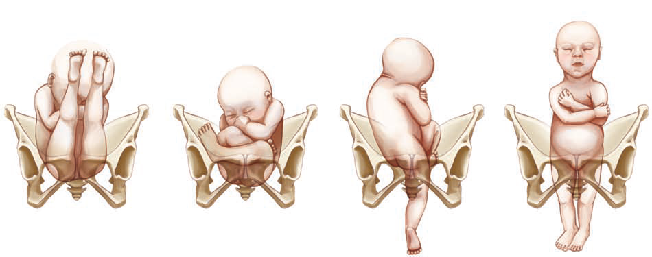
Breech presentations
A. Frank
B. Complete
C. Incomplete
D. Footling

Slide 55
Fetal position
Using the fetal sacrum as the denominator, the position of the breech presentation is described as left sacrum anterior or left sacrum posterior and right sacrum anterior or right sacrum posterior.

Slide 56
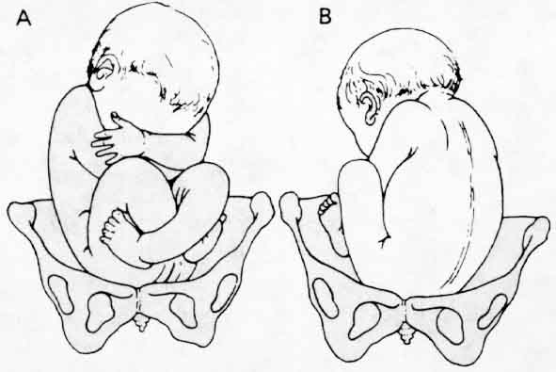
Breech presentations:
A: Right sacrum posterior (RSP) position
B: Left sacrum anterior (LSA) position

Slide 57
Diagnosis
On abdominal examination the head is felt in the upper abdomen and the breech in the pelvic brim. Auscultation locates the fetal heart higher than expected with a vertex presentation.
On palpation, the lie is longitudinal and fundus contains a firm, smooth and rounded mass which dependently moves with the back.
On pelvic palpation no head is palpated pelvic has a soft and irregular mass.

Slide 58
Cont…
On auscultation, the fetal heart beat is heard above the umbilicus if the breech is not engaged below the umbilicus if it is engaged.
Vaginal examination
No sutures and fontanels are felt. When the membrane are ruptured the anal sphincter grips the finger when fresh meconium seen on the examining finger.
Antenatal management
The presentation may be confirmed by ultrasound scan. The obstetrician may decide to do an external cephalic version before 36 weeks of gestation.

Slide 59
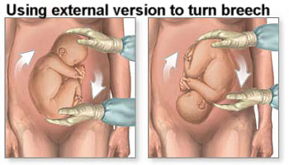

Slide 60
ECV
External cephalic version (ECV) is the transabdominal manual rotation of the fetus into a cephalic presentation.
after ECV successful rate 35-86%
breech presentation at term, after ECV 1 - 1.5%
indications for urgent caesarean after ECV 1 - 3%
The risk of intrauterine death of foetus after ECV is about 0.0001%

Slide 61
contraindication to ECV
preterm
Multiple pregnancy
significant third trimester bleeding
IUGR,
oligohydramnion
PROM
PIH
nonreassuring foetal monitoring patterns
all contraindications to vaginal birth are concerned to execute ECV

Slide 62
Risk of ECV
umbilical cord entanglement
abruptio placenta
premature rupture of the membranes (PROM)
severe maternal discomfort

Slide 63
Management in labor
On vaginal examination during labour, the buttocks and/or feet are felt; thick, dark meconium is normal.
During labor, the fetal descent is slow because the breech is a less effective dilating wedge than the fetal head. The buttocks, legs, and feet are softer than the head and therefore exert less pressure on the cervix. Cord prolapse occurs more often during breech birth and increases the risk of birth trauma because the buttocks (presenting part) are smaller than the head and do not fit as tightly into the pelvis. The risk of postpartum hemorrhage is also increased.

Slide 64
Cont…
The presence of meconium in the amniotic fluid in breech presentations is not necessarily a sign of fetal distress but results from pressure on the fetal abdominal wall and buttocks. Fetal heart tones are best heard at or above the maternal umbilicus. Forceps are sometimes used to deliver the after-coming fetal head. In a breech delivery, when the lower body is born, the umbilical cord extends above the fetal head and is at risk of compression as the head passes through the bony vaginal canal. Birth of the head must occur quickly to avoid hypoxia.

Slide 65
Cont…
The method of delivery is chosen depend on
1. Parity of the mother if she is primigravida
2. Size of the baby
3. Other obstetrical complication

Slide 66
The Principles of Management
- Intelligent observation
- Avoidance of unnecessary interference
- Prompt action carried out with manual dexterity when assistance is needed
- Avoidance of fetal injury and hypoxia

Slide 67
Mechanism of breech delivery
Descent takes place by increasing compaction due to increased flexion of the limbs. Bitrochantric diameter which is 10cm enters the pelvis in the oblique diameter.
- Internal rotation of the buttocks
- Lateral flexion of the body
- Restitution of the buttock
- Internal rotation of the head.
- External rotation of the body
- Birth of the head the chin face and sinciput sweep the perineum and the head is born in a flexed attitude.
N.B. Labor in breech is always considered as a trial
Management of Labor in Breech Delivery

Slide 68
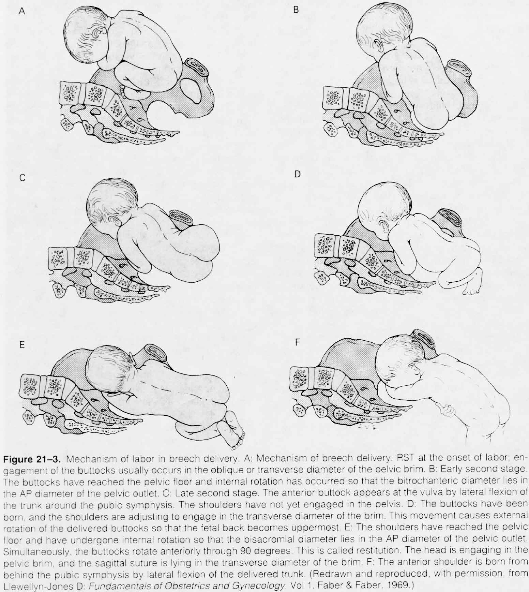
MECHANISM OF LABOR IN BREECH DELIVERY

Slide 69
Cont…
It is managed depending on types of presentations
Types of delivery
- Spontaneous breech delivery
- Assisted breech delivery-assistances for delivery of extended legs arms and the head.
- Breech extraction this is the manipulative delivery to extract the breech when the mother is unable to deliver.

Slide 70
First Stage
- Careful observation
- Warn mother not to push
- Vaginal examination when membrane ruptures (to rule out cord prolapse).
- Sedation often necessary
- Be prepared for the delivery

Slide 71
Delivery of Flexed Breech
- Full dilatation of the cervix should be confirmed by vaginal examination before allowing the woman to push to prevent the breech slipping through incompletely dilated and the head may be trapped by the cervix.
- Active pushing is not commenced until the buttocks are distending the vulva.

Slide 72
Cont…
• Encourage her to push with the contraction and the buttocks are delivered spontaneously episiotomy may be necessary
• The hands off the breech get mother to push when the buttocks are born pull down a loop of cord feel for pulsation put in to the hollow of the sacrum to prevent pressure and traction.
• Feel for the elbows on the chest the shoulder should be born easily with the arms flexed across the chest if not help them out by flexing the arm.

Slide 73
Cont…
• Grasp the baby by iliac crest with the thumbs held parallel over his sacrum and tilt the baby towards the maternal sacrum to free the anterior shoulder.
• Wrap small towel around the baby hip to preserve the warmth and improve the grip on the slippery skin.
•When the anterior shoulder is born lift the buttocks towards the mother’s abdomen to enable the posterior shoulder to pass over the perineum.

Slide 74
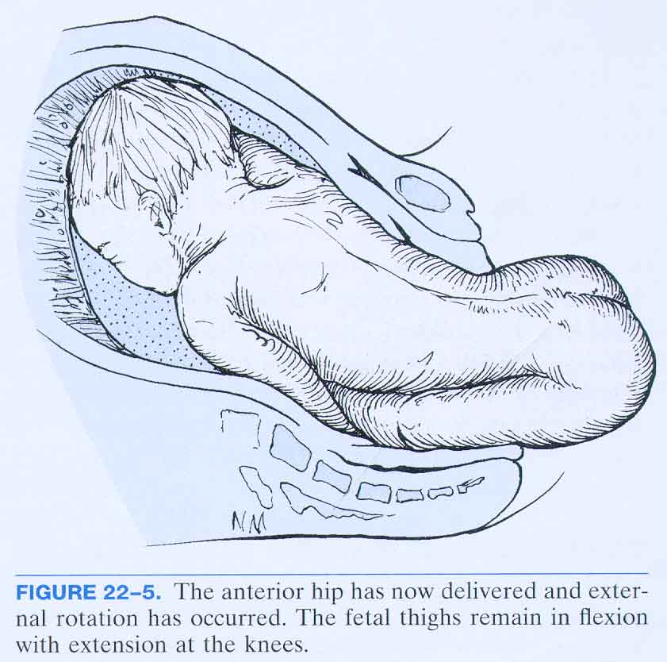
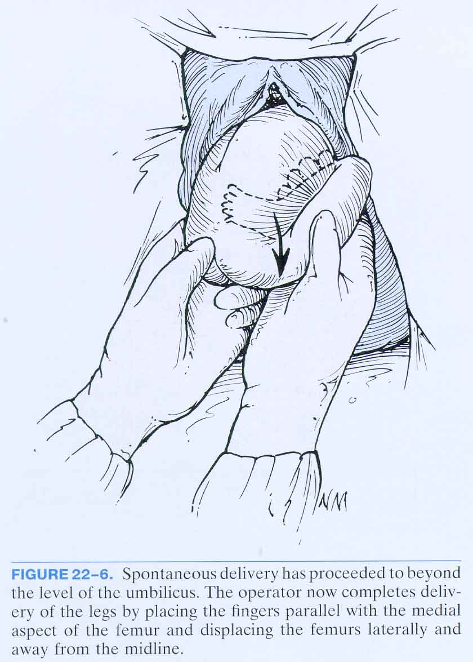
ASSISTED DELIVERY OF FRANK BREECH

Slide 75
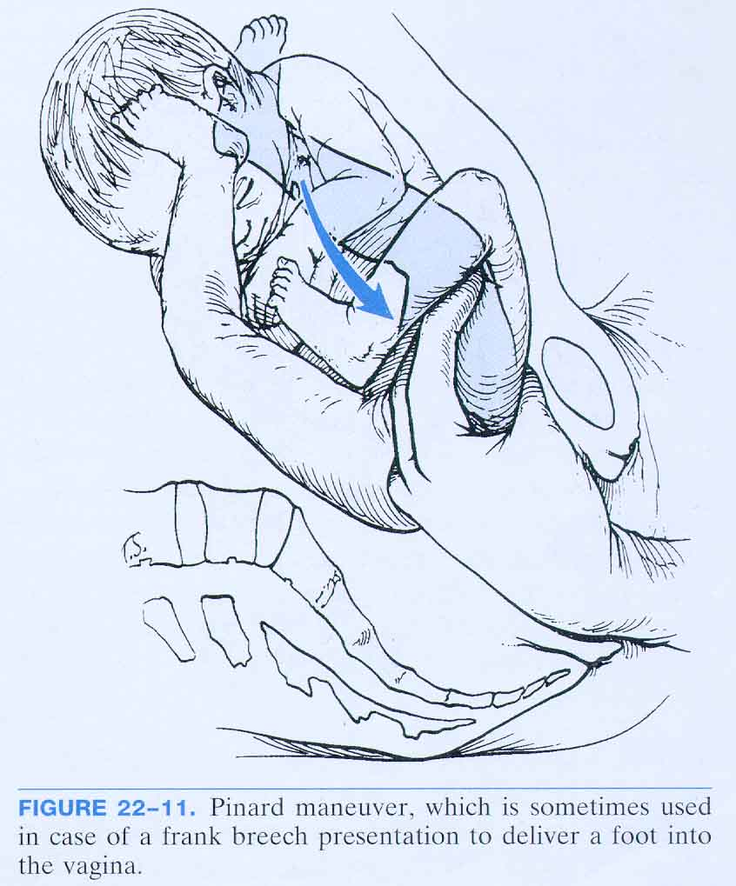
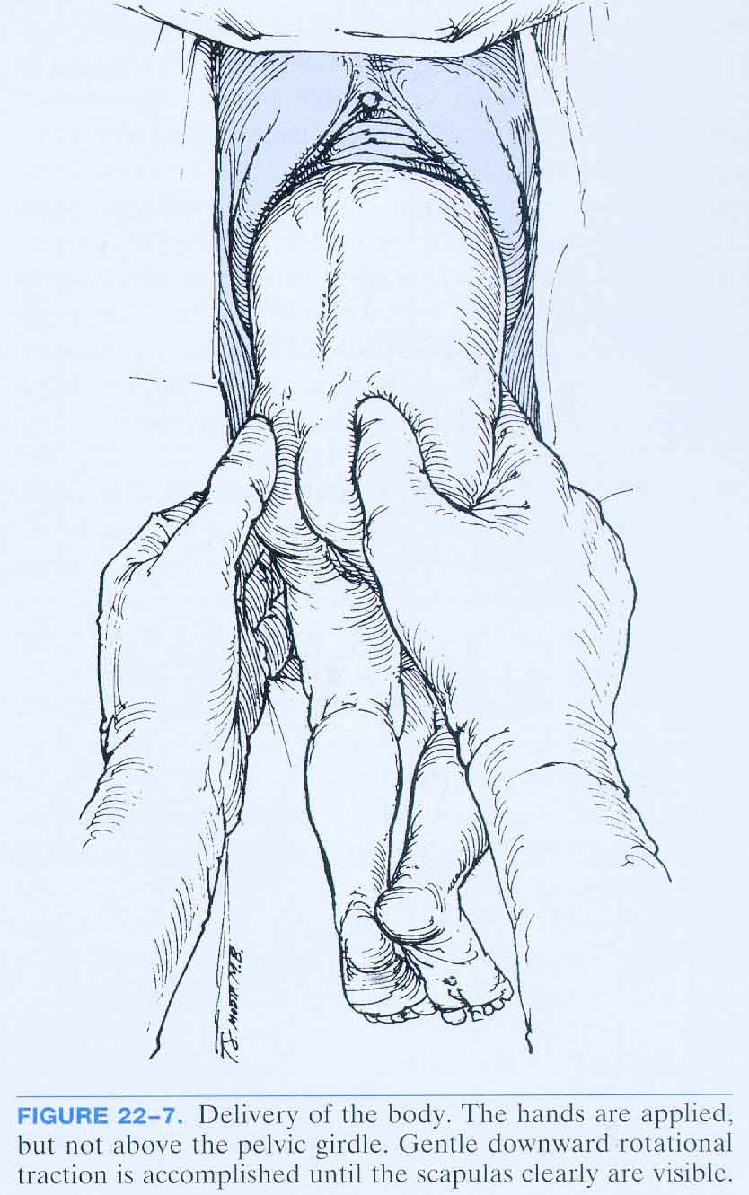
ASSISTED DELIVERY OF FRANK BREECH

Slide 76
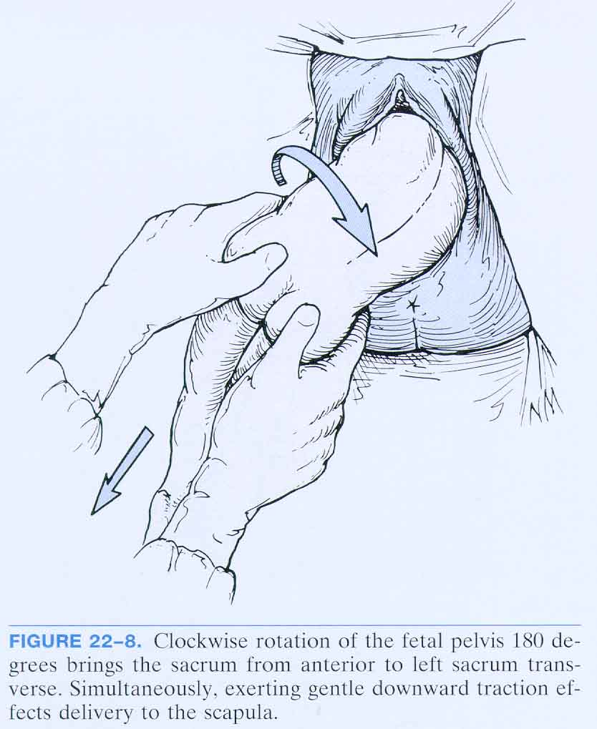
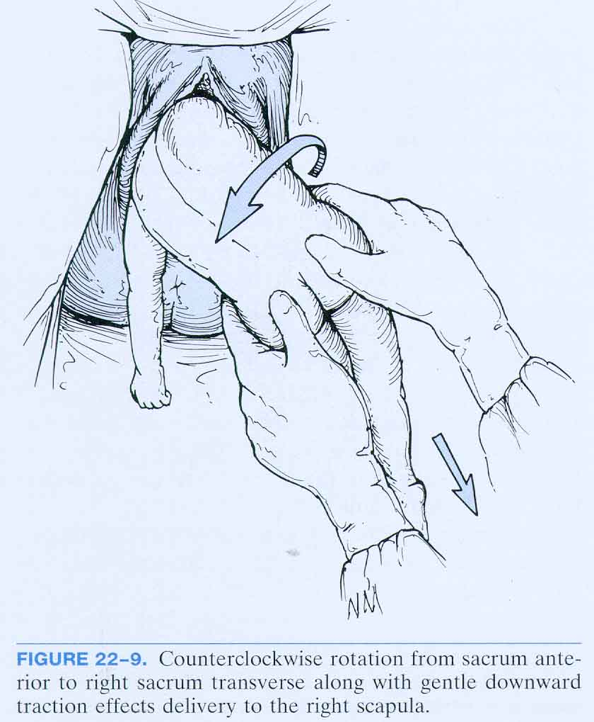
ASSISTED DELIVERY OF FRANK BREECH

Slide 77
Delivery of the head
Delivery of flexed head (Burn’s Marshal Method)
After the shoulder is born the baby is allowed to hang unsupported. Within one minute the nape of the neck (hair line) appears. The baby is now grasped by the ankle and maintains traction while supporting the head on the perineum with the right hand. Hold the baby on a stretch and slowly bring the feet up to an angle of 180 degrees.

Slide 78
Cont…
When the face appears get someone to clean the air ways then delivery the head very slowly taking 2 to3 minutes to allow the vault of the head to be expelled. The mother should breathe out the head.

Slide 79
Delivery of extended head (mauriceau smelle’s veit method)
-When the baby is allowed to hang the neck and hair line is not visible, it indicates that the head is extended.
-Pick up the baby by the feet and lie him astride on the right forearm put the middle finger of the right hand in the babies mouth far back to the roof of the tongue. With the other hand on the head and flex it down wards towards the floor applying traction. When the head is down bring it up gently delivery slowly taking 2 to 3 minutes to deliver it and so prevent cerebral damage

Slide 80
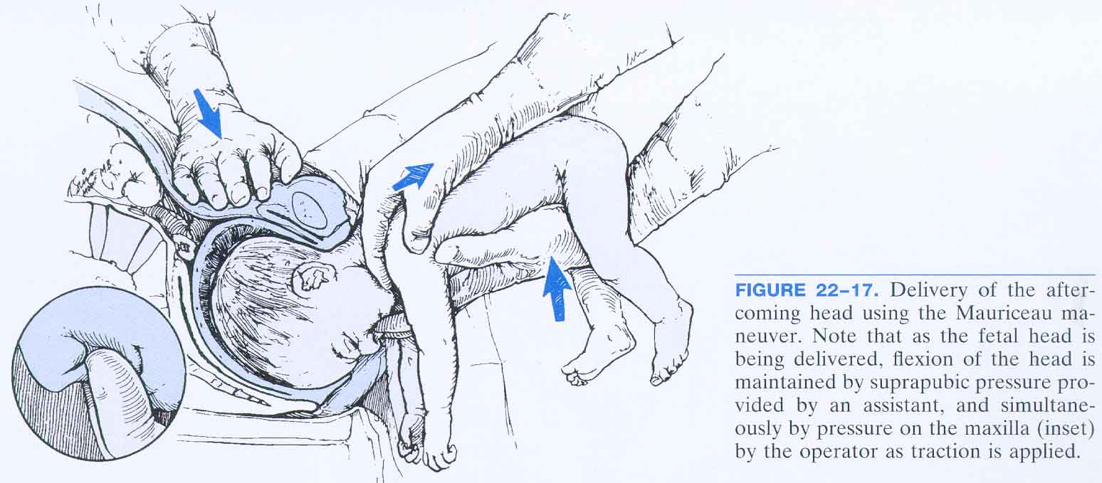
MAURICEAU MANEUVER

Slide 81
Delivery of extended arm
(Lovset manoeuvre)
Extended arms are diagnosed when the elbows are not felt on the chest after umbilicus is born. Prompt action must be taken to avoid delay and consequent hypoxia. This is a combination of rotation and downward traction so as to deliver the arms whenever position they are in. The direction of rotation must bring the back uppermost.When the umbilicus is born and shoulders are in anteroposterior diameter the baby is grasped by the iliac crests with the thumbs over the sacrum. Downward traction is applied until the axilla is visible.

Slide 82
Cont….
Get mother to push, when the axilla is seen it means that the arms are extended. So place the cord sacrum and fingers below the iliac crest, rotate shoulder in to the anterior posterior diameter of the pelvis, then rotate the posterior shoulder anteriorly keeping the back on top, now flex the arm over the face and deliver it, splint it, and now bring the other arm anteriorly, and deliver it by flexing it across the chest now the shoulders are born

Slide 83
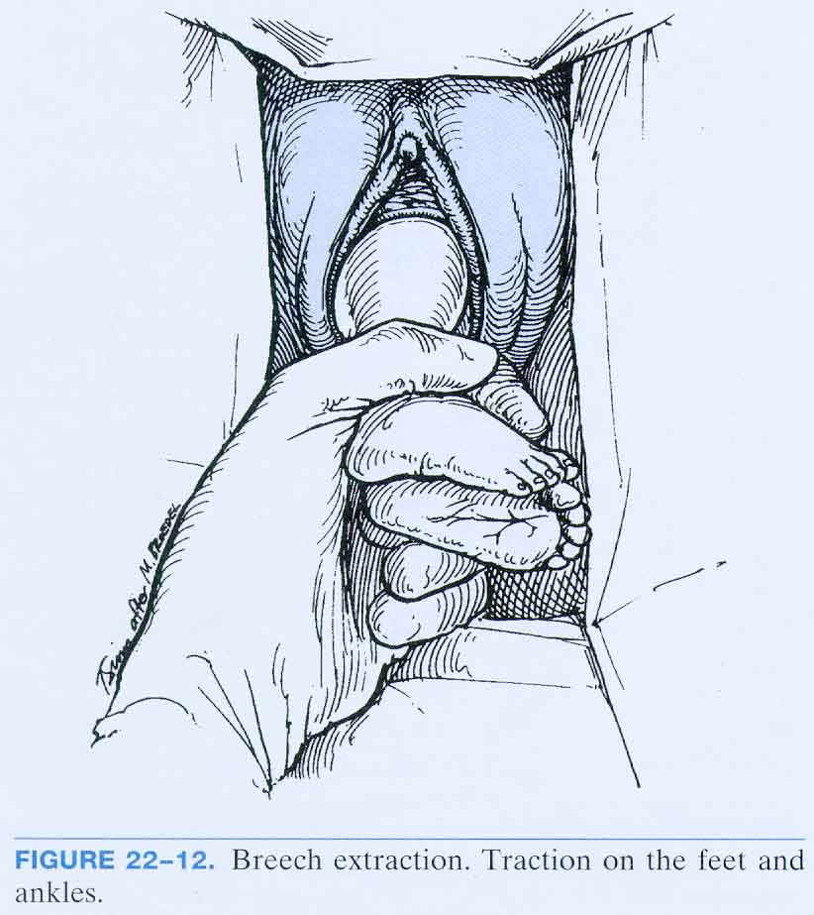
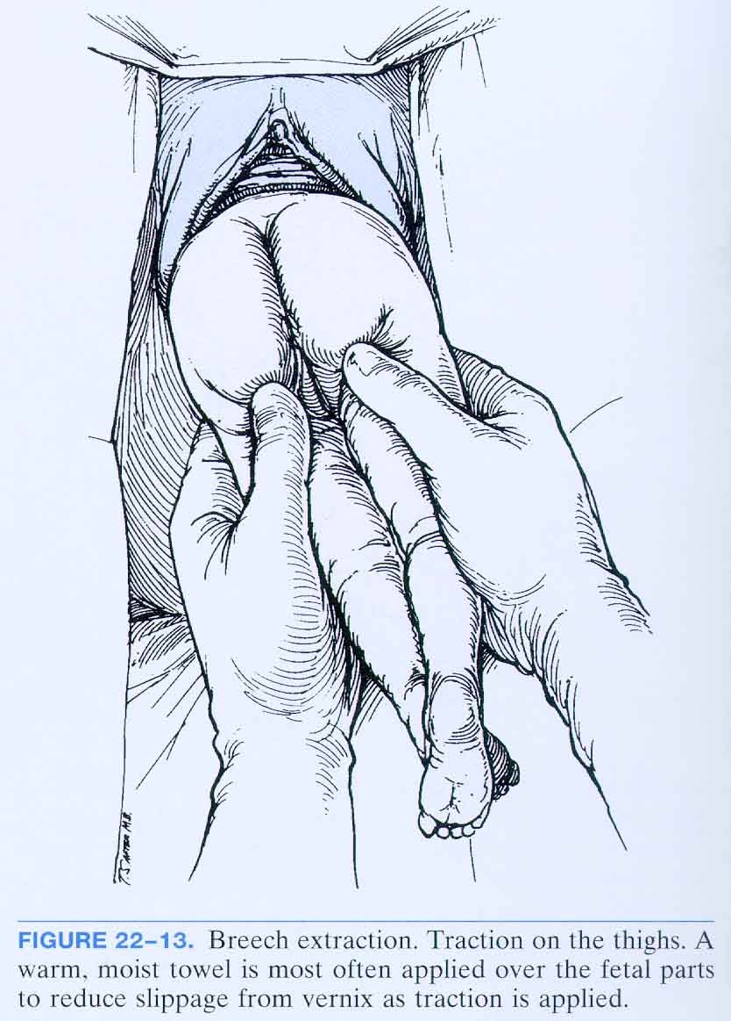
COMPLETE OR INCOMPLETE BREECH EXTRACTION

Slide 84
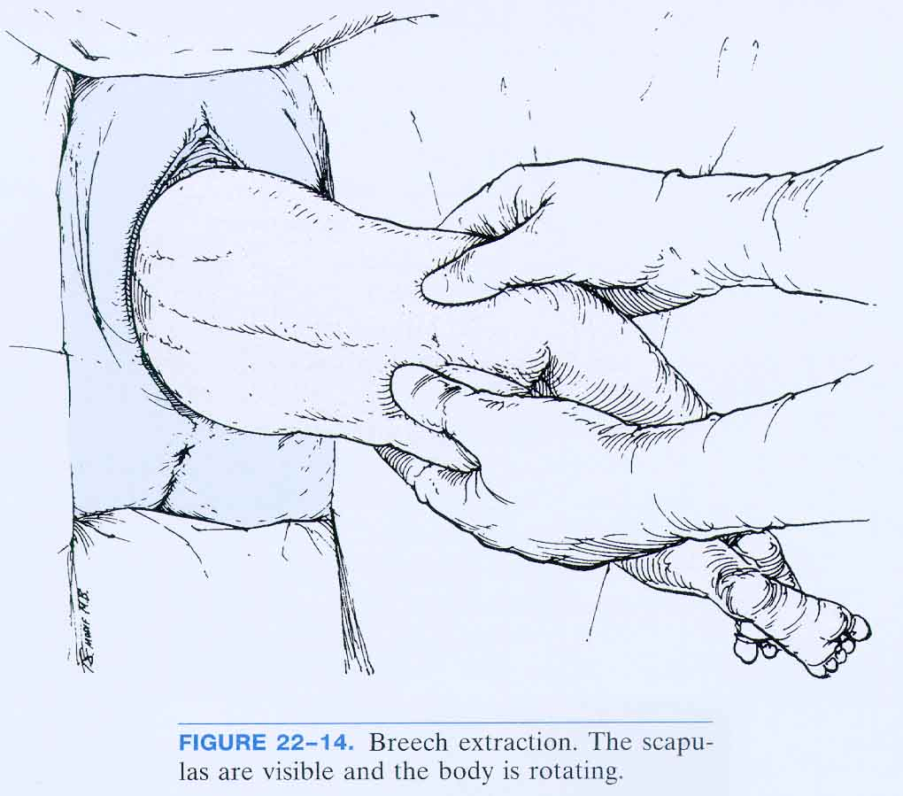
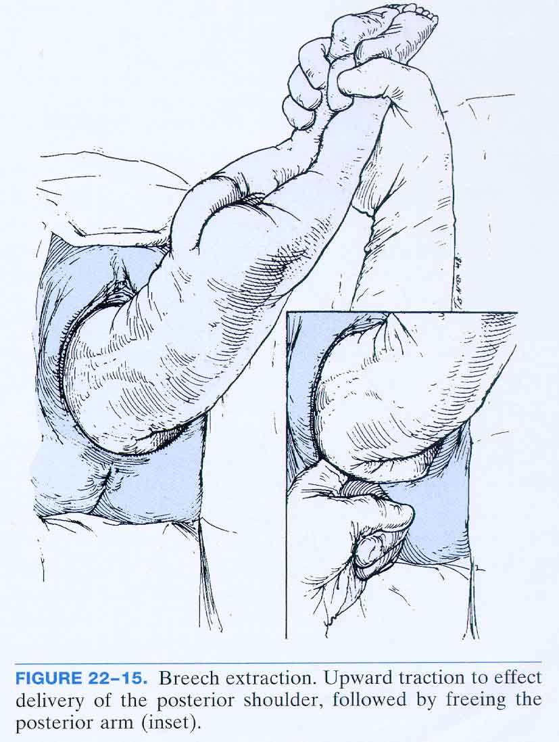
COMPLETE OR INCOMPLETE BREECH EXTRACTION

Slide 85
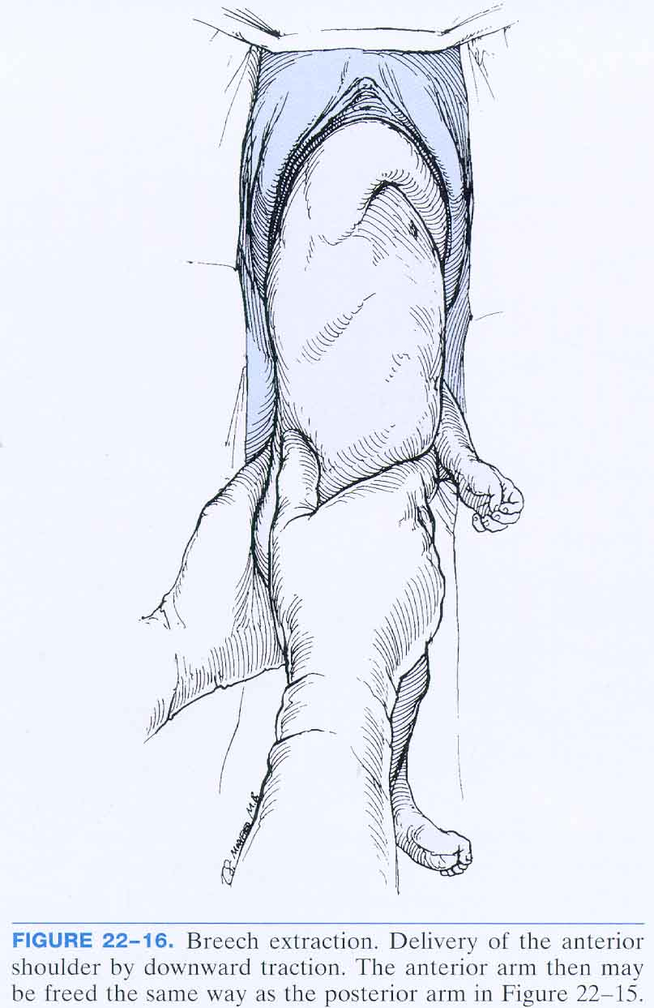
BREECH EXTRACTION

Slide 86
Dangers of breech presentation
1. Delay of the after coming head
2. Cerebral damage due to hypoxia
3. Asphyxia (fetal or neonatal), prolapsed of cord or pressure on cord.
4. Permaturity
5. Intracranial hemorrhage due to trauma
6. Injuries to liver spleen adrenal glands or kidney
7. Erb’s palsy due to damage of the brachial plexus
8. Facial nerve paralysis due to the twisting of the neck.
9. Fracture to femur, tibia, humorous or clavicle
10. Damage to spinal cord due to wrong handling
11. Pneumonia due to premature inspiration.

Slide 87
unfavourable for vaginal breech birth
● other contraindications to vaginal birth (e.g. placenta praevia, compromised fetal condition)
● clinically inadequate pelvis
● footling or kneeling breech presentation
● large baby (usually defined as larger than 3800 g)
● growth-restricted baby (usually defined as smaller than 2000 g)
● Hyperextended fetal neck in labour (diagnosed with ultrasound or X-ray where ultrasound is not available)
● lack of presence of a clinician trained in vaginal breech delivery
● previous caesarean section.

Slide 88
C-SECTION INDICATION
A large fetus ( > 3.500 grams)
A hyperextended fetus
Uterine dysfunction
Footling presentation
Any degree of contraction or unfavorable shape restriction
Previous perinatal death or children suffering from birth trauma

Slide 89
COMPOUND PRESENTATION:
Compound presentation mean prolapse of fetal extremity alongside the presenting part
It is three types:
1.Prolapse of the hand in cephalic presentation
( which is the most common).
2.Prolapse of upper extremity in breech presentation
3.Prolapse of a lower extremity in cephalic presentation (is relatively rare).
Compound presentation uncommon occur in only 1 in 1000 pregnancies

Slide 90
Causes
Any factor that prevent descent of the presenting part into the pelvic inlet predispose to prolapse of extremity alongside the presenting part e.g.
1.Prematurity.
2.Cephalo-pelvic disproportion.
3.Multiple gestation.
4.Grand Multiparity ( more than five deliveries ).
5.Hydramnios (excessive amount of amniotic fluid).
Cord prolapse is common occurring in about 11-20% of cases of compound presentation

Slide 91
Diagnosis:
The diagnosis usually made during labour by vaginal examination when the cervix dilated the prolapsed extremity can be felt alongside the head or breech.
❖ Compound presentation should be suspected when there is poor progress in labour especially when the fetal head fails to engage during the active phase.

Slide 92
TRANSVERSE OR OBLIQUE PRESENTATION
DEFINITION
This occurs when the long axis of the foetus is transverse. In this case the shoulder is typically the presenting part. The amniotic membranes usually rupture early. The cord or arm may prolapse.
2. VARIETY
- shoulder right in dorso-anterior
- shoulder left in dorso-anterior
- shoulder right in dorso-posterior
- shoulder left in dorso-posterior

Slide 93
Cont…
3. ETIOLOGY
Mistake of accommodation: the grand cause of transverse position is multipara (relax of uterine wall)
Other cause can hydramnios, previa tumor, shortness umbilical cord
Uterine malformation
Multiparity
Poly hydraminous
Contracted pelvis

Slide 94
Cont…
4. CLINICAL
Inspection
  The uterus is developing transverse or oblique
Palpation
  Hands explored base part of uterus on of pelvic inlet can not contact fetal pole
  At middle of uterus fundus have no fetal pole

Slide 95
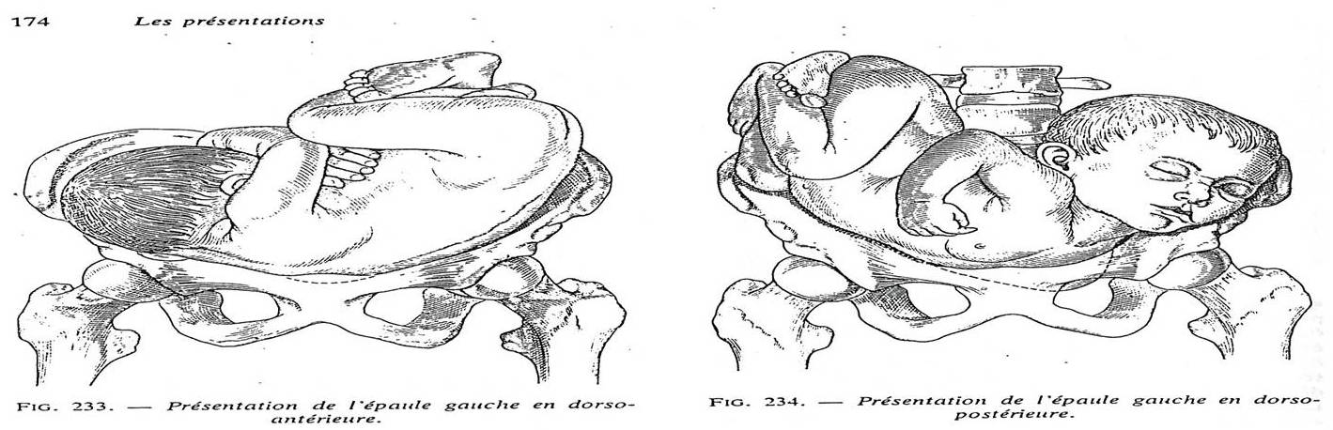
TRANSVERSE OR OBLIQUE PRESENTATION

Slide 96
TRANSVERSE OR OBLIQUE PRESENTATION
Auscultation:
  the fetal cardiac sound can receive a bite under umbilical at cephalic side
Digital exam:
  during pregnancy: the excavation is empty (fingers are not contact the presentation)

Slide 97
TRANSVERSE OR OBLIQUE PRESENTATION
During labor: if membranes are not rupture, the sac amniotic fluid is big volume (can not evaluation the presentation)
After rupture of membranes, the fingers are perception:
. Shoulder and acromial protrusion
. Axillary furrow

Slide 98
Management
The woman is admitted in hospital at 36-37 week and remain in the hospital until delivery to avoid unsupervised onset of labour with tranverse lie.
After hospitalization, the lie may stablilize. If not labour may be induces at 38 weeks provided there is no placenta previa. The woman bladder and rectum are emptied and attempts are made by the obstetrician to correct the abnormal presentation by external version. If unsuccessful, caesarian section is considered.

Slide 99
Cont…
Trial of labour is done if the lie is corrected. Some times AROM is done after correcting the transverse lie to ensure that the woman goes into labour with vertex presentation. An oxytocic drip is usually given after version.
- Extreme caution and close observation is mandatory throughout labour.
- Monitoring of Fetal Heart Beat frequently is very important (every 5 minutes)
- The bladder and the rectum should be emptied to facilitate preservation of the longitudinal lie.

Slide 100
Cont…
Once regular contractions are established the vaginal examination is done to rule out cord presentation. The membranes are then stripped and high ROM is done removing as much amniotic fluid as possible so that the head enters the pelvis.
Forewaters are not ruptured till head is fully engaged and labor is well advanced.

Slide 101
Shoulder Presentation
Definition
When the shoulder of the fetus lies in the lower pole of the uterus in labour. A transverse lie becomes a shoulder presentation in labour.
Dorsum is the denominator.
Incidence, it occurs once in 250-300 deliveries.

Slide 102
Causes
- Laxity of uterus
- Placenta previea, hydraminous,
- Multiple pregnancy
- Uterine abnormality
- Preterm pregnancy

Slide 103
Diagnosis
- The uterus appear broad and the funds height is less than expected for the period of gestation
- Easily seen on abdominal examination. When labour progresses, the hand can be felt or the ribs on V.E.
- Arm may prolapsed when membrane rupture ultrasound

Slide 104
Management
-if placenta previa or contracted pelvis is detected then the women is required to undergo an elective caesarean section.
When diagnosed at antenatal clinic after 36 weeks external version will be attempted. If the version fails or changes to transverse lie the women may be admitted in hospital till delivery because of the risk of placenta previa.

Slide 105
Cont…
- In labour, caesarian section is method of choice when attempt of external version have failed. A caesarean section is also mandatory if the membrane have ruptured before; if there is cord prolapsed, if labor progress has been for some hours, if arm prolepses even with dead fetus
The general management is caesarean section

Slide 106
Complications
Maternal
-Obstructed labour
-Uterine rupture
-Death
-Puerperal sepsis
Fetal
Fetal death (cord prolapsed) when membranes rupture
Arm prolapsed when the shoulder has been impacted
Prematurity
Malformation

Slide 107
MALPOSITION

Slide 108
Introduction
Malpositions are abnormal positions of vertex of the foetal head relative to maternal pelvis.
The malpositions include:
Occiput posterior presentation
Occiput tranverse presentation

Slide 109
1.Persistent Occiput Posterior Position.
It is a malposition of the head, occurs in 13% of the vertex presentations. Head is deflexed-larger diameter present. Persistent occiput posterior positions occur when the back of the fetal head (the occiput) enters the maternal pelvis and is directed toward the back (posterior) of the maternal pelvis instead of toward the front (anterior). When this position occurs, labor is usually prolonged because, in the process of internal rotation, the head must rotate further.

Slide 110
Cont…
A maternal hands-and-knees position may help the fetus rotate from a posterior to an anterior position. A squatting position helps straighten the pelvic curve and aids in rotation. Sometimes the woman is asked to push while lying on her side, which may help the fetus rotate to an anterior position.

Slide 111
Cont…
If the occiput remains posterior, the baby is born with the face upward. The woman usually has a great deal of back discomfort because the baby’s head presses against her sacrum during rotation. Sacral counter pressure and back rubs are appreciated by the woman during labor.

Slide 112
Causes
Direct cause is unknown but associated with
-Pendulous abdomen
-Abnormal pelvis, Androld, Anthropoid, flat sacrum
-The placenta is in anterior wall

Slide 113
Cont…
Spontaneous rotation to the anterior position occurs in 90% of cases. Arrested labour may occur when the head does not rotate and/or descend. Delivery may be complicated by perineal tears or extension of an episiotomy.

Slide 114
Diagnosis
On abdominal examination, the lower part of the abdomen is flattened, fetal limbs are palpable anteriorly and the fetal heart may be heard in the flank.
Inspection
Deep hollow between head and lower limbs
Palpation
The fetal head is found on one side; the limbs are in front and give hollowing above the head. There is a saucer like depression around the umbilicus. There is a bulge like full bladder occiput and sinciput are at the same level. Limbs are found on both sides.

Slide 115
Cont…
Auscultation
Fetal Heart is heard in the flanks and descends down
Vaginal examination
- Membranes may rupture early
-If infant may protrude through cervix as a finger like forewater or fill up the upper vagina
-Due to deflection, anterior fontanel is felt in the anterior part of the pelvis near ileo pectineal eminence

Slide 116
Out Come
- If the flexion of the head increases the occiput strikes the pelvic floor and rotates anteriorly (ROP) to 45° then to 90° rotation and dilivered normally.
- If the flexion remains incomplete, the rotation of the head takes place posteriorly brings the occiput in the hollow of the sacrum. This is known as short rotation. In this case the baby is born by face to Pubis.

Slide 117
Cont…
- Some times the long rotation of occipitoposterior is arrested and the head is left in the Occipito- lateral position in the cavity of the pelvis.
Occipito frontal diameter is caught at the narrow spinous diameter of the outlet.This is known as deep transverse arrest or persistent occiptoposterior. The delivery could be by rotation of the head to anterior or by cesarean section.

Slide 118
MANAGEMENT
Spontaneous rotation to the anterior position occurs in 90% of cases. Arrested labour may occur when the head does not rotate and/or descend. Delivery may be complicated by perineal tears or extension of an episiotomy.
• If there are signs of obstruction but the fetal heart rate is normal, allow the woman to walk around or change position to encourage spontaneous rotation.

Slide 119
Cont…
Encourage the mother to lie on the side where the fetus lies. Patient may have severe back pain analgesics may be given. Retention of urine is common catheterization is necessary.
Patient feels the need to bear down before fully dilation. Two-third of cases will deliver normally.12% will deliver face to pubis. If the ischial spines are prominent the internal rotation may interrupted caesarian section is recommended.

Slide 120
Cont…
• If there are signs of obstruction and the fetal heart rate is abnormal (less than 100 or more than 180 beats per minute) at any stage, deliver by caesarean section .
• If the membranes are intact, rupture the membranes with an amniotic hook or a Kocher clamp.
• If the cervix is not fully dilated and there are no signs of obstruction,augment labour with oxytocin .

Slide 121
Cont…
• If the cervix is fully dilated but there is no descent in the expulsive phase, assess for signs of obstruction
- If there are no signs of obstruction, augment labour with oxytocin.
• If the cervix is fully dilated and if:

Slide 122
Cont…
- the fetal head is more than 3/5 above the symphysis pubis or the leading bony edge of the fetal head is above –2 station, prepare the mother for caesarean section ;
the fetal head is between 1/5 and 3/5 above the symphysis pubis or the leading bony edge of the fetal head is between 0 station and –2 station
- Deliver by vacuum extraction and symphysiotomy

Slide 123
2. Occiput-tranverse position
This occurs when the occiput is transverse to the maternal pelvis.
The head initially engages correctly but fails to rotate and remains in transverse position.

Slide 124
Diagnosis:
On vaginal examination, the anterior and posterior fontanels are felt on the lateral sides of the pelvis

Slide 125
Management
1. If the cervix is fully dilated, the head is engaged and there are no signs of obstruction, the head may be manually rotated with Kielland's forceps or delivered using vacuum extraction.
This is contraindicated if there is any foetal acidosis because of the risk of cerebral haemorrhage.
2. Otherwise deliver by caesarean section

Slide 126
PROLONGED LABOUR

Slide 127
Introduction
Traditionally labour is prolonged if it exceeds 24 hours. When labour is activity managed, It is termed prolonged if delivery is not imminent after 12 hrs of established labour.
NB. The sun should not set twice in woman in labour.

Slide 128
Normal progress of labor;
-effective uterine contractions and cervical changes leading to progressive effacement and dilatation of the cervix, rotation of the fetus and descent of the presenting part, the birth of the baby and expulsion of the placenta and membranes and the control of bleeding.

Slide 129
- ‘failure to progress’ based on the rate of cervical dilatation/hour or the labor is ‘prolonged’ when it exceeds the number of hours considered to be normal for a nulliparous or multiparous woman.
- prolonged labour as one that exceeds 18 hrs in primiparous women.
-Dystocia: a difficult or slow labour and thus includes both failure to progress and prolonged labour.

Slide 130
-Interventions to correct dystocia included
1-ARM
2- oxytocin
3-or a combination of both.
4- If these means fail an instrumental
5- or operative delivery C\S

Slide 131
- expected out come with prolonged labour:
1-the risk of obstructed labour
2- uterine rupture
3- maternal and fetal morbidity and mortality.
4-increase risk of infection with prolonged rupture of membranes,
5- postpartum haemorrhage as a result of an atonic uterus.

Slide 132
The first Stage
The latent phase considered prolonged over 20hrs in primigravidae or over 14 hrs in multigravidae.
Primary dysfunctional-labour progress in active phase of labour is slow and the cervix dilate less than 1 cm on hour.
Secondary arrest:- After normal progress in early labour, cervical dilation is arrested in active phase.

Slide 133
Cause in 1st stage
1) In-efficient uterine contraction (Power) is the most common cause of prolonged labour. The cervix dilates slowly or not at all.
2) Pelvic abnormalities (Passage). A contracted pelvis and pelvic tumors prevent normal progress in labour.

Slide 134
Cont…
3) The fetus (Passenger):- a large fetus malpostion of the occiput of malpresentation inhibit the progress of labour.
4) Psychological cause:- Abnormally tense or apprehensive women tend to have prolonged labors. The primigravidae more often affected than multigravidae

Slide 135
the passages :
causes that a delay in the progress of labor.
-trauma to the pelvis.
- the impact of a full rectum
-full bladder
- fibroids
- A malpresention

Slide 136
*as labour continues the smooth muscle uses up its metabolic reserves and becomes tired.
- signs of ketosis due to continues contraction
- Any change to the strength, length or frequency of contractions will affect progress and is indicative of inefficient uterine action.
-It is important that the woman and her partner are closely involved to enable informed consent to be given for any procedures as artificial rupture of the membranes or an oxytocin infusion if the membranes are ruptured.

Slide 137
- A full assessment should take place to ensure the decision to augment labour is based on sound and accurate clinical findings.
The midwife's role in caring for a woman in prolonged labour
-A prolonged labour leads to increased levels of stress, anxiety and fatigue and increases the risk of infection, postpartum haemorrhage and emergency caesarean section
NB-Raised adrenalin levels as a result of fear, anxiety or pain can impact negatively on uterine activity and slow progress in labour

Slide 138
Management
When progress in labour is slow the cause must be identified week uterine action man be rectified with a syntocinon infusion Caesarian section if no progress despite good uterine contraction Obvious disproportion or malpresentation of the fetus indicate the need for operative deliveries.

Slide 139
-Managing labour should start with
1-appropriate antenatal education.
2-Advice on suitable food and drink to eat in the early stages of labour to maintain energy levels
3-positions and activities to encourage a forward rotation of the head if there is op.
4-An upright position might help to facilitate more effective contractions or an alternative position might help to improve pelvic diameters when the position of the baby is posterior

Slide 140
5- maintain hydration, to encourage voiding
6- and to suggest non-pharmacological ways to relieve pain.
7-Recognition and detection of abnormal progress in labour
8-An abdominal examination can provide vital information about the labour with regard to the lie, presentation, position and descent of presenting part
9- the length, strength and frequency of contractions whereby any change in the pattern of the contractions should be
10 -On VE the midwife is assessing the presence and degree of moulding of the fetal skull, the presence and position of caput succedaneum in relation to sutures and fontanelles and the dilatation of the cervix noting any thickening and its application to the presenting part.

Slide 141
11-Any changes to the colour of the liquor if the membranes have previously ruptured
12- CTG , fetal heart rate will give some indication as to how the fetus is coping with the progress of labour.
13-Psychological as well as physical support is important
-The management of prolonged labour is a collaborative effort involving the woman and her partner, the midwife, obstetrician, and anaesthetist.
14- an ARM has been done to augment labour at appropriate time before oxytocin infusion
15- An assessment will be made 2–4 hrs after ARM or commencing oxytocin to ascertain the likelihood of a successful vaginal birth.

Slide 142
- signs of successful :
1- optimal contractions of four each 10 min lasting >40 s,
2- the woman is pain free
3-well hydrated
4- empty bladder
Never augment labour in multiparae or in women with prior caesarean section because of the very real risk of hyper stimulation and uterine rupture.

Slide 143
Delay in the second stage of labour
-The second stage of labour can be divided into
1-a passive (pelvic) phase
2- and active (perineal) phase.
-Delay in this stage of labour may be due to:
1- malposition causing failure of the vertex to descend and rotate
2-ineffective contractions due to a prolonged first stage
3- large fetus and large vertex
4-absence of the desire to push with epidural analgesia.

Slide 144
-Time limits in second stage;
*- range from 30 min to 2 hrs for multiparae
*-1–3 hrs for nulliparae
- avoid the encouragement of premature bearing down efforts
-the effect of epidural analgesia on the desire to push in the second stage.
-The active phase when the mother is bearing down is the most critical time.

Slide 145
-When a diagnosis of delay in the second stage has been made the case is referred to the obstetrician for review and assessment.
-intervention could be by an instrumental or operative delivery.

Slide 146
Nursing Care
Maternal condition:
She may be exhausted, dehydrated and ketotic and may be suffering severe pain
Encourage and reassure the mother- Help to adopt a comfortable position
Adequate analgesia should be offered because it will enable her to rest.
Administer IV infusion
Empty bladder regularly

Slide 147
Cont…
Test urine for ketoses
Record intake and out put
Allow sips of water
If membrane ruptured 24 hours before high vaginal swab is taken for culture and sensitivity and antibiotic is started

Slide 148
Fetal Condition:
Monitor the fetal heart beat
Observe amniotic fluid (meconium)
Avoid aspiration at delivery

Slide 149
OBSTRUCTED LABOUR

Slide 150
Introduction
When despite good uterine contractions there is no advance of the presenting part.
Possible causes of obstructed labour include :
1-absolute CPD
2-deep transverse arrest
3-malpresentation
4-lower segment fibroids
5-fetal hydrocephaly
6-multiple pregnancy with conjoined or locked twins.
7- high presenting part if the woman goes into labour there may be spontaneous rupture of the membranes and cord prolapse

Slide 151
Clinical presentation
- progressively more dehydrated,
- ketotic
- pyrexia
- and tachycardia.
- severe and unrelenting pain

Slide 152
- the presenting part will be high with excessive moulding .
-The fetus will develop a bradycardia
-In nulliparous women the contractions may cease for a period before resuming again with increasing strength and frequency with little interval between contractions until the uterus assumes a state of tonic contraction. The difference between upper and lower segment may be seen as a ridge obliquely crossing the abdomen (Bandl's ring).
Obstructed labour. The uterus is moulded around the fetus; the thickened upper segment is obvious on abdominal palpation.

Slide 153
-complications of obstructed labor
1- rupture
2- Uterine rupture leads to maternal mortality and the tonic contractions and uterine rupture cause hypoxia, asphyxia, and subsequent perinatal mortality
- Labor suite should be informed and they in turn will contact the senior obstetrician, anaesthetist, paediatrician, theatre staff, and special care baby unit.

Slide 154
Cont…
-While waiting for the ambulance the midwife should cannulate, take blood for urgent cross match, and site an intravenous infusion.
- Observations of mother and fetus and any actions taken and by whom are recorded in the maternity notes as soon as possible.
-If the obstruction is discovered in hospital an emergency caesarean section is performed

Slide 155
-Management of obstructed labour is about its prevention in the antenatal and intrapartum period.
-The midwife should highlight any predisposing factors antenatally
-During labour skilled abdominal examination will alert the midwife to any malpresentation or failure of the presenting part to advance despite optimal uterine contractions.
- VE will confirm suspected malpresentation and where the presentation is vertex reveal increasing caput succedaneum or moulding.

Slide 156
-With a high presenting part in labour cervical dilatation will be extremely slow.
- If the labour is becoming obstructed in the first stage an emergency caesarean section will be carried out.
- If the delay occurs in the second stage as a result of deep transverse arrest the obstetrician may try to deliver the baby vaginally with ventouse but if that fails or is not possible an emergency caesarean is carried out

Slide 157
-With a high presenting part in labour cervical dilatation will be extremely slow.
- If the labour is becoming obstructed in the first stage an emergency caesarean section will be carried out.
- If the delay occurs in the second stage as a result of deep transverse arrest the obstetrician may try to deliver the baby vaginally with ventouse but if that fails or is not possible an emergency caesarean is carried out

Slide 158
PRECIPITATE LABOUR

Slide 159
Introduction
-In some women, the uterus is over-efficient and the onset of labor to birth is an hour or less.
- Much or all of the first stage is not recognized because contractions are not painful and the realization of the birth of the head may be the first indication that labour has actually started

Slide 160
-Such a precipitate birth is not without its problems leading:
1- soft tissue trauma of the maternal genital tract due to sudden stretching and distension as the baby is born.
2-Risks to the baby include: hypoxia as a result of the frequency and strength of the contractions

Slide 161
-intracranial haemorrhage from the sudden compression and decompression of the fetal skull as it passes through the birth canal with speed, and possible injury as the head and body deliver rapidly
-and possibly fall to the floor.

Slide 162
- The unexpected nature of the event means that the place of birth may be inappropriate and the baby may be further compromised if the importance of maintaining the baby's temperature is not recognized.
-The over-efficient uterus may relax after the birth of the baby resulting in retained placenta and/or postpartum haemorrhage.

Slide 163
-The psychological impact of such a rapid birth must not be underestimated and some women will be in a state of shock after the event.
-Precipitate labour will often recur in subsequent pregnancies and the obstetrician may advise induction of labour once term (37 completed weeks) is reached.
-consider every labour a trial of labour.

Slide 164
HYPOTONIC UTERINE CONTRACTION

Slide 165
Introduction
This is poor tone in the uterine muscle fibres which results from weak /short contractions.
Hypotonic uterine dysfunction occurs with abnormally slow progress after the labor has been established .
The uterine contractions become weak and inefficient and may even stop.
The contractions are infrequent and cause less pain .
The contractions are fewer than two or three in a 10-minute period and usually are not strong enough to cause the cervix to dilate beyond 4 cm, and the fundus does not feel firm at the height of the contraction. The uterus may be indented at the height of a contraction.

Slide 166
Cont…
The effects of weak contractions bring about very slow or no cervical dilatation. This results in prolonged labour. Or consequently, labor fails to progress
A prolonged labor can increase the risk of intrauterine infection, placing both the mother and newborn at risk.
There are two types of hypotonia, that is, primary and secondary uterine inertia also respectively known as primary and secondary hypotonia.

Slide 167
Cont…
Primary hypotonia starts at the onset of labour. The cause is unknown and it is common in primigravida.
Secondary hypotonia occurs when labour has already been established. The uterus is exhausted and contractions, slows down, due to the following:
Retained second twin;
Cephalo pelvic disproportion;
Malpresentation or malposition;
Effect after epidural anaesthesia.

Slide 168
Management of Hypotonic Uterine Action
Hypotonic contractions occur as a result of fetopelvic disproportion, fetal malposition, overstretching of the uterus caused by a large newborn, multifetal gestation, or excessive maternal anxiety.
The woman with hypotonic contractions can become exhausted and dehydrated. Medical management includes ruling out cephalopelvic disproportion (CPD) by ultrasound. If CPD is not the problem, augmentation by oxytocin is often started.
The use of epidural analgesia and other regional anesthesia may reduce the effectiveness of the woman’s voluntary pushing efforts. Encouraging position changes and coaching can be helpful.

Slide 169
Cont…
Admit the mother in hospital with adequate facility for emergency. Reassure her and then sedate her to reduce anxiety and calm her down to sleep. You should perform an abdominal and pelvic exam to exclude cephalo-pelvic disproportion. Determine the cause of the occipito-posterior position (OPP). If this is present she should be prepared for a caesarean section.

Slide 170
Cont…
If there are no uterine contractions, these should be stimulated by administering an enema or repeat administration oxytocin if it had been given previously.

Slide 171
Management
You should check on the following factors:
Frequency, strength and duration of the contractions;
Vital signs, that is, maternal pulse and BP and general condition;
Foetal heart rates;
Descent of the presenting part.

Slide 172
Cont…
A vaginal examination is done 2 - 4 hourly to determine cervical dilatation. The urine is tested 2 hourly for sugar, acetone and albumin. If there is foetal or maternal distress in the first stage of labour, the mother is prepared for Caesarean section. However, if the mother is in the second stage or nearing second stage and contracting and dilating well, the delivery should be assisted by vacuum extraction.
The possibility of post partum haemorrhage should be kept in mind. Hence an intramuscular injection of syntocinon 10 units should be within a minutes after the birth of the baby.

Slide 173
Hypertonic Uterine Dysfunction
Hypertonic uterine dysfunction refers to a labor with uterine contractions of poor quality that are painful, out of proportion to their intensity, do not cause cervical dilation or effacement, and are usually uncoordinated and frequent. This is more common with a first pregnancy or an anxious woman who has intense pain and lack of labor progression.
The latent period of labor is prolonged, which increases her exhaustion and anxiety. Often there is not adequate relaxation of muscle tone between contractions, which causes the woman to complain of constant cramps and results in ischemia or reduced blood flow to the fetus.

Slide 174
Cont…
Management of hypertonic uterine dysfunction is rest, which is achieved by analgesia to reduce pain and encourage sleep. An intravenous infusion is frequently administered to maintain hydration and electrolyte balance. Often women awaken with normal contractions

Slide 175
CEPHALO-PELVIC DISPROPORTION

Slide 176
CPD
“DISPROPORTION IN SIZE BETWEEN THE FETAL HEAD AND THE MATERNAL PELVIC CAVITY, WHICH CAUSES DIFFICULTY IN THE LABOUR AND ENDANGER THE FETAL LIFE”

Slide 177
Cause of CPD
Maternal :-
Contracted pelvis:-
Developmental:- android, anthropoid and platypelloid pelvis.
Congenital defect
Acquired defect:- rachitic pelvis, osteomalacic pelvis, any disease or injury of bone.
II. Foetal:- Malpresentation, malposition, hydrocephaly, Macrosomic baby.

Slide 178
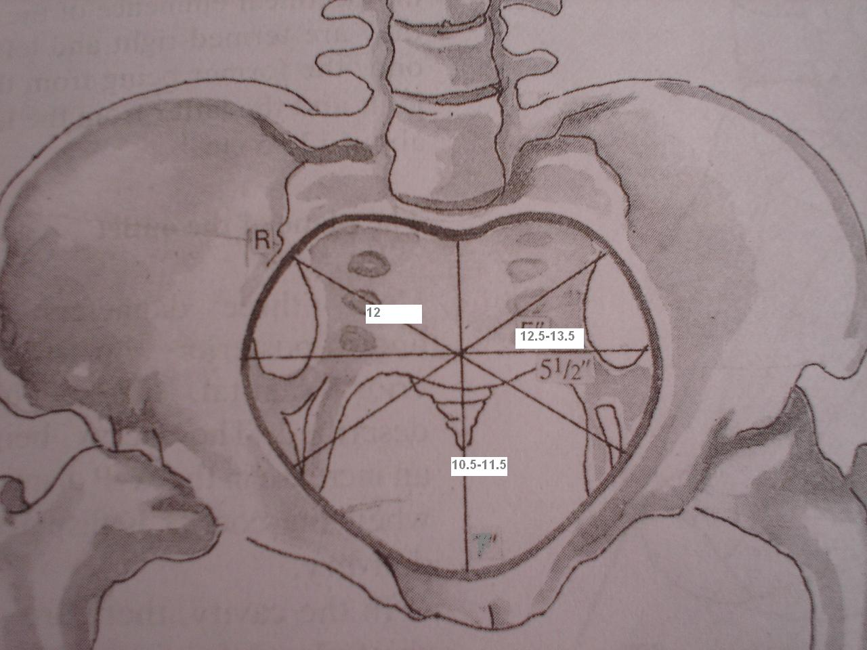
PELVIC ANATOMY

Slide 179
PELVIC ANATOMY
AFFECTED BY:
Evolutionary Influence
Hormonal Influence
Nutrition

Slide 180
PELVIC ANATOMY
ANTHROPOID TYPE
GYNECOID TYPE
ANDROID TYPE
PLATYPELLOID TYPE

Slide 181
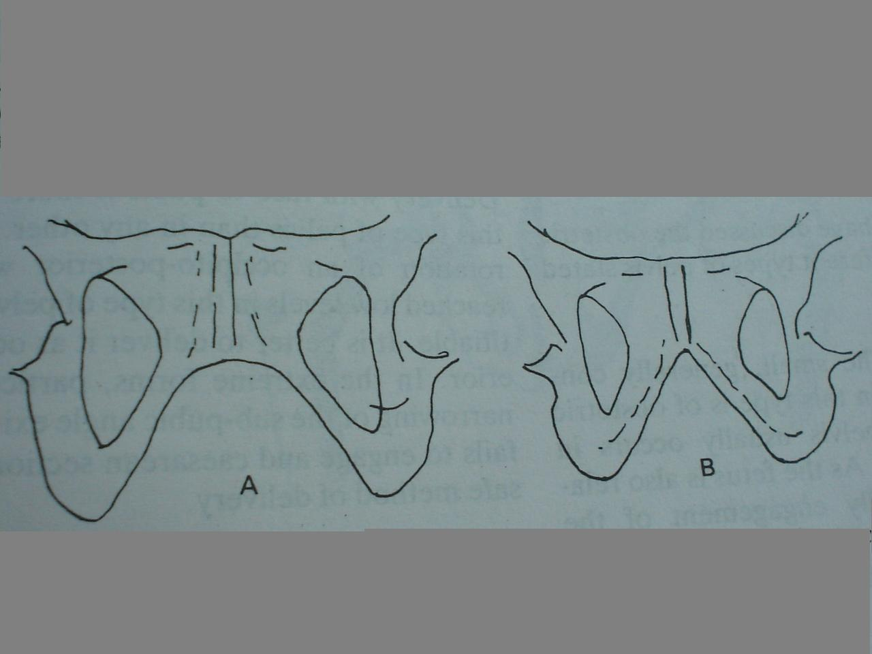
WIDE SUBPUBIC ANGLE IN GYNECOID TYPE
NARROW IN ANDROID TYPE

Slide 182
DIAGNOSIS OF CONTRACTED PELVIS
Diagnosis of CPD is very difficult. This is because it is difficult to estimate exactly how much the mother's ligaments and joints will 'give' or relax before labor starts.
Contraction may be at the level of brim, cavity, outlet or combined.
HISTORY:
GENERAL: Rickets, Osteomalacia, Poliomyelitis, TB
OBSTETRIC: Previous Deliveries

Slide 183
DIAGNOSIS OF CONTRACTED PELVIS
PHYSICAL EXAMINATION:
HEIGHT: high risk <140 cm
SPINAL / CHEST WALL DEFORMITIES
OBSTETRIC EXAMINATION:
Unengaged head in the Primi at term
Deflexed attitude at the onset of labour

Slide 184
DIAGNOSIS OF CONTRACTED PELVIS
EXTERNAL PELVIMETRY:
Poor accuracy, no role in modern Obstetrics
1. Transverse Diameter of Outlet: between two inner surface of Ischial tuberocities
= 11 cm
2. Antero-Posterior Diameter of Outlet: between tip of sacrum to symphysis pubis
= 13 cm
3. Posterior Saggital Diameter of Outlet:
between the mid point of TD to the sacral tip
= 7 cm

Slide 185
CLINICAL PELVIMETRY
DORSAL LITHOTOMY POSITION
ASK TO EMPTY BLADDER
USE INDEX & MIDDLE FINGERS
SACRAL PROMONTARY
DIAGONAL CONJUGATE (12.5 cm)
TRUE CONJUGATE = DC – 1.5 -2 cm
diagonal conjugate
a radiographic measurement of the distance from the inferior border of the symphysis pubis to the sacral promontory. The measurement, may also be determined by vaginal examination.

Slide 186
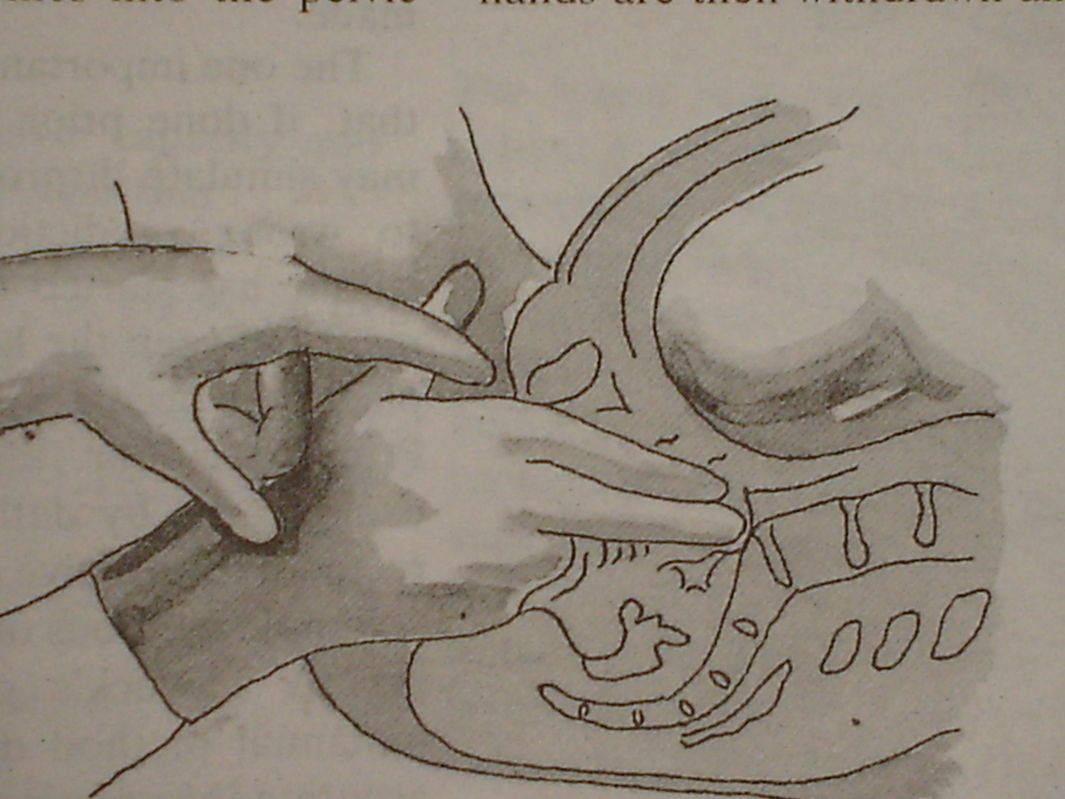
VAGINAL ASSESSMENT OF PELVIS

Slide 187
CLINICAL PELVIMETRY
sacral curvature
pelvic side walls
sacro-sciatic notch (length of the sacro-tuberous ligaments)
ischial spines: bispinous diameter
sub-pubic arch:
fist in between the ischial tuberosities

Slide 188
DIAGNOSIS OF CONTRACTED PELVIS
RADIOLOGICAL ESTIMATION:
1. X-RAY PELVIMETRY:
Pelvis- Lateral view, superio-inferior view, Outlet, Antero-posterior View
2. Ultra sound

Slide 189
MANAGEMENT OF LABOUR IN CONTRACTED PELVIS
HIGH RISK PREGNANCY-----REFERRED TO SPECIALISED CENTRE
MODE:
1. ELECTIVE LSCS
2. TRIAL LABOUR

Slide 190
MANAGEMENT OF LABOUR IN CONTRACTED PELVIS
ELECTIVE LSCS
INDICATIONS:
Gross CPD
Elderly Primi gravida
Toxemia of pregnancy
BOH
Post maturity
Malpresentation

Slide 191
MANAGEMENT OF LABOUR IN CONTRACTED PELVIS
ELECTIVE LSCS
TIMING:
Elective setting – planned procedure
Emergency setting – onset of Labour
lower uterine segment well formed
less bleeding – due to contraction
adequate intra-uterine time for maturation

Slide 192
MANAGEMENT OF LABOUR IN CONTRACTED PELVIS
TRIAL LABOUR
INDICATIONS:
Mild / suspicion of CPD

Slide 193
TRIAL LABOUR
GOOD PROGNOSIS
Good Uterine contraction
Early engagement of Head
Rupture after full dilatation
Good effacement &dilatation
Flat pelvis
Vertex presentation with anterior position
BAD PROGNOSIS
Weak Uterine contraction
Slow descent of the head
Premature rupture of membrane
Uneffaced cervix
Occipito-posterior position
Android pelvis
Other than vertex presentation

Slide 194
TRIAL OF SCAR

Slide 195
Definition
Also commonly referred to as Vaginal birth after caesarean section (VBAC).
Conditions for trial of scar
i. Only one previous C/S which must be LUSCS
ii. Non-recurring indication for previous C/S; foetal distress, cord prolapse, malpresentation, placenta praevia etc.
iii. No post-operative sepsis after previous C/S
iv. Parity <5

Slide 196
Cont…
v. Cephalic presentation
vi. Estimated foetal weight 3500g
vii. Adequate pelvis with true conjugate 10.5cm
viii. No other indication for C/S
ix. Facilities for blood transfusion available
x. Ready theatre, available immediately

Slide 197
Predictors of successful trial of labour
1. Prior vaginal delivery
2. Prior VBAC
3. Spontaneous labour
4. Favourable cervix
5. Non recurring indications like breech, praevia
6. Preterm delivery

Slide 198
Predictor of decreased chances of success
1. Maternal obesity
2. Short maternal stature
3. Macrosomia
4. Increase maternal age>40yrs
5. Recurring indications e.g. CPD, failed second stage
6. Gestational age >41wks
7. Pre-conceptional or gestational diabetes mellitus
8. Increased inter-pregnancy weight gain

Slide 199
Management
a. Early ANC (first half of pregnancy)
b. Review history
c. Obstetric U/S scan in first half of pregnancy
d. ANP
e. Counsel patient on the risks and benefits of undergoing trial of scar

Slide 200
Cont…
f. Pelvic assessment at 36 weeks; clinical/radiological
g. Estimate weight of baby
h. Admit in early labour
i. IV line and GXM
j. Consent for C/S
k. Partograph (pulse, BP, FHR, contractions, descent, cervical dilatation, colour of liquor, PV bleed)

Slide 201
UTERINE RUPTURE

Slide 202
Introduction
"Is an obstetric catastrophe “
Ruptured uterus is a tearing or bursting of the uterus due to the pressure exerted by an obstructed labour. Uterine rupture is very prevalent in developing countries like Kenya, where around 94% of deliveries occur at home with no skilled health professional attending the labour. When labour ends with a ruptured uterus, the usual consequences for the woman (if she survives), are losing her baby and losing her uterus.

Slide 203
Cont….
Almost all cases of uterine rupture occur among multiparous women, who have previously given birth at least once after their baby reached 28 weeks of gestation. You will find out why this is so later in this study session. Uterine rupture can also occur among women with a scarred uterus, if the scar tissue tears open. However, in Kenya and other developing countries, almost all cases of uterine rupture occur in women with an unscarred uterus whose labour became obstructed when no one was present to intervene.

Slide 204
Cont…
The two findings on physical exam indicate uterine rupture is loss of uterine contour and palpable fetal part.The number one risk factor for uterine rupture is previous cesarean section. Other causes include large baby and improper use of oxytocin (IV drip).

Slide 205
Signs and symptoms
    Sudden pain
    Profuse bleeding
    Hypovolemic shock
COMPLETE & INCOMPLETE
Sudden sharp abdominal pain during contractions
Abdominal tenderness
Cessation of contractions
Bleeding into abdominal cavity & sometimes into vagina

Slide 206
Cont…
Fetus easily palpated, FHT ceased
Signs of shock
Abdominal pain during contractions
Contractions continue, but cervix fail to dilate
Vaginal bleeding may be present
Rising pulse rate and skin pallor
Loss of fetal heart tones

Slide 207
Management
Shout for help
IV access with large bore cannulas
Draw blood for GXM
Commence an IV isotonic fluid to treat for shock
Administer oxygen
Treatment for shock
Prepare mother for theatre.

Slide 208
Genital tract injuries during delivery

Slide 209
Types of genital injuries
Perineal tears.
Vaginal tears.
Cervical tears.

Slide 210
Genital injuries are usually manifest as vaginal bleeding after delivery in the presence of well contracted uterus.
The bleeding may be internal bleeding as in haematomas or ruptured uterus.

Slide 211
Cervical injuries:
Bleeding which does not appear to be arising from the vagina or perineum and which continues despite a well contracted uterus, is an indication for examining the cervix to exclude cervical injury.
Minor cervical lacerations are extremely common but does not cause symptoms.
Deep lacerations and particularly those that involve the vaginal vault cause excessive bleeding and need to be managed in the theatre under anesthesia.

Slide 212
Causes of deep cervical lacerations:
1.Precipitate labour.
2.Application of forceps with the cervix
incompletely dilated.
3.Rapid delivery of the head in breech
presentation.
4.A scar in the cervix may also tear.

Slide 213
Management:
Prompt recognition of the injury and action to control the bleeding is essential.
Good light for proper visualization of the tear is essential so the patient should be taken to the theatre and examined under general anesthesia.
By using two pairs of sponge forceps applied to the cervix at any one time, it is possible to inspect the whole circumference accurately.
Identification of the apex of the tear is essential before commencing repair.
Interrupted dexon sutures can be inserted through the whole thickness of its wall.

Slide 214
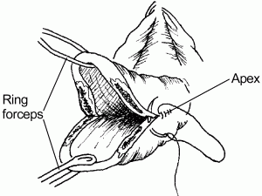
Repair of cervical tears

Slide 215
Perineal tears and vaginal tears:
Perineal lacerations may occur with normal or
instrumental vaginal delivery.
Vulval and anterior vaginal tears do occur with
vaginal delivery but posterior vaginal tear
associated with perineal injury is more common
and occurs with the delivery of the head and
sometimes with the shoulders.
Perineal tears are classified based on the
involvement of the perineum.

Slide 216
Types of perineal tears
1.First degree tear
Involves only the skin and minor part of the perineum
2. second degree perineal tear:
involves the skin, perineal muscle (perineal body) and posterior vaginal wall.
3.Third degree tear :
Injury to anal sphincter in addition to the above structures.
4.fourth degree tear.
When the tear damages the sphincter and involves the anal mucosa.

Slide 217
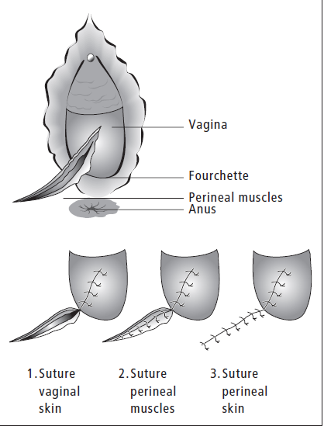
Second degree perineal tear:

Slide 218
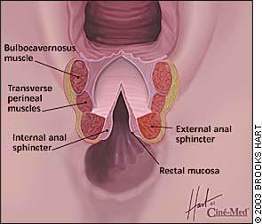
4th degree perineal tear

Slide 219
Treatment of 1st and 2nd degree tears:
It is important to repair all perineal tears
immediately , to prevent any infection of the raw surface.
Local infiltration of the perineum with xylocain is
required for repair.
The vaginal epithelium is sutured from the apex of the
tear ( which must be clearly identified) down to the introitus
with a continuous or interrupted sutures of polygycol.
The perineal muscles are repaired with interrupted
sutures.
The skin edge are brought together without tension.

Slide 220
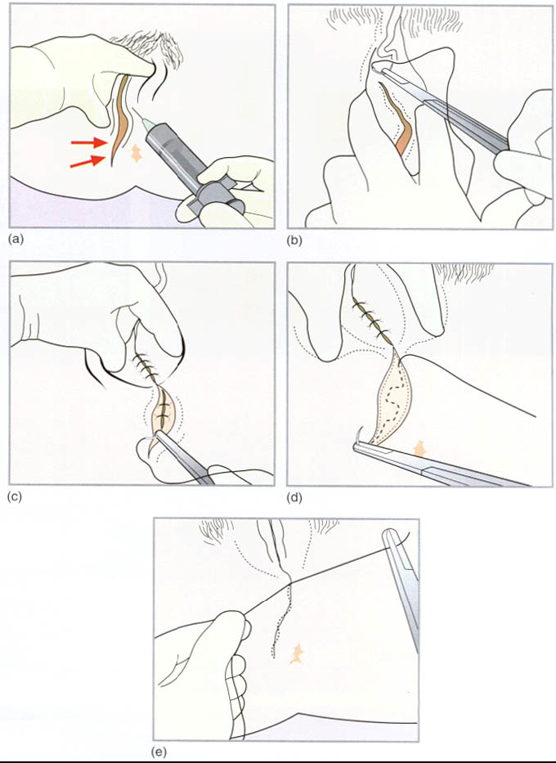

Slide 221
Treatment of 3rd and 4th degree tears:
The operation should be done by an experienced obstetrician in the theatre with general or epidural anesthesia.
The anal mucosa is first repaired with fine stitches, tying the knots inside the bowel lumen
The ends of the sphincter are found and carefully brought together with interrupted suture
The other tissues are repaired as above.

Slide 222
AMNIOTIC FLUID EMBOLISM

Slide 223
Definition
Amniotic Fluid Embolism is a complex disorder during labor characterized by amniotic fluid entering into the maternal circulation which causes acute pulmonary embolism, shock, DIC, acute renal failure or abrupt death.
Amniotic fluid embolism is a rare condition that occurs during pregnancy with an estimated incidence of1/8,000 to 1/80,000 deliveries .
The condition is difficult to recognize because its signs and symptoms may mimic other conditions, such as anaphylactic or septic shock (Clark et al., 1995).
Also, many practitioners have never seen the condition, and as such, their decision making in a critical clinical situation may be negatively impacted

Slide 224
Predisposing factors
Several factors have been associated with amniotic fluid embolism syndrome.
They include:
  precipitous or tumultuous labor,
  advanced maternal age,
  cesarean and instrumental delivery,
  placenta previa and abruption,
  grand multiparity (≥5 live births or stillbirths),
  cervical lacerations,
  fetal distress, eclampsia, and
  medical induction of labor

Slide 225
Cont…
The pathogenesis suggests that these factors probably are associated with amniotic fluid embolism syndrome, but not the direct cause. The syndrome is best considered unpredictable and unpreventable.
Advanced maternal age. If you're 35 or older at the time of your child's birth, you might be at increased risk of an amniotic fluid embolism.
Placenta problems. If there are abnormalities in your placenta — the structure that develops in your uterus during pregnancy — you might be at increased risk of an amniotic fluid embolism. Abnormalities might include the placenta partially or totally covering the cervix (placenta previa) or the placenta peeling away from the inner wall of the uterus before delivery (placental abruption). These conditions can disrupt the physical barriers between you and your baby.

Slide 226
Cont…
Preeclampsia. If you have preeclampsia — high blood pressure and excess protein in the urine after 20 weeks of pregnancy — you might be at increased risk of developing an amniotic fluid embolism.
Medically induced labor. Limited research suggests that certain labor induction methods are associated with an increased risk of amniotic fluid embolism. Research on this link, however, is conflicting.

Slide 227
Cont…
Operative delivery. Having a C-section, a forceps delivery or a vacuum extraction might increase your risk of an amniotic fluid embolism. These procedures can disrupt the physical barriers between you and your baby. It's not clear, however, whether operative deliveries are true risk factors for amniotic fluid embolisms or are used after the condition develops to ensure a rapid delivery.
Genetics. Some experts believe that genetics might play a role in determining a woman's risk of amniotic fluid embolism.

Slide 228
Why amniotic fluid can enter into the maternal circulation?
The pathophysiology of an amniotic fluid embolus involves the entrance of amniotic fluid with fetal cells into the mother’s vascular system through one of three ways:
Etiology : Three factors
There is a tear in the amnion or chorion high in the uterus causing breach in vein or blood sinus at the trauma site of cervix and the body of uterine

Slide 229
Cont…
Higher pressure of amniotic cavity
Disruption of fetal membrane amniotic fluid enters into the maternal circulation through the breached vein and blood sinus (through the site of an abruption or placental separation or through a cervical laceration).
What would happen after the amniotic fluid enter into the maternal circulation
PATHOPHYSIOLOGY
Amniotic fluid→inferior vena → atrio dextrordiopuloma→ right ventricle →pulmonary artery
Fetal cells obstructing the pulmonary vasculature may not be the only pathophysiological event. It has been proposed that amniotic fluid prostaglandins may cause pulmonary vasospasm and hypertension.

Slide 230
Major clinical findings
Fetal compromise
Hypoxia & respiratory failure
  Cyanosis
  Dsypnoea
  Respiratory arrest
Cardiovascular
  Tachycardia
  Hypotension
  Pale clammyskin/shivering
  Cardiac arrest

Slide 231
Cont….
Heamtological
  Hemorrhage
  Disseminated intravascular coagulation
Neurological
  Restlessness, panic
  Convulsions
  Pain less likely

Slide 232
Clinical presentation
Acute amniotic fluid embolism: occur acutely
Premontory signs and symptoms (restlessness, abnormal behavior, respiratory distress and cyanosis) may occur before collapse. There is maternal hypotension and uterine hypertonus. The latter will induce fetal comprise and is in response to uterine hypoxia. Cardiopulmonary arrest follows quickly. Only minutes may elapse before arrest. Blood coagulopathy develops following initial collapse, if mother survives.

Slide 233
Cont…
Typical: three phages
Pulmonary artery hypertension/ Shock
Hemorrhage due to DIC
Acute renal failure

Slide 234
Diagnosis
According to the typical clinic manifestation, we can make the preliminary diagnosis and save the patients immediately
While saving the patients do the necessary auxiliary examination, including:
a. Collecting blood from arteria pulmonalis and inferior vena, and finding components of amniotic fluid
b. The basis of laboratory examination for DIC
c. ECG
d. X-ray
e. Autopsy

Slide 235
Management
Management includes cardiopulmonary resuscitation (CPR) with high-flow O2, with or without ventilation if required, and consideration given to urgent delivery. Two large-bore i.v. lines are inserted and the patient is rapidly infused with a combination of crystalloid and colloid until the blood pressure approaches normal.
This is then stopped to minimize the risk of ARDS. As uterine atony is common, oxytocics are given postnatally. Bloods are sent for clotting, screen and cross-match to anticipate
DIC. Cardiogenic shock, ARDS and ARF are managed as appropriate.

Slide 236
Principle management
Aggressive monitor
About maternal & fetal hypoxia
Pharmacologic therapy
Fluid support
Correct coagulopathy as needed

Slide 237
PREVENTION
Artificial rupture of membrane without stripping of membrane
Don’t conduct artificial rupture of membrane when uterine is constricting
Master the indication of oxytocin application
Protect the vessel during the caesarean section
Avoid precipitate labor, birth trauma, rupture of uterus, cervical laceration
Aware of the predisposing factor

Slide 238
UTERINE INVERSION

Slide 239
Definition
This occurs when there is prolapse of the fundus to or through the cervix so that the uterus is in effect turned inside out. It is said to happen when uterus turns inside out during delivery of the placenta.
Uterine inversion is a potentially life threatening complication of childbirth requiring prompt diagnosis and definitive management. Almost all cases occur after delivery. It very rarely occurs in non-pregnant patients and is then usually associated with prolapsing uterine fibroids1 although it can occur with other tumours. Incidence varies widely from as many as 1 per 1,584 deliveries to as few as 1 per 20,000 deliveries.

Slide 240
Classification of uterine inversion
First degree - the inverted fundus extends to, but not through the cervix.
Second degree - the inverted fundus extends through the cervix but remains within the vagina.
Third degree - the inverted fundus extends outside the vagina.
Total inversion - the vagina and uterus are inverted.

Slide 241
Aetiology:
Identified aetiological factors include:
Short umbilical cord
Excessive traction on the umbilical cord
Excessive fundal pressure
Fundal implantation of the placenta
Retained placenta and abnormal adherence of the placenta
Chronic endometritis
Vaginal births after previous caesarean section
Rapid or long labours
Previous uterine inversion
Certain drugs such as magnesium sulphate (drugs promoting tocolysis)

Slide 242
Presentation
Uterine inversion may present:
Acutely - within 24 hours of delivery
Sub acutely - over 24 hours and up to the 30th postpartum day
Chronic - more than 30 days after delivery
It presents most often with symptoms of a post-partum haemorrhage.
The classic presentation is of:
Post-partum haemorrhage
Sudden appearance of a vaginal mass
Cardiovascular collapse (varying degrees)
There may also be: Pain in the lower abdomen, a Sensation of vaginal fullness with a desire
to bear down after delivery of the placenta

Slide 243
Correcting acute uterine inversion
Procedure
Get help. This should include the most experienced anaesthetic help available.
Give pethidine 1 mg/kg body wt (not more than 100 mg) IM/IV slowly or morphine 0.1 mg/kg IM
Secure further intravenous access with large bore canula and commence fluids.
Resuscitation is usually started with crystalloids such as normal saline or Hartmann's solution

Slide 244
Cont…
Thoroughly cleanse the inverted area with antiseptic solution
. Insert a urinary catheter.
. Administer tocolytics to allow uterine relaxation. For example:
o Nitroglycerin (0.25-0.5 mg) intravenously over 2 minutes OR
o Terbutaline 0.1-0.25 mg slowly intravenously OR
o Magnesium sulphate 4-6 g intravenously over 20 minutes

Slide 245
Give a single dose of prophylactic antibiotics after correcting the inverted uterus
o Ampicilin 2 g IV plus Metronidazole 500mg IV or
o Cefazolin 1 g IV plus Metronidazole 500mg IV

Slide 246
PRETERM LABOUR

Slide 247
Introduction
Preterm labor is defined as the onset of labor between 20 and 37 weeks’ gestation.
It occurs in approximately 8% of pregnancies and accounts for most perinatal deaths not resulting from congenital anomalies. Pre-term labor and premature rupture of membranes are the two most common factors that lead to preterm birth.
Preterm birth has great significance for society because of the high rate of perinatal deaths and the excessive financial cost of caring for the preterm newborns.
Kenyan government provides focused antenatal care for all pregnant starting in the first trimester. Early prenatal care makes it possible for the woman to reduce or eliminate some risk factors that contribute to preterm labor.

Slide 248
Risk Factors for Preterm Labor
History of preterm delivery
Multifetal pregnancy
Bacterial vaginosis
Short cervix
Fetal abnormality
Overdistended uterus caused by hydramnios or two or more fetuses.
Substance abuse
Trauma or surgery during pregnancy
Spontaneous rupture of membranes.
Cervical incompetency - weakness of the cervix.
Uterine anomalies.
Anomalies of the products of conception.

Slide 249
The criteria for diagnosing preterm labor include:
• Gestation less than 36 weeks
• Documented uterine contractions every 5 to 10 minutes lasting for at least 30 seconds and persisting for more than 1 hour
• Cervical dilation more than 2.5 cm and 75% effaced

Slide 250
Associated Factors
poor prenatal care;
infections, including periodontal (dental) infections;
nutritional status; and
sociodemographics (socioeconomic status, race, and lifestyle).
Genital tract infection or colonisation with Chlamydia trachomatis ,Treponema pallidum, Mycoplasma, Neisseria gonorrhoea, Bacterial vaginosis, Group B streptococcus,Gardrenella vaginalis

Slide 251
Signs and Symptoms
Uterine cramping (menstrual-like cramps)
Abdominal cramping (with or without nausea,vomiting, or diarrhea)
Any vaginal bleeding
Change in vaginal discharge
Vaginal or pelvic pressure
Low back pain
Thigh pain (intermittent or persistent)

Slide 252
Physical examination should therefore entail the following:
Check vital signs (Temp, Pulse, Respiration, BP)
Measure the fundal height to try to estimate the gestational age by weeks.
Palpate the uterus to determine the frequency, duration and strength of the contractions as well as the position of the foetus. Determine the presentation.
Take and record foetal heart rate.
Inspect the vulva to see if there is leakage of amniotic fluid or blood
Vaginal speculum assessment (assess cervix, membrane status for swab taking)
Digital exam may be useful BUT not necessary

Slide 253
Investigations
Blood slide for malaria parasites (in malarial endemic areas)
Urine for microscopy culture and sensitivity
Swabs:
o High vaginal swab for gram stain and culture
o Endocervical swab for gonorrhoea culture
o Endocervical swab for Chlamydia
o If genital infection is suspected, urethral and anorectal swabs are indicated as well
Any other investigation as per individual assessment
Ultrasound for foetal assessment (dating, foetal anomalies, presentation, liquor assessment, estimating foetal weight)

Slide 254
Management
Early prenatal care and education about prevention and the warning signs of preterm labor are extremely important to prevent preterm birth.
The nurse should review the signs and symptoms that place a woman at risk for preterm labor and emphasize the importance of reporting the signs for prompt care in order to delay the newborn’s birth until the fetal lungs are mature enough for extrauterine life.

Slide 255
Cont…
Once the woman is admitted to the hospital and the diagnosis of preterm labor is made, management focuses on stopping the uterine activity (contractions) before the cervix dilates beyond 3 cm, or “the point of no return.” The initial measures to stop preterm labor include identifying and treating any infection, restricting activity, ensuring hydration, and using tocolytic drugs

Slide 256
Cont…
The woman should be asked to report any vaginal discharge (color, consistency, and odor). Baseline maternal vital signs are important and may provide clues of infection. Tachycardia and elevation of temperature can be early signs of amniotic fluid infection.
Fetal surveillance includes external fetal monitoring; fetal tachycardia of more than 160 beats/min may indicate infection or distress.
Hydration is encouraged, and intravenous fluids are often administered to increase vascular volume and prevent dehydration.

Slide 257
Cont…
The woman is placed on modified bed rest with bathroom privileges and is encouraged to maintain a lateral position.
Assessment of uterine activity by palpation provides valuable information.
The nurse communicates with the woman to help reduce her anxiety and concerns about fetal wellbeing and birth. Anxiety produces high levels of circulating catecholamines, which may induce further uterine activity. Explaining the planned care and procedures can reduce the patient’s fear of the unknown.

Slide 258
Cont….
A baseline admission complete blood count is useful for determining if there has been a decrease in the hemoglobin levels.
Use of tocolytic agents is an additional measure undertaken to stop uterine activity. The goal of tocolytic therapy is to delay delivery until steroids can hasten lung maturity of the fetus.
Promotion of Fetal Lung Maturity is a goal in management because respiratory distress syndrome (RDS) is a common problem in preterm newborns. Respiratory distress can be reduced if steroids, such as betamethasone or dexamethasone, are given to the mother at least 24 to 48 hours before the birth of a newborn who is less than 34 weeks’ gestation.

Slide 259
Dexamethasone 12mgs twice daily for 48hours.
All tocolytic therapies include Terbutaline/ salbutamol,calcium channel blockers eg nifedipine, magnesium sulphate, prostaglandin inhibitators eg indomethacin.

Slide 260
Management of Preterm labour
Conservative Management
This is done if the cervix less than 2 cm dilated and includes:
Bed rest if less than 34 weeks gestation.
Administer to the mother corticosteroids (Betamethasone 12 mg I.M two doses 24 hours apart or Dexamethasone 6 mg I.M 4 doses 12 hours apart) to improve foetal lung maturity and chances of neonatal survival. (Note: Corticosteroid should not be used in the presence of frank Infection)

Slide 261
Cont…
Sedate the mother
Administer tocolytics drugs to relax the uterine muscles, e.g. IV Salbutamol 10 mg in 1L IV fluids, 10 drops per minute. In case contractions persist, increase infusion rate by 10 drops/minute every 30 minutes until contractions stop or maternal pulse exceeds 120/minute.
Treat any underlying cause(s)

Slide 262
Contra-indications
Contraindication for the use of tocolytic drugs include premature rupture of the membranes, chorio-amnionitis, fever of unknown origin, heart disease, cardiac dysrhythmias, thyrotoxicosis, Pre-eclampsia, severe antepartum haemorrhage, cervical dilatation of more than 2cm, foetal distress, or intrauterine death

Slide 263
Active Management
This is recommended if the cervical dilatation is more than 2cm, there is foetal distress, or intrauterine death. It involves the following:
Administer corticosteroids in anticipation of preterm delivery. Contraindications to this treatment are maternal infection, hypertension, maternal heart disease, or rupture of the membranes.
Commence administration of antibiotics
Rupture the membranes (do not rupture if IUFD)

Slide 264
Cont…
Monitor labour in the usual manner with special consideration for maternal nutrition and hydration and foetal condition.
Caesarean section is sometimes indicated for obstetric reasons, but vaginal delivery is usually preferable. When the head presents at the vulva, perform a wide episiotomy to prevent intracranial injury.
Manage the pre term baby according to set standards

Slide 265
Allow labour to progress if:
Gestation is more than 37 weeks
Cervix is more than 3 cm dilated
There is active bleeding (manage as appropriate)
The foetus is distressed, dead or has an abnormality incompatible with survival
There is evidence of chorioamnionitis
The patient has severe Pre-eclampsia /eclampsia

Slide 266
Preterm Premature Rupture of Membranes (PPROM)

Slide 267
Introduction
Preterm Premature Rupture of Membranes (PPROM) is a condition in which spontaneous rupture of membranes occurs before 37 completed weeks of pregnancy and at least one hour before the onset of labour.
It occurs in about 3% of pregnancies. It varies considerably between different areas due to different population risk factors. It precedes about 30-40 % of spontaneous preterm labour. 30 – 40 % of PPROM will deliver within 48 hours and 56 to 63% within 7 days

Slide 268
Cont…
Premature / prolonged rupture of membranes is a major risk factor for development of puerperal sepsis. It is a major cause of neonatal sepsis. As an etiological factor in these outcomes, PPROM causes chorioamnionitis which together with retained products of conception are the major causes of secondary postpartum haemorrhage.

Slide 269
Causes
The causative factors of PPROM are unclear, however possible factors include:
History of PPROM
Local amniotic membrane defect
Genital tract infection or colonization with: Chlamydia trachomatis, Neisseria gonorrhoea, Bacteria vaginosis, Group B streptococcus,Gardrenella vaginalis.
Incompetent cervix / Short cervix
Multiple gestation

Slide 270
Cont…
Polyhydramnios
Abruptio placentae and placenta praevia
Iatrogenic (Invasive procedures – amniocentesis, foetal blood sampling)
Foetal malformations
Presence of foetal Fibronectin
Intra uterine foetal death
Trauma
Low socio-economic status

Slide 271
Diagnosis
Symptoms
Abnormally heavy watery vaginal discharge, may run up to the feet OR Sudden gush of fluid from the vagina
The fluid may be clear/ transparent, pink, yellow, green or brown
The fluid may be foul smelling
The fluid may leak constantly OR only when walking, standing, after sitting, lying down or on exertion
There may be fever, chills or abdominal pains

Slide 272
Signs
Temperature may be raised (above 37.2°C)
Intermittent or slow leaking from the vagina soaking a vulva pad.
Fluid seen escaping from cervical canal on speculum examination is diagnostic (n.b. Cervical OS can be closed)

Slide 273
Obstetric history
The following information should be obtained from the patient
Last menstrual period, regularity of the menstrual cycles and hence duration of gestation
History of similar episode in previous pregnancies
Duration of drainage and amount of fluid
Pattern of foetal movements

Slide 274
Assessing the condition of a patient with PPROM
Take vital signs
Perform head to toe examination (including obstetric examination)
Inspect the vulva
Inspect the vagina from OUTSIDE to see if liquid is dripping out. If so, how much it is and its colour/odour
Perform speculum examination and rule out cord prolapse
Evaluate the foetal movement, heartbeat and uterine contractions
Determine the baby's presentation
Determine gestational age by palpation

Slide 275
Sterile speculum examination
Only a sterile speculum examination is performed to confirm drainage of liquor from cervical OS and to secure specimens for microbiological and lung maturity studies. Do not perform a digital vaginal examination (unless delivery is anticipated within 24 hours) as it does not help establish the diagnosis and can introduce infection.

Slide 276
Basic investigations include:
Full blood count: Hb, WBC (total and differential count), ESR
Amniotic fluid for microscopy, culture and sensitivity, bubble test for lung maturity
Urine for albumin and sugar
Obstetric ultrasound to determine: viability, maturity, amount of liquor, any foetal abnormalities and presentation

Slide 277
Management of Preterm Premature Rupture of Membranes
The patient is admitted into hospital for bed rest and may use toilet facilities.
A sterile pad is used to monitor drainage of liquor.
Foetal monitoring
Maternal pulse and temperature are recorded 4 hourly
Monitoring for uterine tenderness by abdominal palpation is performed.
Start on antibiotic treatment, first choice prophylactic antibiotics:
- Amoxicillin/Clavulanate Potassium e.g. Augmentin 1.2g IV. 8hrly for 48 hours, then 625 mg orally three times a day for five more days.
- Erythromycin 500mg orally four times a day for seven days

Slide 278
Care of patients without clinical evidence of intrauterine infection
Hospital bed rest
Toilet facilities permitted
Close observation till the patient starts labour
Tocolysis e.g. salbutamol to prevent uterine contraction:
o During referral
o To allow time for steroids given for foetal lung maturity

Slide 279
Cont…
Bethamethasone 12mg IM OD for 2 days (24 hours apart) or Dexamethasone 6mg IM BD for 2 days (12 hours apart)
Preterm delivery may be allowed in cases of spontaneous onset of labour, foetal distress. In cases of extreme prematurity or severe foetal distress caesarean section is the preferred mode of delivery.
Between 34-37 weeks active management is provided:
Assess for foetal well-being and determine best mode of delivery.

Slide 280
Care of patients with intrauterine infection (Chorioamnionitis)
Amoxicillin/Clavulanate Potassium e.g. Augmentin 1.2g IV 8 hourly for 48 hours then 625 mg three times a day for five more days OR give the following combination for 10 days
Injection Ampicillin 500 mg I.M. 6 hourly until abdominal distension subsides and bowel returns followed by 500 mg by mouth 6 hourly.
PLUS
Injection Gentamycin 80 mg IV 8 hourly
PLUS
Injection Metronidazole 500mg I V 8 hourly

Slide 281
CORD PRESENTATION AND CORD PROLAPSE

Slide 282
Definitions of cord prolapse and cord presentation
Cord prolapse is when the cord lies in front of the presenting part of the baby after the membranes have ruptured.
Cord presentation is when the cord lies in front of the presenting part of the baby before the membranes have ruptured.

Slide 283
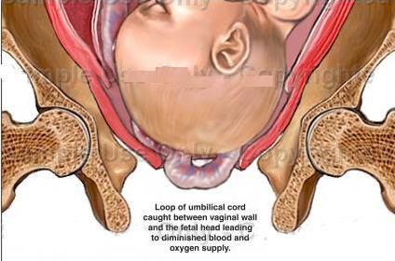
Cord prolapse

Slide 284
Diagnosis of cord presentation and cord prolapse is made on:
Vaginal examination by palpating cord under the intact membranes (cord presentation)
Vaginal examination after rupture of the membranes reveals loops of the cord in the birth canal (cord prolapse).

Slide 285
Potential predisposing risk factors include:
Premature rupture of the amniotic sac
Polyhydramnios (having a large volume of amniotic fluid. The cord may be forced out with the more forceful gush of waters.
Long umbilical cord
Foetal malpresentation
Multiparity
Multiple gestation

Slide 286
Differential Diagnosis
Foetal membranes
Footling breech or compound presentations.

Slide 287
Management of cord prolapse and cord presentation
Emergency Treatment
The aim of management is to deliver the foetus as quickly as possible before hypoxia and death occurs due to cord compression.
o Remove pressure by elevating the buttocks or putting patient in knee chest or exaggerated left lateral position
o Give oxygen to the mother by mask
o Establish IV line with 5% dextrose
o Monitor the foetal heart appropriately, every 5 minutes
o Counsel mother on the condition of the foetus.

Slide 288
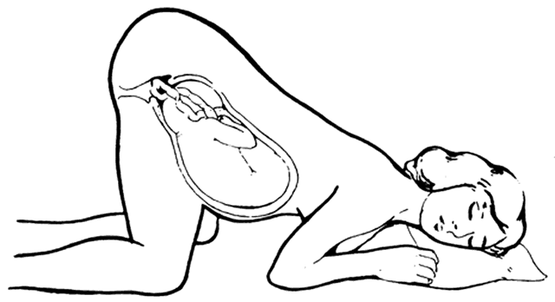
Knee chest position

Slide 289
If the cord is pulsating and patient is in first stage of labour:
• Replace the cord into the vagina.
• Transfer the mother to a healthcare facility capable of providing comprehensive emergency obstetric care for urgent caesarean section.
• Carry a delivery kit during transfer and maintain knee chest position during transfer.
In the comprehensive Emergency Obstetric Care facility, deliver by emergency caesarean section if the baby is alive and the patient is not in second stage of labour.

Slide 290
If the cord is pulsating and patient is in second stage of labour:
Rule out cephalopelvic disproportion and other malpresentations
If in doubt about pelvic capacity, perform caesarean section
If pelvis and presentation are normal, deliver by assisted vacuum extraction.

Slide 291
If the cord is not pulsating and patient is in first or second stage of labour:
Rule out any contraindication to vaginal delivery (e.g. CPD, mal-presentation)
Allow labour to progress.

Slide 292
Subsequent Management
Postpartum and neonatal care as appropriate
Counsel mother on infant feeding and care, diet, family planning and sexual relationships
Provide supportive counselling if baby is dead.

Slide 293
Precautions to take in order to avoid complications
Apply any of the following principles prior to definitive management:
Avoid iatrogenic cord prolapse (correct skill for artificial rupture of membranes –ARM )
Remove pressure from the cord
Keep the cord warm
Refer promptly
Deliver quickly
Be prepared for neonatal resuscitation.

Slide 294
FETAL DISTRESS

Slide 295
Definition of foetal distress
Foetal distress is defined as depletion of oxygen and accumulation of carbon dioxide resulting from interference with gaseous exchange and leading to a state of acidosis. The resulting oxygen deprivation leads to foetal hypoxia.

Slide 296
Causes of foetal distress
Antepartum causes:
Foetal congenital malformations
Cord accidents (e.g. cord tight around the neck; compression of the cord by baby; cord forms a knot)
Obstetric complications:
o Utero-placental insufficiency
o Pre-eclampsia/eclampsia
o Malaria in pregnancy
o APH (vasa previa, placenta previa, abruptio placenta)

Slide 297
Cont…
2. Intrapartum causes:
Prolonged/obstructed labour
Cord presentation/prolapse
Antepartum haemorrhage.

Slide 298
Essentials of Diagnosis of Foetal Distress
Detection of an abnormal foetal heart rate or rhythm
o Foetal tachycardia (foetal heart rate more than 180/min, a early sign of foetal distress)
o Foetal bradycardia (foetal heart rate less than 100/min, a late sign of foetal distress)
o Foetal heart rate deceleration after a uterine contraction, followed by a delayed recovery over 20 seconds or late deceleration
o Variable decelerations as detected by cardiotocograph (CTG) where available

Slide 299
Cont…
Passage of meconium-stained amniotic fluid in cephalic presentation
Biophysical profile score less than 6/10 (especially with reduced amniotic fluid)

Slide 300
Differential Diagnosis
Breech presentation with passage meconium
Effect of drugs administered to a mother (tocolytic agents e.g. salbutamol causing maternal tachycardia).
Maternal fever, hypertension or amnionitis may also result in foetal tachycardia

Slide 301
Management of Foetal Distress
The method of choice for the monitoring of the foetus during labour is intermittent auscultation using the Pinnard stethoscope. CTG with foetal heart rate tracing is an acceptable alternative, where available.

Slide 302
If the foetal heart rate remains abnormal for 3 consecutive contractions:
Explain condition of the foetus to the mother and possible complications
Change the mother’s position (left lateral position preferred)
Stop oxytocin if it was being administered, until foetal heart rate returns to acceptable level
Hydrate with IV normal saline/Ringers lactate
Give oxygen to the mother by face mask
Examine to rule out predisposing factors

Slide 303
Cont….
If in second stage with no malpresentation or severe CPD, deliver quickly with the aid of episiotomy and assisted vacuum delivery
After hydration with at least 1 litre in 30 minutes and foetal heart remains abnormal, perform an emergency caesarean section if still in first stage
Refer to a healthcare facility capable of providing comprehensive EOC if unable to provide Emergency Caesarean section.

Slide 304
Management of the newborn:
Resuscitate the baby as need be
Offer Immediate Essential Newborn Care
Observe baby in nursery for 24 hours if 5-minute APGAR score is less than 7
Give antibiotics to baby if membranes have ruptured for more than 6 hours before labour starts
Refer any severely ill baby
Explain and counsel grieving parents if baby has died.

Slide 305
Precautions to take in order to avoid complications
Use partograph in management of labour
Be prepared for quick delivery
Be prepared to resuscitate baby at delivery
Rule out cord presentation or compression during routine management of labour.
Record foetal heart rate every quarter hour if there is meconium stained liquor or irregular foetal heart rate pattern

Slide 306
Cont….
Test urine for acetone and correct any dehydration/ketosis
Deliver promptly; using the most appropriate route
Manage any other identified maternal causes of foetal distress.

Slide 307
Follow Up
If the baby was born with asphyxia neonatorum, regular check up and prolonged follow up for 5 years is recommended.
Advise the mother and her partner on delivery of subsequent babies.

Slide 308
MATERNAL DISTRESS

Slide 309
Defination
Is a condition that occurs when the mother is physically and mentally exhausted because of inadequate sleep and rest due to pain.

Slide 310
Predisposing factors
All conditions that may lead to prolonged labour.
Early signs
Ketonurea
Dehydration
Low grade fever
Pulse rate over 90 beats per minute
Respiratory rate above 24 breaths per minute
Mother is weak and has apathy

Slide 311
Late signs
Anxiety
Looks and feels ill
Perspiration
Vomiting ( serious sign)
Marked restlessness

Slide 312
Management
Call for help
Provide adequate rest, sedate and hydration
Take observations Temp, pulse, respiration and BP ¼-½ hourly.
FHR ¼ hourly by fetal scope or CTG.
Identify the cause
IV access and commence IV10% Dextrose and her nothing by mouth
If in early labour (less than 7cm dilated) give her pethidine to sedate her

Slide 313
Cont…
If mother is in 1st stage of labour test urine for sugar, albumin and ketone
Prepare mother for C/S if the mother presents with late signs of maternal distress.
If in 2nd stage of labour commence on 10% dextrose and delivery should be hastened by vacuum extraction.

Slide 314
Prevention
Recognition of condition that may lead to prolonged labour e.g contracted pelvis, malpresentation and malposition
Hydration of mother in labour by giving light fluid diet in latent phase and IV 5% to 10% dextrose in established labour
In early labour, give analgesics for pain to ensure adequate rest and sleep
Use of partograph to observe the mother in labour and detect any deviation from normal and manage.

Slide 315

Management:
This depend on:
1.Gestational age.
2.Type of presentation.
in cephalic presentation with prolapsed hand.
Labour can be allowed and vaginal delivery anticipated as the hand will move upward into the lower uterine segment as the vertex descend into the birth canal.
Other compound presentation are treated by c/s.
There is a risk of umbilical cord prolapse and continuous fetal heart monitoring should be done to detect fetal distress which should be treated by immediate caesarian section..
Thank you

