Slide 1

Antiviral agents pharmacology

Slide 2
Target: Life Cycle Stages
Attachment
Fusion/uptake
Uncoating
Reverse transcription
Integration
Transcription

Slide 3
Classification of Antiviral Agents
By mechanism of action
By target condition
By mode of administration
By chemical composition

Slide 4
Classification by Target virus
Anti-herpesvirus agents
  Acyclovir
□ Valacyclovir/ Ganciclovir/ Valganciclovir/ Famciclovir
  Foscarnet
  Fomiversen
  Docosanol

Slide 5
2. Anti-influenza agents
Uncoating Inhibitors
Amantadine, Rimantadine
Viral release inhibitors
Oseltamivir, Zanamivir, Peramivir
RNA Polymerase Inhibitors
Ribavirin, Favipravir
Endonuclease Inhibitor
Baloxavir

Slide 6
3. Anti-hepatitis B virus agents
Immunomodulant
Interferon (IFN)
HBV DNA Polymerase Inhibitors
Entecavir
Tenofovir
Lamivudine
Telbivudine
Adefovir

Slide 7
4. Anti-Hepatitis C virus agents
1. Immunomodulant
Interferon
2. RNA Polymerase Inhibitors
Ribavirin, Sofosbuvir, Dasabuvir
3. Protease Inhibitors
Simeprevir, Paritaprevir, Grazoprevir, (Ritonavir)
4. NS5A Inhibitors
Daclatasvir, Ledipasvir, Velpatasvir, Ombitasvir, Elbasvir

Slide 8
5. Anti-retroviral agents (ARVs):
Attachment blocker - Maraviroc
Fusion Blocker - Enfuvirtide
Reverse transcriptase inhibitors
  Nucleoside analogues – Zidovudine, Lamivudine
  Non-Nucleoside analogues – Efavirenz, Nevirapine, Etravirine
Integration inhibitors – Raltegravir, Dolutegravir
Protease inbitors – Ritonavir, Lopinavir

Slide 9
1. Receptor binding Inhibitors
Maraviroc
Blocks CCR5 co-receptor preventing binding of HIV
HIV tropism test required before use

Slide 10
2. Fusion inhibitors
Enfuvirtide
Binds HIV gp41 hence preventing fusion with host cell membrane
Palivizumab
Monoclonal antibody - binds F protein of RSV preventing fusion

Slide 11
3. Agents that block Uncoating
Amantadine/ Rimantadine
Block M2 ion channels – a viral protein
Prevents acidification of the endosome (required for uncoating)
Active on Influenza A only, not B or C
Resistance is widespread especially in H1N1 and H3N2 strains

Slide 12
4. Nucleic acid synthesis inhibitors
DNA Synthesis Inhibitors
  DNA polymerase inhibitors
  Reverse transcriptase inhibitors
DNA Integration inhibitors
RNA Synthesis inhibitors

Slide 13
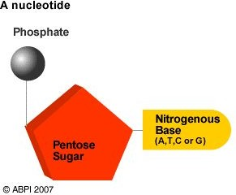
4(a) DNA Synthesis Inhibitors
(i). DNA Polymerase Inhibitors (DdDp)
Incorporated into DNA chain by DNA polymerase causing termination
Nucleoside analogues
Acyclovir, Idoxuridine
Nucleotide analogues
Cidofovir
Pyrophosphate analogues:
Foscarnet, Phosphonoacetic acid

Slide 14
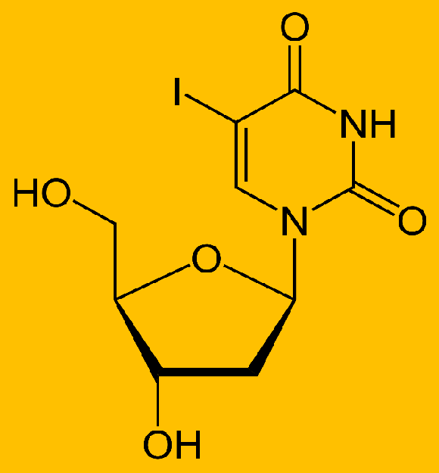
Idoxyuridine
First antiviral agent (1963)
A pyrimidine analogue
Inhibits viral DNA polymerase
Non-selective – also inhibits host DNA polymerase
Largely replaced by less toxic drugs e.g. Acyclovir

Slide 15
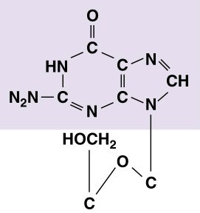
Acyclovir
Acyclic nucleoside analogue
Active against HSV-1, HSV-2 and VZV
A pro-drug, undergoes 3 phosphorylation steps to its active form
  Initial phosphorylation by Viral thymidine kinase
  Subsequent di & tri phosphorylation by host-cell enzymes

Slide 16
Acyclovir…
MoA: Inhibition of DNA Polymerase
□Acyclovir triphosphate competes with endogenous nucleotides for DNA Polymerase
□Incorporated into the growing DNA chain (viral genome)
□Causes chain termination once incorporated
Mechanisms of Resistance:
  Reduced production of Viral Thymidine kinase (TK)
  Altered TK hence reduced affinity for Acyclovir
  Altered DNA polymerase

Slide 17
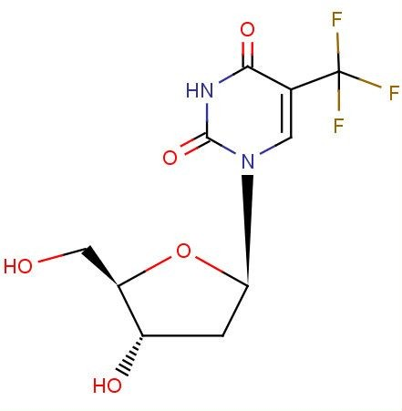
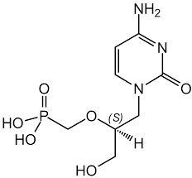
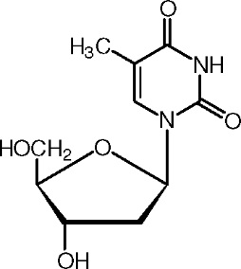
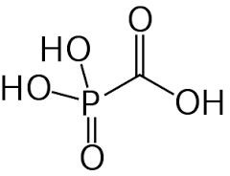
Other DNA Polymerase Inhibitors
1.
Trifluridine
2.
Cidofovir
Thymidin e
3. Foscarnet

Slide 18
(ii) Reverse Transcriptase Inhibitors
Block DNA synthesis from RNA by Reverse transcriptase (aka RNA-dependent DNA polymerase)
Nucleoside Reverse Transcriptase Inhibitors (NRTIs)
Zidovudine, Lamivudine, Abacavir
Nucleotide RT Inhibitors (NtRTIs)
Tenofovir (HIV)
iii.
Non-Nucleoside RT Inhibitors
Nevirapine, Efavirenz, Etravirine

Slide 19
4 (b).DNA Integration inhibitors
Prevent integration of viral DNA into host genome by binding Integrase enzyme
Raltegravir
Dolutegravir
Elvitegravir
All are ARVs

Slide 20
4(c). RNA Synthesis Inhibitors
Block action of RNA polymerase
Ribavirin
  Inhibits RNA polymerase of several RNA viruses (HCV, Influenza)
  Prevents capping of mRNA in Influenza viruses
Sofosbuvir
Inhibits Hepatitis C virus RNA Polymerase

Slide 21
Novel RNA synthesis inhibitor
Favipiravir
Approved in Japan in 2014 for Influenza
  Inhibits RNA polymerase in several viruses (e.g. Influenza virus)
  In vitro activity against: Arenaviridae, Bunyaviridae, Flaviviridae, etc.

Slide 22
5. Protein Synthesis Inhibitors
Formivirsen
5'-GCG TTT GCT CTT CTT CTT
GCG-3'
An anti-sense oligonucleotide
Binds the complementary CMV mRNA
Prevents translation of the mRNA into protein
Stabilized to prevent degradation by nucleases
Used to treat CMV retinitis – intravitreal injection

Slide 23
6. Protease Inhibitors
Bind Protease preventing protein cleavage hence blocking viral maturation
Hepatitis C protease inhibitors:
Simeprevir, Paritaprevir, etc.
HIV protease inhibitors:
Lopinavir, Ritonavir, etc.

Slide 24
7. Viral release inhibitors
Oseltamivir/Zanamivir
Block viral neuraminidase of Influenza A & B viruses
□NA clears sialic acid from the infected cell surface and mucus secretions allowing the Influenza virus to spread to other cells

Slide 25
8. Interferons
Cytokines with antiviral, immunomodulatory and antiproliferative activity
Synthesized by the body in response to certain stimuli
IFNs induce synthesis of proteins that prevent viral entry, replication or maturation
Numerous side effects

Slide 26
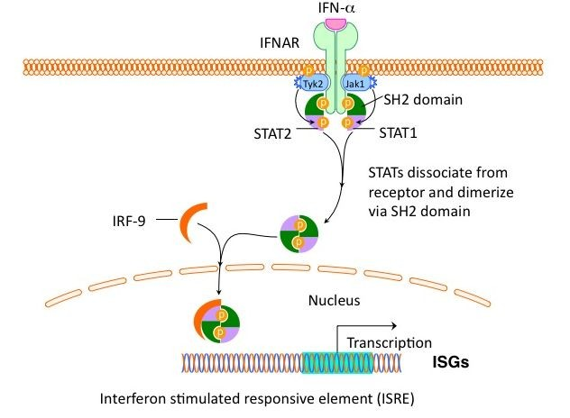

Slide 27
Interferon: Mechanism of action
Bind specific cellular receptors >
Induce gene expression through the JAK-STAT signaling pathway >
Synthesis of several proteins which have antiviral activity through inhibition of viral:
Transcription
Translation
Post-translational modification of protein
Virus maturation
Virus release

Slide 28
Available forms
Natural IFN
Recombinant IFN
Pegylated IFN
PEG – PolyEthylGlycol – large inert molecule
□slows metabolism allowing for lower, less frequent doses

Slide 29
Therapeutic Use
Hepatitis B virus infection
Hepatitis C virus infection

Slide 30
Recap
Receptor binding inhibitors
Fusion inhibitors
Uncoating inhibitors
Nucleic acid synthesis inhibitors
Protein synthesis inhibitors
Protease inhibitors
Viral release inhibitors
Interferons

