Slide 1
VASOPRESSORS

Slide 2
DEFINITIONS
Vasopressors
Increase vasoconstriction → increase systemic vascular resistance →
increase mean arterial pressure
Inotropes
Increase cardiac contractility → improves cardiac output → increased perfusion to organs
Chronotropes
Increase heart rate → improves cardiac output → increased perfusion to organs

Slide 3
WHY DO WE NEED VASOPRESSORS, INOTROPES, CHRONOTROPES
Shock is an acute, generalized state of inadequate perfusion of critical organs
Shock is defined as a state of cellular and tissue hypoxia due to reduced oxygen delivery and/or increased oxygen consumption or inadequate oxygen utilization
Early shock is reversible, BUT persistent hypoperfusion leads to IRREVERSIBLE
tissue damage, progressive organ dysfunction, and potential death

Slide 4
TYPES OF SHOCK
Distributive
Severe peripheral vasodilation due to release of cytokines and interleukins from
bodies natural inflammatory response to stimulus → hypotension
Septic shock (most common)
Neurogenic shock
Anaphylactic shock
Cardiogenic
Intracardiac abnormality → cardiac pump failure → reduction in cardiac output (CO)
Myocardial infarction, atrial/ventricular tachyarrhythmias, valve abnormalities

Slide 5
TYPES OF SHOCK
Hypovolemic
Reduction in intravascular volume (reduction in preload) → reduction in CO
Hemorrhagic vs non-hemorrhagic
Obstructive
Extracardiac abnormality → cardiac pump failure → reduction in CO
Pulmonary embolism and pulmonary hypertension
Tension pneumothorax and pericardial tamponade are mechanical causes

Slide 6

SIGNS OF SHOCK
Hypotension (SBP < 90 mmHg, MAP < 65 mmHg, drop in SBP > 40 mmHg)
Tachycardia
Early compensatory signs
Tachypnea
Oliguria
Abnormal mental status Metabolic acidosis Hyperlactatemia
Cool, clammy, cyanotic skin
Late stage shock sign

Slide 7
HEMODYNAMIC PARAMETERS
Mean arterial pressure (MAP)
Average arterial pressure in one cardiac cycle
Central venous pressure (CVP)
Estimate the pressure of blood returning to the right atrium
Changes in CVP can estimate changes in intravascular volume
Pulmonary artery occlusion pressure (PAOP)
Estimates the pressure in the left ventricle at the end of diastole (LVED pressure)
Estimates preload

Slide 8
HEMODYNAMIC PARAMETERS
Cardiac output (CO)
Amount of blood (in liters) per minute that is ejected by ventricles
Systemic vascular resistance (SVR)
Resistance to blood flow by the systemic vasculature → Afterload

Slide 9
HEMODYNAMIC PARAMETERS
Arterial oxygen saturation (SaO2)
Amount of hemoglobin binding sites occupied by oxygen in arterial blood
Affected by supply of oxygen to the patient and the ability to oxygenate the blood
Central venous oxygen saturation (ScvO2)
Amount of hemoglobin binding sites occupied by oxygen in venous blood
Affected by CO, oxygen demand, hemoglobin, and SaO2
Low levels may indicate that tissues are extracting more oxygen due to tissue hypoperfusion or that inadequate oxygen was available in arterial blood

Slide 10
HEMODYNAMIC PARAMETERS
Serum lactate
Byproduct of anaerobic metabolism
Indicative of global perfusion
Need a series of measurements for adequate assessment

Slide 11
HEMODYNAMIC RELATIONS
CO = heart rate (HR) x stroke volume (SV)
Stroke volume
Amount of blood pumped per heart beat
Contractility (“Squeeze”)
Preload (“Fill the tank”)
Afterload (“Clamp down”)
Cardiac index (CI)
Relation of CO to body surface area (BSA) = L/min/m²

Slide 12
FACTORS THAT IMPACT CONTRACTILITY
Strength of muscle
Injury to muscle (MI, cardiomyopathy)
Medications

Slide 13
FACTORS THAT IMPACT PRELOAD
Blood volume, fluid status
Vascular capacity/tone
Ability for the heart to pump volume
Medications

Slide 14
FACTORS THAT IMPACT AFTERLOAD
Vascular tone (systemic or pulmonary)
Medications

Slide 15
ORGAN SPECIFIC CLINICAL SIGNS
Brain
Changes in mental status
Heart
Arrhythmias, myocardial dysfunction, elevated serum troponins
Liver
Elevated AST/ALT, elevated bilirubin, elevated INR
Gut
Decreased gut motility, gastroparesis
Kidney
Elevated SCr and/or BUN, decreased urine output

Slide 16
RECEPTOR OVERVIEW
Alpha-1 receptors
Located on vascular walls
Stimulation → Vasoconstriction
Beta-1 receptors
Located on heart
Stimulation → Increase chronotropy and inotropy
Beta-2 receptors
Located on vascular walls
Stimulation → Vasodilation

Slide 17
RECEPTOR OVERVIEW
Dopamine-1 receptors
Located on renal, splanchnic, coronary, and cerebral vascular beds
Stimulation → Vasodilation
Dopamine-2 receptors
Located on renal tubules
Stimulation → Naturesis
Vasopressin-1 receptors
Located on vascular wall
Stimulation → Vasoconstriction

Slide 18
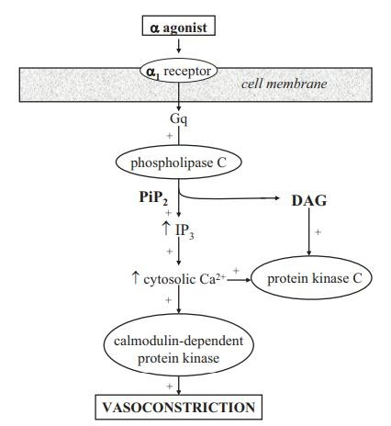
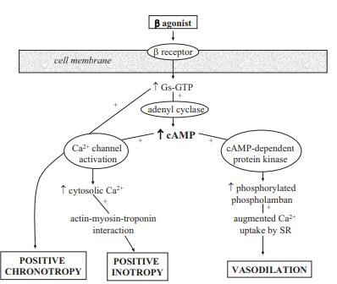
RECEPTOR PHARMACOLOGY

Slide 19
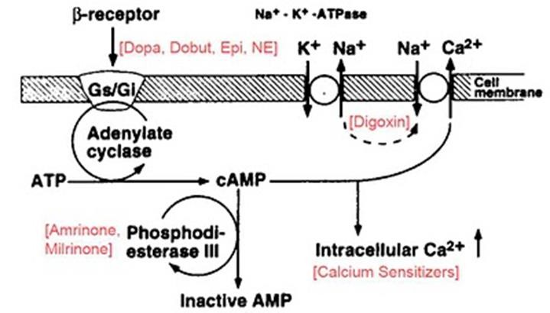
RECEPTOR PHARMACOLOGY
Milrinone

Slide 20
MANAGEMENT OF SHOCK
Determining causative reason for shock will guide therapeutic decisions
Determining fluid status of the patient will be important
Determining need for vasopressors and/or inotropes support will be important if
initial management options are not adequate

Slide 21
FLUIDS
Fluid | Intracellular/Interstitial/Intravascular | Major Indication
Normal 0.9% saline (NSS) Lactated Ringer (LR) | 75% interstitial 25% intravascular | Intravascular repletion
3% sodium chloride (hypertonic saline) | 75% interstitial 25% intravascular | Intravascular repletion for patients with head trauma, use in combination NSS or LR
5% dextrose/0.45% sodium chloride | 33% intracellular 50% interstitial 17% intravascular | Maintenance fluid
5% dextrose (D5W) | 67% intracellular 25% interstitial 8% intravascular | Dehydration, maintenance fluid
5% albumin | 100% intravascular | Intravascular repletion
25% albumin | 100% intravascular | Intravascular repletion in patients with excessive interstitial fluid

Slide 22
COMPARISON OF NSS AND LR
Fluid | Na | Cl | K | Ca | Mg | Buffer | pH | Osmolarity
Plasma | 140 | 103 | 4 | 5 | 2 |  | 7.4 | 290
NSS | 154 | 154 |  |  |  |  | 5.7 | 308
LR | 130 | 109 | 4 | 3 |  | Lactate | 6.4 | 273
LR and plasma are similar is components, thus LR is labeled as a balanced fluid compared to NSS, which has higher amounts of sodium and chloride than plasma.

Slide 23
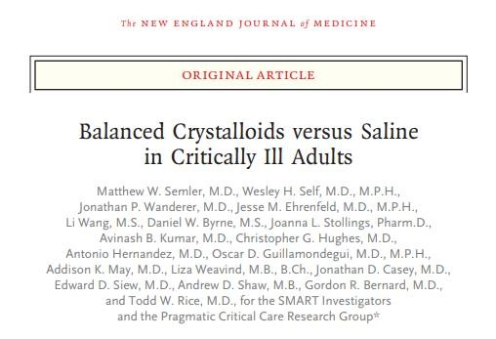
WHICH IS BETTER NSS VS LR?

Slide 24
VASOPRESSORS
Medication | Infusion rate | Receptor Binding |  |  |  | Hemodynamic effect
 |  | α₁ | β₁ | β₂ | Dopamine
Dopamine | 0.5-2 mcg/kg/min | - | + | - | +++ | ↑CO
 | 2-10 mcg/kg/min | + | +++ | + | ++ | ↑↑CO, ↑SVR
 | 10-20 mcg/kg/min | +++ | ++ | - | + | ↑↑SVR, ↑CO
Norepinephrine | 0.05-0.4 mcg/kg/min | ++++ | ++ | + | - | ↑↑SVR, ↑CO
Epinephrine | 0.01-0.5 mcg/kg/min | ++++ | ++++ | +++ | - | ↑↑CO, ↑SVR
Phenylephrine | 0.1-10 mcg/kg/min | +++ | - | - | - | ↑↑SVR
Vasopressin | 0.02-0.04 units/min | Stimulates V₁₋₂ receptors in vascular smooth muscles |  |  |  | ↑↑SVR
Dobutamine | 2.5-20 mcg/kg/min | + | ++++ | ++ | - | ↑↑CO, ↓SVR, ↓PVR
Milrinone | 0.125-0.75 mcg/kg/min | PD-3 inhibitor |  |  |  | ↑CO, ↓SVR, ↓PVR

Slide 25
DOPAMINE RECEPTOR EFFECT
Dopamine is a naturally occurring neurotransmitter in the body
Dose-dependent response
Low (1-3 mcg/kg/min)
Intermediate (3-10 mcg/kg/min)
High (10-20 mcg/kg/min)
Dopamine receptor priority
Dopamine > Beta > Alpha

Slide 26
DOPAMINE RECEPTOR EFFECT
Low (2-5 mcg/kg/min)
Stimulation of D1 postsynaptic receptors in coronary, renal, mesenteric, cerebral beds
Stimulation of D2 presynaptic receptors in vasculature and renal tissues
Both D1 and D2 receptor activation → vasodilation and ↑blood flow to tissue
Renal dopamine receptor activation → ↑natriuretic effects
Intermediate (5-10 mcg/kg/min)
Stimulation of B1 adrenergic receptors → ↑contractility, ↑chronotropy
High (10-20 mcg/kg/min)
Stimulation of α1 adrenergic receptors → ↑vasoconstriction

Slide 27
NOREPINEPHRINE RECEPTOR ACTIVITY
Endogenous catecholamine
Norepinephrine receptor priority
Alpha > Beta
Has potent α1 -receptor activity → ↑vasoconstriction
Predominates at higher doses
Has modest B1-receptor activity → ↑contractility
Predominates at lower doses

Slide 28
EPINEPHRINE RECEPTOR ACTIVITY
Endogenous catecholamine
Norepinephrine receptor priority
Beta > Alpha
Has potent α1 -receptor activity → ↑vasoconstriction
Predominates at higher doses
Has modest B1-receptor activity → ↑contractility, ↑CO, ↑HR
Predominates at lower doses
Has modest B2-receptor activity → ↑vasodilation, ↑bronchodilation
Predominates at lower doses

Slide 29
PHENYLEPHRINE RECEPTOR ACTIVITY
Synthetic catecholamine
Phenylephrine ONLY binds to alpha receptors
Has potent α1 -receptor activity → ↑vasoconstriction

Slide 30
VASOPRESSIN RECEPTOR ACTIVITY
Endogenous peptide
Has V1 -receptor activity → ↑vasoconstriction (SVR and PVR)
Has V2 -receptor activity → ↑antidiuresis

Slide 31
DOBUTAMINE RECEPTOR ACTIVITY
Synthetic catecholamine
Has B1 -receptor activity → ↑contractility, ↑CO, ↑HR
Has B2 -receptor activity → ↑vasodilation

Slide 32
MILRINONE RECEPTOR ACTIVITY
Phosphodiesterase III (PDE-3) inhibitor
Inhibiting PDE-3 in cardiac myocytes → ↑contractility, ↑CO
Reduces the breakdown of intracellular cAMP → enhancing calcium delivery
→ increasing contractility
Inhibiting PDE-3 in vascular smooth muscle → ↑vasodilation

Slide 33

GENERALIZED EFFECT
Increased SVR
Increased CO
Phenylephrine
Milrinone
Vasopressin
Dobutamine
Norepinephrine
Dopamine
Epinephrine
Epinephrine
Dopamine
Norepinephrine
Dobutamine
Vasopressin
Milrinone
Phenylephrine

Slide 34
ADVERSE EFFECTS
Drug | Adverse Effects
Norepinephrine | Arrhythmias, bradycardia, peripheral ischemia, hypertension
Epinephrine | Ventricular arrhythmias, severe hypertension, cardiac ischemia, sudden cardiac arrest
Vasopressin | Arrhythmias, hypertension, decrease CO, cardiac ischemia, severe peripheral vasoconstriction, splanchnic vasoconstriction
Phenylephrine | Reflex bradycardia, hypertension, severe peripheral vasoconstriction
Dopamine | Severe hypertension, ventricular arrhythmias, cardiac ischemia, tissue ischemia

Slide 35
ADVERSE EFFECTS
Drug | Adverse Effects
Dobutamine | Tachycardia, ventricular arrhythmia, cardiac ischemia, hyper/hypotension
Milrinone | Ventricular arrhythmia, hypotension, cardiac ischemia

Slide 36

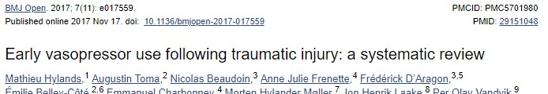
MANAGING HYPOVOLEMIC SHOCK
 | CI: ↓ | CVP: ↓ | MAP: ↓
 | HR: ↑ | PAOP: ↓ | SVR: ↑
The magnitude and duration of decreased organ perfusion in hypovolemic shock are DIRECTLY related to mortality
Fluid resuscitation is primary treatment and goal, blood transfusion as needed
Vasopressor use has been associated with increase mortality

Slide 37
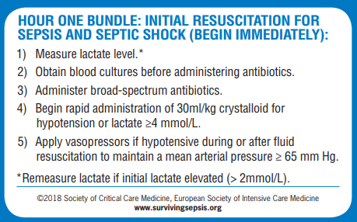
MANAGEMENT OF SEPTIC SHOCK
 | CI: ↑ | CVP: ↓ | MAP: ↓
 | HR: ↑ | PAOP: ↓ | SVR: ↓
Hemodynamic goals:
CVP 8-12 mmHg (12-15 mmHg in ventilated patients)
MAP > 65 mmHg
Urine output 0.5 mL/kg/hr
ScvO2 >70% or SvO2 > 65%

Slide 38
CHOICE OF VASOPRESSOR IN SEPTIC SHOCK
1st line
Norepinephrine 2-30 mcg/min
Dopamine 10-20 mcg/kg/min
2nd line
Epinephrine 1-10 mcg/min
Vasopressin 0.03 unit/min
3rd line
Phenylephrine 40-300 mcg/min
Dobutamine 2.5-20 mcg/kg/min
Milrinone 0.125-0.75 mcg/kg/min

Slide 39
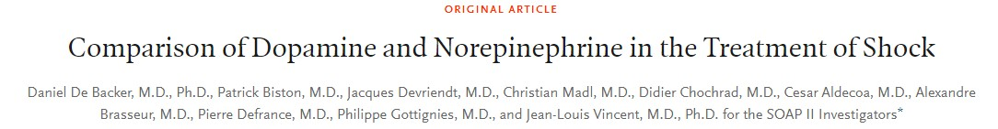
CHOICE OF FIRST LINE VASOPRESSOR
\
Efficacy:
No difference in mortality data between the two groups
Safety:
Almost double the rate of tachyarrhythmia with dopamine compared to norepinephrine
Almost 80% of the drug discontinuations secondary to tachyarrhythmia were with dopamine

Slide 40
CHOICE OF SECOND LINE VASOPRESSOR
No strong literature is available to compare epinephrine and vasopressin head to head when used in combination with norepinephrine
Vasopressin
Shown the benefit of leading to reduction in norepinephrine demand, while improving the MAP
Augments other vasopressors agents
Epinephrine
Has stronger beta 1 and beta 2 activity than norepinephrine

Slide 41
CHOICE OF THIRD LINE AGENT
Phenylephrine
Pure alpha agonist, thus activity in vasculature (no myocardial stimulation)
Dobutamine
Assists in patients with persistently low ScvO2
Tachyphylaxis after few days of therapy
Milrinone
Assists in patients with persistently low ScvO2
Use after dobutamine starts to demonstrate tachyphylaxis

Slide 42
MANAGEMENT OF NEUROGENIC SHOCK
Fluid resuscitation is primary treatment
Vasopressors will be utilized in refractory patients
1st line: Dopamine or norepinephrine
Both resolve bradycardia and hypotension
Atropine can be used acutely for symptomatic bradycardia
Avoid phenylephrine in these patients secondary to risk of reflex bradycardia

Slide 43
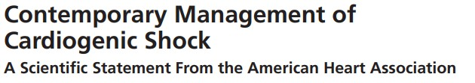
MANAGEMENT OF CARDIOGENIC SHOCK
Obtaining a pulmonary artery catheter should be attempted first to determine hemodynamic parameters of the patient
In addition, can assist in determining cardiac cause of shock
Fluid resuscitation should be done in patients that do NOT demonstrate fluid overload
Choice of vasopressor or inotrope dependent of cause of cardiogenic shock

Slide 44
MANAGEMENT OF OBSTRUCTIVE SHOCK
Usually does not require vasopressor therapy initially, since the causative reason is an obstruction
Typically, after resolution of the obstruction, patient should start to recover rapidly

Slide 45
CASE 1
53 year old male, presents to the ED after complaining the past few days of high fevers, chills, stiff neck, headache, and cough.
BP: 72/40
HR: 62
T = 39.4˚C
Weight = 90 kg
Past medical history: Atrial fibrillation, hypertension, diabetes, peptic ulcer disease
Medication: Expresses non-compliance due to cost of medication
You are called to see this patient, what’s the first medical management step you’ll take?
Start the patient with fluid challenge
30 mL/kg
NSS or LR
2,700 mL

Slide 46
CASE 1
53 year old male, presents to the ED after complaining the past few days of high fevers, chills, stiff neck, headache, and cough.
BP: 72/40
HR: 62
T = 39.4˚C
Weight = 90 kg
Past medical history: Atrial fibrillation, hypertension, diabetes, peptic ulcer disease
Medication: Expresses non-compliance due to cost of medication
So you have given the patient 2.7L of fluid but still the BP: 76/46, what is the next step?
Start the patient on norepinephrine. Why not dopamine in this patient specifically?
MAP > 65
2-5 mcg/min

Slide 47
CASE 1
53 year old male, presents to the ED after complaining the past few days of high fevers, chills, stiff neck, headache, and cough.
BP: 72/40
HR: 58
T = 39.4˚C
Weight = 90 kg
Past medical history: Atrial fibrillation, hypertension, diabetes, peptic ulcer disease
Medication: Expresses non-compliance due to cost of medication
So you have given the patient 2.7L of fluid and started the norepinephrine but still the
BP: 80/50, what is the next step?
Vasopressin or epinephrine
MAP > 65
0.03 units/min
1-2 mcg/min

Slide 48
CASE 2
42 year old female, presents to the ED being brought from a nearby motor vehicle accident. She complains of abdominal pain and just as she was going to tell you more she says she thinks she is going to faint.
BP: 60/42
HR: 110
Weight = 60 kg
Past medical history: None
Medication: None
You exam her abdominal area and notice it’s completely bruised and concerned for internal bleeding
Start the patient with fluid challenge
30 mL/kg
NSS or LR
+/- blood
1,800 mL
NO!

Slide 49
CASE 3
61 year old male, presents to the ED being brought from home. His wife reports he has been complaining of shortness of breath the past few days but thought it was because of the humid weather. He did recently fly to New York, which required 17 hours of total flight time.
BP: 92/62
HR: 120, RR: 30
Past medical history: Asthma
Medication: Albuterol
What are potentially causes for this patient’s symptoms?
PE, pneumonia, asthma exacerbation
Obstructive shock
Anticoagulation for PE

Slide 50
CASE 4
78 year old male, presents to the ED being brought from home. The patient states he has been admitted 4 times this past year for heart failure exacerbation episodes. He states walking down the hall just now has become extremely difficult and going up the stairs required him to take frequent breaks. His extremities are cold to touch.
BP: 84/58
HR: 118, RR: 27
Past medical history: Chronic heart failure (x15 years)
Medication: Lisinopril, furosemide, metoprolol XL, spironolactone
Cardiogenic shock
Higher SVR, Lower CO
Dobutamine/Milrinone +/- Norepinephrine

Slide 51

QUESTIONS?

Slide 52
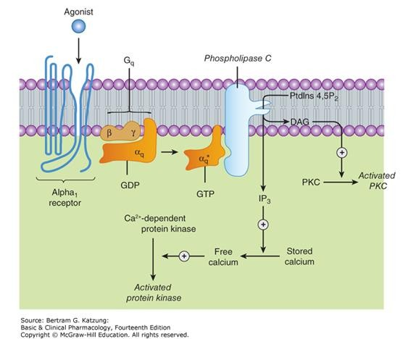

Slide 53
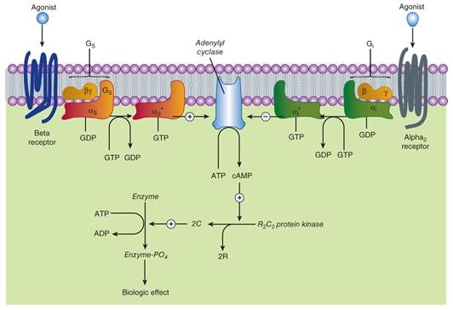

Slide 54
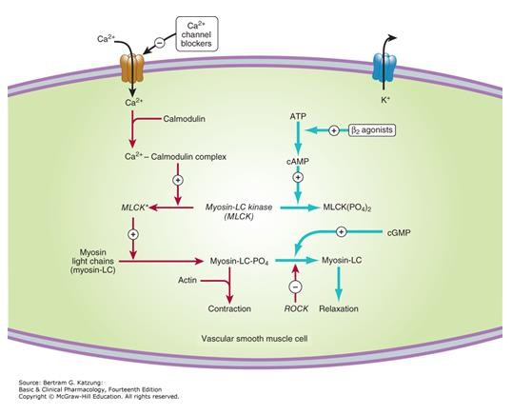

Slide 55
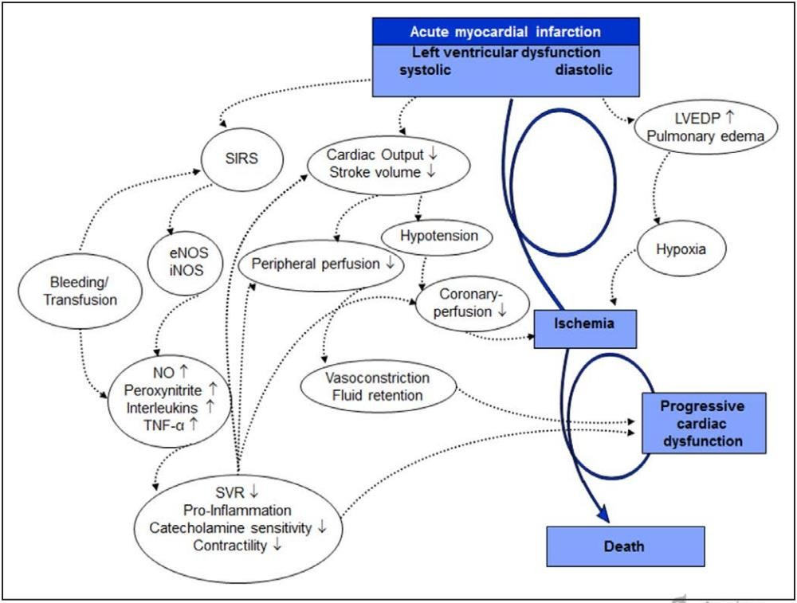

Slide 56
