Slide 1
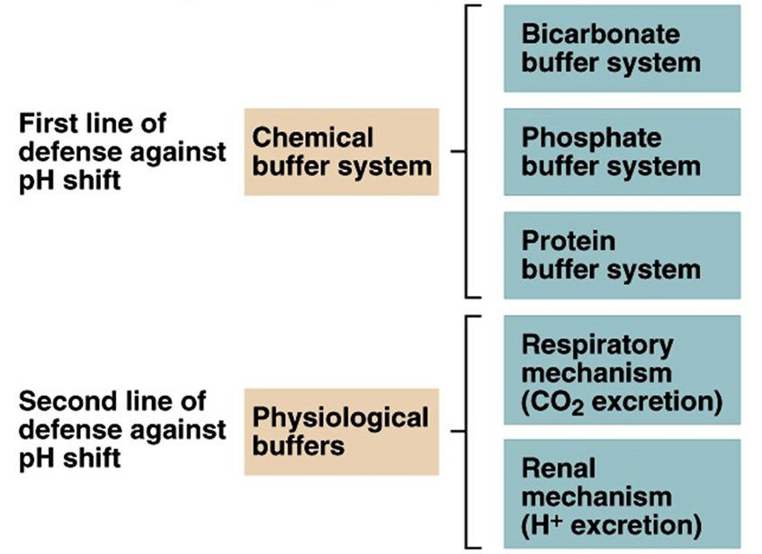
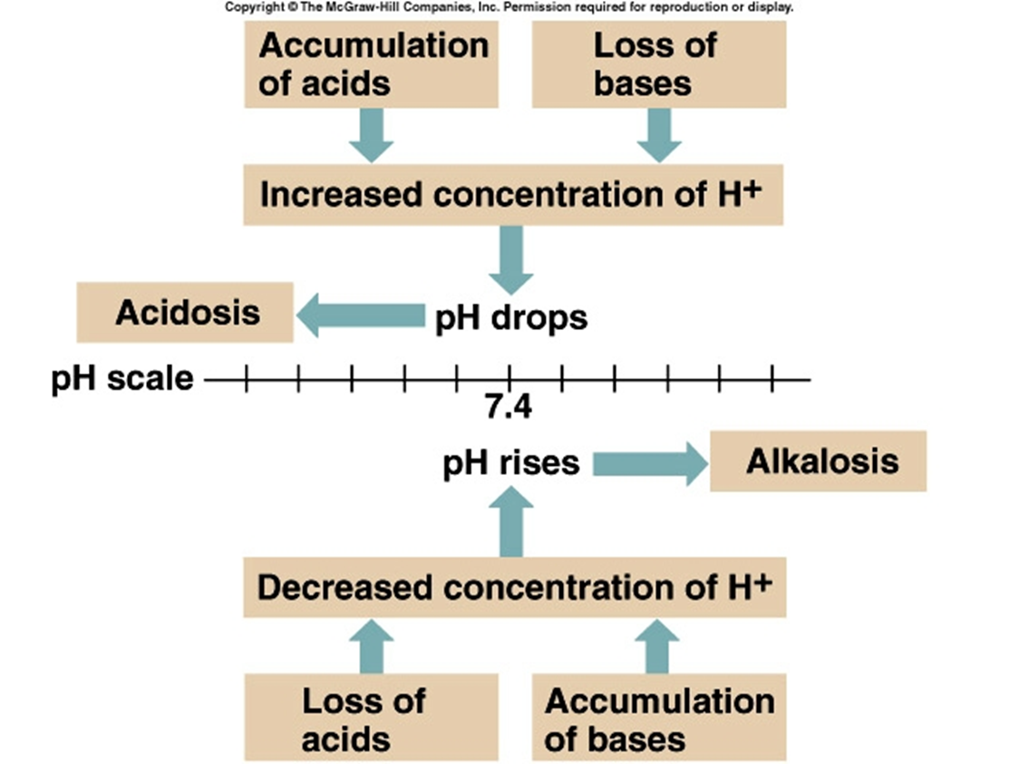
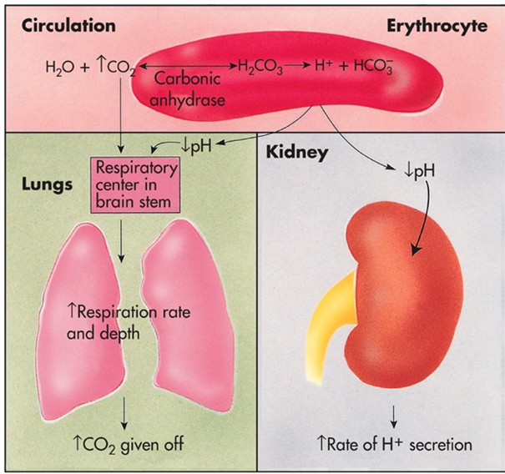
Acid and Base Balance and Imbalance

Slide 2
1
Acid and Base Balance and Imbalance
Acid-base balance in the human body is one of the most paramount physiological processes.
This tutorial intends to impart a basic understanding of acid-base balance in the body while providing a systematic way to approach patients who present with conditions causing alterations in pH.
The human body experiences four main types of acid-based disorders: metabolic acidosis, metabolic alkalosis, respiratory acidosis, and respiratory alkalosis.
1: Introduction
2: pH Review
3: Buffer systems
4: respiratory acidosis
5: Respiratory alkalosis
6: Metabolic acidosis
7: Metabolic alkalosis
8: Metabolic acidosis
9: Compensation

Slide 3
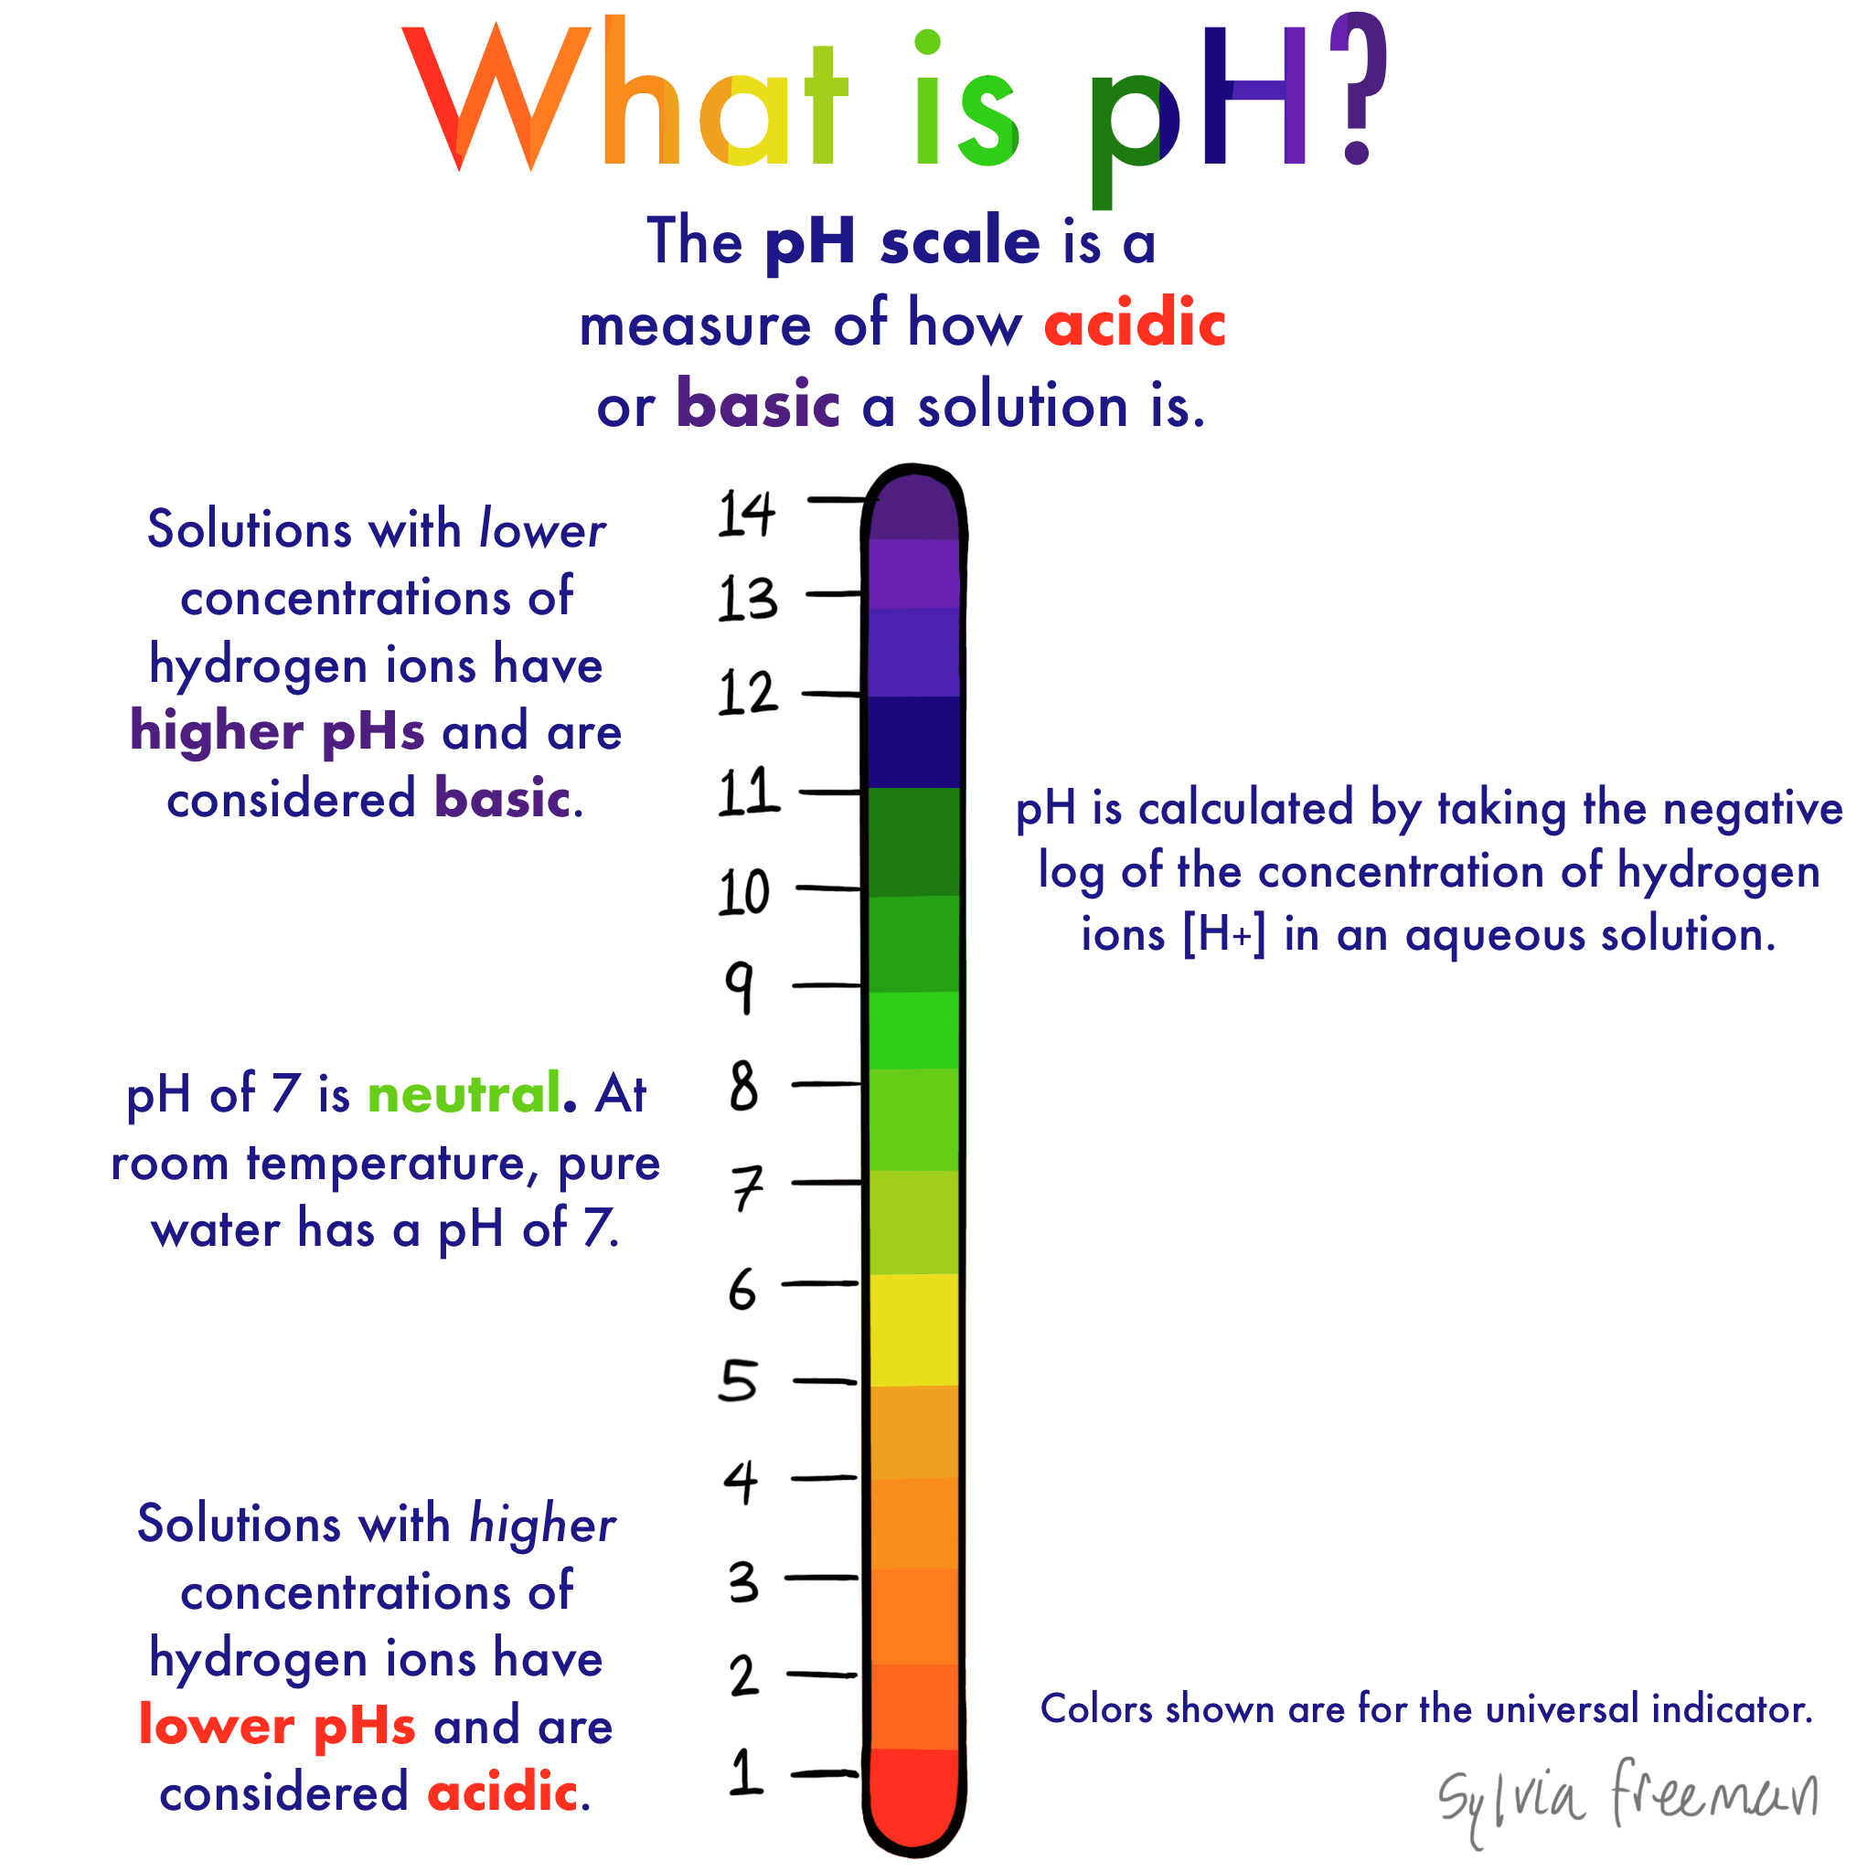
1
pH Review
pH = - log [H⁺]
H⁺ is really a proton
Range is from 0 - 14
If [H⁺] is high, the solution is acidic; pH < 7
If [H⁺] is low, the solution is basic or alkaline ; pH > 7

Slide 4

2
pH Review
Acids are H⁺ donors.
Bases are H⁺ acceptors, or give up OH⁻ in solution.
Acids and bases can be:
Strong – dissociate completely in solution i.e HCl,
Weak – dissociate only partially in solution
Lactic acid, carbonic acid

Slide 5
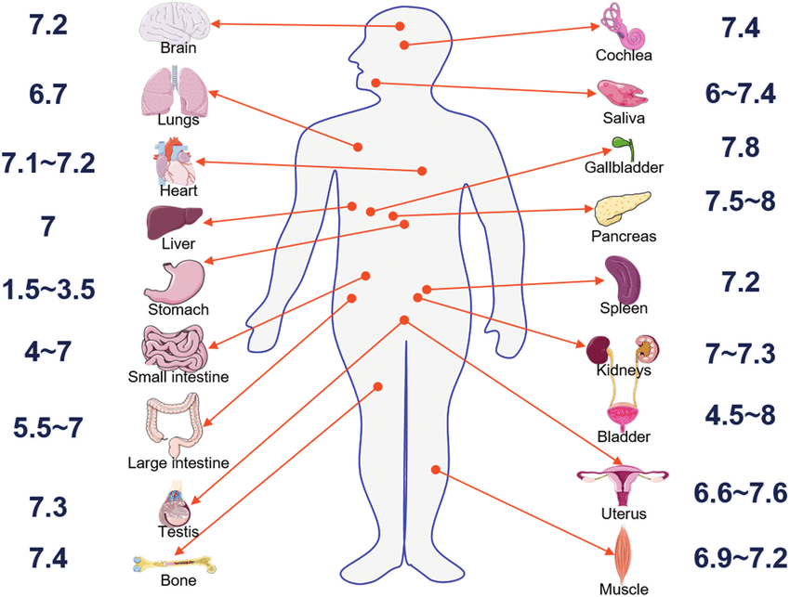
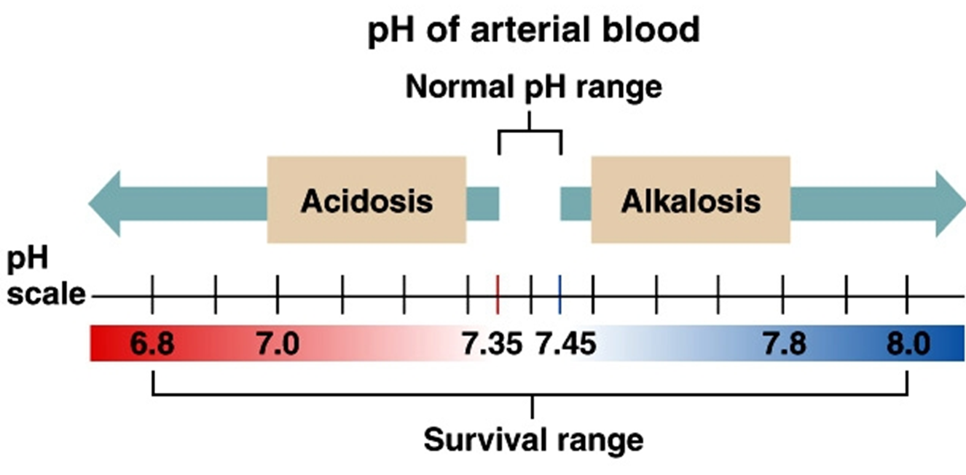
3
The Body and pH
Homeostasis of pH is tightly controlled
Extracellular fluid = 7.4
Blood = 7.35 – 7.45
< 6.8 or > 8.0 death occurs
Acidosis (acidemia) below 7.35
Alkalosis (alkalemia) above 7.45

Slide 6
4
Small changes in pH can produce major disturbances
Small changes in pH can produce major disturbances
Most enzymes function only with narrow pH ranges
Acid-base balance can also affect electrolytes (Na⁺, K⁺, Cl⁻)
Can also affect hormones

Slide 7
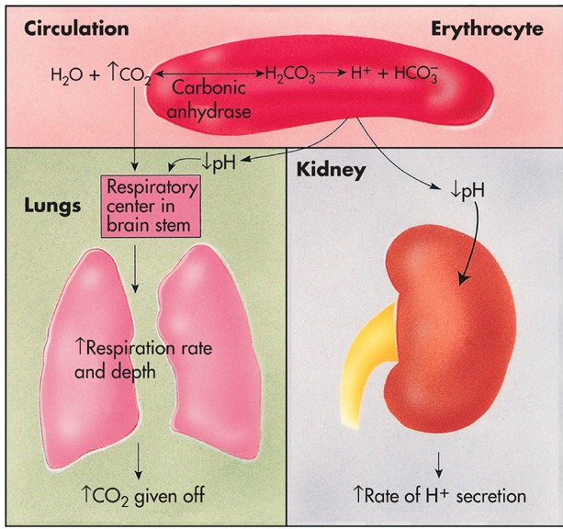
5
The body produces more acids than bases
The body produces more acids than bases
Acids take in with foods
Acids produced by metabolism of lipids and proteins
Cellular metabolism produces CO₂.
CO₂ + H₂0 ↔ H₂CO₃ ↔ H⁺ + HCO₃⁻

Slide 8
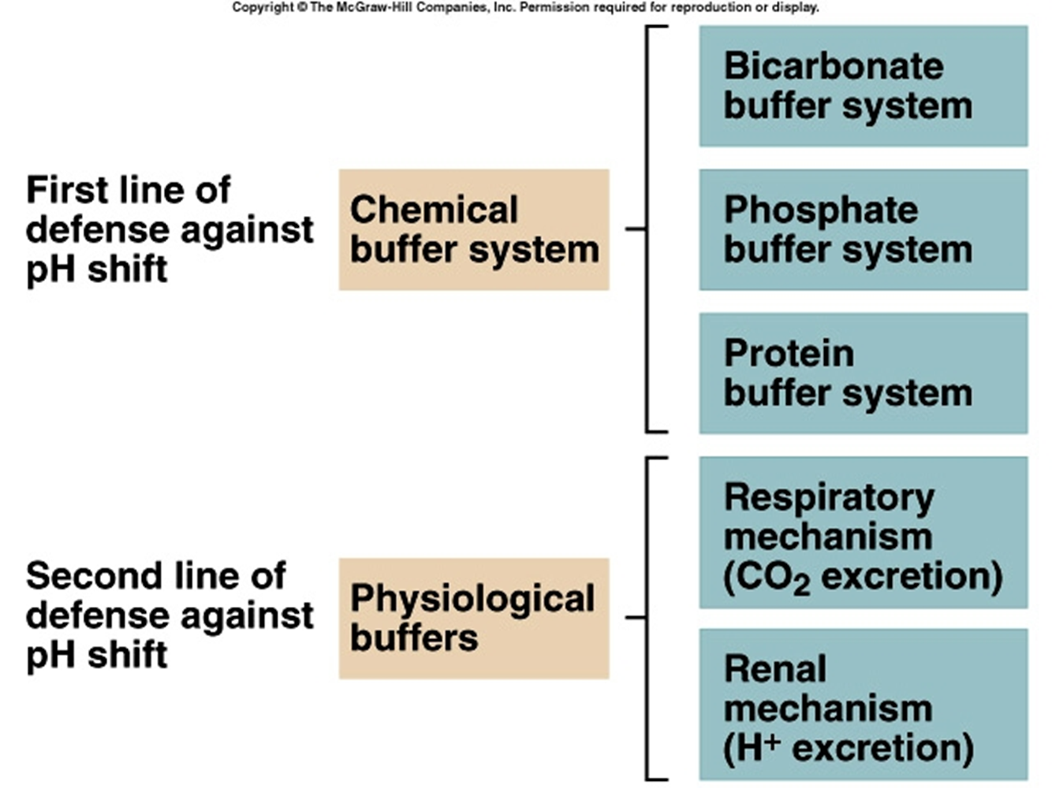
6
Control of Acids
Buffer systems take up H+ or release H+ as conditions change
Buffer system pairs weak acid and a base
They exchange a strong acid or base for a weak one
This results in a much smaller pH change

Slide 9
BICARBONATE BUFFER
7
Bicarbonate buffer
Sodium Bicarbonate (NaHCO₃) and carbonic acid (H₂CO₃)
Maintain a 20:1 ratio : HCO₃⁻ : H₂CO₃
HCl + NaHCO₃ ↔ H₂CO₃ + NaCl
NaOH + H₂CO₃ ↔ NaHCO₃ + H₂O

Slide 10
8
Phosphate buffer
Major intracellular buffer
H⁺ + HPO₄²⁻ ↔ H₂PO4⁻
OH⁻ + H₂PO₄⁻ ↔ H₂O + H₂PO₄²⁻
PHOSPHATE BUFFER

Slide 11
Protein Buffers
9
Protein Buffers
Protein buffers include hemoglobin, work in blood and ISF
Carboxyl group gives up H⁺
Amino Group accepts H⁺
Side chains that can buffer H⁺ are present on 27 amino acids.

Slide 12
10
Respiratory mechanisms
Exhalation of carbon dioxide
Powerful, but only works with volatile acids
Doesn’t affect fixed acids like lactic acid
CO₂ + H₂0 ↔ H₂CO₃ ↔ H⁺ + HCO₃⁻
Body pH can be adjusted by changing rate and depth of breathing

Slide 13
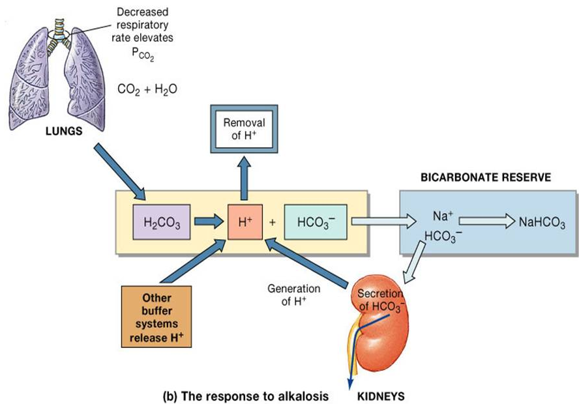
11
Kidney excretion
It can eliminate large amounts of acid
Can also excrete base
Can conserve and produce bicarbonate ions
Most effective regulator of pH
If kidneys fail, pH balance fails

Slide 14
Rates of correction
12
Rates of correction
Buffers function almost instantaneously
Respiratory mechanisms take several minutes to hours
Renal mechanisms may take several hours to days

Slide 15
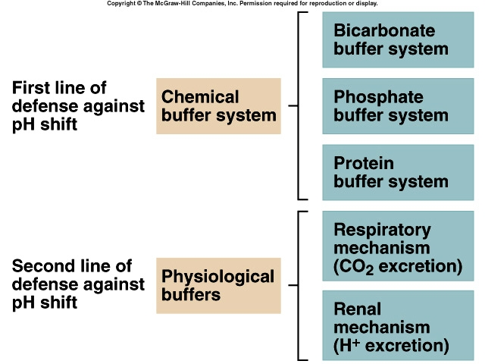
13
Buffer systems
Buffer
systems

Slide 16
Acid-Base Imbalances
14
Acid-Base Imbalances
pH< 7.35 acidosis
pH > 7.45 alkalosis
The body response to acid-base imbalance is called compensation
May be complete if brought back within normal limits
Partial compensation if range is still outside norms.

Slide 17
Compensation
15
Compensation
If underlying problem is metabolic, hyperventilation or hypoventilation can help : respiratory compensation.
If problem is respiratory, renal mechanisms can bring about metabolic compensation.

Slide 18
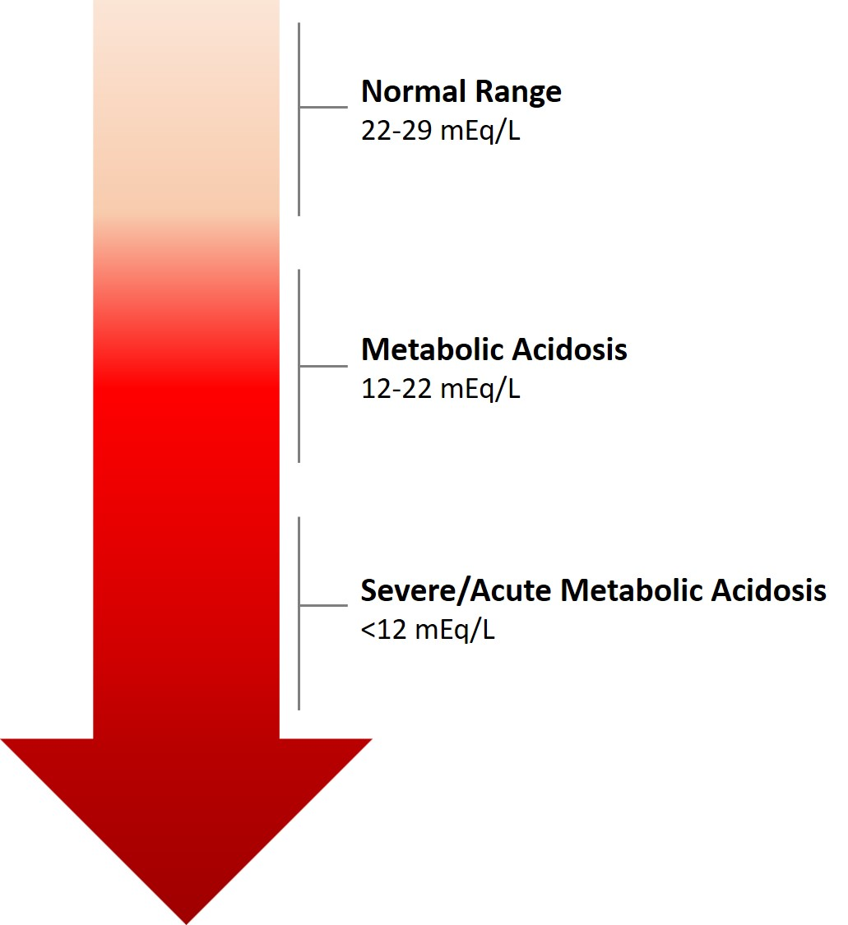
16
Acidosis
Principal effect of acidosis is depression of the CNS through ↓ in synaptic transmission.
Generalized weakness
Deranged CNS function the greatest threat
Severe acidosis causes
Disorientation
coma
death

Slide 19
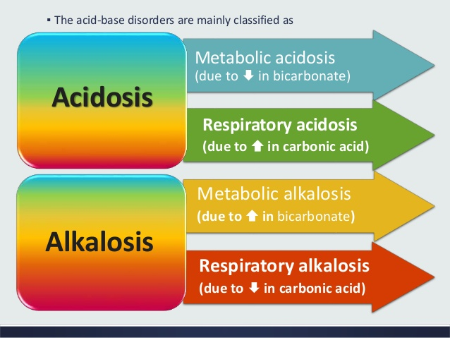
17
Alkalosis
Alkalosis causes over excitability of the central and peripheral nervous systems.
Numbness
Lightheadedness
It can cause :
Nervousness
muscle spasms or tetany
Convulsions
Loss of consciousness
Death

Slide 20
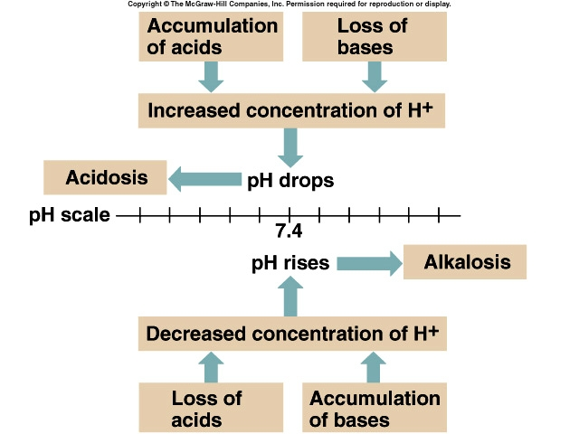
18
Alkalosis vs acidosis
How acidosis and alkalosis occur

Slide 21
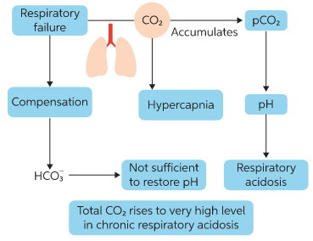
19
Respiratory Acidosis
Respiratory acidosis occurs as a result of carbonic acid excess caused by blood levels of CO₂ above 45 mm Hg.
Hypercapnia – high levels of CO₂ in blood
Chronic conditions:
Depression of respiratory center in brain that controls breathing rate – drugs or head trauma
Paralysis of respiratory or chest muscles
Emphysema
Acute conditions:
Adult Respiratory Distress Syndrome
Pulmonary edema
Pneumothorax

Slide 22
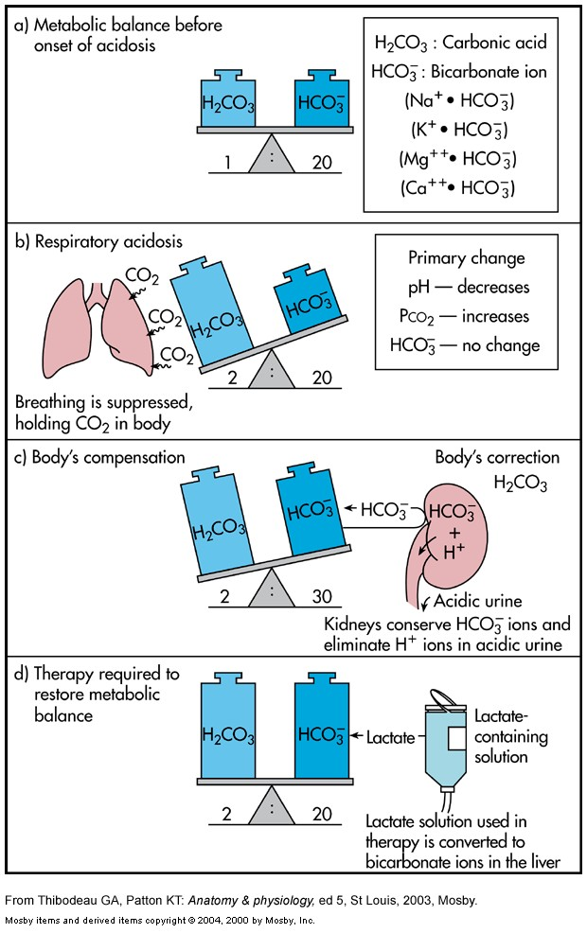
Compensation for Respiratory Acidosis
20
Compensation for Respiratory Acidosis
kidneys eliminate hydrogen ion and retain bicarbonate ions when acidemia is present (1:1 ratio) - renal compensation.
Remember HCO3 is a base

Slide 23
Signs and Symptoms and treatment
21
Signs and Symptoms of Respiratory Acidosis
Principal effect of acidosis is depression of the CNS through ↓ in synaptic transmission.
Breathlessness
Restlessness
Lethargy and disorientation
Tremors, convulsions, coma
Respiratory rate rapid, then gradually depressed
Skin warm and flushed due to vasodilation caused by excess CO₂
Restore ventilation
IV lactate solution
Treat underlying dysfunction or disease

Slide 24
22
Respiratory Alkalosis
Respiratory Alkalosis results from carbonic acid deficit
pCO₂ less than 35 mm Hg (hypocapnea)
Most common acid-base imbalance
Primary cause is hyperventilation
Conditions that stimulate respiratory center:
Oxygen deficiency at high altitudes
Pulmonary disease and Congestive heart failure – caused by hypoxia
Acute anxiety
Fever, anemia
Early salicylate intoxication
Cirrhosis
Gram-negative sepsis

Slide 25
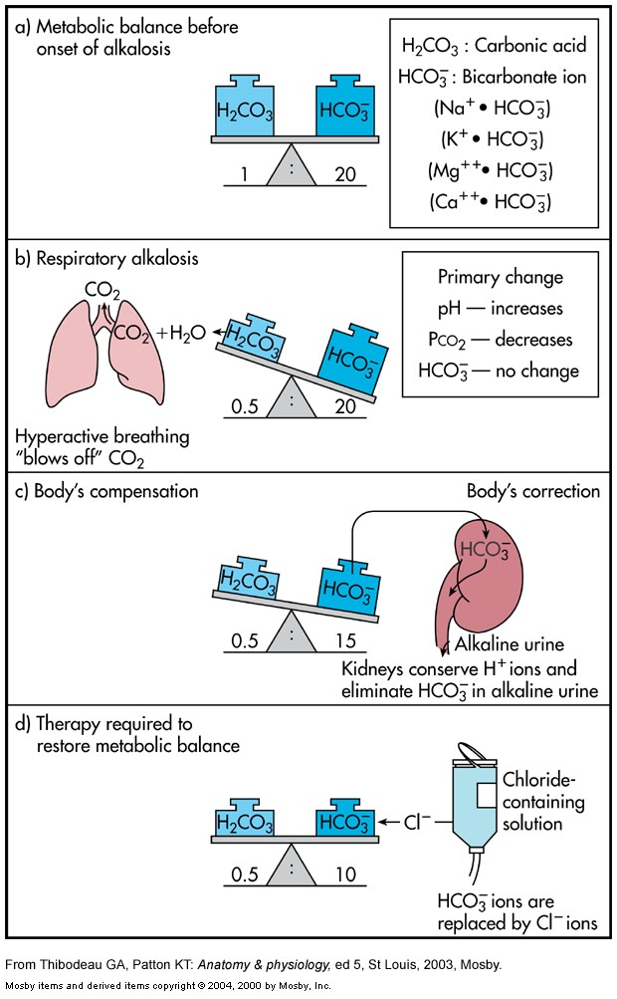
Compensation of Respiratory Alkalosis
23
Compensation of Respiratory Alkalosis
Kidneys conserve hydrogen ion
Excrete bicarbonate ion
Treatment of Respiratory Alkalosis
Treat underlying cause
Breathe into a paper bag
IV Chloride containing solution – Cl⁻ ions replace lost bicarbonate ions

Slide 26
Metabolic Acidosis
24
Metabolic Acidosis
Bicarbonate deficit - blood concentrations of bicarb drop below 22mEq/L
Causes:
Loss of bicarbonate through diarrhea or renal dysfunction
Accumulation of acids (lactic acid or ketones)
Failure of kidneys to excrete H+

Slide 27
Symptoms of Metabolic Acidosis
25
Symptoms of Metabolic Acidosis
Headache, lethargy
Nausea, vomiting, diarrhea
Coma
Death

Slide 28
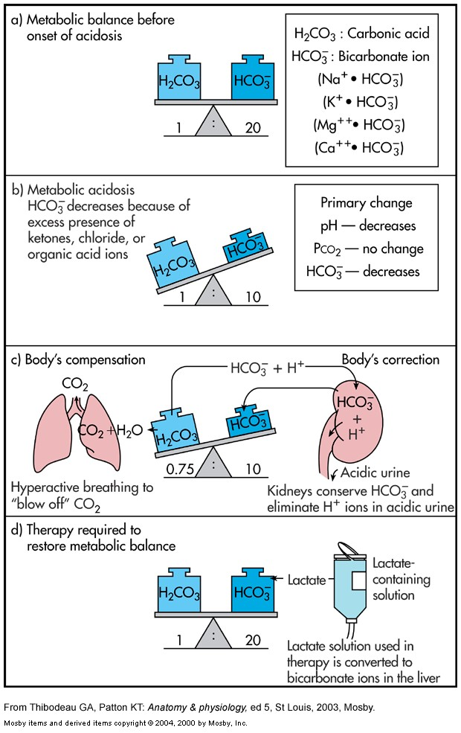
Compensation of Metabolic Alkalosis
26
Compensation for Metabolic Acidosis
Increased ventilation
Renal excretion of hydrogen ions if possible
K+ exchanges with excess H+ in ECF
( H+ into cells, K+ out of cells)
Treatment of Metabolic Alkalosis
IV lactate solution

Slide 29
Metabolic Alkalosis
27
Metabolic Alkalosis
Bicarbonate excess - concentration in blood is greater than 26 mEq/L
Causes:
Excess vomiting = loss of stomach acid
Excessive use of alkaline drugs
Certain diuretics
Endocrine disorders
Heavy ingestion of antacids
Severe dehydration

Slide 30
Compensation of Metabolic Alkalosis
28
Compensation for Metabolic Alkalosis
Alkalosis most commonly occurs with renal dysfunction, so can’t count on kidneys
Respiratory compensation difficult – hypoventilation limited by hypoxia
Symptoms of Metabolic Alkalosis
Respiration slow and shallow
Hyperactive reflexes ; tetany
Often related to depletion of electrolytes
Atrial tachycardia
Dysrhythmias

Slide 31
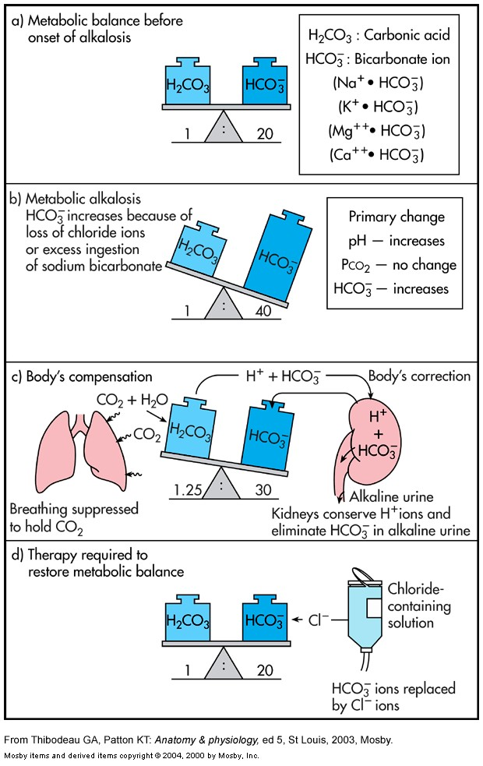
Treatment of Metabolic Alkalosis
29
Treatment of Metabolic Alkalosis
Electrolytes to replace those lost
IV chloride containing solution
Treat underlying disorder

Slide 32
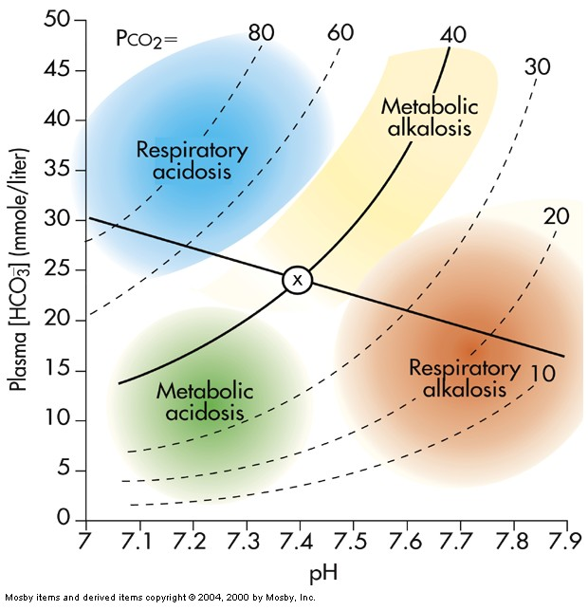
30
Diagnosis of Acid-Base Imbalances
Note whether the pH is low (acidosis) or high (alkalosis)
Decide which value, pCO₂ or HCO₃⁻ , is outside the normal range and could be the cause of the problem. If the cause is a change in pCO_{2,} the problem is respiratory. If the cause is HCO₃⁻ the problem is metabolic.
Look at the value that doesn’t correspond to the observed pH change. If it is inside the normal range, there is no compensation occurring. If it is outside the normal range, the body is partially compensating for the problem.

