Slide 1
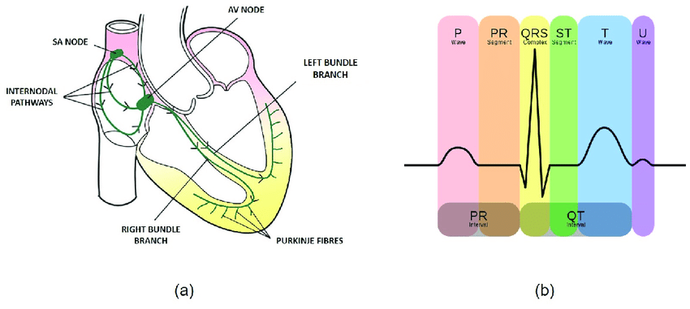
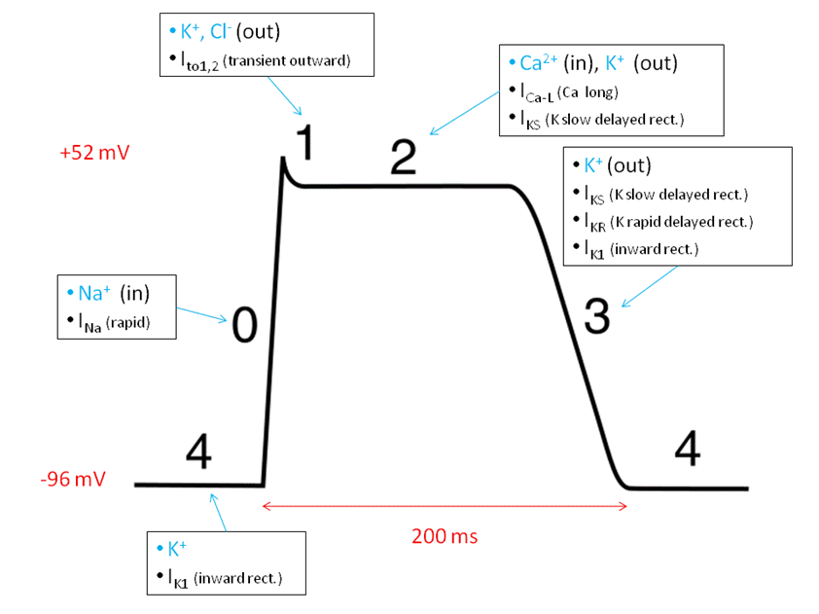
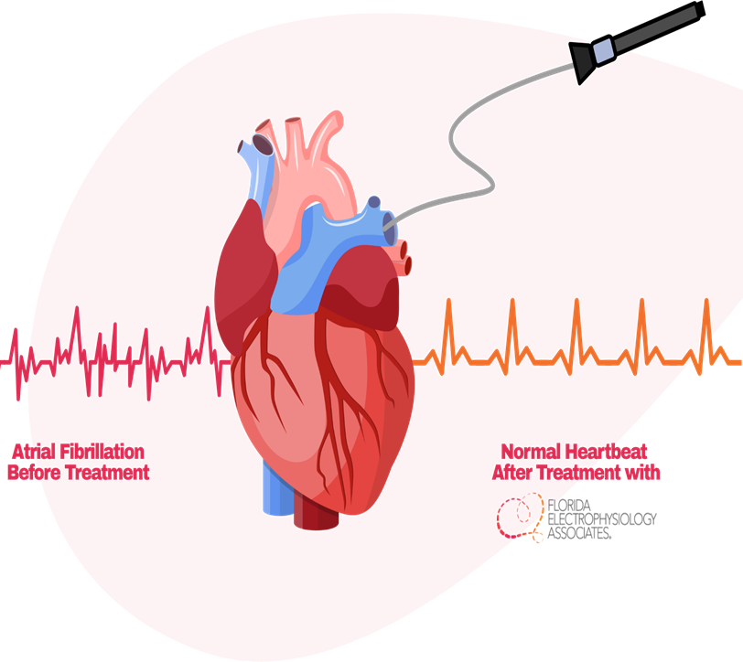
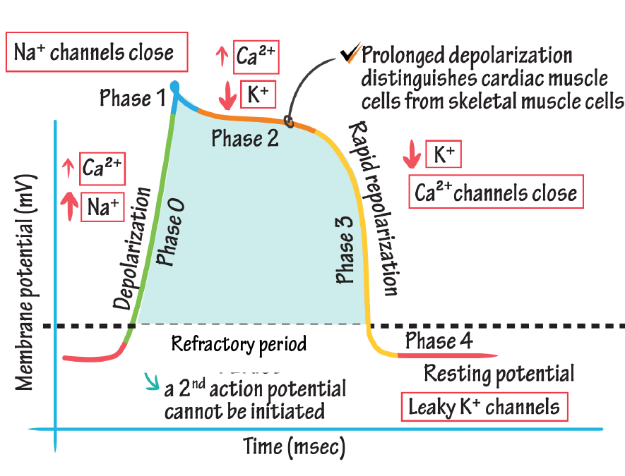
Antiarrhythmic drugs

Slide 2
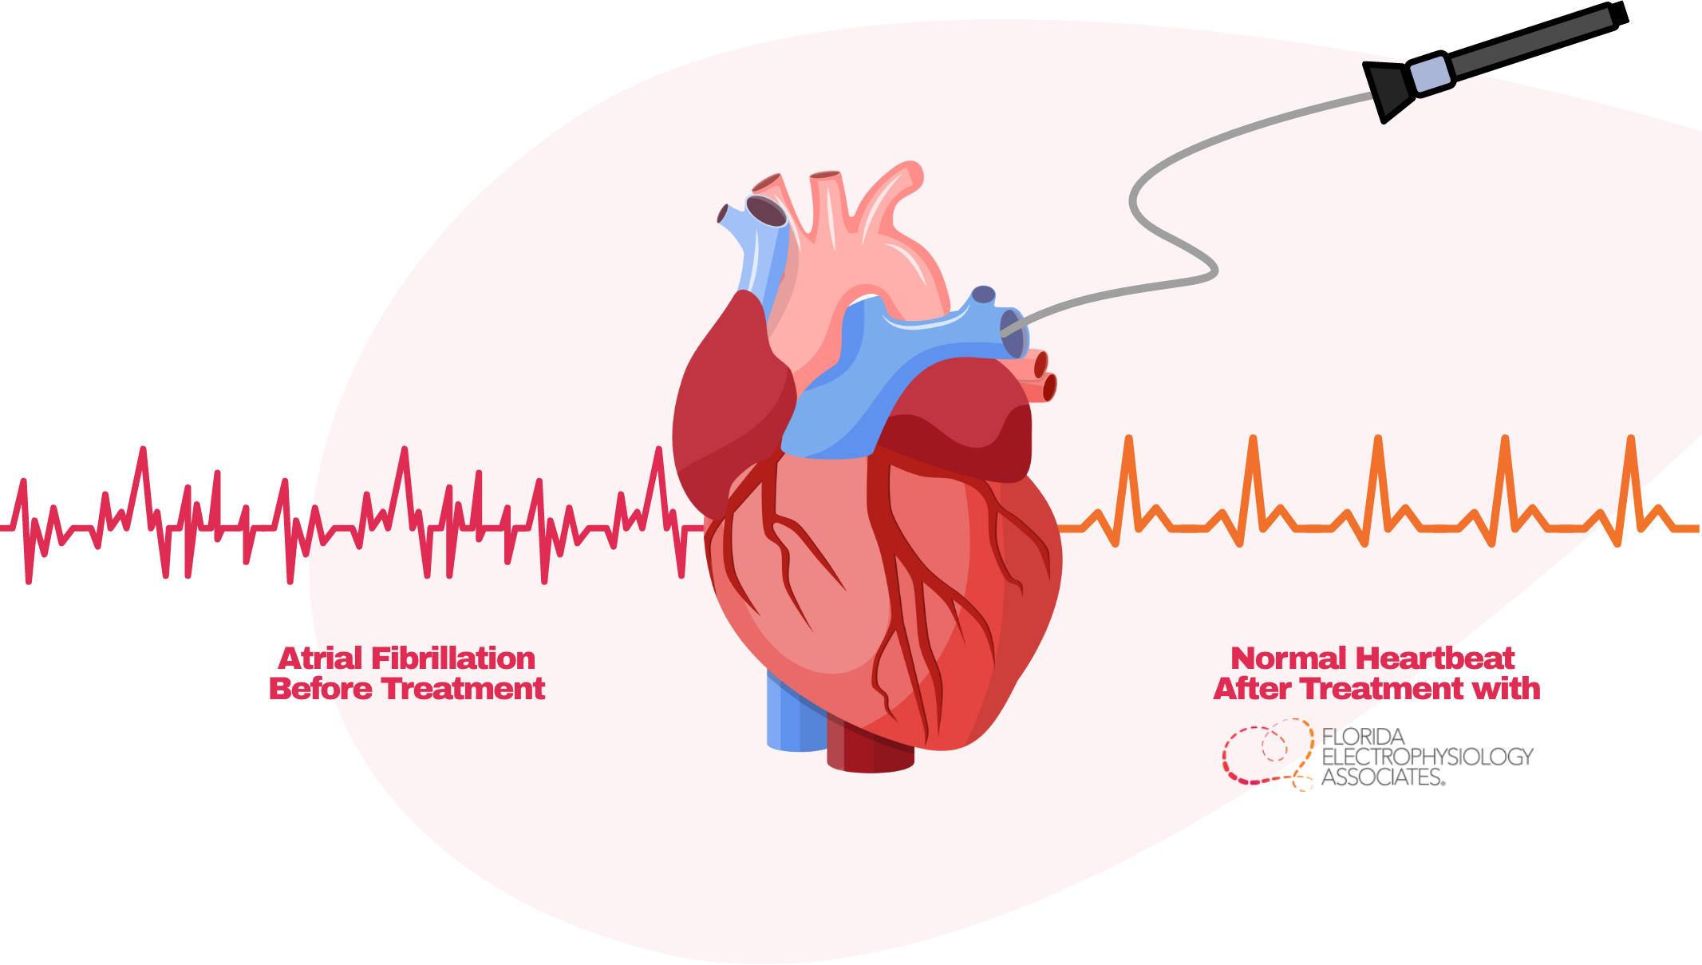
What are cardiac arrhythmias?
A cardiac arrhythmia is an abnormal heart rhythm
Cardiac arrhythmias commonly occur in the presence of preexisting heart disease.
Most common cause of death in patients with a MI or terminal heart failure.
Arrhythmias/dysrhythmias involve changes in the automaticity and conductivity of the heart cells.

Slide 3
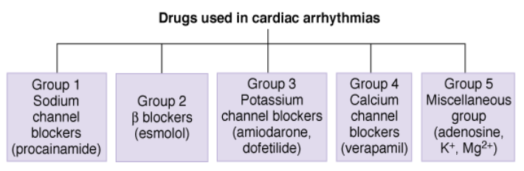
Classification of Antiarrhythmic drugs
Drugs used for arrhythmias fall into 5 major groups or classes, (Group (class) 1, 2, 3, and 4)
This classification is known as the Singh-Vaughan Williams classification; based loosely on the channel or receptor affected
Antiarrhythmics address arrhythmia by altering cells’ automaticity and conductivity

Slide 4
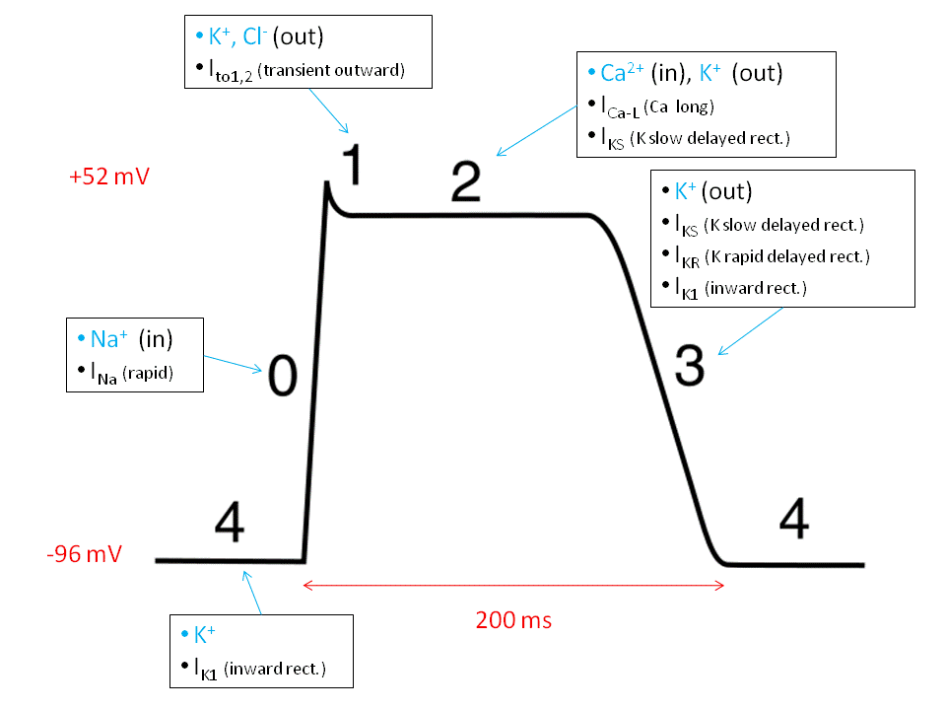
Heart and normal cardiac electrical activity
Conductivity is the property of the heart cells to transmit spontaneous impulses starting from the sinoatrial (SA) node, activating all parts of the heart muscle almost spontaneously.
Different areas of the specialized conductive system include:
SA node – impulse generation of 60-100 impulses per minute
AV node – 40-50 impulses per minute
Ventricular muscle cells – 10-20 impulses per minute
Automaticity is the property of the heart cells to undergo spontaneous depolarization during relaxation. This is because at this point, potassium flows out of the cell while sodium moves inside: the condition necessary to produce an action potential.
Five phases of action potential
Phase 0 – depolarization phase; Voltage-gated Na+ channels open in response to depolarisation that spreads into the cell through gap junctions. The influx of Na+ ions depolarises the cell further causing the opening of more Na+ channels
Phase 1 – a very short period wherein concentration of Na equalizes inside and outside of the cell
Phase 2 – plateau phase; the cell is trying to go back to its resting stage (repolarization) the cell becomes less permeable to Na, K begins to leave the cell, and Ca starts to enter the cell.
Phase 3 – rapid repolarization phase; stage in which the Na gates are closed and K flows out of the cell. As Ca2+ channels close, K+ currents succeed in repolarising the cell, driving the membrane potential toward EK.
Phase 4 – resting phase; stage in which Na/K pump restores the cell’s resting membrane potential in preparation for the next action potential

Slide 5
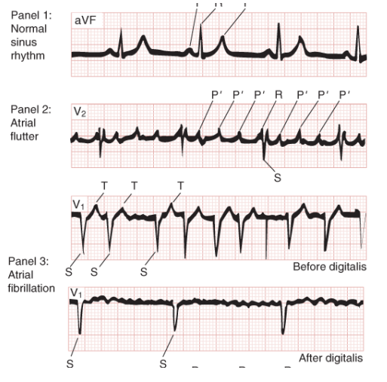
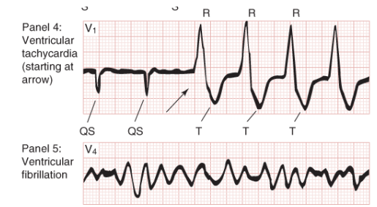
Typical ECGs of normal sinus rhythm and some common arrhythmias

Slide 6
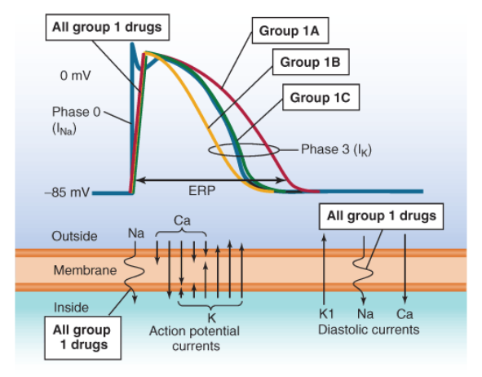
Class Ia antiarrhythmics- Sodium channel blockers
They block sodium channels in the cell membrane during action potential.
Subgroup under this class is based on their mechanism in blocking sodium channels.
These class are local anesthetics and membrane-stabilizing agents because of their ability to bind more quickly to sodium channels.
Therapeutic Action
Class I antiarrhythmics stabilize cell membrane by depressing phase 0 of action potential. They bind to Na channels and change the duration of action potential of the cells.
Class Ia drugs depress phase 0 and prolong duration of action potential.
Class Ib drugs somewhat depress phase 0 and shorten duration of action potential.
Class Ic drugs markedly depress phase 0 and extremely slows conduction but has little effect on the duration of action potential.

Slide 7
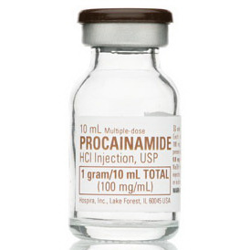
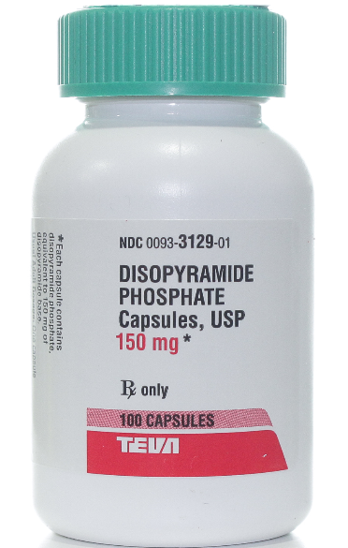
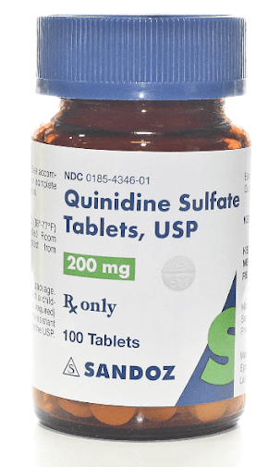
Class Ia antiarrhythmics
Oldest group and commonly used
Procainamide- Blocks Na channels, direct depressant of SA and AV nodes
Disopyramide: Similar to procainamide but longer duration of action; toxicity includes antimuscarinic effects and heart failure
Quinidine: Similar to procainamide but toxicity includes cinchonism (tinnitus, headache, GI disturbance) and thrombocytopenia
Mechanism of Action
Use- and state-dependently block of Na channels, some block K channels, slow conduction velocity and pacemaker activity; prolonged action potential duration and refractory period, prolong QRS duration
Clinical Applications
Atrial and ventricular arrhythmias, especially after MI
Pharmacokinetics
Oral and parenteral; oral slow-release forms available
Duration: 2–3 hours
Toxicities, Interactions
Increased arrhythmias, hypotension, lupus-like syndrome

Slide 8
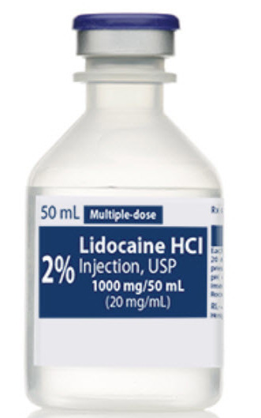
Class Ib antiarrhythmics
Class Ib drugs somewhat depress phase 0 and shorten duration of action potential.
Lidocaine
Mexiletine: Similar to lidocaine but oral activity and longer duration of action
Mechanism of Action
Highly selective use and state-dependent Na block with minimal effect in normal tissue and no effect on K
Clinical application
Ventricular arrhythmias post-myocardial infarction and digoxin induced arrhythmias
Pharmacokinetics
• IV and IM Duration: 1–2 h
Toxicities, interaction
• Central nervous system (CNS) sedation or excitation

Slide 9
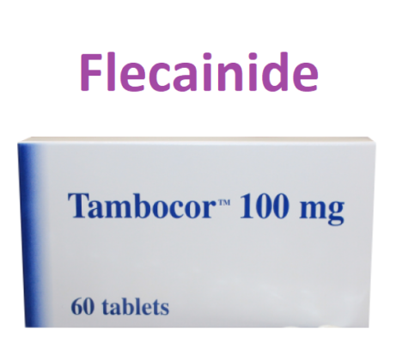
Class Ic antiarrhythmics
Flecainide
Mechanism of Action
Selective use and state-dependent block of Na channels, slowed conduction velocity and pacemaker activity
Clinical application • Refractory arrhythmias
Pharmacokinetics • Oral Duration: 20 h
Toxicities, interactions • Increased arrhythmias; CNS excitation

Slide 10
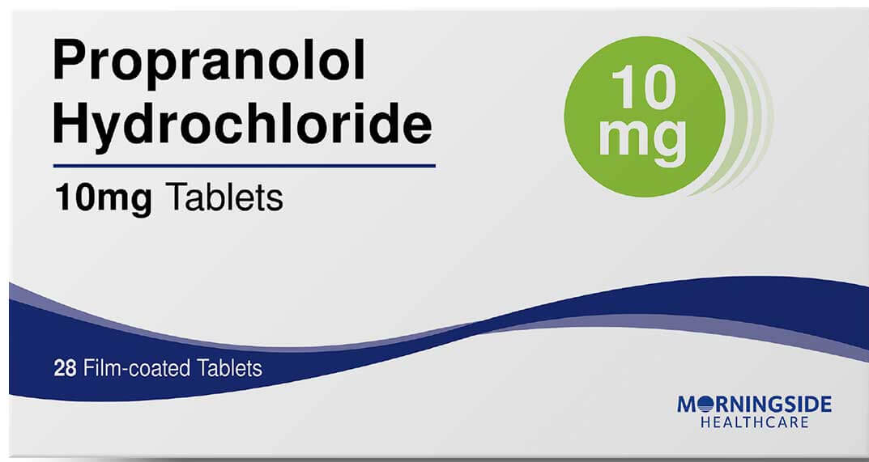
Class 2 antiarrhythmics- Beta Blockers
Propranolol
Esmolol: Selective β1-receptor blockade; IV only, 10-min duration. Used in perioperative and thyrotoxicosis arrhythmias
Mechanism of Action
Block of β receptors; slowed pacemaker activity
Clinical application
Post-myocardial infarction as prophylaxis against sudden death ventricular fibrillation; thyrotoxicosis
Pharmacokinetics
Oral, parenteral Duration: 4–6 h
Toxicities, interaction
Bronchospasm; cardiac depression, atrioventricular (AV) block, hypotension

Slide 11
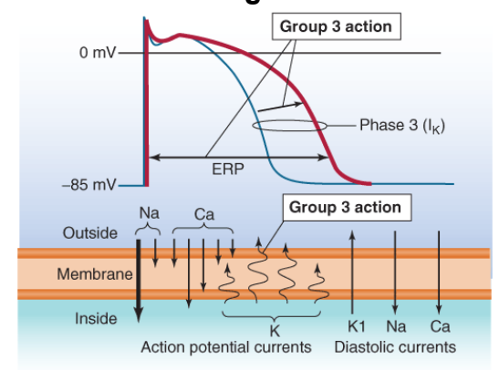
Class 3 antiarrhythmics- Potassium channel Blockers
Amiodarone
Sotalol
Ibutilide
Dofetilide
This class prolongs and slows down the outward movement of potassium during phase 3 of action potential.
These drugs act directly on the heart muscles to prolong repolarization and refractory period.
All of these drugs are proarrhythmic and have the possibility of inducing arrhythmias.

Slide 12
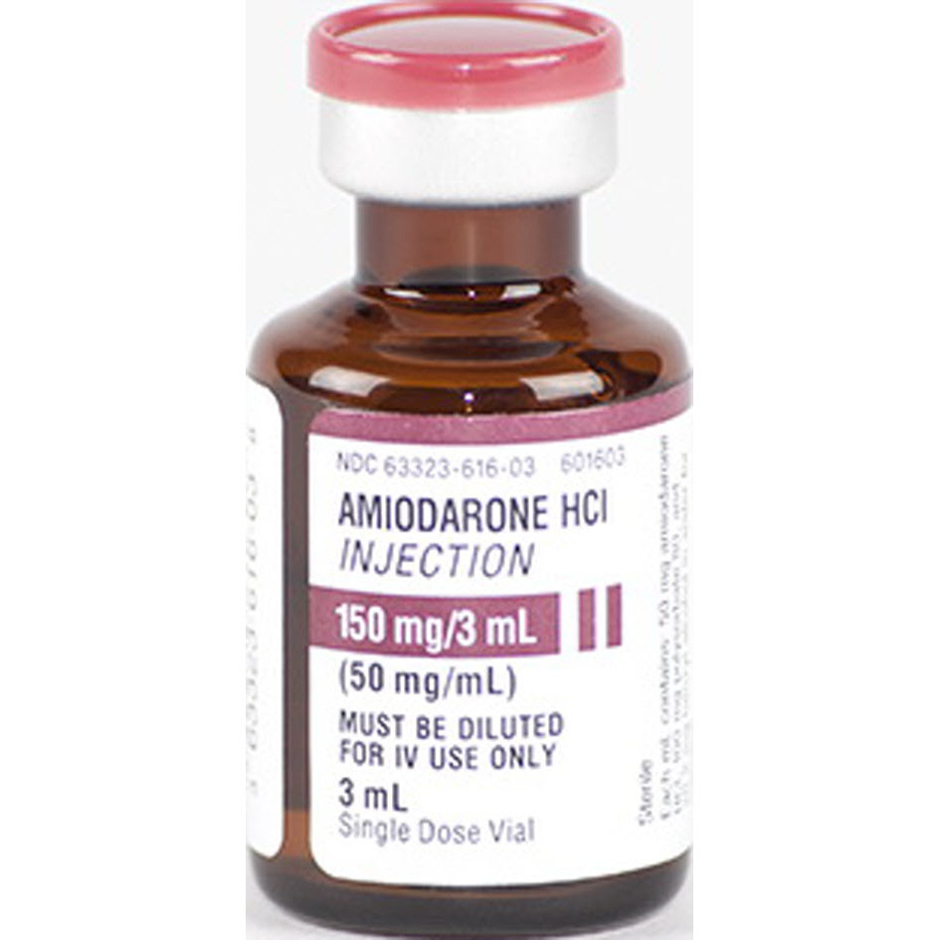
Class 3 antiarrhythmics- Potassium channel Blockers
Amiodarone
Mechanism of Action
Strong K block produces marked prolongation of action potential and refractory period.
Group 1 activity slows conduction velocity; groups 2 and 4 activity confer additional antiarrhythmic activity
Clinical application
Refractory arrhythmias; used off-label in many arrhythmias
Pharmacokinetics
Oral, parenteral Half-life and duration of action: 1–10 wk
Toxicities, interaction
Thyroid abnormalities, deposits in skin and cornea, pulmonary fibrosis, optic neuritis

Slide 13
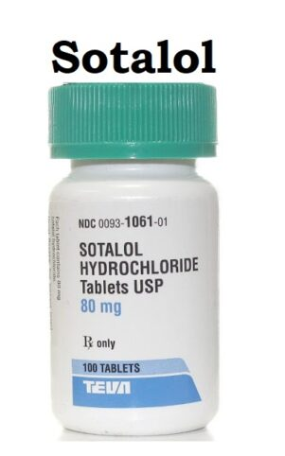
Class 3 antiarrhythmics- Potassium channel Blockers
Sotalol
Mechanism of Action
K block and -adrenoceptor block
Clinical application
Ventricular arrhythmias and atrial fibrillation
Pharmacokinetics
Oral Duration: 7 h
Toxicities, interactions
Dose-related torsade de pointes; cardiac depression

Slide 14
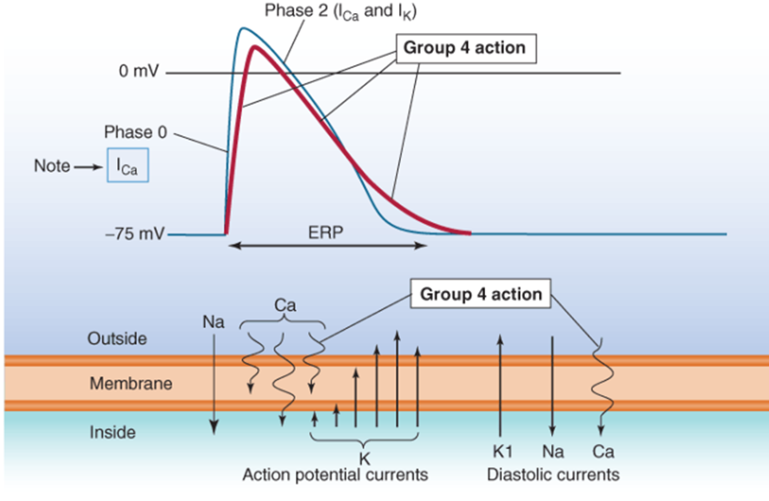
Class 4 antiarrhythmics- Calcium channel Blockers
Verapamil and Diltiazem
Mechanism of Action
State and use-dependent Ca block slows conduction in AV node and pacemaker activity; PR interval prolongation
Clinical application
AV nodal arrhythmias, especially in prophylaxis
Pharmacokinetics
Oral, parenteral Duration: 7 h
Toxicities, interaction
Cardiac depression; constipation, hypotension

Slide 15
Miscellaneous
Adenosine
Mechanism of Action
Increase in diastolic K of AV node that causes marked hyperpolarization and conduction block; reduced ca
Clinical application
Acute nodal tachycardias
Pharmacokinetics
IV only Duration: 10–15 s
Toxicities, interaction
Flushing, bronchospasm, chest pain, headache
Potassium ion
Mechanism of action
Increase in all K currents, decreased automaticity, decreased digitalis toxicity
Clinical applications
Digitalis toxicity and other arrhythmias if serum K is low
Pharmacokinetics
Oral or IV
Toxicities, interactions
Both hypokalemia and hyperkalemia are associated with arrhythmogenesis. Severe hyperkalemia causes cardiac arrest
Magnesium ion
Mechanism of action
Poorly understood, possible increase in Na+/K+ ATPase activity
Clinical applications
Digitalis arrhythmias and other arrhythmias if serum Mg is low
Pharmacokinetics
IV
Toxicities, interactions
Muscle weakness, severe hypermagnesemia can cause respiratory paralysis

Slide 16
Thank You

