Slide 1
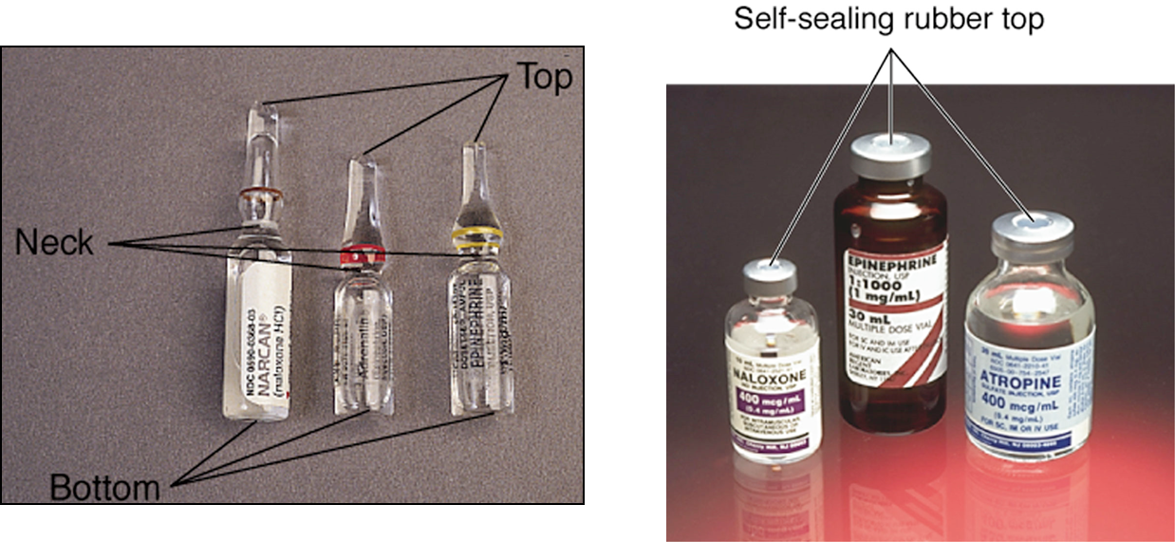
DRUG ADMINISTRATION
Clinical skills

Slide 2
DRUG ADMINISTRATION
The administration of medications is controlled by three Acts of Parliament – the Medicines Act (1968), the Misuse of Drugs Act (1971) and the Poisons Act (1972) – and a Statutory Instrument – the Misuse of Drugs Regulations (1985). These provide the framework within which medicines are stored, transported, prescribed, recorded, dispensed and administered.
Pharmacy and poisons board regulates drugs in Kenya established under pharmacy and poisons act(cap 244 ).
The British National Formulary (BNF) provides a summary of the key legal issues for health care practitioners.

Slide 3
DRUG ADMINISTRATION
The nurse should always assess a client’s health status and obtain a medication history prior to giving any medication.
The extent of assessment depends on the client’s illness or current condition, the intended drug and route of administration.
During drug administration, as a nurse you should:
● Have the knowledge of the drug
● Know its effects and potential side effects
● Know the patient’s condition
● Assess the suitability for that medication at that given time.

Slide 4
DRUG ADMINISTRATION
The A–F of safe practice
To ensure safe administration, some principles of safe practice can be considered.
● Accurate prescription
● Best information
● Correct dispensing
● Deliberation before administration
● Effective systems
● Fail-safe policies.

Slide 5
Practice guidelines
Nurses who administer medications are responsible for their own actions.
Be knowledgeable
Keep narcotics and barbiturates in a locked place
Use only medications that are in a clearly labeled container
Calculate drug dosages accurately
Administer only medications that are personally prepared
Identify the client correctly before drug administration
Do not leave medications on the bedside with certain exceptions e.g cough syrup
Take special precautions when administering certain medications e.g insulin
Incase of a medication error, report immediately.

Slide 6
Stages of the medication process
There are five stages of the medication process:
Ordering/prescribing,
Transcribing and verifying,
Dispensing and delivering,
Administering, and
Monitoring and reporting.

Slide 7
Rights of Medication Administration
1. Right patient
Check the name on the order and the patient.
Use 2 identifiers.
Ask patient to identify himself/herself.
2. Right medication
Check the medication label.
Check the order.
3. Right dose
Check the order.
Confirm appropriateness of the dose using a current drug reference.
If necessary, calculate the dose and have another nurse calculate the dose as well.

Slide 8
Rights of Medication Administration
4. Right route
Again, check the order and appropriateness of the route ordered.
Confirm that the patient can take or receive the medication by the ordered route.
5. Right time
Check the frequency of the ordered medication.
Double-check that you are giving the ordered dose at the correct time.
Confirm when the last dose was given.
6. Right documentation
Document administration AFTER giving the ordered medication.
Chart the time, route, and any other specific information as necessary.

Slide 9
Rights of Medication Administration
7. Right reason
Confirm the rationale for the ordered medication. What is the patient’s history? Why is he/she taking this medication?
Revisit the reasons for long-term medication use.
8. Right response
Make sure that the drug led to the desired effect. If an antihypertensive was given, has his/her blood pressure improved?
Be sure to document your monitoring of the patient and any other nursing interventions that are applicable.

Slide 10
Calculating drug doses
Example: a prescription requires 30 mg of a drug that is dispensed as
60 mg in 5 ml
What you want: 30 mg × total volume:
What you’ve got: 60 mg
5 ml = 30× 5 = 2.5 ml required
60

Slide 11
Routes of drug administration
A route of drug administration is the path by which a drug or other substance is brought into contact with the body.
Drugs are introduced into the body by several routes.
When administering a drug, the nurse should ensure that the pharmaceutical preparation is appropriate for the route specified.

Slide 12
PARENTERAL
The term parenteral administration implies the routes through which the drug directly reaches the body fluids, by passing the preliminary process of transport through the intestinal wall or pulmonary alveoli which is an essential process when drugs are taken orally, inhaled or administered rectally.

Slide 13
Parenteral routes
Subcutaneous (S/C)
Intramuscular (I/M)
Intravenous (I/V)
Intraperitoneal (I/P)
Intradermal
Intra Medullary
Intrathecal
Intraarticular
Intra-cardiac
Intra arterial

Slide 14
Techniques for Administering Drugs
Parenteral drug packaging
  Ampule – glass or plastic container that is sealed and sterile (open with care)
  Vial – small bottle with rubber diaphragm that can be punctured by needle

Slide 15
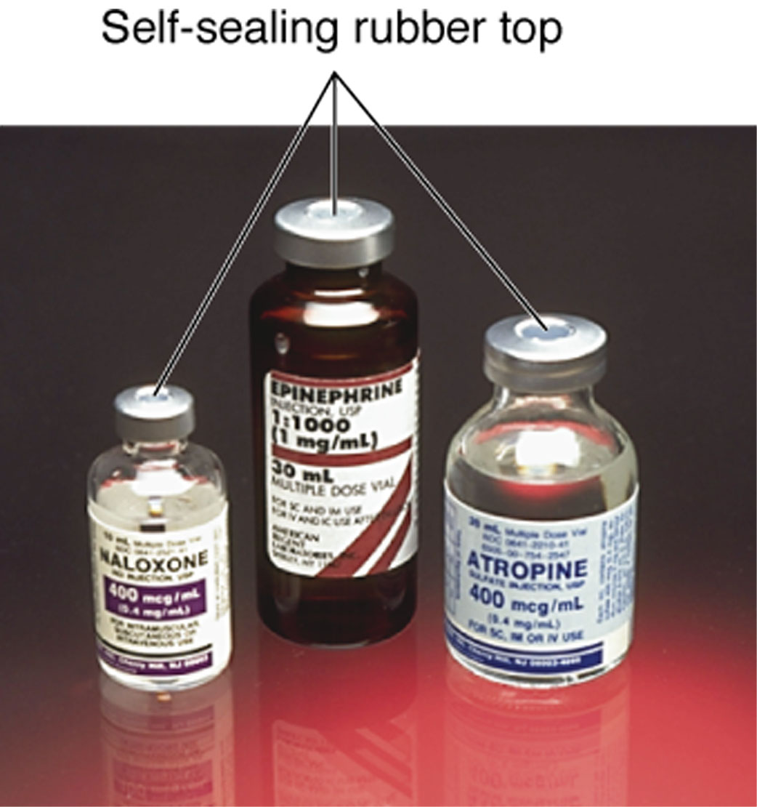
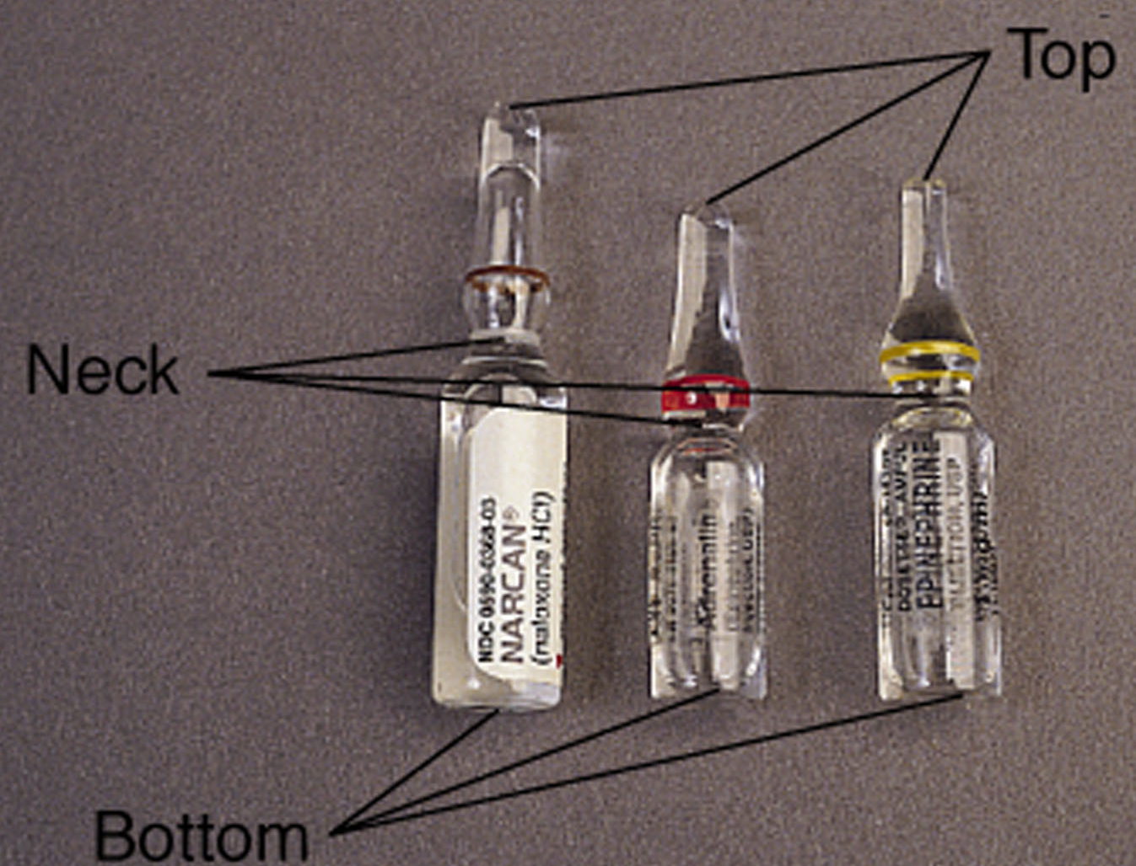
Ampules and Vials
Vials
Ampules

Slide 16
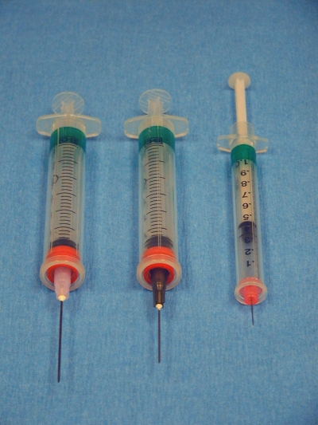
Parenteral routes syringes

Slide 17
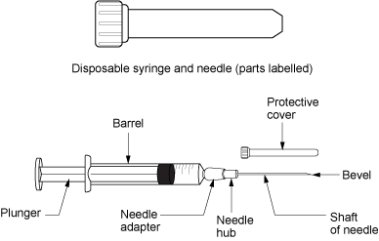
Parts of syringe and needle

Slide 18
Advantages of the Parenteral administration over oral route.
Drug is neither invaded nor destroyed by digestive enzymes.
A higher concentration of drug in blood may be achieved because the hepatic metabolism of drug due to First-Pass effect is avoided.
Absorption is complete and predictable.
In emergency this method is particularly useful.
If the patient is unconscious, uncooperative or vomiting, the Parenteral therapy becomes necessary.

Slide 19
Disadvantages of the parenteral therapy
It is expensive because all the parenteral preparations should be sterilized.
Asepsis must be maintained to avoid infection.
An intravascular injection may accidentally occur when it is not actually intended.
Pain may accompany or follow the injection.
It requires the services of a professionally skilled personnel because it is difficult for the patient to perform the injection himself.

Slide 20
Types of Oral Medication
1. Lozenges - sweet medicinal tablet containing sugar that dissolve in the mouth so that the medication is applied to the mouth and throat
2. Tablets - a small disc or flat round piece of dry drug containing one or more drugs made by compressing a powdered form of drug(s)
3. Capsules - small hollow digestible case usually made of gelatin, filled with a drug to be swallowed by the patient.
4. Syrups - sugar containing medicine dissolved in water

Slide 21
Types of Oral Medication
5. Tinctures - medicinal substances dissolved in water
6. Suspensions - liquid medication with undissolved solid particles in it.
7. Pills and gargle - a small ball of variable size, shape and color some times coated with sugar that contains one or more medicinal substances in solid form taken in mouth.
8. Effervescence - drugs given of small bubbles of gas.
9. Gargle - mildly antiseptic solution used to clean the mouth or throat.
10. Powder - a medicinal preparation consisting of a mixture of two or more drugs in the form of fine particles.

Slide 22
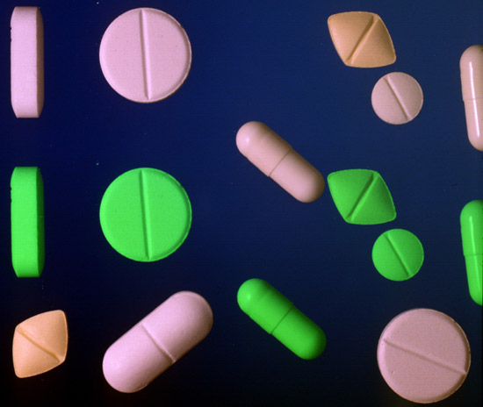


Slide 23
Medication administration
Do NOT use Kardex to medicate
Report any unexpected reactions, medication error, error in preparation by pharmacist
Observe the 8 rights
Document and report adverse reactions

Slide 24
Administering oral medication
Equipment
● Stock of specific personal prescription drugs – ensure adequate supplies, within expiry date
● Medicine pots – to dispense individual medication
● Disposable cups – to provide a drink to assist easy swallowing of medication, or to dissolve tablets if necessary
● Water jug, freshly filled, to ensure water is easily available
● Straws – some patients find it easier to take unpalatable medicine through a straw, and a straw may help a patient with swallowing difficulties to wash tablets down more easily
● Teaspoons or medicine spoons – to put tablets into a patient’s mouth without contaminating the medication

Slide 25
Administering oral medication
Pestle and mortar – to crush tablets if necessary (NB: check with pharmacist that a liquid form is not available, and that the tablet is suitable to be crushed)
Tablet file or cutter or knife – to divide a tablet evenly (NB: check with pharmacist that smaller doses are not available and that the tablet is suitable for cutting)
Note pad – to keep a record of actions that are to be taken as a result of medication, e.g. Re-ordering medication or discharge drugs, or returning to check BP or peak expiratory flow
Drug reference book, e.g. BNF – to check unfamiliar doses or drugs.

Slide 26
Administering oral medication
Procedure
Wash and dry hands.
Consult the patient’s prescription sheet. For regular drug administration times, work systematically from the front page of the prescription sheet to identify the following issues:
– Does the patient have any known allergies?
– What medication is due, e.g. regular doses? When was it last given?
– Once-only prescriptions, such as pre-medications: when are they due, or have they been given?

Slide 27
Cont..
–Variable doses – these may need to be updated as a result of blood tests; therefore, are they current? Check date.
– Is analgesia required? If so, when was the last dose and was it effective?
– Progress of any current intravenous therapy – if a patient has an intravenous infusion in place, then it is an ideal opportunity to check (a) that it is running to time and (b) sufficient is prescribed for the patient’s needs over the next shift

Slide 28
Administering oral medication
Check each medication prescribed for dose, time, date, route and doctor’s signature.
Select the medicine bottle, checking the name of the drug with that on the prescription sheet. If the patient needs to have a pre- medication check of pulse, blood pressure or peak expiratory flow, now is the time to do that.
Calculate the dose.
Tip the required number of tablets into the lid of the container
If working with another nurse, show the name of the container and the number of tablets to the other person, stating the written dose aloud.

Slide 29
Administering oral medication
Tip the dose into the pot.
If measuring liquid: ensure the lid is on firmly and then shake the bottle to ensure the contents are well mixed.
Put the pot on a level surface, pour the liquid into it, turning the bottle label away so that it does not get dripped on and obscured by medicine.
Pour to the required level

Slide 30
Administering oral medication
Take the medication to the patient.
Greet the patient by name and check identity against the prescription sheet label.
Assist the patient into an upright position to aid swallowing.
Ensure the patient understands the sequential order to take the medication; for example, antacids are taken after other tablets.
Do not leave any medicines beside the bed to be taken later. They may get forgotten, knocked over, or consumed accidentally by someone else.

Slide 31
Administering oral medication
Document the drug dose and time. If the patient has refused the medication or is nil by mouth, record on the prescription sheet the reasons for withholding the dose according to the local policy code. Report to medical staff.
Dispose of waste and used containers.
Monitor the patient for effects such as degree of pain relief, or side effects such as nausea or rashes, and document as necessary.

Slide 32
Information on Drug Labels
Name of medication
Expiration date
Total dose and concentration

Slide 33
Obtaining Medication from a Glass Ampule

Slide 34
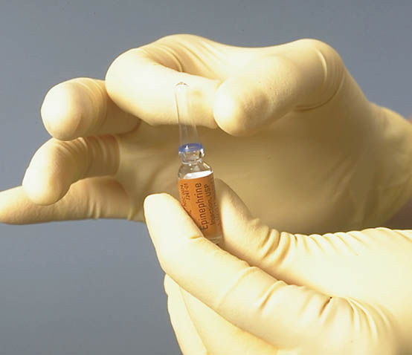
Hold the ampule upright and tap its top to dislodge any trapped solution.

Slide 35
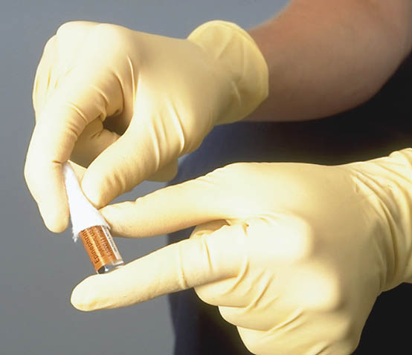
Place gauze around the thin neck…

Slide 36
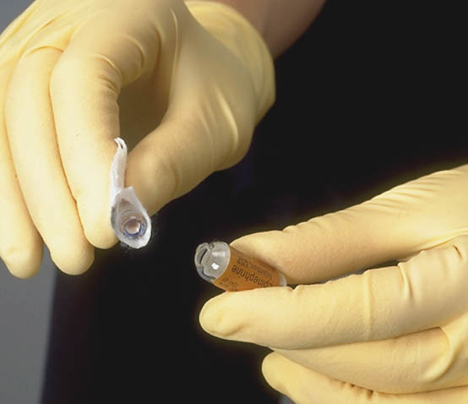
…and snap it off with your thumb.

Slide 37
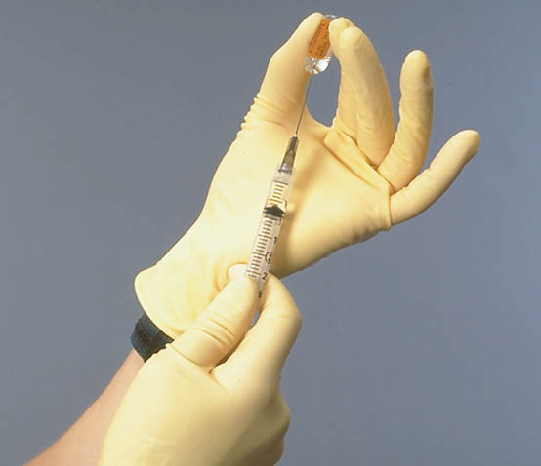
Draw up the medication.

Slide 38
Obtaining Medication from a Vial

Slide 39
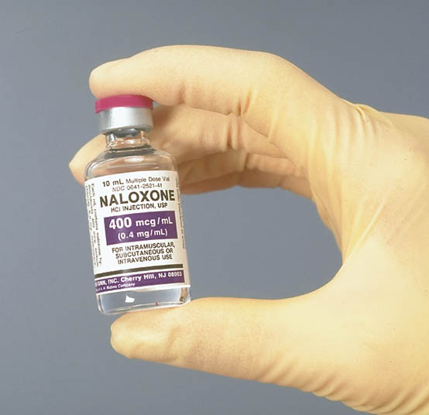
Confirm the vial label.

Slide 40
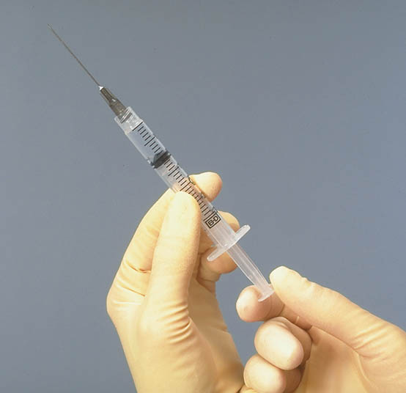
Prepare the syringe and hypodermic needle.

Slide 41
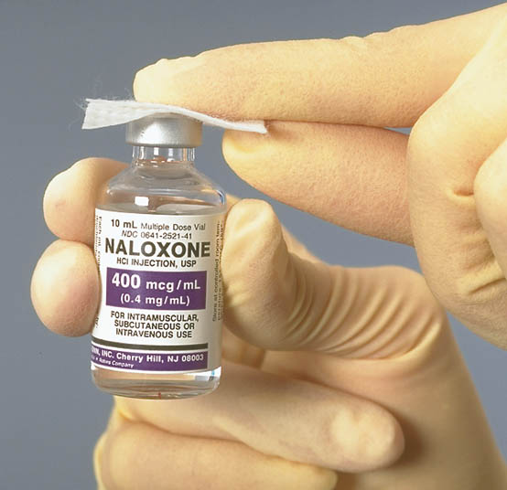
Cleanse the vial’s rubber top.

Slide 42
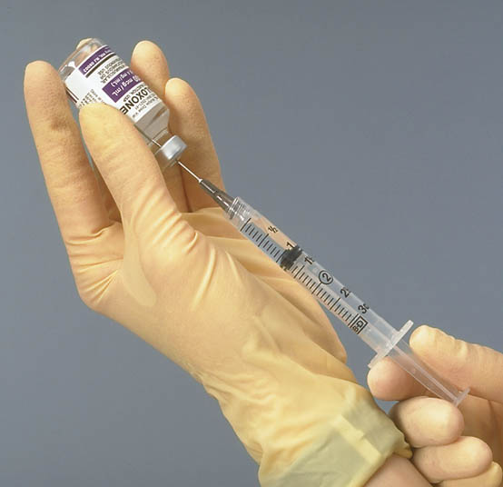
Insert the hypodermic needle into the rubber top and inject the air from the syringe into the vial.

Slide 43
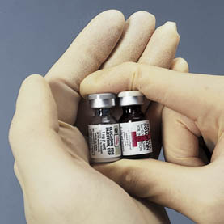
The nonconstituted drug vial actually consists of two vials, one containing a powdered medication and one containing a liquid mixing solution.

Slide 44

Nonconstituted drugs come in separate vials. Confirm the labels.

Slide 45
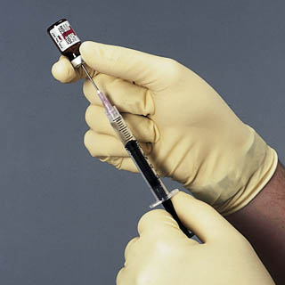
Remove all solution from the vial containing the mixing solution.

Slide 46
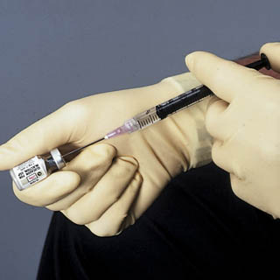
Cleanse the top of the vial containing the powdered drug and inject the solution.

Slide 47
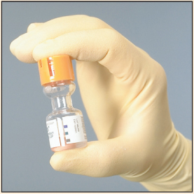
Agitate or shake the vial to ensure complete mixture.

Slide 48
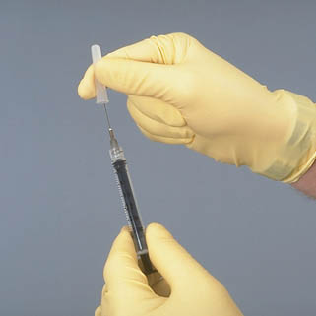
Prepare a new syringe and hypodermic needle.

Slide 49
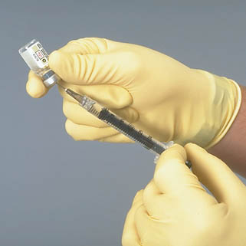
Withdraw the appropriate volume of medication.

Slide 50
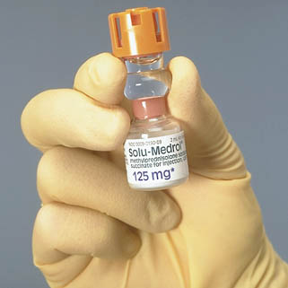
In the Mix-O-Vial system, the vials are joined at the neck. Confirm the labels.

Slide 51
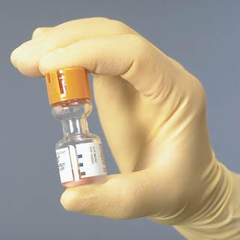
Squeeze the vials together to break the seal. Agitate or shake to mix completely.

Slide 52

Withdraw the appropriate volume of medication.

Slide 53
Intramuscular (IM) injections
Injections deliver medication directly into the body and are not retrievable.
It is essential, therefore, to be accurate in identifying safe entry points for injections, and to take the utmost care in administering medication by the parenteral route.
The intramuscular route delivers injections directly into muscles which have an efficient blood supply and can absorb from 1 ml to 5 ml of medication, depending on the site.

Slide 54
Considerations before administration by the IM route
● The patient’s age: elderly patients may have muscle wasting which may limit the choice of site, and babies who are not yet walking may have underdeveloped muscles, particularly in the buttocks.
● General physical status: emaciated or cachectic patients may also have muscle wasting or poor perfusion and skin condition. Oedematous limbs will not absorb medication as effectively as those with good perfusion.
● The drug therapy: the amount to be given, and the frequency and consistency of medication will influence the choice of location.

Slide 55
Assessment of appropriate site
There are five sites that may be used for IM injections:
Deltoid;
Dorso-gluteal;
Ventro-gluteal;
And the thigh muscles – vastus lateralis and rector femoris.

Slide 56
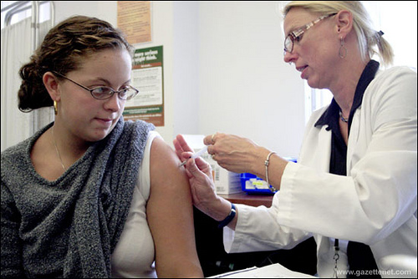
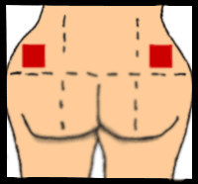
Intramuscular injection in deltoid and gluteal muscles

Slide 57
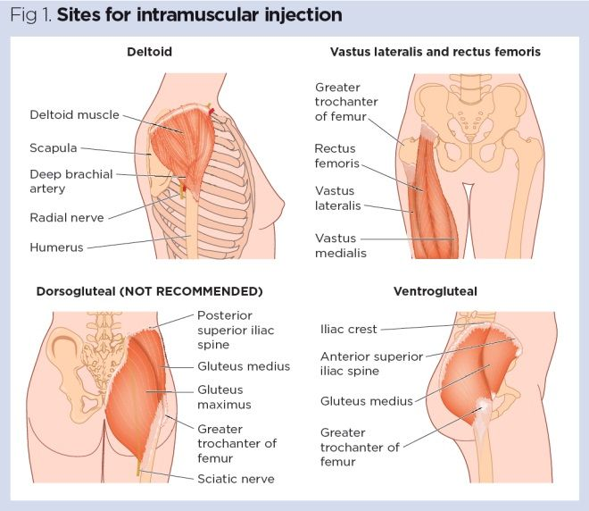

Slide 58
Locating deltoid site
The densest part of the muscle can be located on the mid-lateral aspect of the arm in line with the axilla, and about 2.5 cm below the acromial process .
This avoids the radial nerve and brachial artery.
The typical absorption volume is no greater than 1–2 ml.

Slide 59
Dorso-gluteal site
The patient should lie either on their side with knees slightly bent, or prone with toes pointing inwards .
An imaginary line is drawn across from the cleft of the buttock to the greater trochanter of the femur. Then a vertical line is drawn midway across the first line, and the outer quadrant is identified. This quadrant is then divided into four quadrants: the desired location is the upper outer quadrant
The aim is to access the gluteus maximus muscle, and to avoid the sciatic nerve and gluteal artery.
The typical absorption volume is 2–4 ml.

Slide 60
Vastus lateralis and rector femoris
These quadriceps muscles are particularly good for toddlers or patients who have wasted muscles as they can be ‘bunched up’ before injecting
They can be located by measuring a hand’s breadth down from the greater trochanter, and a hand’s breadth up from the knee, identifying the middle third of the muscle as the safe location
The vastus lateralis is located on the side of the leg, and the rector femoris is at the front of the thigh.
The typical absorption volume is 1–4 ml.

Slide 61
Intramuscular injection procedure
Equipment
● 2 ml or 5 ml syringe (depending on amount for injection).
● 2 × 21 (green) or 23 (blue) gauge needle.
Note: a large needle should be used for adults to ensure that it reaches the muscle layer. Short needles may result in the injection going into the adipose tissue, resulting in reduced effectiveness
● Alcohol wipe
● Gauze swab.
● Receiver.
● Prescribed drug and prescription sheet.
● Gloves – to protect from drug spillage and body fluids.
● Apron –for protection as above.

Slide 62
Preparing the injection
This is an aseptic procedure and therefore all equipment should be sterile.
● Check all equipment to ensure it is sealed and used within expiry date.
● Wash hands and put on gloves.
● Prepare drug vial. Carry out the same checks as described in the procedure for oral drug administration .
If a glass ampoule is used, flick the top of the ampoule to encourage all fluid to drain into the reservoir.
Use a tissue or piece of gauze to protect your fingers from glass cuts when breaking the top off the ampoule.
If a vial with a rubber bung is being used, remove the cover using scissors or forceps to prevent injury to your fingers; clean the rubber bung with an alcohol wipe.

Slide 63
Preparing the injection
● Assemble needle and syringe, taking care not to touch the needle, except for the barrel when connected to the syringe.
● Uncap the needle. It is best practice never to resheath an uncapped needle, even if unused, to prevent needlestick injuries.
To dilute a drug – if the drug requires mixing with a diluent, or if you are drawing fluid from a closed vial – draw up the equivalent amount of air into the syringe, steady the vial on a flat surface with one hand, and insert the syringe into the vial and inject the vial with the air. This will make it easier to withdraw. Ensure drug is dissolved before aspirating the medication into the syringe.

Slide 64
Preparing the injection
Withdraw required amount into the syringe. Remove the vial, and holding the syringe with the needle uppermost, tap the syringe firmly to encourage air bubbles to rise to the top to be expelled.
Larger syringes may have the connection on the side, rather than the middle of the syringe. To aid the air to rise to the top, tip the syringe to a slight angle so that the air collects under the connection, and keep it at that angle until all the air is expelled.

Slide 65
Subcutaneous (SC) injections
Small amounts of medication (0.2–2 ml) are given into the subcutaneous tissue to allow a slow, sustained absorption of medication.
It is an ideal route for insulin, which requires frequent injections, but is also used regularly for heparin.
Preferred sites for self-administered SC injections are the outer upper arms, the upper thighs, and the lower abdomen around the umbilicus.
Nurses can also use the back of the upper arms, outer thighs and upper buttocks but these are not accessible for self-administration.

Slide 66
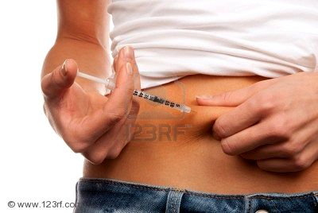

Slide 67
Subcutaneous (SC) injections
Equipment
● Insulin syringe or 1 ml syringe. If injecting insulin use an insulin syringe with a 25 or 27 gauge needle.
● 2 × 25 or 27 gauge needles (orange).
● Gauze swab.
● Receiver.
● Prescribed drug and prescription sheet.

Slide 68
Subcutaneous (SC) injections
Preparing an insulin drug dose
Preparing an insulin dose may require drawing up from more than one multi-dose vial.
The following procedure explains how to do this, and allows you to draw up from an ampoule that has a vacuum in it.
If the air were not injected first, it would be very difficult to withdraw insulin as the vacuum within the ampoule would draw in the contents of the syringe and cause mixing of the two different types.
To prepare an injection from two multi-dose vials

Slide 69
Subcutaneous (SC) injections
● Clean the rubber bung on both vials with an alcohol wipe.
● Draw air into the syringe to equal the volume of drug to be with- drawn from the first vial.
● With the first vial on a flat surface, insert the needle into the first vial. Do not touch the liquid with the needle, but inject the air and remove the needle.

Slide 70
Subcutaneous (SC) injections
● Draw air into the syringe to equal the volume of drug to be with drawn from the second vial, insert into the second vial, and inject the air.
Then invert the vial and withdraw the required dose, tap to remove air bubbles and expel, and remove needle from vial.

Slide 71
Subcutaneous (SC) injections
● Return to first vial, clean rubber bung, insert needle, invert vial and withdraw required amount carefully. Remove needle and expel air, taking care not to lose any of the first drug.
● If necessary change the needle before administration. Some disposable insulin syringes have an integral needle which cannot be changed.

Slide 72
Sites for Intravenous (IV) injection
1. Dorsal Venous network
2. Dorsal metacarpal Veins
3. Cephalic Veins
4. Radial vein
5. Ulnar vein
6. Basilic vein
7. Median cubital vein
8. Greater saphenous vein

Slide 73
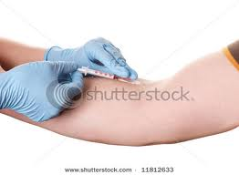
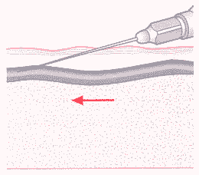
Intravenous Administration

Slide 74
Administering Intradermal Injections:-
1. Check physician's order
2. Prepare equipment:
Draw up 0.1ml of the medication in a 1cc syringe - ones called a TB/tuberculin syringe.
Collect medication, gloves, alcohol wipe, and cotton ball
3. Cleanse the site with an alcohol pad going in a circular motion
4. Hold the skin taut

Slide 75
5. Hold the needle at a 15 degree angle to the skin with the bevel facing up.
6. Insert the needle through the skin, just below the epidermis into the dermis.
7. Inject the fluid, making a bubble just below the skin
8. Remove the needle
9. Dispose of used syringe and needle in a Sharps container

Slide 76
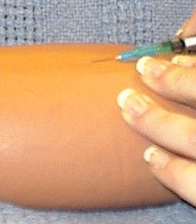

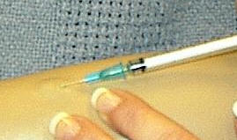

Slide 77
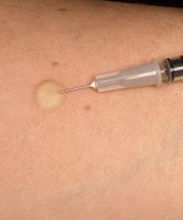
Intradermal Injection

Slide 78
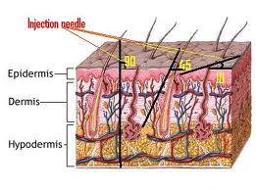

Slide 79
Rectal medication
Rectal medication bypasses the upper gastro-intestinal tract, avoiding liver metabolism and therefore working quickly. It is suitable for patients who are unconscious, unable to swallow or are vomiting.
Drugs given by suppository or enema can produce a local effect – e.g. to relieve constipation or treat local inflammation – or can work systemically – e.g. to provide pain relief.

Slide 80


Suppositories

Slide 81
Rectal medication
Before administering medications rectally you should check the anal area to ensure there are no signs of rectal bleeding, skin tags, recent anorectal surgery, undiagnosed abdominal pain or paralytic ileus.
An unhurried and gentle approach should be taken to administering medication rectally, because the procedure can induce vagal stimulation resulting in bradycardia and vasodilation, and on rare occasions may cause the patient to collapse

Slide 82
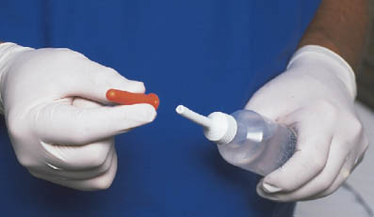
Prepackaged enema container

Slide 83
Administering suppositories
Equipment
● Tray.
● Prescribed suppositories – as per prescription
● Disposable gloves and apron.
● Lubricant
● Tissues or gauze swabs.
● Protective bed cover such as incontinence pad.
● Waste disposal bag.
● Easy access to toilet, bedpan or commode.

Slide 84
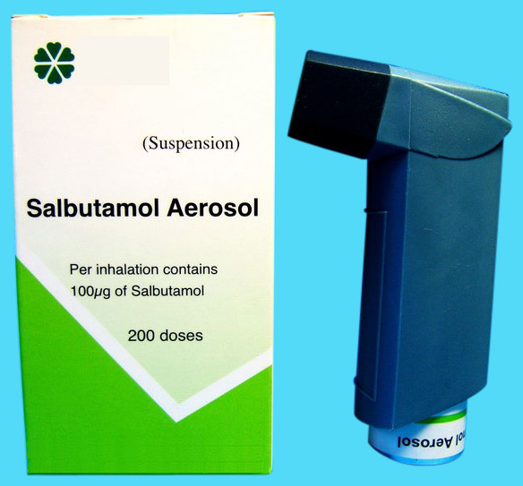
Inhalation route:
- Used for gaseous and volatile agents and aerosols.
Advantages
A- Large surface area
B- thin membranes separate alveoli from circulation
C- high blood flow
As result there is rapid onset of action due to rapid access to circulation.

Slide 85
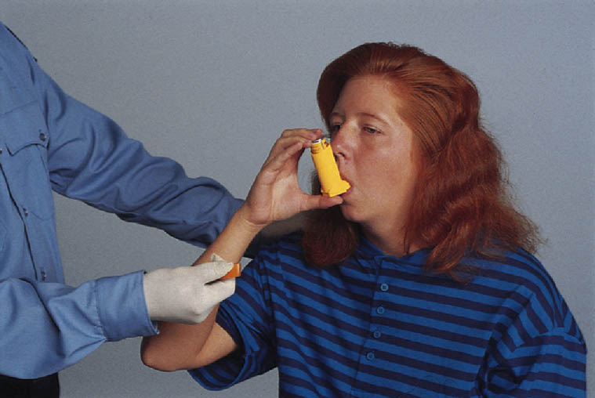
Metered dose inhaler

Slide 86
Inhalation route (Cont.)
Disadvantages
1- Most addictive route of administration because it hits the brain so quickly.
2- Difficulties in regulating the exact amount of dosage.
3- Sometimes patient having difficulties in giving themselves a drug by inhaler.

Slide 87
Ophthalmic medication
Ophthalmic medication is usually applied topically, the most common methods being eye drops or ointment.
These may be used for diagnostic purposes such as dilating the pupil prior to examination; anaesthetizing the eye prior to treatment, or for treatment of eye conditions such as glaucoma or infection.

Slide 88
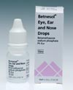
Eye/ ear/ nasal drops

Slide 89
Ophthalmic medication
● Always use separately labelled drug containers for each eye to prevent cross-infection.
● If eye drops and ointment are prescribed to be administered at the same time, give the drops first, then administer ointment several minutes later, as the ointment can prevent absorption of the drops.
● Medication should not be directed onto the cornea of the eye as this may damage the cornea, but directed into the area in the lower eyelid

Slide 90
Ophthalmic medication
● When clearing discharge from the eye or wiping away excess medication, do not use dry cotton-wool balls as fibres may get into the eye and damage the cornea.
● Always work from the inner canthus (nose side) outwards to edge of eye when applying ointment or swabbing eye to reduce infection risk.
● Medication containers should not touch the eye during administration as they may become contaminated or damage the eye.
● Once an eye medication has been opened, record the starting date on the container and discard after two weeks.
● If both eyes are to be treated but only one is discharging, treat the cleaner eye first to prevent cross-infection. Wash hands between eyes.

Slide 91
Administering eye medication
Equipment
● Prescribed medication and prescription.
● Tissues or gauze swabs.
● Sterile saline solution and sterile eye dressing pack containing gallipot and sterile gauze (if eye requires cleansing prior to drug administration).

Slide 92
Routes of drug administration
ROUTE | ADVANTAGE | DISADVANTAGE
Oral | Most convenient Usually least expensive • Safe, does not break skin barrier • Administration usually does not cause stress | Inappropriate for patients with nausea and vomiting • Drug may have unpleasant taste or odor • Inappropriate when gastrointestinal tract has reduced motility • Inappropriate if patient cannot swallow or is unconscious • Cannot be used before certain diagnostic tests or surgical procedures • Drug may discolor teeth, harm tooth enamel • Drug may irritate gastric mucosa • Drug can be aspirated by seriously ill patients

Slide 93
Routes of drug administration
ROUTE | ADVANTAGE | DISADVANTAGE
Sublingual | Same as oral route, plus • Drug can be administered for local effect • More potent than oral route because drug directly enters the blood and bypasses the liver | If swallowed, drug may be inactivated by gastric juice • Drug must remain under tongue until dissolved and absorbed • Drug is rapidly absorbed into the bloodstream
Buccal | Same as sublingual | • Same as sublingual

Slide 94
Routes of drug administration
ROUTE | ADVANTAGES | DISADVANTAGES
Rectal | Can be used when drug has objectionable taste or odor • Drug released at slow, steady rate | Dose absorbed is unpredictable
Vaginal | • Provides a local therapeutic effect | Limited use
Topical | Provides a local effect • Few side effects • Maybe be messy and may soil clothes | Drug can enter body through abrasions and cause systemic effects
Transdermal • • | Prolonged systemic effect • Few side effects • Avoids gastrointestinal absorption problems | Leaves residue on the skin that may soil clothes

Slide 95
Routes of drug administration
ROUTE | ADVANTAGES | DISADVANTAGES
Subcutaneous | Onset of drug action faster than oral | Must involve sterile technique because breaks skin barrier • More expensive than oral • Can administer only small volume • Slower than intramuscular administration • Some drugs can irritate tissues and cause pain • Can produce anxiety
Intramuscular | • Pain from irritating drugs is minimized • Can administer larger volume than subcutaneous • Drug is rapidly absorbed | • Breaks skin barrier • Can produce anxiety

Slide 96
Routes of drug administration
ROUTE | ADVANTAGES | DISADVANTAGES
Intradermal | Absorption is slow (this is an advantage in testing for allergies) | • Amount of drug administered must be small • Breaks skin barrier
Intravenous | • Rapid effect Entire administered dose reaches the systemic circulation immediately - the Dose can be accurately titrated against response | • Limited to highly soluble drugs • Drug distribution inhibited by poor circulation Requires a functioning cannula •More expensive and labour intensive than other routes. •Cannulation is distressing to some patients, especially children •Cannulae are prone to infection •IV injection of drugs may cause local reactions

Slide 97
Routes of drug administration
Inhalation | • Introduces drug throughout respiratory tract • Rapid localized relief • Drug can be administered to unconscious client | • Drug intended for localized effect can have systemic effect • Of use only for the respiratory system

Slide 98
Common causes of Medication Error’s
Assuming the physician's order and patient information are correct, there are three general possibilities for mistakes when administering IV medications via a pump:
Dosage miscalculation;
Transcription data entry error;
Titration of the wrong medication.

Slide 99
Common causes of Medication Error’s
Miscalculation Error: A miscalculation error can occur for any number of reasons, including the use of inaccurate parameters such as dose, weight, height, drug units, or solution volume. A misplaced decimal or missing number in this complex calculation can result in a calculation error that may not be immediately apparent to the clinician.
Data Entry Error: A transcription type data entry error occurs when a nurse inadvertently inputs the wrong data into the infusion pump. Another type of transcription error is the inputting of an incorrect decimal point. For example, the proper infusion rate is calculated, but the rate is incorrectly entered as 54.0 ml/hr instead of 5.40 ml/hr.

Slide 100
Common causes of Medication Error’s
Titration Errors: According to their effect on the patient, many drug delivery rates are changed while the infusion pump is infusing. This type of rate change is called titration. Understanding the medication that is being ordered and the dosage that this drug is routinely given in is key to assuring that the patient is getting the proper dose of medication.
Transcription Errors: Being able to read a physicians writing is sometimes a difficult task, get clarity if uncertain about what has actually been written. If taking a verbal or phone order, a "read-back" system can be instituted in which the nurse who is taking the order, writes down the verbal order and reads it back to the prescribing physician.

Slide 101
Factors associated with medication errors
Include:
Medications with similar names or similar packaging
Medications that are not commonly used or prescribed
Commonly used medications to which many patients are allergic (e.g., antibiotics, opiates, and nonsteroidal anti-inflammatory drugs)
Medications that require testing to ensure proper (i.e., nontoxic) therapeutic levels are maintained (e.g., lithium, warfarin, theophylline, and digoxin)

Slide 102
Controlled drugs
These are substances that are controlled under the Controlled Substances Act (CSA). In Kenya ,
Narcotic drugs and psychotropic substances (control) act No. 4 of 1994
Dangerous drugs act cap 245

Slide 103
To check and administer a controlled drug
Two people should be involved in the administration procedure of all controlled drugs, and where these two are nurses, one must be a registered nurse.
The prescription is checked as for usual medication. In addition, consider the time of the previous dose of controlled drug – is it within the prescribed time period? Has the patient already received his allotted dose?
Take the appropriate drug from the locked cupboard and compare it with the prescription sheet. Verify the dose and name of the drug. Check the quantity in the box with the record book and remove the drug from the container. Check that the remaining ampoules or tablets tally with the record book, and return the remainder to the cupboard and lock it.

Slide 104
To check and administer a controlled drug
● Check the dose required, route, time, and patient’s identity on the prescription.
● Prepare the appropriate amount of drug required, discarding any excess in the sink.
● In the controlled drug record book, document (a) the patient details, (b) date and time, (c) dose given, (d) dose discarded, and (e) the amount of remaining stock.
● Both persons should go to the bedside, where the patient’s identity should be confirmed and the prescription dose, time and route should be checked again.
● Administer the medication by the prescribed route, and document this on the prescription sheet and in the controlled drug record.

