Slide 1
SECRETIONS OF THE DIGESTIVE SYSTEM
Dr. A. W. Muriithi
MBChB, BPharm, BDS
March 2019

Slide 2
Secretions of the g i tract
Derived from
  Goblet cells (single-cell mucous glands)
  Secretory cells located in intestinal pits (crypts of Lieberkhün)
  Tubular glands in stomach and upper duodenum
  Complex glands (salivary glands, pancreas, liver)

Slide 3
Secretions of the G I tract
Stimuli for secretion
  Contact of food with epithelium (ENS)
    Tactile stimulation, chemical stimulation, distension of wall
  Autonomic stimulation
    Parasympathetic -  rate of secretion
    Sympathetic –  rate of secretion (on its own)
     rate of secretion (reduces blood to glands)
  Humoral control
    Presence of, and type of, food in lumen

Slide 4
Mechanism of secretion
Nutrient material diffuses or is actively transported in blood to base of glandular cell
Mitochondria in glandular cell use oxidative energy to form ATP
In endoplasmic reticulum and Golgi complex, organic secretory substances are synthesized from energy from ATP and substrates provided by nutrients
Secretory materials transported through tubules of endoplasmic reticulum to vesicles of Golgi complex – 20 minutes (Transit time)

Slide 5
Mechanism of secretion (2)
Materials are modified, added to, concentrated and discharged into cytoplasm in form of secretory vesicles
Secretory vesicles are released from apical ends of cell in response to neural and humoral stimuli via exocytosis:
  Stimulus  cell membrane permeability to calcium
  Calcium enters cell
  Calcium causes vesicles to fuse with apical cell membrane
  Membrane breaks open and empties vesicles

Slide 6
Mechanism of secretion (3)
Secretion of water and electrolytes
Neural stimulation causes active transport of chloride ions into cell
Excess negative charge causes positive ions (sodium) to move into cell
Excess of both positive and negative charges creates osmotic force that drives water into interior of cell

Slide 7
Mechanism of secretion (4)
Pressure inside cell initiates minute openings in the secretory border of the cell.
Cell volume and hydrostatic pressure are increased; cell swells
Water, electrolytes and organic materials are then flushed out of secretory end of glandular cell

Slide 8
Total amount of fluid found in lumen
Endogenous secretions = about 7000 ml/day
    Exogenous secretions (ingested fluids) = about 1500 ml per day
    BUT
    Only 200 ml lost in faeces

Slide 9
Daily secretions
  Secretion Daily volume (ml) pH
  Saliva 1000 6.0 – 7.0
  Gastric fluid 1500 1.0 – 3.5
  Pancreatic juice 1000 8.0 – 8.3
  Bile 1000 7.8
  Small intestine 1800 7.5 – 8.0
  Brunner’s glands 200 8.0 – 8.9
  Large intestine 200 7.5 – 8.0
  TOTAL 6700

Slide 10
Regulation of secretions
Three phases of regulation of secretion:
(Especially of gastric and pancreatic juices)
  Cephalic stimulant: sight, smell, taste, thought, memory
  Gastric stimulant: chyme in lumen distention of wall
  Intestinal stimulant: chyme in lumen

Slide 11
Secretions
Mucous
  Secreted along entire length of gut
  goblet cells; glands
  Protective role (against acid, enzymes, lacerations) has amphoteric properties
  lubricant
  Forms part of Mucosal barrier
Oesophagus, colon, rectum
‘heartburn’

Slide 12
Secretions
Saliva
  Serous; mucous; 1 – 1.5 l secreted per day (Circadian rhythm)
  Role in mastication
  primary fluid (isotonic) from acinar cells; modified along duct system  secondary fluid
    K, bicarbonate ions  (into lumen), Na, chloride ions  (out)
  Salivary amylase; lingual lipase: enhance taste
  NB: Salivary amylase is produced in its active form
  Xerostomia; dental caries

Slide 13
Gastric fluid
Gastric juice contains water, salts. HCl, pepsins, intrinsic factor (IF), mucous
  Initiates digestion of protein
  Released from gastric glands
    Parietal (oxyntic) cells - secrete HCl, intrinsic factor
    Chief (peptic) cells - secrete pepsinogen (jnactive)
    Pyloric glands – secrete mucous, gastrin
Secretory canaliculi branch throughout the cytoplasm of parietal cells: have common outlet
HCl transporters and Cl⁻ channels are located in the lining membrane
IF binds with B12 in ileum. The complex is then absorbed in colon

Slide 14
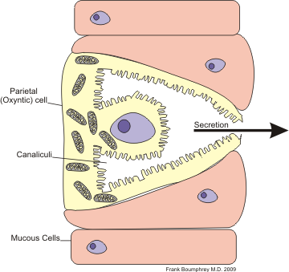
Active parietal (oxyntic) cell

Slide 15
Gastric formation of HCl (1)
Chloride ions actively transported into lumen of canaliculi.
Sodium ions then actively transported into cytoplasm.
The result is a negative potential of -40 to -70 mV inside the canaliculi.
Subsequently more K than Na ions move from cell cytoplasm into canaliculi. (i.e. KCl and small amounts of NaCl enter the canaliculus)

Slide 16
Gastric formation of HCl (2)
Water disociates into hydrogen and hydroxyl ions inside the cytoplasm.
Hydrogen ions are actively secreted into canaliculus in exchange for K⁺ (catalyzed by H,K ATPase).
Na⁺ ions actively reabsorbed by a separate sodium pump
Most K⁺ and Na⁺ that had diffused into canaliculi are reabsorbed into cytoplasm while H⁺ take their place in the canaliculi  strong HCl solution. HCl is then secreted into gastric lumen without damage to the cell

Slide 17
Gastric formation of HCl (3)
Water passes into canaliculus by osmosis as a result of the extra ions that are in the canaliculus.
Final secretion from canaliculus contains:
  water
  hydrochloric acid conc 150 – 160 mEq/L
  KCl conc 15 mEq/L
  small amount of NaCl

Slide 18
Gastric formation of HCl (4)
Carbon dioxide, from blood or formed during cell metabolism, combines with hydroxyl ions to form bicarbonate ions under the influence of carbonic anhydrase.
The bicarbonate ions then diffuse out of the cytoplasm in exchange for chloride ions that originate from ECF and are later secreted into the canaliculus.
  alkaline tide (↑ alkalinity of blood after a meal)

Slide 19
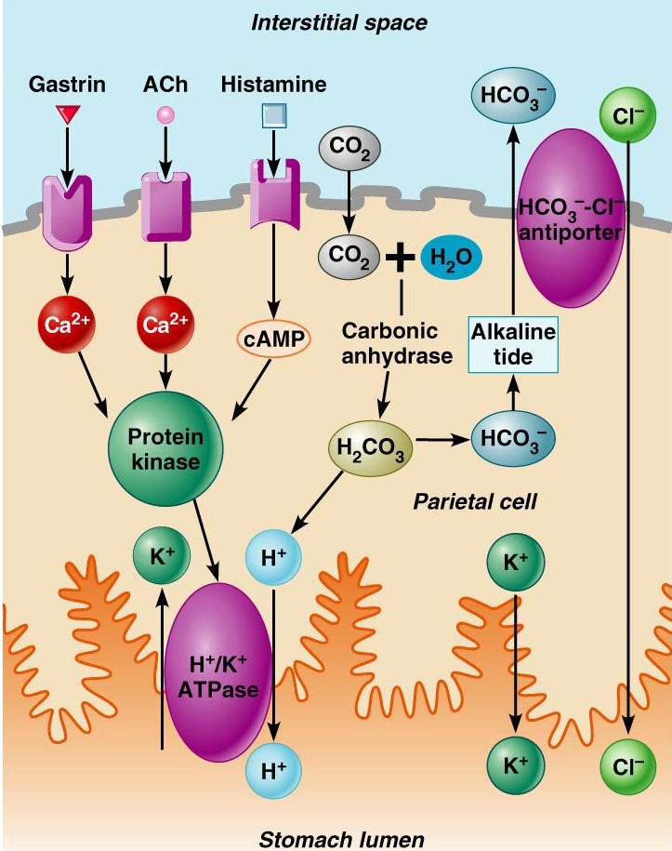
Regulation of gastric acid secretion

Slide 20
Medical interventions
Aim = to reduce gastric acid levels in stomach:
Antacids
‘selective’ vagotomy
Proton pump inhibitors (PPIs)
**histamine** - there is always a basal production of HCl even when other mechanisms are blocked because histamine stimulates HCl secretion

Slide 21
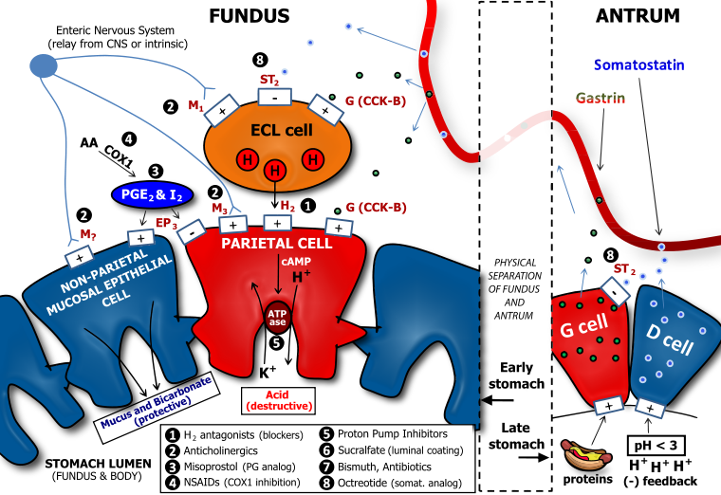
Regulators of HCl secretion

Slide 22
Pancreatic secretions
Pancreatic gland (100g) secretes 1 l of fluid/day
  Aqueous component – rich in HCO₃⁻
  Enzyme component - for digestion of fat, CHO and protein
Main enzymes are
  Protein: trypsin, chymotrypsin, carboxypolypeptidase
  CHO: pancreatic amylase
  Fat: pancreatic lipase, cholesterol esterase, phospholipase

Slide 23
Pancreatic secretions (2)
Protease enzymes are secreted in their inactive form (zymogen) and then activated in duodenum (initiated by enterokinase)
Secretion of a trypsin inhibitor prevents digestion of gland tissue
Bicarbonate ions and water are secreted by epithelial cells in ducts and ductules that lead from the pancreatic acini

Slide 24
Bile
Continuously secreted in liver; concentrated in gall bladder
Bile contains bile acids, cholesterol, lecithins and bile pigments, Na, K, Cl and bicarbonate ions
Role - Emulsification of fats: formation of micelles
Bile salts are absorbed in the terminal ileum – enterohepatic circulation. Small amounts are lost in faeces
250 - 1500 ml bile enters duodenum each day.
  After a fatty meal, bile acids are recycled 2 or 3 times

Slide 25
Intestinal secretions
Contain electrolytes, H₂O and mucous (1500 ml/day)
Mostly protect mucosa from mechanical damage
Secretion rate increases during or after a meal
Stimulated by distension of wall and mechanical stimulation of the mucosa
Secretions are formed by enterocytes in the crypts of Lieberkhün and are mostly pure ECF. Usual fate – rapidly absorbed in the villi
Mechanism: active secretion of Cl and bicarbonate; movement of sodium and osmotic movement of water

Slide 26
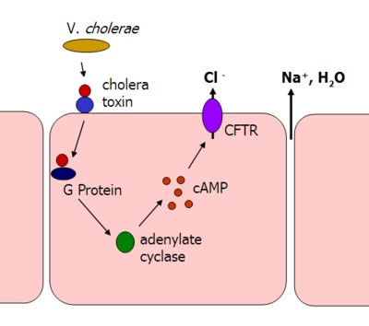
Mechanism – Cholera vibrio toxin

Slide 27
Colonic secretions
Colonic secretions are smaller in volume than those of the small intestine, and richer in mucous content
NB: Colon has crypts of Lieberkhün, but no villi

Slide 28
Thank you

