Slide 1
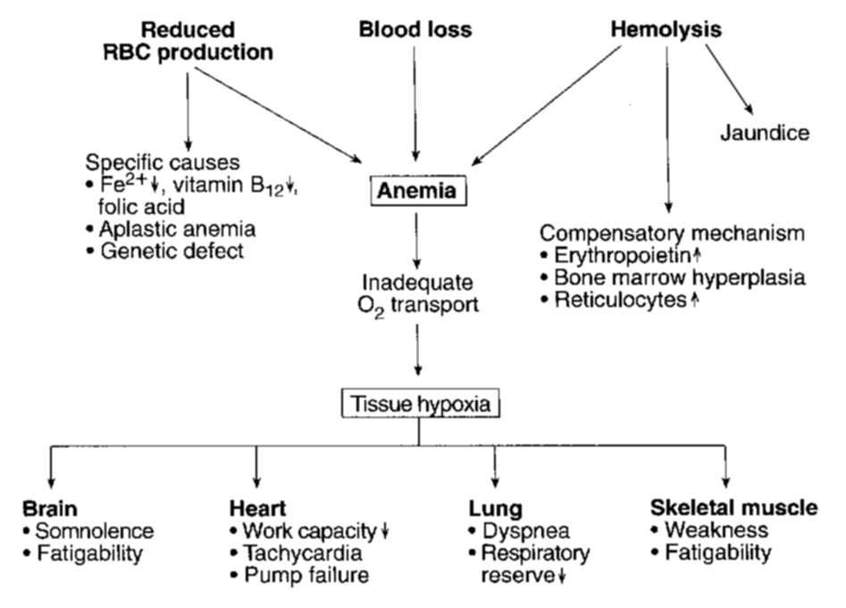
OVERVIEW OF ANEMIA

Slide 2
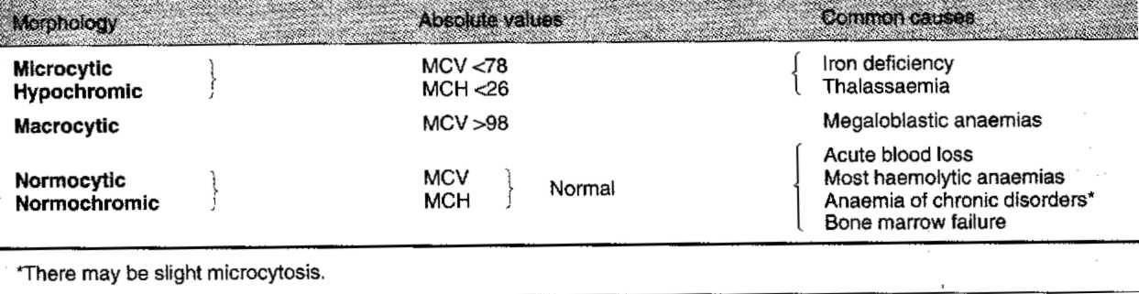
OVERVIEW OF ANEMIA
MORPHOLOGICAL CLASSIFICATION OF ANEMIA

Slide 3
OVERVIEW OF ANEMIA- Blood Parameters
Hemoglobin concentration (Hg):12-18 g/dl
Erythrocytes count (RBC):4-6 x10⁹/l
Hematocrit (Hct):37-54%
Platelet count (Plt):150-450 x 10⁹/l
Leukocytes count (WBC):4-11 x 10⁹/l

Slide 4
OVERVIEW OF ANEMIA- RBC Parameters/Indices
Mean corpuscular volume (MCV)
N: 80-100 fl
Mean corpuscular hemoglobin (MCH)
N: 27-34 pg
Mean corpuscular hemoglobin concentration (MCHC)
N: 31-37 g/dl
RDW(Red cell Distrubution Width)

Slide 5
OVERVIEW OF ANEMIA- Reticulocytes
Normal Retic count: 0.5-2%
Absolute Retic Count: 25-75x 10⁹/l

Slide 6
IRON DEFICIENCY ANEMIA- Iron metabolism
Absorption in duodenum
Transferrin transports iron to the cells
Ferritin and Hemosiderin store iron
10% of daily iron is absorbed

Slide 7
IRON DEFICIENCY ANEMIA- Iron metabolism
Most body iron is present in hemoglobin in circulating red cells
The macrophages of the reticuloendotelial system store iron released from hemoglobin as ferritin and hemosiderin
Small loss of iron each day in urine, faeces, skin and nails and in menstruating females as blood (1-2 mg daily)

Slide 8
IRON DEFICIENCY ANEMIA- Iron metabolism
Iron concentration (Fe)-N: 60-170 mg/dl
Total Iron Binding Capacity-N: 50-450mg/dl
Transferrin saturation-N: 20-50%
Transferrin receptor concentration
Ferritin concentration-N: 50-300 μg/l

Slide 9
IRON DEFICIENCY ANEMIA- Aetiology
1.Chronic bleeding
Menorrhagia
Peptic ulcer
Stomach cancer
Ulcerative colitis
Colorectal cancer
Haemorhoids
2.Dietary insufficiency
3. Increased iron requirement- children, pregnancy, lactation
4. Malabsorption- gluten-induced enteropathy, gastrectomy, atrophic gastritis, etc

Slide 10
IRON DEFICIENCY ANEMIA-Pathogenesis(stages)
Prelatent
reduction in iron stores without reduced serum iron levels
Hb (N), MCV (N), iron absorption (↑), transferin saturation (N), serum ferritin (↓), marrow iron (↓)
Latent
iron stores are exhausted, but the blood hemoglobin level remains normal
Hb (N), MCV (N), TIBC (↑), serum ferritin (↓), transferrin saturation (↓), marrow iron (absent)
Iron deficiency anemia
blood hemoglobin concentration falls below the lower limit of normal
Hb (↓), MCV (↓), TIBC (↑), serum ferritin (↓), transferrin saturation (↓), marrow iron (absent)

Slide 11
IRON DEFICIENCY ANEMIA- General symptoms/sings
Fatigability
Dizziness
Headache
Scotomas
Irritability
Palpitations
Pallor
CAD, CHF

Slide 12
IRON DEFICIENCY ANEMIA- Characteristic symptoms/signs
Glossitis, stomatitis
Dysphagia(Plummer-Vincent syndrome)
Atrophic gastritis
Dry pale skin
Koilonychia(spoon shaped nails)
Blue sclerae
Hair loss
Pica
Splenomegaly(in about 10%)
Slight thrombocytosis

Slide 13
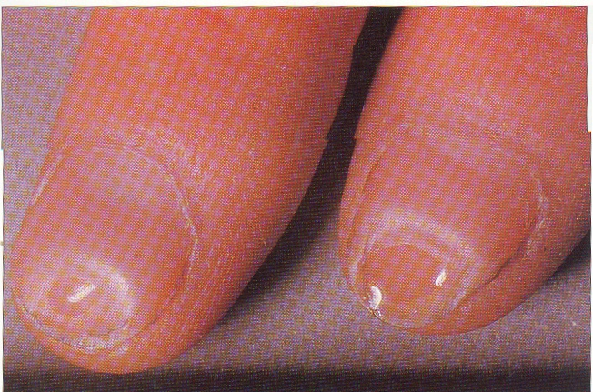
Koilonychia

Slide 14
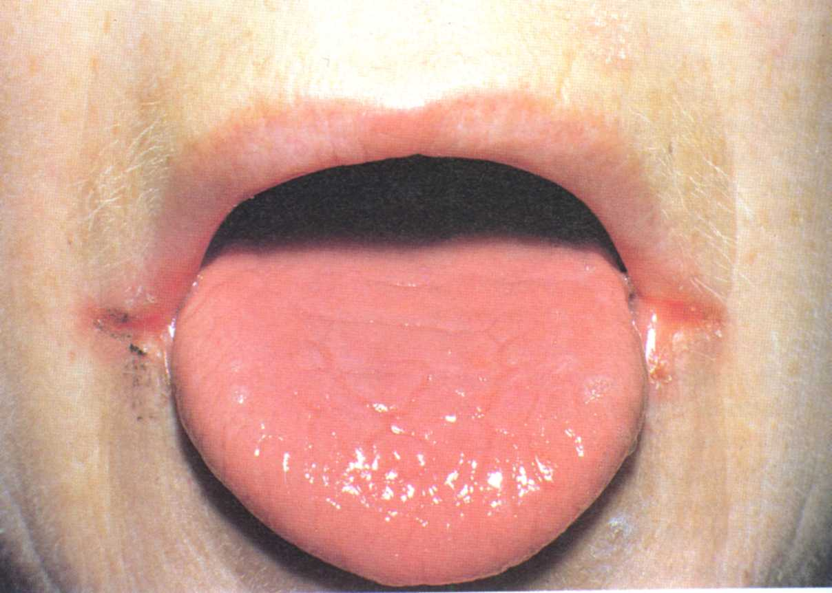
ANGULAR CHEILITIS AND SMOOTH TONGUE IN IRON DEFICIENCY

Slide 15
IRON DEFICIENCY ANEMIA- Diagnosis
History-Symptoms and to determine etiology
Physical exam-Signs and to determine etiology
Laboratory investigations/findings:
Complete Blood Count
MCV ↓
MCH ↓
MCHC normal or ↓
↑RDW
White blood cell count- normal
Platelets may be↑

Slide 16
IRON DEFICIENCY ANEMIA- Diagnosis
Laboratory investigations/findings(cont.)
Peripheral blood film
Microcytosis
Hypochromia
Anisocytosis
Poikilocytosis- target cells, elliptocytes

Slide 17
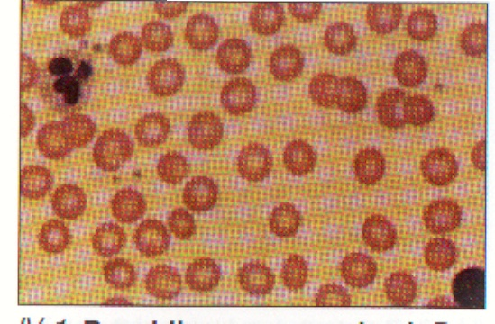
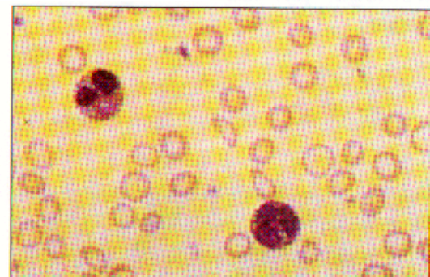

Slide 18
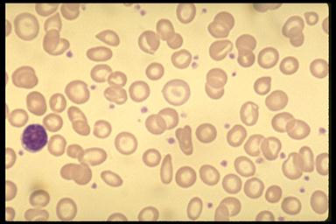

Slide 19
IRON DEFICIENCY ANEMIA- Diagnosis
Labortory investigations/findings(cont.)
Blood iron studies
Fe ↓
TIBC ↑
Transferrin saturation ↓
Ferritin ↓

Slide 20
IRON DEFICIENCY ANEMIA- Diagnosis
Laboratory investigations/findings(cont,)
Bone marrow findings
High cellularity
Mild to moderate erythroid hyperplasia(25-35%, N16-18%)
Polychromatic and pyknotic cytoplasm of erythroblasts
Absence of stainable iron

Slide 21
IRON DEFICIENCY ANEMIA- Diagnosis
Laboratory investigations/findings(cont.)
Investigations to find out suspected etiology e.g
Colonoscopy
OGD
Gynecologic examinations

Slide 22
IRON DEFICIENCY ANEMIA- Treatment
1.Definitive- iron supplementation
Oral iron
Parenteral iron
2. Treatment of underlying cause

Slide 23
ANEMIAS CAUSED BY ABNORMAL IRON METABOLISM
Sideroblastic anemias
Anemia of chronic disease

Slide 24
SIDEROBLASTIC ANEMIA
Characterized by
Increase in total body iron
Presence of ringed sideroblasts in bone
marrow
Hypochromic anemia
Classification
Hereditary form
Acquired form(more common)
Idiopathic- refractory anemia with ringed sideroblasts- acquired stem disorder
Secondary- lead poisoning, alcoholism, malignancy

Slide 25
SIDEROBLASTIC ANEMIA- Pathophysiology
Disturbances of enzymes regulating heme synthesis
Ringed sideroblasts form when nonferritin iron accumulated in the mitochondria that circle the normoblast nucleus

Slide 26
SIDEROBLASTIC ANEMIA- Laboratory findings
Peripheral Blood
Moderate to severe anemia – dimorphic
(mild macrocytosis prevalent in RARS and
alcoholism)
Target cells
Pappenheimer bodies
Basophilic stippling – coarse basophilic
stippling characteristic in lead poisoning
↓Fe, N to ↑TIBC, ↓% saturation, ↓ ferritin

Slide 27
SIDEROBLASTIC ANEMIA- Laboratory findings
Bone marrow
Erythroid hyperplasia - megaloblastosis
Ringed sideroblasts in 50% of
normoblasts

Slide 28
SIDEROBLASTIC ANEMIA- Therapy
Pyroxidine – hereditary form (50%
response)
Folic acid if megaloblastoid features
Phlebotomy/chelation therapy to remove excess iron

Slide 29
ANEMIA OF CHRONIC DISEASE
Anemia that occurs in patients with:
Chronic infections
Chronic inflammatory disorders
Neoplastic disorders
Characterized by low serum iron, normal iron stores

Slide 30
ANEMIA OF CHRONIC DISEASE- Pathophysiology
Impaired marrow response to anemia –cytokines produced as result of immune response inhibit EPO production
Block in iron release from macrophage
Shortened erythrocyte survival

Slide 31
ANEMIA OF CHRONIC DISEASE- Laboratory findings
Mild anemia (not less than 9 g/dL)
Normocytic, normochromic (some are
normocytic, hypochromic)
↓Fe (10-70 mg/dL), N to ↑ TIBC (100-
300 mg/dL), N to ↑ % saturation (10-
25%), N or ↓ ferritin

