Slide 1
MALE REPRODUCTIVE SYSTEM

Slide 2
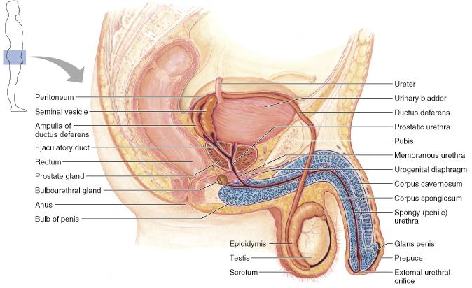
Male Reproductive System
Testes, a system of ducts, accessory sex glands, and several supporting structures (including the penis)

Slide 3
MAIN FUNCTIONS
Production of the gametes (sex cells)-spermatogenesis,
Secretion of hormones to regulation of male reproductive functions
Performance of the male sexual act –copulation.

Slide 4
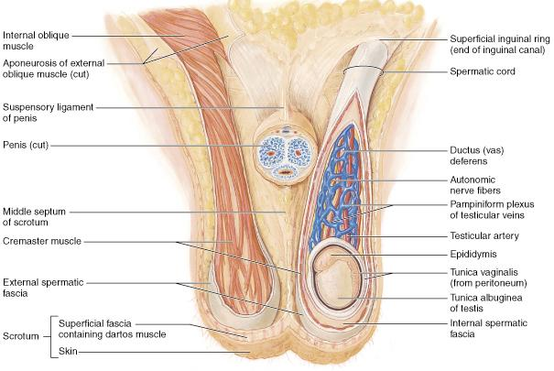
Function of - scrotum.
Scrotum –
Cutaneous bag containing testis, epidydimis& part of spermatic cord
Support and protect the testes

Slide 5
TESTIS
Testes - testicles
Paired(2) oval glands 4 x2x 2 cm volume =15-20mls
Develop from premodial gonad by influence of Y chromosome and TDF
Develop in abdomen and descent to scrotum
Undescended =Cryptochidism
Suspended in scrotum by spermatic cord

Slide 6
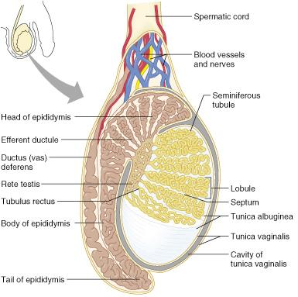
TESTIS – X-Section
Enclosed by 3 coverings:
Tunica vasculosa (innermost): made up of connective tissue & is rich in blood vessels.
Tunica albuginea: dense fibrous capsule
Has septa extensions dividing testis into 200-300 lobules
Tunica Vaginalis (outermost):
visceral layer: adheres to tunica albuginea.
Parietal layer: lines the inner surface of scrotum.
tunica albuginea
tunica vaginalis

Slide 7
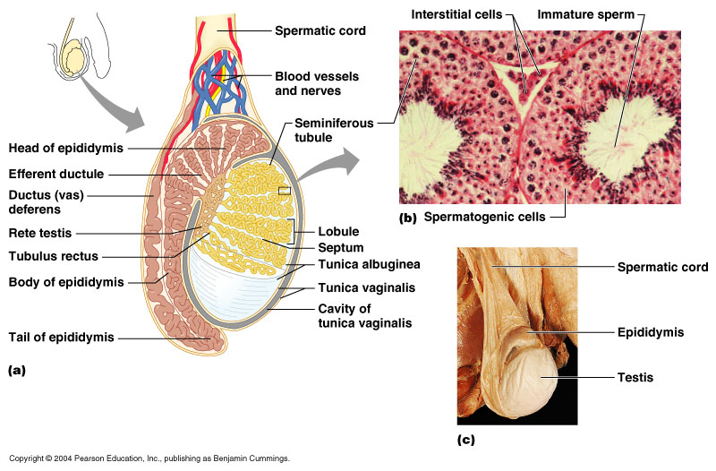

Slide 8
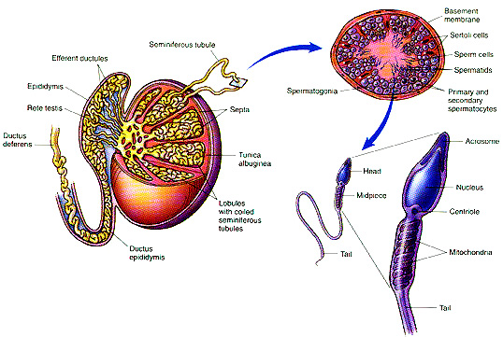
Seminiferous Tubules
Each testis has 200-300 lobules.
Each lobule has 1-4 convoluted seminiferous tubules, surrounded & supported by interlobular Connective Tissue.
Both ends of each loop drain into a network of ducts in the head of the epididymis

Slide 9
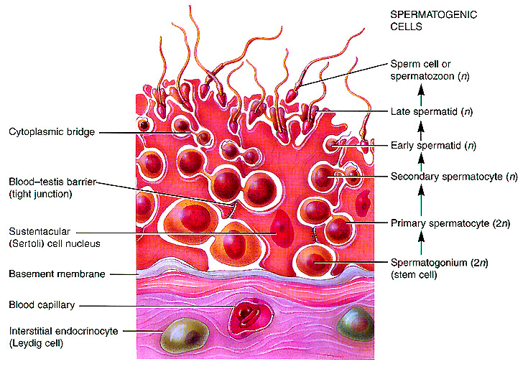
Seminiferous Tubules.
Between the tubules
Interstitial cells of Lydig
containing lipid granules,
Secrete testosterone in response to LH (= ICTH)
Also between the tubules are blood cells.

Slide 10
Seminiferous Tubules.
Has stratified epithelium that consists of 2 types of cells: germ cells & sertoli cells.
Germ cells (spermatogenic cells):
They are the precursor cells of spermatozoa.
They occupy the spaces between basement membrane & lumen of seminiferous tubules.
In children, only primitive germ cells called spermatogonia are present.
With the onset of puberty, different stages of spermatogenic cells are seen: (from periphery to lumen):
Spermatogonium, à primary spermatocyte, à secondary spermatocyte ,à spermatid and spermatozoa

Slide 11
Sertoli cells -
They are large irregular columnar glycogen-containing cells
Extend from the basement membrane to the lumen.
Functions of sertoli cells:
Protection & nourishment for spermatogenic cells
Secrete hormones
inhibin & activin– which inhibit & stimulate the release of FSH from anterior pituitary respectively
Convert androgens into estrogens via the enzyme aromatase present in sertoli cells.
Secrete factors and proteins
Mullerian regression factor (MRF) or Mullerian inhibiting substance (MIS) in fetal testes.
Binding proteins -androgen binding (ABP) & EstrogenBP (EBP).
Create blood-testis barrier with tight junctions

Slide 12
Blood testis barrier
It is a mechanical barrier that separates seminiferous tubules of testes from blood & other testicular tissues.
It is formed by tight junctions between the adjacent sertoli cells near the basal membrane of seminefirous tubule.
The testosterone must be bound to androgen- binding protein (ABP) to cross the barrier.
Functions:
Prevents the entry of large molecules (such as proteins & cytotoxic substances, galactose) from the interstitial tissue to lumen
Protects the germ cells from blood-borne noxious agents
Prevents antigenic products of germ cell division and maturation from entering the circulation and generating an autoimmune response
Allows the passage of water, urea, nutritive substances & hormones for spermatogenesis.

Slide 13
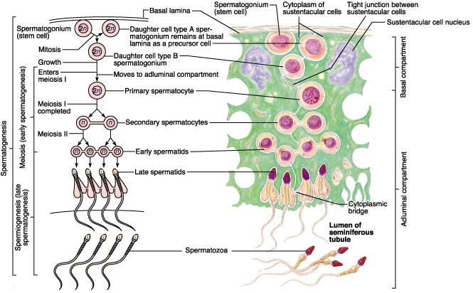
Male Reproductive System
Spermatogenesis
meiosis occurs in the seminiferous tubules
produces haploid spermatozoa
64-72 days in humans
Spermatogonia
Diploid stem cells
by mitosis, some remain as viable stem cells through out life
others undergo developmental changes to become primary spermatocytes and undergo meiosis

Slide 14
Male Reproductive System
Reduction division
primary spermatocytes undergo meiosis I to become secondary spermatocytes (haploid)
secondary spermatocytes undergo meiosis II to become immature spermatids (haploid)
Spermatids mature morphologically into spermatozoa = sperm cells
spermatid do not separate their cytoplasm completely
they maintain cytoplasmic bridges until released into the tubule lumen

Slide 15
Male Reproductive System
Spermatogenesis
spermatids mature physiologically into spermatozoa
Requires 10-14 days for migration to and 3-4 days for maturation in the ductus epididymus
Older sperms are removed gradually by phagocytes within the epididymus
Many sperms are abnormal, either morpholically, physiologically, or genetically
30% abnormal is considered “normal”

Slide 16
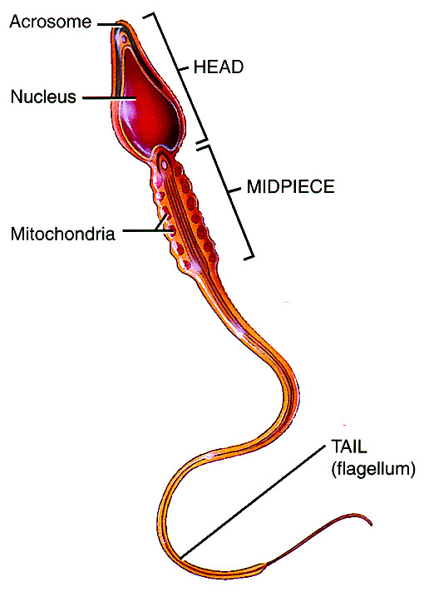
Male Reproductive System
Spermatozoa
Takes approximately 72 hrs
300 million/day mature
survive about 48 hrs following ejaculation in the female reproductive tract
Structure
Head
nuclear chromosomal material
acrosome - enzymes for penetration into egg
Midpiece - site of ATP production to power tail
Tail - flagellum

Slide 17
Effect of Temperature
Spermatogenesis requires a temperature considerably lower than that of the interior of the body.
The testes are normally maintained at a temperature of about 32 °C.
They are kept cool by
air circulating around the scrotum and
probably by heat exchange in a countercurrent fashion between the spermatic arteries and veins.
When the testes are retained in the abdomen or when, in experimental animals, they are held close to the body by tight cloth binders, degeneration of the tubular walls and sterility result.
Hot baths (43-45 °C for 30 minutes per day) and insulated athletic supporters reduce the sperm count in humans, in some cases by 90%.
In addition, there is evidence suggesting a seasonal effect in men, with sperm counts being greater in the winter regardless of the temperature to which the scrotum is exposed.

Slide 18
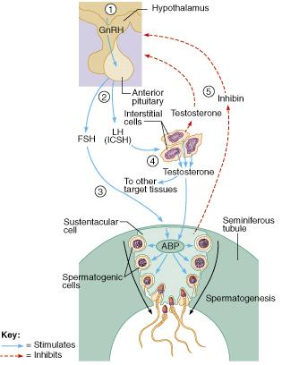
Male Reproductive System
Hormones of brain-testicular axis
anterior pituitary drives changes during puberty
controlled by GnRH from hypothalamus
begins to secrete FSH, LH
LH – targets Interstitial(Lydig cells) endocrinocytes
testosterone
dihydrotestosterone (DHT)
FSH - Sustentacular cells
Androgen-Binding Protein (ABP) concentrates androgens for spermatids
Inhibin – negative feedback to the pituitary and hypothalamus

Slide 19
Male Reproductive System
Development
testosterone stimulates pattern development before birth (internal ducts)
DHT 🡪 external genitals
estrogens from testes 🡪 brain development
Puberty – testosterone & DHT stimulate enlargement of male sex organs and secondary sexual characteristics

Slide 20
Male Reproductive System
Testosterone -
secondary sex characteristics:
Muscular-skeletal growth
Heavier & thicker muscles and bones in men than in women
Also triggers epiphyseal closure
Hair growth-pubic, axillary, facial and chest hair
Skin changes-oil gland secretion
larynx enlargement 🡪 deepening the voice
sexual functions
Male sexual behavior and aggressive behaviors
Spermatogenesis
Sex drive in both male and female
metabolism - stimulates protein synthesis
“anabolic steroids” are often misused and abused

Slide 21
Male Reproductive System
Ducts
sperm move slowly from the lumen of seminiferous tubules → straight tubules → rete testis → epididymis
continuous sperm and testicular fluid production move sperms along
fluid contains: H₂O, androgens, estrogens, K⁺, glutamic acid, aspartic acid

Slide 22
Male Reproductive System
Epididymis
posterior border of testes
tightly coiled tube - head, body, tail
6 m long if uncoiled
pseudostratified columnar epithelium
microvilli provide nutrients
reabsorb testicular fluid
phagocytize degenerating older sperm
ductus epididymis
site of sperm maturation (10-14 days) - ↑ motility
may remain in storage for a month, then reabsorbed

Slide 23
Male Reproductive System
Ductus (vas) deferens
less convoluted with a larger diameter
ascends, enters pelvic cavity through inguinal canal
loops up, over urinary bladder to end in the ampulla

Slide 24
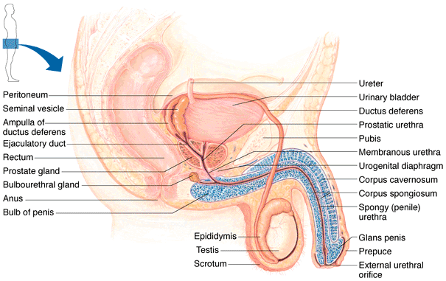
Male Reproductive System
Ductus (vas) deferens
pseudostratified columnar epithelium with thick muscularis
transports sperm from epididymis to urethra by peristalsis during ejaculation

Slide 25
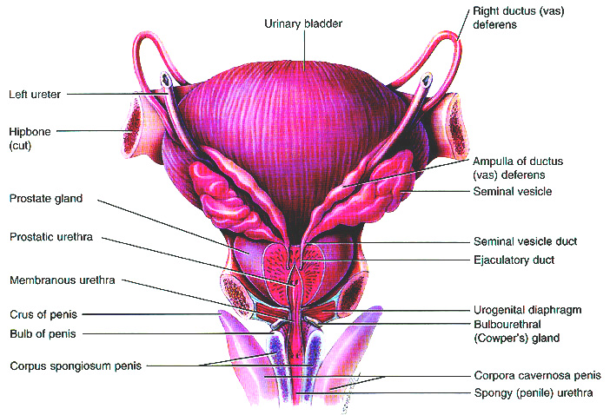
Male Reproductive System
Posterior View

Slide 26
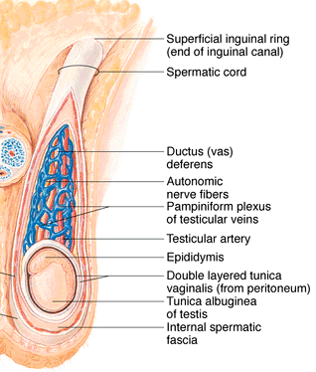
Male Reproductive System
Spermatic cord: testicular artery, veins, lymphatic vessels, autonomic nerves, vas deferens, cremaster muscle descend with the testes
Exit the abdominal cavity through the inguinal canal
Vasectomy – a portion of each duct is removed

Slide 27
Male Reproductive System
Ejaculatory Ducts
formed by ducts from seminal vesicle and ductus deferens
move sperm into prostatic urethra before ejaculation

Slide 28
Male Reproductive System
Urethra
terminal tract for urinary and reproductive systems
3 regions:
prostatic urethra
membranous urethra
spongy (cavernous) urethra
Ends at external urethral orifice at the bulb/glans of the penis

Slide 29
Male Reproductive System
Accessory sex glands: seminal vesicles, prostate, and bulbourethral glands

Slide 30
Male Reproductive System
Accessory sex glands secrete the fluid portion of the semen
Seminal vesicles
base of urinary bladder
≈ 60% of semen volume
secrete alkaline viscous fluid containing:
fructose, ascorbic acid
prostaglandins
vesiculase (coagulating enzyme) keeps semen near cervix while sperm swim into cervix via flagellar movements

Slide 31
Male Reproductive System
Prostate
below bladder, around urethra
secretes milky, slightly acidic fluid with:
citrate
enzymes
phosphatase
fibrinolysin
prostate specific antigen (PSA)
Bulbourethral (Cowper's) glands
beneath prostate gland at membranous urethra
secrete:
alkaline fluid
mucus
neutralize acidic urine

Slide 32
SEMEN
The fluid that is ejaculated at the time of orgasm
A mixture of sperms and secretions
contains sperms and the secretions of the seminal vesicles, prostate, Cowper's glands, and, probably, the urethral glands
Charecteristics
Volume
An average volume per ejaculate is 2.5-3.5 mL after several days of continence.
50-150 million sperm/mL
below 20 million/mL infertility
The volume of semen and the sperm count decrease rapidly with repeated ejaculation
Large numbers needed for successful fertilization
Slightly alkaline (pH 7.2-7.6), milky and mucoid
decreases acidity of vagina
fructose is the nutrient for sperm metabolism
prostaglandins decrease mucous viscosity and stimulate reverse peristalsis
Contains natural antibiotic = seminalplasmin
Coagulates after ejaculation into vagina
somewhat different mechanism than blood clotting
breaks down in 5-20 minutes

Slide 33
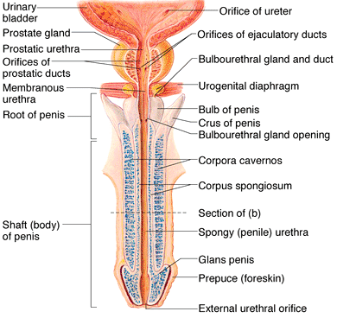
Male Reproductive System
Penis
root (attachment)
body (shaft)
glans penis (head)

Slide 34
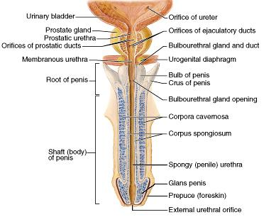
Male Reproductive System
Root of penis - bulb (base of corpus spongiosum)
Glans penis with outer corona
Terminal slitlike opening (external urethral orifice)
Covering is prepuce (foreskin)
circumcised in a variety of societies globally

Slide 35
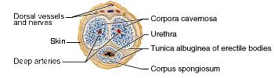
Male Reproductive System
Body
3 cylindrical tissue masses surrounded by tunica albuginea
Dorsolateral pair, the corpora cavernosa penis
midventral corpus spongiosum penis with spongy urethra
All surrounded by fascia and skin
Each section has blood sinuses = erectile tissue

Slide 36
Male Reproductive System
Erection
Arteries dilate with sexual stimulation, a parasympathetic reflex
Large quantities of blood enter the sinuses
compress superficial veins from sinuses
trapped blood → erection
Close bladder sphincter
prevent urine flow
prevent semen backflow
Ejaculation
Sympathetic reflex
Peristalsis
Arteries constrict, capillary sinuses empty

Slide 37
THE END
THANKS

