Slide 1
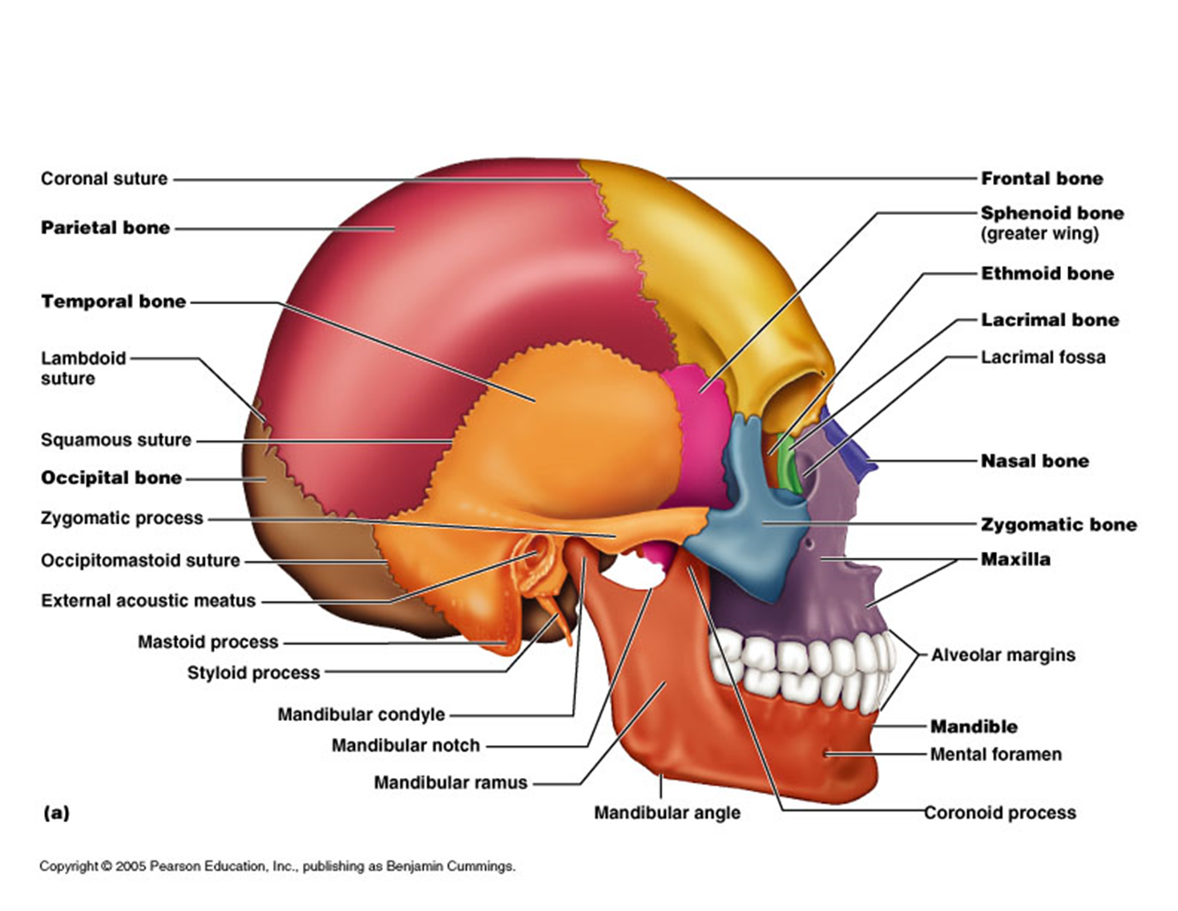
Skull Bones
Anatomy

Slide 2
The skull (cranium), with its 22 bones, rests on the superior end of the vertebral column (backbone).
The bones of the skull are grouped into two categories: cranial bones and facial bones.
The cranial bones form the cranial cavity, which encloses and protects the brain.

Slide 3
The eight cranial bones are:
  the frontal bone
  two parietal bones
  two temporal bones
  the occipital bone
  the sphenoid bone
  the ethmoid bone

Slide 4
Fourteen facial bones form the face, are:
  two nasal bones,
  two maxillae (or maxillas),
  two zygomatic bones,
  the mandible,
  two lacrimal bones,
  two palatine bones,
  two inferior nasal conchae, and
  the vomer.

Slide 5
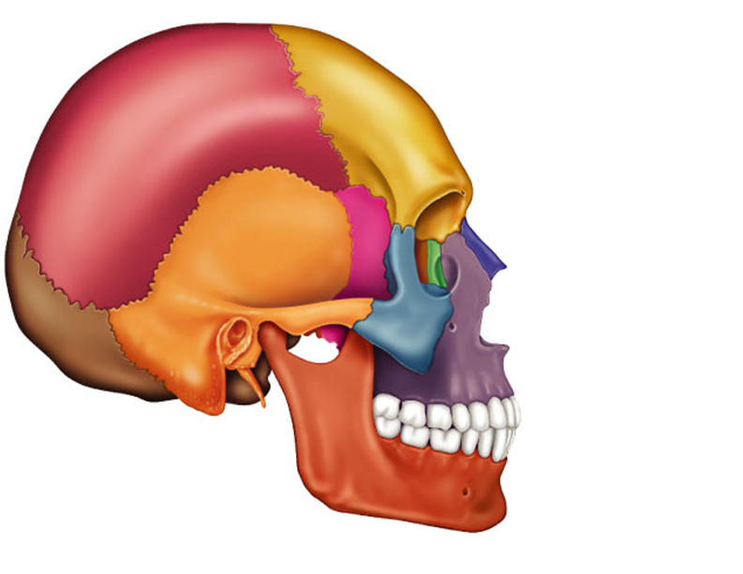

Slide 6
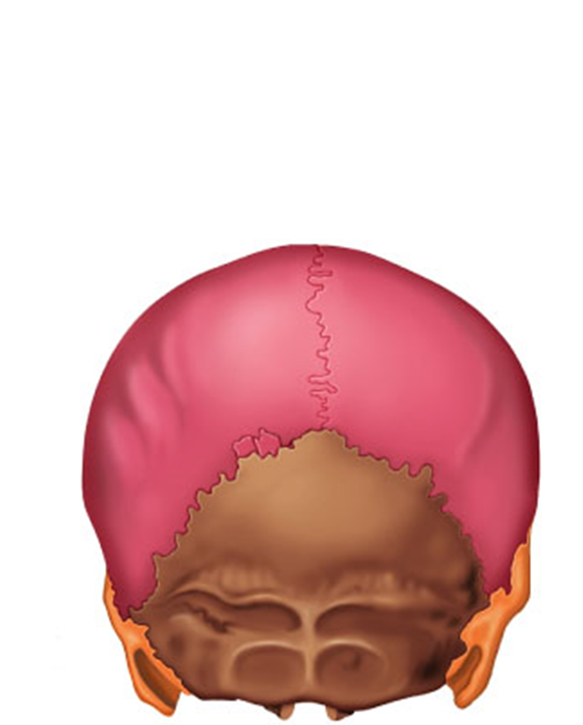

Slide 8
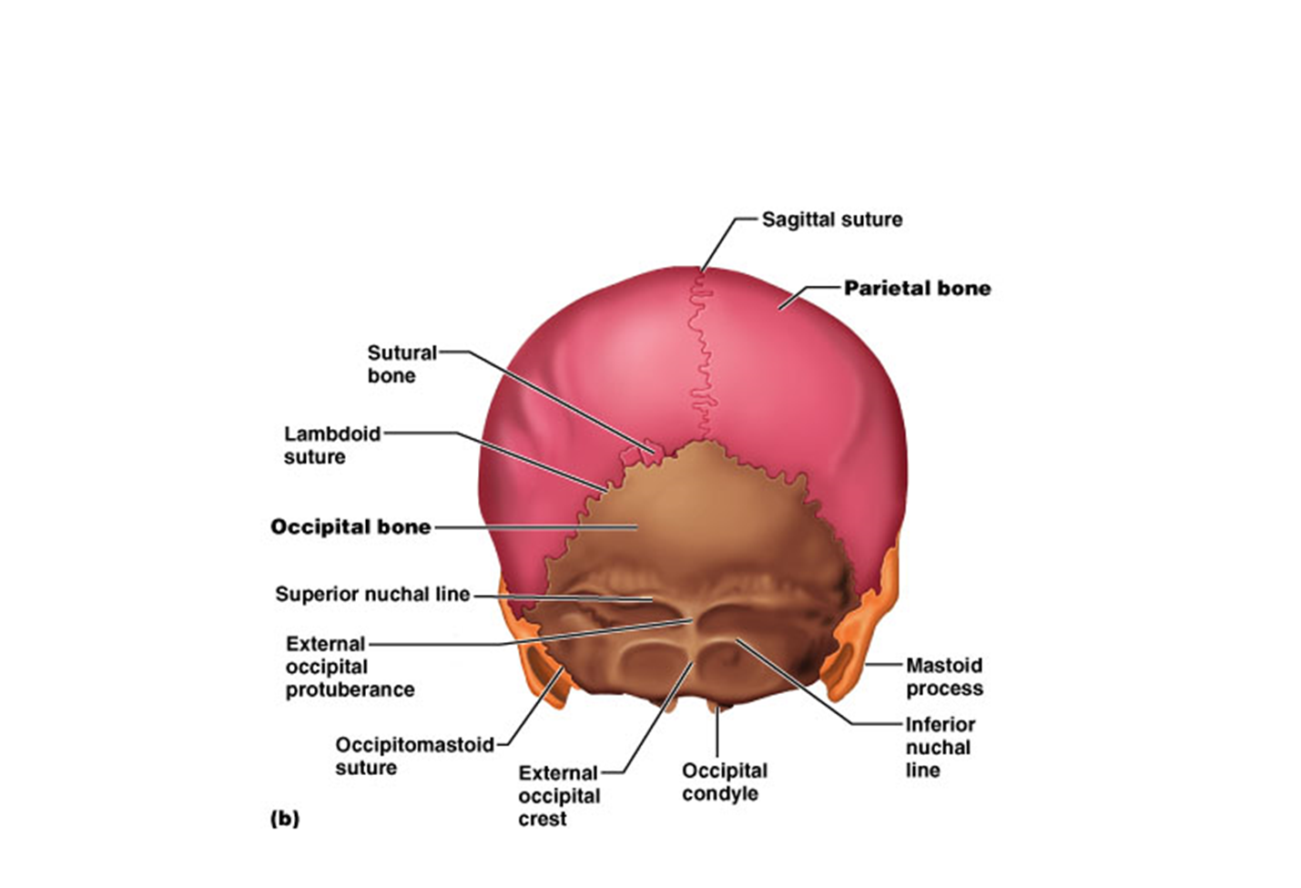

Slide 9
Frontal Bone
The frontal bone forms the forehead (the anterior part of the cranium), the roofs of the orbits (eye sockets), and most of the anterior part of the cranial floor.
Soon after birth, the left and right sides of the frontal bone are united by the metopic suture, which usually disappears between the ages of six and eight.

Slide 10
It gradually slopes inferiorly from the coronal suture, on the top of the skull, then angles abruptly and becomes almost vertical.
Superior to the orbits the frontal bone thickens, forming the supraorbital margin
From this margin, the frontal bone extends posteriorly to form the roof of the orbit, which is part of the floor of the cranial cavity.

Slide 11
Parietal Bones
The two parietal bones form the greater portion of the sides and roof of the cranial cavity
The internal surfaces of the parietal bones contain many protrusions and depressions that accommodate the blood vessels supplying the dura mater, the superficial connective tissue covering of the brain.

Slide 13
Temporal Bones
The paired temporal bones form the inferior lateral aspects of the cranium and part of the cranial floor. In
note the temporal squama ( scale), the thin, flat part of the temporal bone that forms the anterior and superior part of the temple.

Slide 14
Projecting from the inferior portion of the temporal squama is the zygomatic process, which articulates (forms a joint) with the temporal process of the zygomatic (cheek) bone.
Together, the zygomatic process of the temporal bone and the temporal process of the zygomatic bone form the zygomatic arch.

Slide 15
The mastoid portion (mastoid breast-shaped; Figure 7.4) of the temporal bone is located posterior and inferior to the external auditory meatus (meatus passageway), or ear canal, which directs sound waves into the ear.
In an adult, this portion of the bone contains several mastoid air cells. These tiny airfilled compartments are separated from the brain by thin bony partitions.

Slide 16
The mastoid process is a rounded projection of the mastoid portion of the temporal bone posterior and inferior to the external auditory meatus.
It is the point of attachment for several neck muscles.

Slide 17
The styloid process projects inferiorly from the inferior surface of the temporal bone and serves as a point of attachment for muscles and ligaments of the tongue and neck

Slide 18
At the floor of the cranial cavity (see Figure 7.8a) is the
petrous portion ( petrous rock) of the temporal bone. This
triangular part, located at the base of the skull between the
sphenoid and occipital bones, houses the internal ear and the
middle ear, structures involved in hearing and equilibrium

Slide 19
Occipital Bone
The occipital bone forms the posterior part and most of the base of the cranium
The foramen magnum ( large hole) is in the inferior part of the bone.
The medulla oblongata (inferior part of the brain) connects with the spinal cord within this foramen, and the vertebral and spinal arteries also pass through it.

Slide 20
The external occipital protuberance is the most prominent midline projection on the posterior surface of the bone just above the foramen magnum.
You may be able to feel this structure as a bump on the back of your head, just above your neck.

Slide 21
Sphenoid Bone
The sphenoid bone lies at the middle part of the base of the skull
This bone is the keystone of the cranial floor because it articulates with all the other cranial bones, holding them together.
View the floor of the cranium superiorly and note the sphenoid articulations.

Slide 22
It joins anteriorly with the frontal bone, laterally with the temporal bones, and posteriorly with the occipital bone.
The sphenoid lies posterior and slightly superior to the nasal cavity and forms part of the floor, side walls, and rear wall of the orbit -

Slide 24
The shape of the sphenoid resembles a butterfly with outstretched
The body of the sphenoid is the hollowed cubelike medial portion between the ethmoid and occipital bones.
The space inside the body is the sphenoidal sinus, which drains into the nasal cavity

Slide 25
The greater wings of the sphenoid project laterally from the body and form the anterolateral floor of the cranium.
The lesser wings, which are smaller, form a ridge of bone anterior and superior to the greater wings

Slide 26
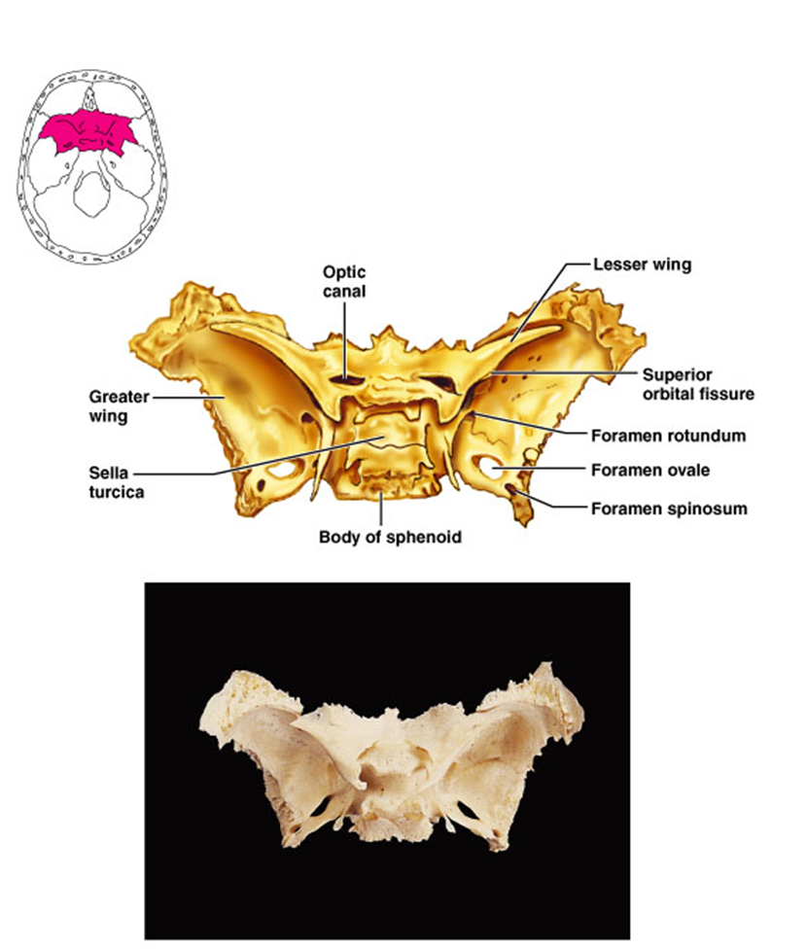

Slide 27
The ethmoid bone is spongelike in appearance and is located on the midline in the anterior part of the cranial floor medial to the orbits
It is anterior to the sphenoid and posterior to the nasal bones

Slide 28
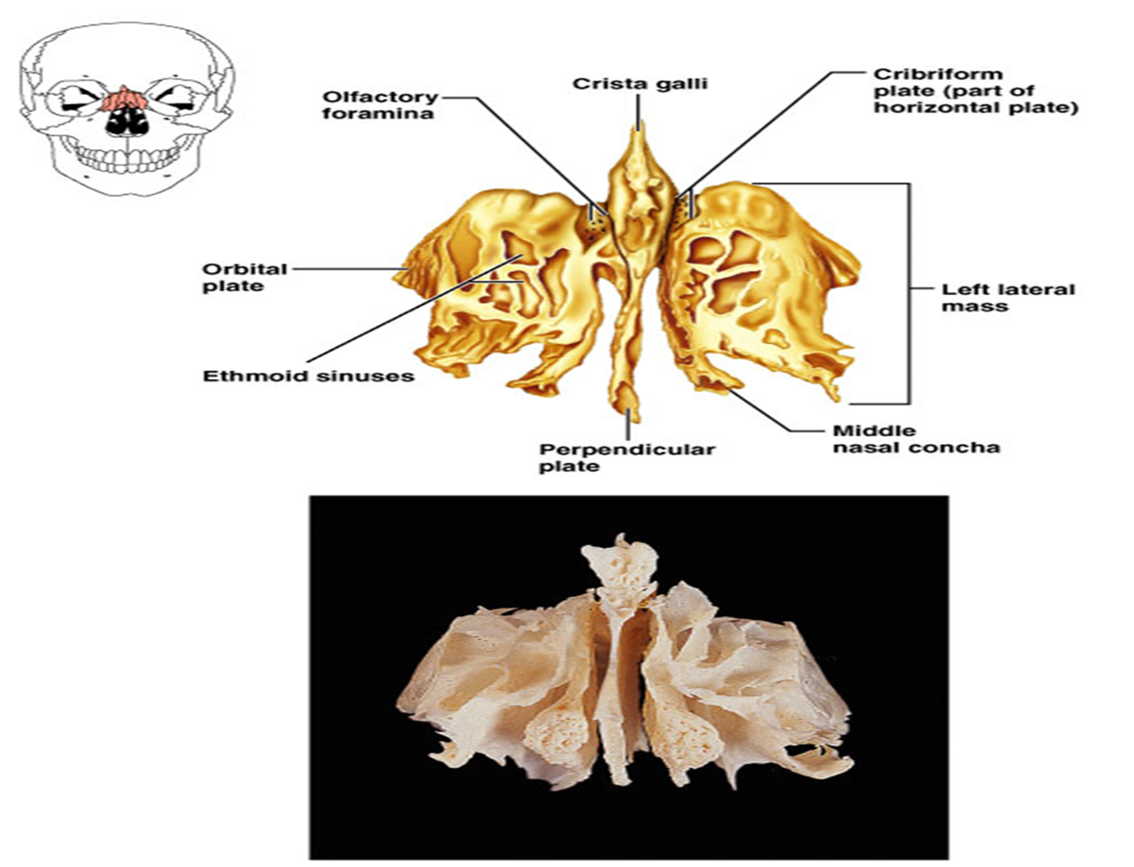

Slide 29
The ethmoid bone forms
  (1) part of the anterior portion of the cranial floor;
  (2) the medial wall of the orbits;
  (3) the superior portion of the nasal septum, a partition that divides the nasal cavity into right and left sides; and
  (4) most of the superior sidewalls of the nasal cavity.

Slide 30
The ethmoid bone is a major superior supporting structureof the nasal cavity.

Slide 32


