Slide 1
ANTICANCER DRUGS
By
MR KIMANI MORRIS
DNS(KIU), BSCN(MUST), MPH STUDENT(MUST)

Slide 2
These are drug used to destroy malignant cells with minimal damage to normal cells, but few drugs are so selective.
The majority of anticancer agents (with the exceptional of hormonal drugs) attack all rapidly dividing cells which accounts for their severe side effect.
Anti-cancers can be categorized into the following groups:
o Alkylating Agents
o Anti-metabolites
o Cytotoxic antibiotics
o Vinca Alkaloids
o Hormones

Slide 3
ALKYLATING AGENTS
Alkylating drugs kill cancer cells by directly attacking DNA, the genetic material of the genes.
By attacking the DNA, the drug prevents the cell from forming new cells.
Nitrogen mustards, which were the first nonhormonal chemicals with anticancer abilities, are alkylating drugs.
Cyclophosphamide and Mustargen are two alkylating agents.
Cyclophosphamide, the most common alkylating agent, is often used in combination with other drugs to treat breast cancer, lymphomas, and other tumors in both children and adults.
Mustargen is part of the treatment for Hodgkin's disease

Slide 4
ANTIMETABOLITES
These drugs interfere with the production of DNA and keep cells from growing and multiplying.
They are used to treat a variety of cancers including breast cancer, leukemia, lymphoma, colorectal cancer, head and neck cancer, osteogenic sarcoma, choriocarcinoma (a rare uterine cancer), and urothelial cancer.
Examples of antimetabolites are 5-fluorouracil (5-FU), Tegafur, and Uracil.

Slide 5
ANTITUMOR ANTIBIOTICS
These are made from natural substances such as fungi in the soil. They interfere with important cell functions, including production of DNA and cell proteins.
Examples of drugs in this group include, Doxorubicin, Daunorubicin, Idarubicin, Epirubicin, Dactinomycin, and Bleomycin

Slide 6
VINCA ALKALOIDS
A microtubule is an important part of a cell and is the target of this class of anticancer drugs.
Vinca alkaloids, which attack the cell's microtubules, are found in very small amounts in the periwinkle plant.
Three types of vinca alkaloids are vincristine, vinblastine and vinorelbine. Vincristine is used more frequently in treating childhood, rather than adult cancers.

Slide 7
CONT’D
It is used in combination chemotherapy for the treatment of acute lymphocytic leukemia and Hodgkin's and non-Hodgkin's lymphoma, as well as other cancers.
Vinblastine is used in combination chemotherapy for Kaposi's sarcoma, as well as cancers of the bladder, brain and breast.
It is also used in the treatment of advanced cases of lymphoma and germ cell cancers.
Vinorelbine is used mainly in non small cells lung cancer and in relapsed or resistant advanced lung cancer

Slide 8
HORMONES
Progestogens: They are alternative drugs used in breast cancer e.g Tamoxifen is used to treat breast cancers that depend on the hormone estrogen.
Gestronol is used in endometrial cancer and benign prostate hypertrophy.
Oestrogens: Inhibits the production of androgens, and on that account, they have been used in the treatment of prostatic cancer. Examples of drugs in this group include; Ethinyloestradol.

Slide 9
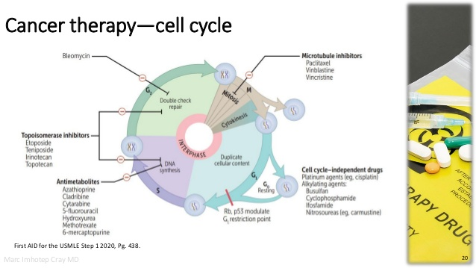

Slide 10
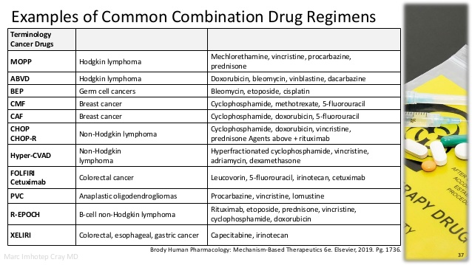

Slide 11
ASSIGNMENTS
Read and write short notes on drugs used together with Anticancer drugs.

