Slide 1
Anti diabetic drugs

Slide 2
Anti-diabetic drugs
Diabetes - Disease resulting from a breakdown in the body’s ability to produce or utilize insulin (Causes liver, muscle and fat cells to absorb glucose).
The hallmark of type 1 diabetes is selective beta cell (B cell) destruction and severe or absolute insulin deficiency.
For persons with type 1 diabetes, insulin replacement therapy is necessary to sustain life.
Types:
Type I: results from autoimmune destruction of insulin-producing beta cells of the pancreas.
Type II: results from insulin resistance

Slide 3
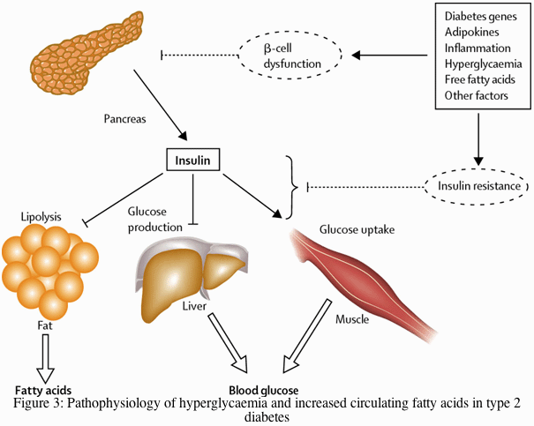

Slide 4
Insulin
Insulin is a hormone produced by beta cells in the pancreas.
It regulates the metabolism of carbohydrates and fats by promoting the absorption of glucose from the blood to skeletal muscles and fat tissue and by causing fat to be stored rather than used for energy.
Pharmacologic insulin is administered by injection into the subcutaneous tissue using a manual injection device or an insulin pump that continuously infuses insulin

Slide 5
Type 2 diabetes mellitus
Type 2 diabetes is characterized by tissue resistance to the action of insulin combined with a relative deficiency in insulin secretion.
A given individual may have more resistance or more beta-cell deficiency, and the abnormalities may be mild or severe.
Although insulin is produced by the beta cells in these patients, it is inadequate to overcome the resistance, and the blood glucose rises.
The impaired insulin action also affects fat metabolism, resulting in increased free fatty acid flux and triglyceride levels and reciprocally low levels of high-density lipoprotein (HDL).

Slide 6
Antidiabetic drugs
Anti-diabetics are also subdivided into the following groups:
Insulin
oral hypoglycemic agents

Slide 7
Insulin
Insulin: Lowers the blood glucose by facilitating the uptake and utilization of glucose by muscle and fat cells and by decreasing the release of glucose from the liver.

Slide 8
Types of insulins
There are four principal types of injected insulins :
(1) rapid acting, with very fast onset and short duration;
(2) short-acting, with rapid onset of action;
(3) intermediate-acting;
(4) long-acting, with slow onset of action
NB: Injected rapid acting and short-acting insulins are dispensed as clear solutions at neutral pH and contain small amounts of zinc to improve their stability and shelf life.
Injected intermediate-acting NPH insulins have been modified to provide prolonged action and are dispensed as a turbid suspension

Slide 9
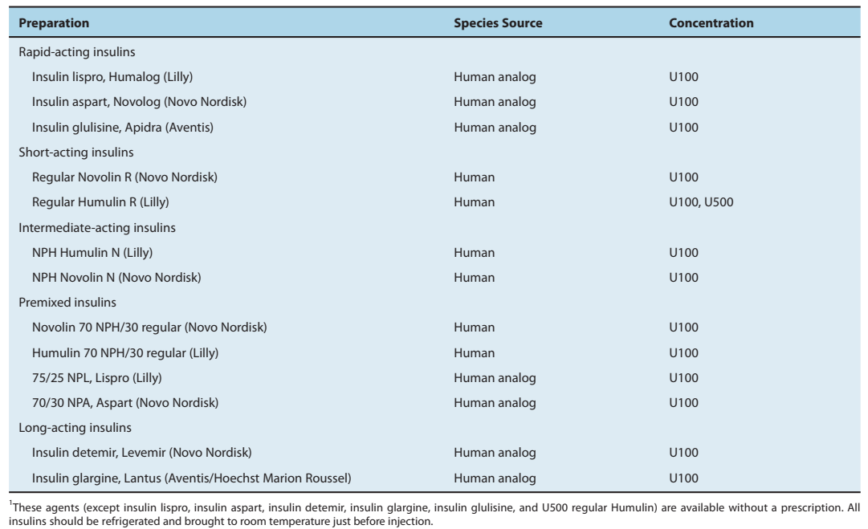
Types of insulins

Slide 10
Insulin
Sources: beef or pork pancreases or can be produced semi-synthetically
Types:
Rapid acting insulin e.g. insulin lispro, insulin aspart, and insulin glulisine
Onset: 10-30min; duration of action: 3-5hrs
Time: injected 10mins before a meal. Used with longer-acting insulin.
Short acting insulin e.g. actrapid (soluble insulin)
Onset: 30min-1hr; duration of action: 5-8hrs
Time: injected 30-60 minutes before meals

Slide 11
Types of insulin
Intermediate acting e.g. Isophane insulin also known as Humulin N, Novolin N
Onset: 1-2½hrs; duration of action: 18-24hrs
Time: injected 1hr before meals. It is often combined with rapid- or short-acting insulin.
Long acting e.g. Ultralente
Onset: 30mins-3hrs; duration: 20-36hrs
Action: Covers insulin needs for about one full day. This type of insulin is often combined, when needed, with rapid- or short-acting insulin.

Slide 12
Premixed insulins
Premixed: a combination of specific proportions of intermediate-acting and short-acting insulin in one bottle. E.g. Mixtard (dose -0.3 and 1.0 IU/kg/day)
Time: depending on combination given 30-45mins before meals
Administered twice in a day.

Slide 13
MIXTARD
2 formulations of Mixtard
Mixtard® 30 Containing 30% short-acting insulin and 70% intermediate acting
Mixtard® 50 Containing 50% short-acting insulin and 50% intermediate-acting insulin

Slide 14
Because intermediate-acting NPH insulins require several hours to reach adequate therapeutic levels, their use in diabetic patients usually requires supplements of rapid- or short-acting insulin before meals.
For convenience, these are often mixed together in the same syringe before injection.
Insulin lispro, aspart, and glulisine can be acutely mixed (ie, just before injection)

Slide 15
Insulin guidelines
General guidelines, 0.5–1 unit/kg/day. The number and size of daily doses, times of administration, and type of insulin preparation are determined after close medical scrutiny of the patient's blood and urine glucose, diet, exercise, and intercurrent infections and other stresses

Slide 16
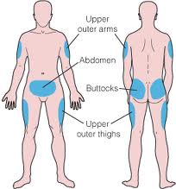
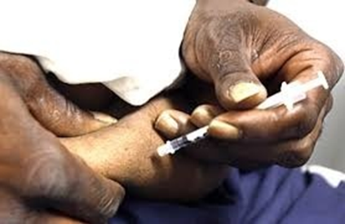
Sites of insulin injection

Slide 17
Uses
Diabetes
ketoacidosis
Diabetic ketoacidosis (DKA) is a life-threatening medical emergency caused by inadequate or absent insulin replacement, which occurs in people with type 1 diabetes

Slide 18
Side effects
Hypoglycemia
hepatotoxicity
allergic responses
Lipodystrophy-atrophy of subcutaneous fat at the sites of injection
Lipohypertrophy-enlargement of subcutaneous fat.
prevention by changing injection sites frequently.

Slide 19
Complications of insulin therapy
Hypoglycemia
Immune insulin resistance
Increased cancer risk

Slide 20
Contraindications
Sensitivity
hypoglycemia

Slide 21
Oral hypoglycemic drugs
Include:
Sulfonylureas e.g. glibenclamide
Biguanide e.g. Metformin
Thiazolidinediones e.g. pioglitazone (bladder cancer)
Alpha-glucosidase inhibitors e.g. acarbose (Precose)

Slide 22
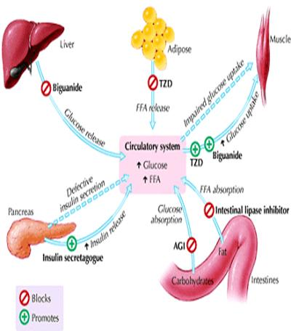

Slide 23
Oral hypoglycemic drugs
1. Sulfonylureas
Examples. Glibenclamide, Glyburide,Glipizide,Glimepride, chlorpropamide /Tolbutamide, Tolazamide,Rapaglinide, Neteglinide
MOA: stimulate insulin secretion from the pancreas
S.E: Hypoglycemia

Slide 24
Biguanides
Biguanide: e.g. Metformin (250mg)
MOA: increases insulin action i.e. by suppression of glucose output from the liver. They also reduce hepatic glucose production
Metformin causes lactic acidosis
Metformin (glucophage) is often used in patients with type 2 diabetes who are obese, because it promotes weight reduction.
Given in combination with a sulfonylurea lowers blood glucose concentrations more than either drug alone.
Absorption of vitamin B12 appears to be reduced during long-term metformin therapy, and annual screening of serum vitamin B12 levels and red blood cell parameters has been encouraged
Biguanides are contraindicated in patients with renal disease, alcoholism, hepatic disease
Advantages:
less likely to cause hypoglycemia.
It has prominent lipid-lowering activity
S.E: GIT-metallic taste in the mouth, mild anorexia, nausea, abdominal discomfort, and diarrhea.

Slide 25
Thiazolidinediones
Thiazolidinediones act to decrease insulin resistance
Two thiazolidinediones are currently available: pioglitazone and rosiglitazone
e.g. Actos (Pioglitazone) increase glucose up take of glucose in muscle. Inhibits the breakdown of fat to FFA. The risk of bladder cancer appears to be cumulatively increased with high doses.
An adverse effect common to both Tzds is fluid retention, which presents as a mild anemia and peripheral edema,
Both drugs increase the risk of heart failure
These agents should not be used during pregnancy or in the presence of significant liver disease

Slide 26
Alpha-glucosidase inhibitors
e.g. acarbose & Miglitol.
They inhibit the upper GIT enzymes that converts dietary starch and other complex carbohydrates into simple sugars which can be absorbed.
The result is to slow the absorption of glucose after meals.
Both acarbose and miglitol are taken in doses of 25–100 mg just before ingesting the first portion of each meal;

Slide 27
Nursing considerations
Monitor blood glucose i.E. FBS and RBS
Assess for hypoglycemia –lethargy, sweating
Rotate insulin injection sites .
And use human insulin with pork or beef sensitivity.

