Slide 1
CLINICAL PHARMACOLOGY CONTINUATION

Slide 2
ANTI-PROTOZOANS

Slide 3
TREATMENT OF MALARIA:
Antimalarial drugs;
4 – Methoxyquinolines;
Quinine: 10mg / kg b.w per dose 8 hourly I.V or oral); severe infection
Quinine + Clindamycin
Quinine + Tetracycline
Mefloquine + Artemisinin
Mefloquine; used alone for prophylaxis
4 – Aminoquinolines;
Chloroquine
Amodiaquine
8 – Aminoquinolines;
Primaquine – for eradication of exoerythrocytic forms of P. Vivax,
P. Ovale and gametocidal against P. Falciparum.
(ADR: causes massive haemolysis in G 6PD – def.)

Slide 4
Sulphonamides combination;
Sulfadoxine / Pyrimethamine e.g. Fansidar
Sulphamethoxypyridazine / pyrimethamine e.g.
Metakelfin
Artemisinin derivatives – from Artemisia annua;
Artemether e.g. Paluther
Artesunate; a semi-synthetic artemisinin e.g. arsumax
Dihydroartemisinin; the active metabolite of artemisinin
e.g. cotecxin
Artemether + lumefantrin = Coartem*
Artesunate + Mefloquine = Arteqiun
Artesunate + Amodiaquine = Larimal
Artesunate + Sulphamethoxypyridazine + Pyrimethamine = Co-Arinate
Dihydroartemisinin + Piperaquine = Duo-cotecxin
Artemisinin 62.5mg + Piperaquine 375mg = Artequick

Slide 5
Biguanides & other combinations;
Proguanil 100mg + Atovaquone 250mg = malarone
Proguanil alone used only in prophylaxis
9 – Phenanthrenemethanols;
Halofantrine ( Halfan)
lumefantrine; used only in combinations

Slide 6
Antimalarial drugs include;
Quinine and related agents
Chloroquine
Amodiaquine
Pyrimethamine
Sulphadoxine
Proguanil
Mefloquine
Atovaquone
Primaquine
Artemisinin and derivatives
Halofantrine
Doxycycline
Clindamycin

Slide 7
QUININE AND RELATED AGENTS
Quinine has a long history stretching from Peru, and the discovery of the cinchona tree, and the potential uses of its bark, to the current day and a collection of derivatives that are still frequently used in the prevention and treatment of malaria.
Quinine is a 4 – Methoxyquinoline, an alkaloid that acts as a blood schizonticidal and weak gametocide against Plasmodium vivax and Plasmodium malariae.
It is especially useful in areas where there is known to be a high level of resistance to chloroquine, mefloquine, and sulfa drug combinations with pyrimethamine.
Quinine is also used in post-exposure treatment of individuals returning from an area where malaria is endemic.

Slide 8
Quinimax and quinidine are the two most commonly used alkaloids related
to quinine in the treatment or prevention of malaria.
Quinimax is a combination of four alkaloids (quinine, quinidine, cinchoine
and cinchonidine). This combination has been shown in several studies to
be more effective than quinine, supposedly due to a synergistic action
between the four cinchona derivatives.
Quinidine is a direct derivative of quinine. It is a distereoisomer, thus having
similar anti-malarial properties to the parent compound. Quinidine is
recommended only for the treatment of severe cases of malaria.

Slide 9
Mechanism of action;
As an alkaloid, it is accumulated in the food vacuoles of Plasmodium species,
especially Plasmodium falciparum.
It acts by inhibiting the hemozoin biocrystallization, thus facilitating an
aggregation of cytotoxic heme.
Quinine is more toxic as a blood schizonticidal agent than chloroquine.

Slide 10
Pharmacokinetics
Doses can be given by oral, intravenous or intramuscular routes.
The oral bioavailability of quinine is 76 to 88% in healthy adults.
Quinine tablets may be administered without regard to meals.
Generally 10mg/kg b.w per dose every 8-hours is routinely given
(both I.V & oral)
Quinine is moderately protein-bound in blood of healthy subjects, ranging from 69
to 92%.
Quinine is metabolized almost exclusively via hepatic oxidative cytochrome
P450 (CYP) pathways.
Quinine is eliminated primarily via hepatic biotransformation.
Approximately 20% of quinine is excreted unchanged in urine. Because quinine is
reabsorbed when the urine is alkaline, renal excretion of the drug is twice as rapid
when the urine is acidic than when it is alkaline.

Slide 11
Adverse effects
Quinine can adversely affect almost every body system.
The most common adverse events associated with quinine use are a cluster of
symptoms called “cinchonism”, which occurs to some degree in almost all
patients taking quinine.
Symptoms of mild cinchonism include headache, vasodilation and sweating,
nausea, tinnitus, hearing impairment, vertigo or dizziness, blurred vision, and
disturbance in color perception.
More severe symptoms of cinchonism are vomiting, diarrhea, abdominal pain,
deafness, blindness, and disturbances in cardiac rhythm or conduction.
Most symptoms of cinchonism are reversible and resolve with discontinuation
of quinine.

Slide 12
Hematologic: hypoprothrombinemia, hemolytic uremic syndrome (HUS),
thrombotic thrombocytopenic purpura, blackwater fever, aplastic anemia,
and lupus anticoagulant.
Neuropsychiatric: headache, diplopia, confusion, altered mental status,
seizures, coma,
Dermatologic: cutaneous rashes,
Respiratory: asthma, dyspnea, pulmonary edema.
Cardiovascular: atrioventricular block, irregular rhythm, QT prolongation
Gastrointestinal: nausea, vomiting, diarrhea, abdominal pain, gastric
irritation

Slide 13
Hepatobiliary: granulomatous hepatitis, hepatitis, jaundice, and abnormal
liver function tests.
Metabolic: Quinine can cause hypoglycaemia through its action of
stimulating insulin secretion
Musculoskeletal: myalgias and muscle weakness.
Renal: hemoglobinuria, renal failure, renal impairment, and acute interstitial
nephritis.

Slide 14
CHLOROQUINE
Mechanism of action
Chloroquine is a 4-aminoquinoline compound with a complicated and still unclear mechanism of action.
Chloroquine is used in malaria treatment and prophylaxis where resistance is not encountered.
It is believed to reach high concentrations in the vacuoles of the parasite, which, due to its alkaline nature, raises the internal pH.
It controls the conversion of toxic heme to hemozoin by inhibiting the biocrystallization of hemozoin, thus poisoning the parasite through excess levels of toxicity.

Slide 15
Other potential mechanisms through which it may act include interfering with the
biosynthesis of parasitic nucleic acids and the formation of a chloroquine-haem
or chloroquine-DNA complex.
The most significant level of activity found is against all forms of the schizonts
(with the obvious exception of chloroquine-resistant P. falciparum and P. vivax
strains)
Chloroquine also has a significant anti-pyretic and anti-inflammatory effect when
used to treat P. vivax infections.

Slide 16
Pharmacokinetics
Recommendation by the WHO, involves giving an initial dose of 10 mg/kg
followed 6–8 hours later by 5 mg/kg, then 5 mg/kg on the following 2 days.
For chemoprophylaxis: 5 mg/kg/week (single dose) or 10 mg/kg/week divided
into 6 daily doses is advised. Chloroquine is only recommended as a prophylactic
Drug in regions only affected by P. vivax and sensitive P. falciparum strains.
It is considered very safe to use during pregnancy.

Slide 17
Adverse effects
gastrointestinal disturbances
skin eruptions
headache with visual disturbances
hearing disorders / tinnitus
blood dyscrasias
skin photosensitivity
myopathy
Neuropathy
Hypotension
ECG changes

Slide 18
AMODIAQUINE
Amodiaquine is a 4-aminoquinoline anti-malarial drug similar in structure and
mechanism of action to Chloroquine.
It is thought to be more effective in clearing parasites in uncomplicated malaria
than Chloroquine, thus leading to a faster rate of recovery.
The drug should be given orally in doses between 25 mg/kg and 35 mg/kg
over 3 days in a similar method to that used in Chloroquine administration.

Slide 19
Adverse effects
Adverse reactions are generally similar in severity and type to that seen in
Chloroquine treatment.
However, some fatal adverse effects of the drug were noted during the 1980s,
thus reducing its usage in chemoprophylaxis. The WHO's most recent advice on
the subject still maintains that the drug should be used when the potential risk of
not treating an infection outweighs the risk of developing side effects.
In addition, bradycardia, itching, nausea, vomiting, abdominal pain, blood and
hepatic disorders have been recorded.

Slide 20
PYRIMETHAMINE
Indications
Treatment of Acute Malaria:
It should not be used alone to treat acute malaria.
Conjoint use of pyrimethamine with a sulfonamide (e.g. with sulfadoxine & sulphamethoxypyridazine to give fansidar & metakelfin respectively)
Chemoprophylaxis of Malaria:
Indicated for the chemoprophylaxis of malaria due to susceptible strains of plasmodia.
Resistance to pyrimethamine is however prevalent worldwide. It is not suitable as a prophylactic agent for travelers to most areas.
Treatment of Toxoplasmosis:
Used conjointly with a sulfonamide, since synergism exists with this combination.

Slide 21
Mechanism of Action
Pyrimethamine acts by inhibiting dihydrofolate reductase in the parasite thus
preventing the biosynthesis of purines and pyrimidines. It therefore halts the
processes of DNA synthesis, cell division and reproduction. This activity is
primarily directed on the schizonts during the hepatic and erythrocytic phases.
It does not destroy gametocytes and is highly selective against plasmodia. It is
also active against Toxoplasma gondii.
Pyrimethamine possesses blood schizonticidal and some tissue schizonticidal
activity against malaria parasites of humans. However, the 4-amino-quinoline
compounds are more effective against the erythrocytic schizonts.

Slide 22
Pharmacokinetics
Pyrimethamine (Daraprim) is an antiparasitic compound available in tablet form
(25mg) for oral administration.
Pyrimethamine is well absorbed with peak levels occurring between 2 to 6 hours
following administration.
Pyrimethamine is 87% bound to human plasma proteins.
It is eliminated slowly and has a plasma half-life of approximately 96 hours.

Slide 23
Dose and Administration
Treatment of malaria
Dosage of 25 mg daily for 2 days with a sulfonamide will initiate transmission control and suppression of non-falciparum malaria.
25mg pyrimethamine + 500mg sulphadoxine = Fansidar
25mg pyrimethamine + 500mg sulphamethoxypyridazine = Metakelfin
For Chemoprophylaxis of Malaria:
Adults and pediatric patients over 10 years — 25 mg (1 tablet) once weekly
Children 4 through 10 years — 12.5 mg (1/2 tablet) once weekly
Infants and children under 4 years — 6.25 mg (1/4 tablet) once weekly.

Slide 24
Treatment of Toxoplasmosis:
The adult starting dose is 50 to 75 mg of the drug daily, together with 1 to 4 g daily of a sulfonamide of the sulfapyrimidine type, e.g., sulfadoxine for 1 to 3 weeks, depending on the response of the patient and tolerance to therapy.
Concurrent administration of folinic acid is strongly recommended in all patients (folinic acid dose 10mg OD)

Slide 25
Adverse effects;
Mainly hypersensitivity reactions including;
Stevens-Johnson syndrome
Toxic epidermal necrolysis (TEN)
Erythema multiforme
Anaphylaxis
Hyperphenylalaninemia, can occur particularly when pyrimethamine is
administered concomitantly with a sulfonamide.

Slide 26
Artemesinin and derivatives
Artemisinin is an antimalarial agent extracted from the dry leaves of the Chinese
herb Artemisia annua (qinghaosu or sweet wormwood).
Artemisinin has a very rapid action and the vast majority of acute patients
treated show significant improvement within 1–3 days of receiving treatment.
It has demonstrated the fastest clearance of all anti-malarials currently used and
acts primarily on the trophozite phase, thus preventing progression of the
disease.
Semi-synthetic artemisinin derivatives (e.g. artesunate, artemether) are easier to
use than the parent compound and are converted rapidly once in the body to the
active compound dihydroartemesinin.

Slide 27
Pharmacokinetics
It is only used in combination therapy to prevent the development of resistance
for severe acute cases of drug-resistant P. falciparum.
On the first day of treatment 20 mg/kg should be given, this dose is then reduced
to 10 mg/kg per day for the 6 following days.

Slide 28
Adverse effects
Few side effects are associated with artemesinin use.
Common adverse effects include;
Headaches
Nausea / vomiting
Abnormal bleeding
Dark urine
Itching
Drug fever

Slide 29
Artemisinin Derivatives
Artemether;
Artemether is a methyl ether derivative of Dihydroartemesinin.
It is similar to Artemesinin in mode of action but demonstrates a reduced ability as a hypnozoiticidal compound, instead acting more significantly to decrease gametocyte carriage.
Similar restrictions are in place, as with Artemesinin, to prevent the development of resistance, therefore it is only used in combination therapy for severe acute cases of drug-resistant P. falciparum.
It should be administered in a 7 day course with 4 mg/kg given per day for 3 days, followed by 1.6 mg/kg for 3 days. Side effects of the drug are few but include potential neurotoxicity developing if high doses are given.

Slide 30
Artesunate;
Artesunate is a hemisuccinate derivative of the active metabolite Dihydroartemisin.
Currently it is the most frequently used of all the Artemesinin-type drugs.
Its only effect is mediated through a reduction in the gametocyte transmission.
It is used in combination therapy and is effective in cases of uncomplicated P. falciparum.
The dosage recommended by the WHO is a 5 or 7 day course (depending on the predicted adherence level) of 4 mg/kg for 3 days (usually given in combination with Mefloquine) followed by 2 mg/kg for the remaining 2 or 4 days. In large studies carried out on over 10,000 patients in Thailand no adverse effects have been shown.

Slide 31
Dihydroartemisinin;
Dihydroartemisinin is the active metabolite to which Artemesinin is reduced.
It is the most effective Artemesinin compound and the least stable.
It has a strong blood schizonticidal action and reduces gametocyte transmission.
It is used for therapeutic treatment of cases of resistant and uncomplicated P. falciparum. 4 mg/kg doses are recommended on the first day of therapy followed by 2 mg/kg for 6 days.
As with Artesunate, no side effects to treatment have thus far been recorded.

Slide 32
Arteether;
Arteether is an ethyl ether derivative of Dihydroartemesinin.
It is used in combination therapy for cases of uncomplicated resistant
P. falciparum.
The recommended dosage is 150 mg/kg per day for 3 days given by IM injections.
With the exception of a small number of cases demonstrating neurotoxicity following parenteral administration no side effects have been recorded.

Slide 33
Mefloquine
Mefloquine was developed during the Vietnam War and is chemically related to
quinine. It was developed to protect American troops against multi-drug
resistant P. falciparum.
It is a very potent blood schizonticide with a long half-life and thought to act by
forming toxic heme complexes that damage parasitic food vacuoles.

Slide 34
Indication & Dosing
Mefloquine is effective in prophylaxis and for acute therapy. It is now strictly
used for resistant strains (and is usually combined with Artesunate).
A dose of 15–25 mg/kg is recommended, depending on the prevalence of
Mefloquine resistance.
The effects during pregnancy are unknown. It is not recommended for use
during the first trimester, although considered safe during the second and
third trimesters.
Mefloquine can only be taken for a period up to 6 months (due to side effects)
following which other drugs again need to be taken.

Slide 35
Adverse effects
Mefloquine frequently produces side effects, including;
GIT effects;
nausea & vomiting
Diarrhea / abdominal pain
CNS effects;
affective and anxiety disorders
Hallucinations / dizziness
sleep disturbances
Psychosis
toxic encephalopathy
convulsions and delirium
Cardiovascular effects;
bradycardia and sinus arrhythmia

Slide 36
Drug Interaction;
Concomitant administration of Mefloquine (Lariam) and other related compounds
(e.g., quinine, quinidine and chloroquine) may produce electrocardiographic
abnormalities and increase the risk of convulsions.
If these drugs are to be used in the initial treatment of severe malaria, Lariam
administration should be delayed at least 12 hours after the last dose.
There is evidence that the use of halofantrine after mefloquine causes a
significant lengthening of the QTc interval.

Slide 37
Primaquine
Primaquine is a highly active 8-aminoquinoline that is used in treating all types
of malaria infection.
It is most effective against gametocytes but also acts on hypnozoites, blood
schizonticytes and the dormant plasmodia in P. vivax and P. ovale.
It is the only known drug to cure both relapsing malaria infections and acute
cases.
Mechanism of Action;
The mechanism of action is not fully understood but it is thought to mediate
some effect through creating oxygen free radicals that interfere with the
plasmodial electron transport chain during respiration.

Slide 38
Adverse effects
There are few significant side effects including;
Dizziness & syncope
Abdominal cramps
Chest tightness
Haemolysis in G6PD-deficiency
Anaemia
Suppression of myeloid activity
Erythema multiforme & Steven Johnson syndrome

Slide 39
Halofantrine
Halofantrine is a relatively new drug developed by the Walter Reed Army
Institute of Research in the 1960s. It is a phenanthrene methanol.
It is chemically related to Quinine and acts as a blood schizonticide
effective against all plasmodium parasites.

Slide 40
Mechanism of Action
The mechanism of action is similar to other anti-malarials i.e. Cytotoxic
complexes are formed with ferritoporphyrin XI that cause plasmodial
membrane damage.
A dose of 8 mg/kg of Halofantrine is advised to be given in three doses at six
hour intervals for the duration of the clinical episode.
It has very variable bioavailability and has been shown to have potentially
high levels of cardiotoxicity.
It is not recommended for children under 10 kg despite data supporting the use
and demonstrating that it is well tolerated.

Slide 41
Adverse effects
The most frequently experienced side-effects include;
Nausea
Abdominal pain & diarrhoea
Pruritus
Severe ventricular dysrhythmias due to prolongation of the QTc interval.
Halofantrine is not recommended for use in pregnancy and lactation, in small
children, or in patients who have taken Mefloquine previously.

Slide 42
Proguanil
Proguanil (Chloroguanadine) is a biguanide; a synthetic derivative of
pyrimidine.
It was developed in 1945 by a British Antimalarial research group.
It has no known effect against hypnozoites therefore is not used in the
prevention of relapse.
It has a weak blood schizonticidal activity and is not recommended for
therapy of acute infection.
However it is useful in prophylaxis when combined with Atovaquone i.e.
Malarone.
The Proguanil- Chloroquine combination does not provide effective protection
against resistant strains of P. falciparum.

Slide 43
Mechanism of Action & Pharmacokinetics / Adverse effects;
Proguanil has many mechanisms of action but primarily is mediated through
conversion to the active metabolite cycloguanil pamoate. This inhibits the malarial
dihydrofolate reductase enzyme.
3 mg/kg is the advised dosage per day, (hence approximate adult dosage is
200 mg).
The pharmacokinetic profile of the drugs indicates that a half dose, twice daily
maintains the plasma levels with a greater level of consistency, thus giving a
greater level of protection.
There are very few side effects to Proguanil, with slight hair loss and mouth
ulcers being occasionally reported following prophylactic use.

Slide 44
Doxycycline
Probably one of the more prevalent antimalarial drugs prescribed, due to its
relative effectiveness and cheapness, doxycycline is a tetracycline compound
derived from oxytetracycline.
Doxycycline is used primarily for chemoprophylaxis in areas where chloroquine
resistance exists.
It can also be used in combination with quinine to treat resistant cases of
P. falciparum but has a very slow action in acute malaria, and should not be
used as monotherapy.

Slide 45
Mechanism of Action;
Doxycycline is a bacteriostatic agent that acts to inhibit the process of protein
synthesis by binding to the 30S ribosomal subunit thus preventing the 50s and
30s units from bonding.
Indication & Dosing;
When treating acute cases and given in combination with quinine; 100 mg of
doxycycline should be given per day for 7 days.
In prophylactic therapy, 100 mg (adult dose) of doxycycline should be given every
day; 1-week before exposure, during exposure and 1-week after exposure to
malaria.

Slide 46
Adverse effects
The most commonly experienced side effects are;
permanent enamel hypoplasia
transient depression of bone growth
gastrointestinal disturbances
photosensitivity.
Due to its effect of bone and tooth growth it is not used in children under 8,
pregnant or lactating women and those with a known hepatic dysfunction.

Slide 47
Clindamycin
Clindamycin is a derivative of Lincomycin, with a slow action against blood
schizonticides.
It is only used in combination with Quinine in the treatment of acute cases of
resistant P. falciparum infections and not as a prophylactic.
Being more expensive and toxic than the other antibiotic alternatives, it is used
only in cases where the Tetracyclines are contraindicated (for example in
children).
Clindamycin should be given in conjunction with Quinine as a 300 mg dose (in
adults) four times a day for 5 days.

Slide 48
Adverse Effects
The side effects recorded in patients taking Clindamycin are;
nausea
vomiting
abdominal pains and cramps.
Pseudomembranous colitis (caused by Clostridium difficile)
These adverse effects can however be alleviated by consuming large quantities
of water and food when taking the drug.
Pseudomembranous colitis also develops in some patients; this condition may be
fatal in a small number of cases.

Slide 49
Atovaquone
Atovaquone is only available in combination with Proguanil under the name
Malarone.
It is most commonly used as prophylaxis by travelers; also used for treatment of acute attack of malaria.

Slide 50
Chemoprophylaxis drugs:
Proguanil (paludrine) 200mg daily for 1 – 2 days before exposure, then daily
during exposure and 4 weeks after exposure.
Mefloquine ( larium): 250mg once weekly ¹/₅₂ before exposure , during
exposure and ⁴/₅₂ post exposure.
Chloroquine (In sensitive areas): 300mg once weekly for ¹/₅₂ before exposure,
during exposure and ⁴/₅₂ after exposure
Doxycline 100mg daily for ¹/₅₂ before exposure, during exposure and 4 weeks
after exposure.
Malarone (proguanil + atovaquone); 1-tab OD 1-2 days before exposure,
during exposure and 4-weeks after exposure.

Slide 51
Drugs used for the Prevention of Malaria in Travellers
Drug | Use | Adult Dosage
Chloroquine | Areas without resistant P falciparum | 500 mg weekly
Malarone | Areas with multidrug-resistant P falciparum | 1 tablet (250 mg atovaquone/100 mg proguanil) daily
Mefloquine | Areas with chloroquine-resistant P falciparum | 250 mg weekly
Doxycycline | Areas with multidrug-resistant P falciparum | 100 mg daily
Primaquine | Terminal prophylaxis of P vivax and P ovale infections | 26.3 mg (15 mg base) daily for 14 days after travel

Slide 52
Antiprotozoal drugs

Slide 53
AMPHOTERICIN
Liposomal amphotericin B (AMBISOME) cures nearly 100% of cases of visceral leishmaniasis and has become the drug of choice for antimonial-resistant disease.
Likely due to pharmacokinetic considerations, it is not useful against cutaneous or mucosal leishmaniasis.
The recommended dose for the treatment of visceral leishmaniasis is 3 mg/kg/day intravenously for days 1–5, 14, and 21, with the dose being increased to 4 mg/kg and extended to days 1–5, 10, 17, 24, 31, and 38 for immunosuppressed patients.
Shorter courses of the drug provide a lower-cost alternative.
Cure rates are ~90% with either regimen.

Slide 54
CHLOROQUINE
Chloroquine is directly toxic to E. histolytica trophozoites and is highly concentrated within the liver, making it effective for amebic liver abscess.
It is used only when metronidazole or another nitroimidazole is either contraindicated or unavailable.
Chloroquine is not effective against intestinal amebiasis because it only attains low concentrations in the colon; patients receiving chloroquine for amebic liver abscess also should receive paromomycin or iodoquinol to eliminate intestinal colonization.
The conventional course of treatment with chloroquine for extraintestinal amebiasis in adults is 1 g/day for 2 days, followed by 500 mg/day for at least 2–3 weeks.
Because of its low toxicity, this dose can be increased or the schedule can be repeated if necessary.

Slide 55
METRONIDAZOLE
Antiparasitic and antimicrobial effects of metronidazole and other related
Nitroimidazoles;
These are active in vitro against a wide variety of anaerobic protozoal parasites and anaerobic bacteria.
The drug also has potent amebicidal activity against E. histolytica.
Metronidazole has antibacterial activity against all anaerobic cocci and both anaerobic gram negative bacilli, including Bacteroides spp., and anaerobic spore-forming gram-positive bacilli.
Metronidazole is clinically effective in trichomoniasis, amebiasis, and giardiasis, and in a variety of infections caused by obligate anaerobic bacteria, including Bacteroides, Clostridium, and microaerophilic bacteria such as Helicobacter and Campylobacter spp.

Slide 56
Mechanism of action metronidazole;
Metronidazole is a prodrug that is activated by reduction of the nitro group by susceptible organisms.
Unlike their aerobic counterparts, anaerobic and microaerophilic pathogens such as T. vaginalis, E. histolytica, and G. lamblia and anaerobic bacteria contain electron transport components that have a sufficiently negative redox potential to donate electrons to metronidazole.
Electron transfer forms a highly reactive nitro radical anion that kills susceptible organisms by radical-mediated mechanisms that target DNA. Metronidazole is catalytically recycled; loss of the active metabolite’s electron regenerates the parent compound.

Slide 57
Increasing levels of O₂ inhibit metronidazole-induced cytotoxicity because O₂ competes with metronidazole for electrons generated by energy metabolism. Thus, O₂ can both decrease reductive activation of metronidazole and increase recycling of activated drug.
In susceptible organisms, pyruvate decarboxylation, catalyzed by pyruvate:ferredoxin oxidoreductase (PFOR), produces electrons that reduce ferredoxin, which then catalytically donates electrons to biological electron acceptors or to metronidazole.

Slide 58
Absorption, fate, and excretion
Metronidazole is supplied for oral, intravenous, intravaginal, and topical administration. It usually is absorbed completely after oral intake.
The t_{1/2} of metronidazole in plasma is ~8 hours, and its volume of distribution is approximately that of total-body water.
Less than 20% of the drug is bound to plasma proteins.
With the exception of the placenta, metronidazole penetrates well into body tissues and fluids, including vaginal secretions, seminal fluid, saliva, and breast milk. Therapeutic concentrations also are achieved in CSF.
The liver accounts for >50% of the systemic clearance of metronidazole.
After an oral dose, >75% of metronidazole is eliminated in the urine largely as metabolites; only ~10% is recovered as unchanged drug.

Slide 59
The urine of some patients may be reddish brown due to pigments derived from the drug.
Oxidative metabolism of metronidazole is induced by phenobarbital, prednisone, rifampin, and possibly ethanol and is inhibited by cimetidine.

Slide 60
Therapeutic uses metronidazole
T. Vaginalis; The preferred regimen is 2 g metronidazole as a single oral dose.
Amebiasis; metronidazole is the agent of choice for all symptomatic forms including colitis and liver abscess. The recommended dose is 500–750 mg metronidazole taken orally three times daily for 7–10 days. The daily dose for children is 35–50 mg/kg, given in three divided doses, for 7–10 days.
Giardiasis; usual regimen is 250 mg given three times daily for 5 days for adults and 15 mg/kg given three times a day for 5 days for children. A daily dose of 2 g for 3 days also has been used successfully.
Anaerobic bacteria; metronidazole is used for the treatment of serious infections owing to, including Bacteroides, Clostridium, Fusobacterium, Peptococcus, Peptostreptococcus, Eubacterium, and Helicobacter.
Pseudomembranous colitis due to Clostridium difficile infection.

Slide 61
Toxicity, contraindications, and drug interactions side effects
These are rarely are severe enough to discontinue therapy.
The most common are headache, nausea, dry mouth, metallic taste, vomiting, diarrhea, and abdominal distress.
Neurotoxic side effects e.g., numbness or paresthesias, dizziness, vertigo, and very rarely, encephalopathy, convulsions, incoordination, and ataxia mandate metronidazole discontinuation..
Urticaria, flushing, and pruritus are indications of drug sensitivity.
Metronidazole rarely causes toxic epidermal necrolysis.
Metronidazole has a disulfiramlike effect, and some patients will experience abdominal distress, vomiting, flushing, or headache if they drink alcoholic beverages during or within 3 days of therapy.
Metronidazole and disulfiram or any disulfiram-like drug should not be taken together because confusional and psychotic states may occur.

Slide 62
There are conflicting data about the teratogenicity of metronidazole in animals.
While metronidazole has been taken during all stages of pregnancy with no apparent adverse effects, its use during the first trimester generally is not advised.

Slide 63
MELARSOPROL
Melarsoprol (Mel B) is supplied as a 3.6% (w/v) solution in propylene
glycol for intravenous administration.
Antiprotozoal effects
Melarsoprol is a prodrug that is metabolized rapidly (t1/2 of 30 minutes) to melarsen oxide, the active form. Arsenoxides react avidly and reversibly with sulfhydryl groups and thereby inactivate many enzymes.
Melarsoprol reacts with trypanothione to form melarsen oxide–trypanothione which inhibits trypanothione reductase.
Both the sequestering of trypanothione and the inhibition of trypanothione reductase are thought to have lethal consequences to the cell.

Slide 64
Absorption, fate, and excretion
Melarsoprol is always administered intravenously with care to avoid tissuing
. A small but therapeutically significant amount of the drug enters the CSF and has a lethal effect on CNS trypanosomes.
A typical course of treatment is three 3- to 4-day courses of 2–3.6 mg/kg with 7-day intervals between courses.
Lesser doses should be given to children and debilitated patients. A continuous 10-day course of 2.2 mg/kg/day also is effective and will likely become standard unless contraindicated.
Glucocorticoids should be given to decrease the incidence of reactive encephalopathy.
The compound is excreted rapidly, with 70–80% of the arsenic appearing in the feces.

Slide 65
Therapeutic uses
Melarsoprol is the only effective drug available for treatment of the late meningoencephalitic stage of East African (Rhodesian) trypanosomiasis.
Melarsoprol treatment of East African trypanosomiasis is initiated soon after diagnosis because CNS involvement occurs early in this aggressive infection.
Melarsoprol is not used for prophylaxis because of its toxicity and rapid elimination.
The pattern of resistance to melarsoprol differs between the two subspecies of T. Brucei;
Patients infected with T. brucei rhodesiense who relapse after a course of melarsoprol usually respond to a second course of the drug.
In contrast, patients infected with T. brucei gambiense who are not cured with melarsoprol rarely benefit from repeated treatment with this drug but often respond to eflornithine.

Slide 66
Toxicity and side effects
Toxicity is common during treatment with melarsoprol.
A febrile reaction often occurs soon after drug injection, especially if parasitemia is high.
Reactive encephalopathy occurs in ~5–10% of patients, leading to fatality in perhaps half of these.
It is more likely to develop in patients whose CSF contains many cells and trypanosomes.
Manifestations include convulsions associated with acute cerebral edema, rapidly progressive coma, and acute mental disturbances; this likely represents a reaction to trypanosomal antigens.
Co-administration of glucocorticoids reduces the frequency of reactive encephalopathy and also can help to control hypersensitivity reactions during the second or subsequent courses of therapy.

Slide 67
Peripheral neuropathy, noted in ~10% of patients, probably is a direct toxic effect of the drug.
Hypertension and myocardial damage are not uncommon.
Proteinuria occurs frequently, and evidence of renal or hepatic dysfunction may necessitate treatment modification.
Vomiting and abdominal colic are reduced by injecting melarsoprol slowly into the supine, fasting patient.

Slide 68
EFLORNITHINE
Eflornithine is an irreversible suicide inhibitor of ornithine decarboxylase, which catalyzes the rate-limiting step in the biosynthesis of polyamines. Polyamines are required for cell division and normal cell differentiation.
In trypanosomes, spermidine also is required for the synthesis of trypanothione, a conjugate of spermidine and glutathione that replaces many functions of glutathione in the parasite.
Eflornithine is used to treat trypanosomiasis caused by T. brucei gambiense, the Gambian trypanosomiasis.
The drug usually is curative even for late CNS stages of infection resistant to arsenicals but is largely ineffective for East African trypanosomiasis.
Its high cost, production shortages, and difficult treatment regimen have limited use. Eflornithine is no longer available for systemic use in the U.S. but is available for treatment of by special request.

Slide 69
Anti-trypanosomal effects
Eflornithine inhibits ornithine decarboxylase; it irreversibly inhibits both mammalian and trypanosomal enzymes, thereby preventing the synthesis of polyamines needed for cell division.
The parasite and human enzymes are equally susceptible to eflornithine, but the mammalian enzyme is turned over rapidly, whereas the parasite enzyme is stable.
T. brucei rhodesiense cells are less sensitive to eflornithine inhibition than T. brucei gambiense cells, and effective levels generally cannot be achieved clinically.

Slide 70
Absorption, fate, and excretion
Eflornithine is given intravenously. Peak plasma levels are achieved ~4 hours after an oral dose, and the elimination t1/2 averages 200 minutes.
The drug does not bind to plasma proteins.
It is well distributed and readily penetrates into the cerebrospinal fluid (CSF), which is especially important in late-stage West African trypanosomiasis.
Over 80% of eflornithine is cleared by the kidney, largely in unchanged form.

Slide 71
Therapeutic uses
Dose for adult patients is 100 mg/kg given intravenously every 6 hours for 14 days as a 2-hour infusion.
Response rates exceed 90% even in late-stage patients.
Eflornithine and melarsoprol may act synergistically.
Eflornithine failed to improve treatment of East African trypanosomiasis owing to T. Brucei rhodesiense, consistent with the relatively short t1/2 and high activity of ornithine decarboxylase in these parasites.

Slide 72
Toxicity and side effects
Eflornithine causes adverse effects that are generally reversible on drug withdrawal.
Anemia (48%), diarrhea (39%), and leukopenia (27%) are the most common complications in patients receiving intravenous drug.
Convulsions
Other complications—such as thrombocytopenia, alopecia, vomiting, abdominal pain, dizziness, fever, anorexia, and headache occur in <10% of treated patients.
Reversible hearing loss can occur after prolonged therapy.
Therapeutic doses of eflornithine require co-administration of substantial volumes of intravenous fluid, which poses practical limitations in remote settings and causes fluid overload in susceptible patients.

Slide 73
FUMAGILLIN
Fumagillin (FUMIDIL B, others) is an acyclic polyene macrolide.
Fumagillin is toxic to microsporidia and also has some activity against E. histolytica.
Fumagillin is used topically to treat keratoconjunctivitis caused by E. hellem at a dose of 3–10 mg/mL in suspension.
For intestinal microsporidiosis fumagillin is used at a dose of 20 mg orally three times daily for 2 weeks.
Adverse effects of fumagillin include abdominal cramps, nausea, vomiting, and diarrhea, reversible thrombocytopenia and neutropenia.
Fumagillin is not approved for the systemic treatment of microsporidia infection.

Slide 74
8-HYDROXYQUINOLINES
These include; Iodoquinol and Clioquinol
The halogenated 8-hydroxyquinolines iodoquinol (diiodohydroxyquin) and clioquinol (iodochlorhydroxyquin) have been used to eliminate intestinal colonization with E. histolytica.
Iodoquinol is safer and is available for oral use.
The most important toxic reaction, ascribed primarily to clioquinol, is subacute myelo-optic neuropathy. Peripheral neuropathy is a milder manifestation of neurotoxicity.
Administration of iodoquinol in high doses to children has been associated with optic atrophy and permanent loss of vision.

Slide 75
Because of its superior safety, paromomycin is preferred as the luminal agent for amebiasis; however, iodoquinol is a reasonable alternative. Iodoquinol is used in combination with metronidazole to treat individuals with amebic colitis or amebic liver abscess but may be used as a single agent for asymptomatic individuals found to be infected with E. histolytica.
For adults, the recommended dose of iodoquinol is 650 mg orally three times daily for 20 days, whereas children receive 10 mg/kg of body weight orally three times a day (not to exceed 2 g/day) for 20 days.

Slide 76
MILTEFOSINE
Antiprotozoal effects
Miltefosine is the first orally available therapy for leishmaniasis. It is safe and effective treatment for visceral leishmaniasis and has also shown >95% efficacy against cutaneous leishmaniasis
In Leishmania, the drug may alter ether–lipid metabolism, cell signaling, or lycosylphosphatidylinosital anchor biosynthesis.

Slide 77
Absorption, fate, and excretion
Miltefosine is well absorbed orally and distributed throughout the body.
Therapeutic uses;
Oral miltefosine is used in the treatment of visceral leishmaniasis in adults at a dose of 100 mg/kg daily (for patients weighing more than 25 kg) for 28 days. A similar dosing schedule has shown efficacy against cutaneous disease. Children should be given 2.5 mg/kg/day. The compound cannot be given intravenously because of hemolysis.
Toxicity and side effects;
Vomiting and diarrhea have been reported in up to 60% of patients.
Elevations in hepatic transaminases and serum creatinine also have been
reported.
The drug is contraindicated in pregnant women.

Slide 78
NIFURTIMOX AND BENZNIDAZOLE
Antiprotozoal effects
Nifurtimox and benznidazole are trypanocidal against both the trypomastigote and amastigote forms of T. cruzi. Nifurtimox also has activity against T. Brucei and can cure early- and late-stage disease.
The trypanocidal action of nifurtimox derives from its ability to undergo activation by partial reduction to nitro radical anions.
Reaction of free radicals results in lipid peroxidation and membrane injury, enzyme inactivation, and DNA damage leading to cellular damage that kills the parasites.

Slide 79
Absorption, fate, and excretion
Nifurtimox is well absorbed after oral administration, with peak plasma levels observed after ~3.5 hours. Less than 0.5% of the dose is excreted in urine.
The elimination t1/2 is ~3 hours. High concentrations of several unidentified metabolites are found, and nifurtimox undergoes rapid biotransformation, probably via a presystemic first-pass effect.
Whether the metabolites have any trypanocidal activity is unknown.

Slide 80
Therapeutic uses
Nifurtimox and benznidazole are used to treat American trypanosomiasis (Chagas’ disease) caused by T. cruzi.
Both drugs markedly reduce the parasitemia, morbidity, and mortality of acute Chagas’ disease, producing parasitological cures in 80% of cases.
Even without a complete parasitological cure, treatment also reduces clinical symptoms
Both drugs are given orally;
Nifurtimox; adults with acute infection should receive 8–10 mg/kg/day in four divided doses for 90–120 days. Children 1–10 years of age with acute Chagas’ disease should receive 15–20 mg/kg/day in four divided doses for 90 days;
For benznidazole; the recommended treatment is 5–7 mg/kg/day in two divided doses for 30–90 days, with children up to 12 years receiving 10 mg/kg/day.

Slide 81
Toxicity and side effects
Toxicity, benznidazole is preferably less toxic than nifurtimox.
Ingestion of alcohol should be avoided
Adverse effects include;
Skin rashes
Nausea and vomiting,
Myalgia, and weakness are common.
Peripheral neuropathy
GI symptoms are especially common after prolonged treatment.
Headache, psychiatric disturbances, paresthesias, polyneuritis, and CNS excitability are less frequent.
Leukopenia
Decreased sperm counts also have been reported.
Because of the seriousness of Chagas’ disease and the lack of superior drugs, there are few absolute contraindications to the use of these drugs.

Slide 82
NITAZOXANIDE
Antimicrobial effects
Nitazoxanide and its active metabolite tizoxanide inhibit the growth of sporozoites and oocytes of C. parvum and inhibit the growth of the trophozoites of G. intestinalis, E. histolytica, and T. vaginalis in vitro.
Nitazoxanide also demonstrated activity against intestinal helminths.
Mechanism of action and resistance
Nitazoxanide appears to interfere with the electron-transfer reaction, which is essential in anaerobic metabolism.
No resistance to nitazoxanide in infectious agents previously known to be susceptible to the drug has yet been reported.

Slide 83
ANALGESICS

Slide 84
CLASSIFICATION OF ANALGESICS
I. Opioid (narcotic) analgesics
1. Agonists of opioid receptors – morphine hydrochloride, promedol, omnopon, fentanyl, codeine;
2. Agonists – antagonists and partial agonists of opioid receptors – pentazocin, buprenorphine.
II. Non-opioid analgesics and non steroidal anti-inflammatory drugs - NSAIDs
acetylsalicylic acid, paracetamol, analgin, indometacin, butadion, ibuprofen, pyroxicam, diclofenac-sodium, ketorolac, ketoprofen.
III. Substances with mixed mechanism of action
(opioid and non-opioid components) tramadole

Slide 85
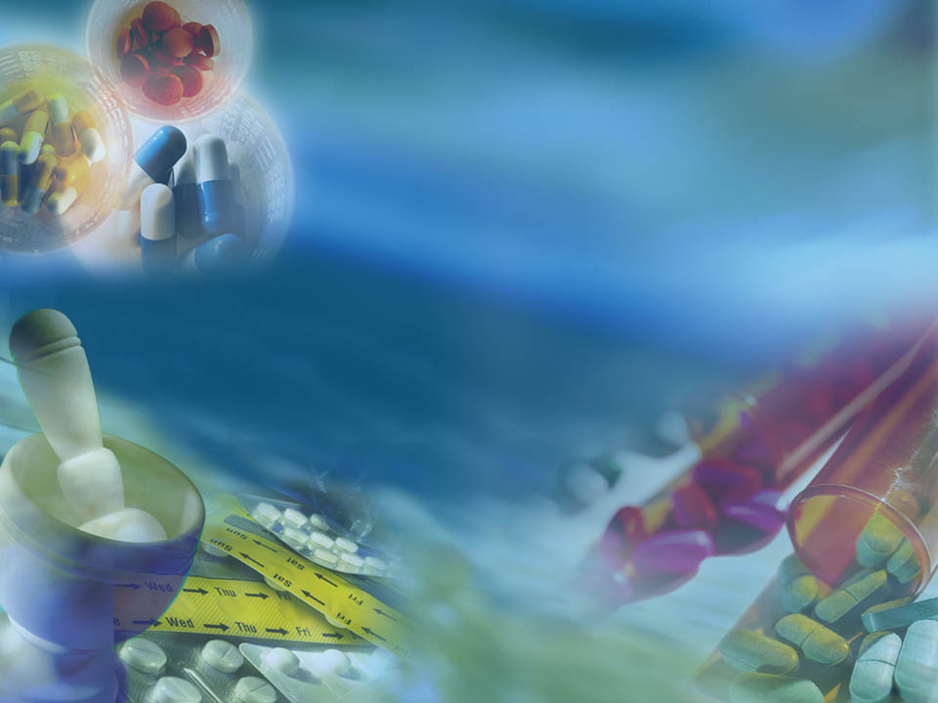


OPIOID ANALGESICS

Slide 86
OPIOID ANALGESICS
They include opioid agonists, mixed agonist–antagonists, and antagonists mainly used in treatment of severe and chronic pain.
They mimic the action of endogenous opioids found in the CNS which include dynorphins, enkephalins, endorphins, endomorphins and nociceptin
These endogenous opioids act as self/natural pain killers for the body.

Slide 87
Natural painkillers
They are produced naturally in the body.
Mainly Endorphins and enkephalins
They are the natural opiates found in the part of the brain and the spinal cord that transmit pain impulses.
They are able to bind to neuro-receptors in the brain and produce relief from pain.
The temporary loss of pain immediately after an injury is associated with the production of these chemicals.

Slide 88
OPIOID ANALGESICS (Strong analgesics)
They temporarily bind to the opiate receptor sites in the brain preventing the transition of pain impulses
They are opium alkaloids
Opiate is term used for a natural or synthetic drug that exerts actions on the body similar to those induced by morphine.
Narcotic is a term generally used for drugs that have both a narcotic and analgesic action.

Slide 89
Opioid receptors
these are group of G-protein coupled receptors with opioids as their ligands and are located in the CNS.
The subtypes of opiod receptors include:
mu, delta, kappa, sigma
Most opioid analgesics activate a multiple of these receptors thus producing multiple effects
Notes:
Opioid receptors are a group of G-protein coupled receptors with opioids as ligands. The endogenous opioids are dynorphins, enkephalins, endorphins, endomorphins and nociceptin.

Slide 90
Opiod Receptor Activation
Response | Mu-1 | Mu-2 | Kappa | Delta | Sigma
Analgesia
Respiratory depression
Euphoria
Dysphoria (Distress)
Decrease GI motility
Physical Dependence
Mania, hallucination

Slide 91
Examples of opioid analgesics
Morphine is the principal alkaloid and makes up about 10% by mass of raw opium.
Codeine makes up about 0.5% by mass of raw opium.
Heroin is usually synthesized from morphine and thus is a semi-synthetic drug and it is obtained by relatively simple structural modification of morphine or codeine. Has no clinical use

Slide 92
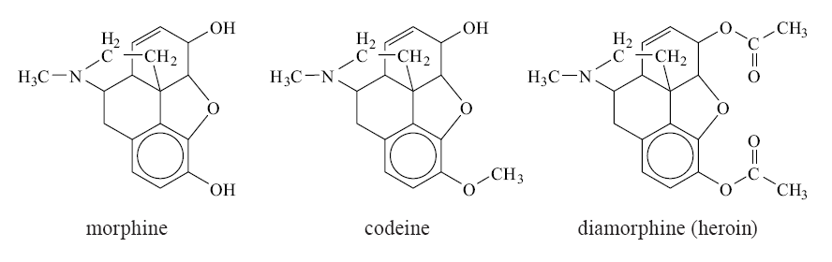

Slide 93
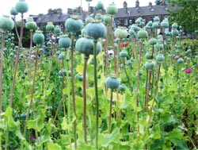
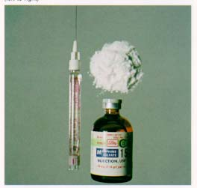
Opium plant
Morphine

Slide 94
Effects of opiates.
Pharmacological effects:
Opiates exert major effects on:
The central nervous system.
The eye
The gastrointestinal tract (the digestive system)
The prime medical uses of opiates are:
As strong analgesic in the relief of severe pain caused by injury and chronic disease.
In the treatment of diarrhea by producing a constipating effect.
To relieve coughing by suppressing the “cough centre” situated in the brain system.

Slide 95
Effects of opiates.
Physiological effects of opiates:
Opiate produce:
Analgesia
Drowsiness
Mood changes
Medical clouding
Some individuals experience:
Anxiety
Fear
Lethargy(comatose/stupor/inactivity)
Sedation
Lack of concern
Inability to concentrate

Slide 96
Tolerance
Tolerance appears due to the induction of drug metabolizing enzymes in the liver and also to the adaptation of neurons in the brain to the presence of the drug.
The users that became tolerant to one opiate will also exhibit a tolerance to all other opiates.

Slide 97
Dependence
Physical dependence is the state in which people do not function properly without a drug.
Symptoms:
Restlessness
Sweating
Fever
Chills
Vomiting
Increase rate of respiration
Cramping
Diarrhea
Unbearable aches

Slide 98
Dependence
Depends on:
The dose
Frequency of drug administration
The duration of the drug dependence
The opiate used

Slide 99
The opiates (in general)
They are extremely potent and valuable drugs for the treatment of pain
They have the capacity of inducing a state of euphoria and relief from physiological pain
The opiates induce profound tolerance and physiological dependence
They are important both medically and sociologically as the user is difficult to treat and might frequently resort to crime to support the habit and reach a source of supply.

Slide 100
Summary of the effects of opiates
Short term effects
Sedation and stupor
Euphoria
Reduced tension, worry and fear
Reduced coughing reflex
Occasional death from overdose
Long term effects
Loss of appetite
Sterility
Withdrawal illness, loss of job, crime
Diversion of energy and money
Risk of dangerous infections due to shared needles.

Slide 101
MORPHINE HYDROCHLORIDE
routes of administration
subcutaneously and intramuscularly
(analgesic action after 10-15 min)
oral administration – subject to presystemic elimination
( only 20-60 % enters general blood circulation)
Sublingual administration leads to quick absorption
i.v. is indicated in emergencies
Epidural or intrathecal ( into the spinal canal ) injection produces segmental analgesia lasting 12 hours without affecting other sensory, motor or autonomic modalities
Duration of analgesic action – 4-6 hours
Maximum single dose of morphine is 0.02 g,
maximum daily dose – 0.05 g

Slide 102
Indications
Morphine is indicated for the treatment of moderate to severe and chronic pain.
It is useful preoperatively for sedation, anxiolytic(anxiety reliever) effects, and to reduce the dose of anesthetics.
Morphine is the drug of choice for the treatment of myocardial infarction because of its bradycardiac and vasodilatory effects.
morphine is the most commonly used drug for the treatment of dyspnea associated pulmonary edema. It is thought that morphine reduces the anxiety associated with shortness of breath in these patients along with the cardiac preload and afterload.
Commonly used to relieve pain in cancer patients

Slide 103
Side effects of morphine
Respiratory depression
Vomiting (excitation of starting zone of vomiting center)
bradycardia (increasing of tone of n. vagus nuclei)
spasm of sphincters of gastro-intestinal tract accompanied by constipations
increasing of tone of smooth musculature of urinary and bile-excreting tracts (retentions of urination, bile stasis)
Decreasing of BP

Slide 104
CONTRAINDICATIONS -MORPHINE
acute respiratory depression/ acute bronchial asthma
renal failure (due to accumulation of the metabolites morphine-3-glucuronide and morphine-6-glucuronide)
chemical toxicity (potentially lethal in low tolerance subjects)
raised intracranial pressure, including head injury (risk of worsening respiratory depression)
Biliary colic
hypersensitivity reactions to the opioids.
Use with caution in
pain that accompanies chronic inflammatory pain
children before the age of 2 years
Pts on barbiturates, alcohol abusers ,psychotropic drugs, such as chlorpromazine and monoamine oxidase inhibitors, or the anxiolytics, such as diazepam.

Slide 105
Tolerance
Tolerance is a diminished responsiveness to the drug’s action that is seen with many compounds
Tolerance can be demonstrated by a decreased effect from a constant dose of drug or by an increase in the minimum drug dose required to produce a given level of effect
Physiological tolerance involves changes in the binding of a drug to receptors or changes in receptor transductional processes related to the drug of action
This type of tolerance occurs in opioids

Slide 106


Addiction
Physical dependence
Physiological dependence
Withdrawal reactions

Slide 107
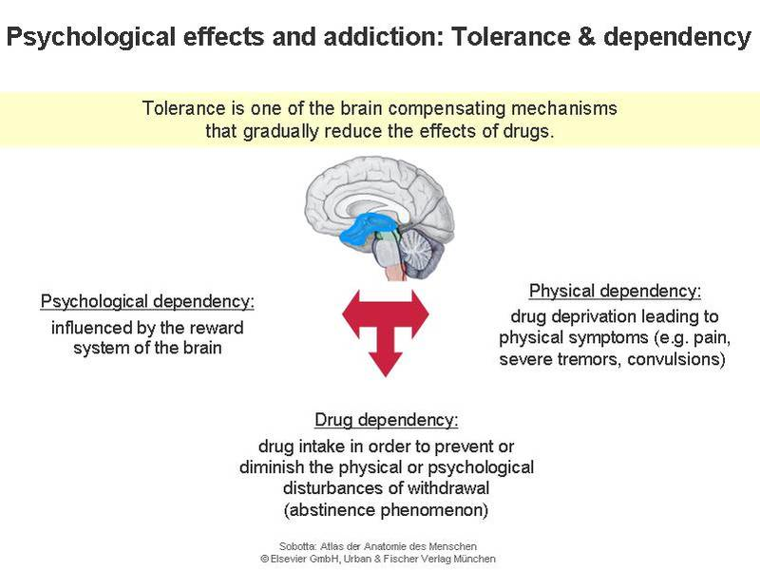

Tolerance and Dependence

Slide 108
Withdrawl Reactions
Acute Action
Analgesia
Respiratory Depression
Euphoria
Relaxation and sleep
Tranquilization/calming
Decreased blood pressure
Constipation
Pupillary constriction
Hypothermia
Drying of secretions
Reduced sex drive
Flushed and warm skin
Withdrawl Sign
Pain and irritability
Hyperventilation
Dysphoria and depression
Restlessness and insomnia
Fearfulness and hostility
Increased blood pressure
Diarrhea
Pupillary dilation
Hyperthermia
Lacrimation, runny nose
Spontaneous ejaculation
Chilliness and “gooseflesh”

Slide 109
OMNOPON
contains mixture of opium alkaloids
(48-50% morphine)
does not cause spasms of smooth musculature, as it contains alkaloids of isoquinoline raw
is used for analgesia according to all the indications of morphine hydrochloride, for example, colics

Slide 110
Levorphanol
an L-isomer morphinan derivative of morphine that is five to seven times more potent than morphine.
It produces all of the side effects associated with morphine but less nausea
It is indicated for moderate to severe pain as a preoperative anxiolytic(relieves anxiety).
It is often used in combination with thiopental to reduce the latter drug’s anesthetic dose and to decrease postoperative recovery time
The D-isomer of levorphanol (Dextromethorphan), does not possess opioid analgesic activity but is a useful antitussive(relieves cough).

Slide 111
Methadone
has an analgesic profile and potency similar to that of morphine but a longer duration of action and better oral bioavailability.
Methadone is a useful analgesic drug for the treatment of moderate to severe pain.
Also useful in the treatment of opioid addiction,
Unlike morphine, it is generally not used epidurally because of its long duration of action
Overdose is treated with naloxone.
Clearance of methadone is via the urine and bile as the cyclic Ndemethylated drug.
Alkalization of the urine or renal insufficiency decreases excretion of the drug.

Slide 112
Promedol (trimeperidine)
produces similar effects to other opioids, such as analgesia and sedation, along with side effects such as nausea, itching, vomiting and respiratory depression which may be harmful or fatal.
duration of analgesic action - 3-4 hours
moderate spasmolytic influence on smooth musculature of internal organs
stimulation of rhythmic contractions of uterus
can be used for analgesia in case of pain syndrome connected with spasms of smooth musculature
Notes:
Trimeperidine is an opioid analgesic that is an analogue of prodine (meperidine). It was developed in or around 1954 in the USSR during research into the related drug pethidine.

Slide 113
Fentanyl, Sufentanil, and Alfentanil
synthetic opioid analgesics of short action
analgesic activity is 300 times higher than of morphine
analgesic effects after intravenous introduction – after 1-3 min, lasts for 15-30 min
used with neuroleptic droperidol (complex drug – “talamonal”) for neuroleptanalgesia
Notes:
a form of analgesia achieved by the concurrent administration of a neuroleptic such as droperidol and an analgesic such as fentanyl. Anxiety, motor activity, and sensitivity to painful stimuli are reduced; the person is quiet and indifferent to surroundings

Slide 114
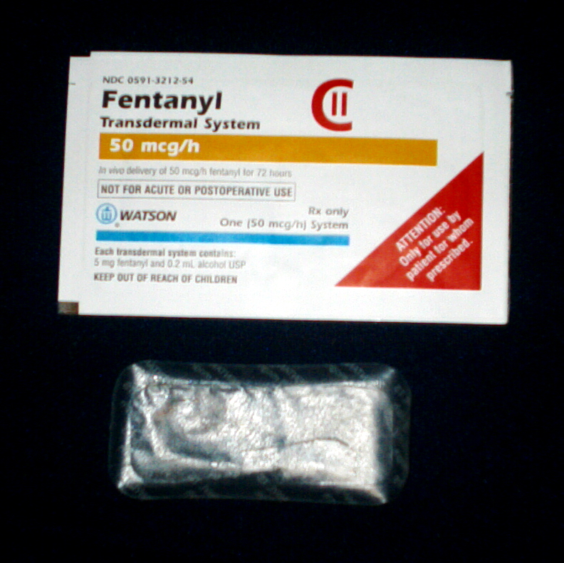
fentanyl transdermal system
should be used for long-term (chronic) pain requiring continuous narcotic pain
Is designed to release the drug into the skin at a constant rate ranging from 25 to 100 micrograms/h,

Slide 115
Codeine
opium alkaloid
analgesic action is not strong, but anticough effect is considerable
administered as an anticough drug of central action
Codeine is metabolized in part to morphine, which is believed to account for its analgesic effect.
combination with non opiod analgesics
(eg. Paracetamol) is supra-additive

Slide 116
Pentazocin
agonist-antagonist of opioid receptors
comparatively with morphine, it is a bit less dangerous in the aspect of addiction development
indicated in case of pain of medium intensity in such conditions like other opioid analgesics. In case of strong pain its administration is limited as in case of increasing of dose of the drug excitation appears
it can cause increasing of blood pressure and tachycardia that’s why it’s not advised to use in case of acute myocardium infarction
if it is administered for people with narcotic addiction manifestations of abstinence develop

Slide 117
Buprenorphine
Partly agonist of mu-opioid receptors
Acts longer than morphine (approximately 6 hours)
Analgesic activity is higher than of morphine, that’s why it’s used in doses of 0,3-0,6 mg
In case of breathing depression, which it causes, naloxon is less effective since buprenorphine is slowly released from the connection with mu-receptors
Indicated for pain decreasing in the same situations as other narcotic analgesics
May be used for detoxication and supporting treatment of individuals who is addicted to heroine

Slide 118
Acute poisoning with opioid analgesics
Respiratory Depression
Euphoria
Relaxation and sleep
Tranquilization
Decreased blood pressure
Constipation
Pupillary constriction
Hypothermia
Drying of secretions
Flushed and warm skin

Slide 119

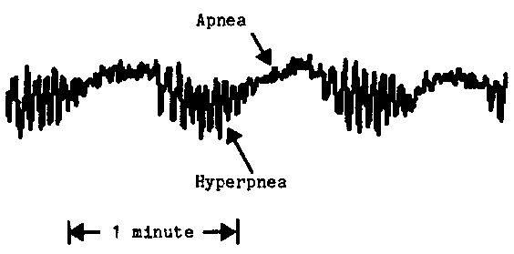
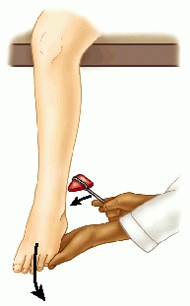
Triad in case poisoning with morphine
Acute miosis (Pinpoint pupils)
Cheyne Stokes respiration
deep tendon reflexes increased

Slide 120

Treatment of acute poisoning
Naloxone (antagonist of opioid receptors)
intravenously - 0,4-1,2 mg
general dose of naloxon should not overcome 10 mg
stomach lavage(flush with water) (for morphine enterohepatic circulation is typical) with 0,05-0,1% solution of potassium permanganate and 0,5 % tannin solution
suspension of 20-30 g of activated charcoal
salt laxative agents (sodium sulfate)
forced diuresis
atropine sulfate
inhalation of carbogen (5-7 % СО₂ and 93-95 % O₂)

Slide 121
Treatment of acute poisoning
Respiratory depression, miosis, hypotension, and coma are signs of morphine overdose.
While the IV administration of naloxone reverses the toxic effects of morphine, naloxone has a short duration of action and must be administered repeatedly at 30- to 45minute intervals until morphine is cleared from the body.

Slide 122
Naltrexone
Naltrexone (Trexan) is three to five times as potent as naloxone and has a duration of action of 24 to 72 hours, depending on the dose.
It is used orally in the treatment of opioid abstinence.
Naltrexone exhibits a large first pass effect in the liver. However, the major metabolite, 6--naltrexol, is also a pure opioid antagonist and contributes to the potency and duration of action of naltrexone.
Administration of naltrexone orally blocks the subjective effects of abused opioids and is used to decrease the craving for opioids in highly motivated recovering addicts.
Naltrexone also has been used with success in treating apneic episodes in children, an effect hypothesized to be due to blockade of -endorphin–induced respiratory depression.

Slide 123
Analgesic–Antipyretic– Anti-inflammatory and Related Drugs

Slide 124
OBJECTIVES
Discuss the role of prostaglandins in the etiology of pain, fever/pyresis, and inflammation.
Discuss aspirin and other nonsteroidal antiinflammatory drugs (NSAIDs) in terms of mechanism of action, indications for use, contraindications to use, nursing process, and principles of therapy.
Compare and contrast aspirin, other NSAIDs, and acetaminophen in terms of indications for use and adverse effects.
Differentiate among antiplatelet, analgesic, and anti inflammatory doses of aspirin.

Slide 125
OBJECTIVES-Ct
Differentiate between traditional NSAIDs and cyclooxygenase-2 inhibitors.
Teach clients interventions to prevent or decrease adverse effects of aspirin, other NSAIDs, and acetaminophen.
Identify factors influencing the use of aspirin, NSAIDs, and acetaminophen in special populations.
Discuss recognition and management of acetaminophen toxicity.
Discuss the use of NSAIDs and antigout drugs.
Discuss the use of NSAIDs, triptans, and ergot antimigraine drugs.

Slide 126
The analgesic–antipyretic–anti-inflammatory drug group includes chemically and pharmacologically diverse drugs that share the ability to relieve pain, fever, and/or inflammation, symptoms associated with many injuries and illnesses.

Slide 127
Introductions
These drugs include aspirin (acetylsalicylic acid or ASA); the prototype, aspirin-related drugs that are often called nonsteroidal anti-inflammatory drugs (NSAIDs, eg, ibuprofen); acetaminophen; and drugs used to prevent or treat gout and migraine.
Aspirin, NSAIDs, and acetaminophen can also be called antiprostaglandin drugs, because they inhibit the synthesis of prostaglandins.

Slide 128
Prostaglandins
Prostaglandins are chemical mediators found in most body tissues; they help regulate many cell functions and participate in the inflammatory response.
They are formed when cellular injury occurs and phospholipids in cell membranes release arachidonic acid.
Arachidonic acid is then metabolized by cyclooxygenase enzymes to produce prostaglandins, which act briefly in the area where they are produced and are then inactivated.

Slide 129
effects of prostaglandins
The main effects of prostaglandins are:
The constriction of blood vessels, which helps increase the body temperature.
Direct effect on the body’s heat regulating centre, hypothalamus, which produces fever.
Increase of the permeability of capillaries which allows water to pass to the tissue and cause pain and swelling.

Slide 130
What is
Pain?
Fever?
Inflammation?
Cardinal signs of inflammation include:
-Redness and heat result from vasodilation and increased blood supply;
edema results from leakage of blood plasma into the area; and
pain occurs when pain receptors on nerve endings are stimulated by heat, edema, pressure, chemicals released by the damaged cells, and prostaglandins.

Slide 131
MECHANISM OF ACTION
Aspirin, NSAIDs, and acetaminophen inactivate cyclooxygenases, the enzymes required for prostaglandin formation
Two forms of cyclooxygenase, called COX-1 and COX-2, have been identified. Aspirin and traditional NSAIDs inhibit both COX-1 and COX-2 enzymes.

Slide 132
COX-1
COX-1 is normally synthesized continuously and present in all tissues and cell types, especially platelets, endothelial cells, the gastrointestinal (GI) tract, and the kidneys.
Prostaglandins produced by COX-1 are important in numerous homeostatic functions and are associated with protective effects on the stomach and kidneys.

Slide 133
COX-1
In the stomach, they decrease gastric acid secretion, increase mucus secretion, and regulate blood circulation.
In the kidneys, these prostaglandins help to maintain adequate blood flow and function
In the cardiovascular system, the prostaglandins help regulate vascular tone (ie, vasoconstriction and vasodilation) and
Platelet function.

Slide 134
COX-1 inhibition
Drug-induced inhibition of these prostaglandins results in the adverse effects associated with aspirin and related drugs, especially gastric irritation, ulceration, and bleeding.
Inhibition of COX-1 activity in platelets may be more responsible for GI bleeding than inhibition in gastric mucosa.

Slide 135
COX-2
COX-2 is also normally present in several tissues (eg, brain, bone, kidneys, GI tract, and the female reproductive system).
However, it is thought to occur in small amounts or to be in- active until stimulated by pain and inflammation.
In inflamed tissues, COX-2 is induced by inflammatory chemical mediators such as interleukin-1 (IL-1) and tumor necrosis factor, alpha (TNF alpha).
In the GI tract, COX-2 is also induced by trauma and Helicobacter pylori infection, a common cause of peptic ulcer disease.
Overall, prostaglandins produced by COX-2 are associated with pain and other signs of inflammation.

Slide 136
COX-2 inhibition
Inhibition of COX-2 results in the therapeutic effects of analgesia and anti-inflammatory activity.
The COX-2 inhibitor drugs are NSAIDs designed to selectively inhibit COX-2 and relieve pain and inflammation with fewer adverse effects, especially stomach damage.

Slide 137
INDICATIONS FOR USE
These drugs are widely used to prevent and treat mild to moderate pain and/or inflammation associated with musculoskeletal disorders (eg, osteoarthritis, tendinitis, gout),
Headache
Dysmenorrhea/painful menstruation,
Minor trauma (eg, athletic injuries such as sprains),
Minor surgery (eg, dental extraction, episiotomy),and other acute and chronic conditions

Slide 138
INDICATIONS FOR USE-Ct
Low dose aspirin is increasingly prescribed for clients at risk of myocardial infarction or stroke from thrombosis.
This indication stems from its antiplatelet activity and resultant effects on blood coagulation (ie, decreased clot formation).
NSAIDs such as ibuprofen (Motrin) and related drugs are widely used as anti-inflammatory agents and analgesics
Also used in rheumatoid arthritis and other musculoskeletal disorders

Slide 139
Acetaminophen, which differs chemically from aspirin and other NSAIDs, is commonly used as an aspirin substitute for pain and fever, but it lacks anti-inflammatory and antiplatelet effects.

Slide 140
CONTRAINDICATIONS TO USE
Contraindications to aspirin and nonselective NSAIDs include
peptic ulcer disease,
gastrointestinal (GI) or other bleeding disorders,
history of hypersensitivity reactions,
and impaired renal function

Slide 141
In children and adolescents, aspirin is contraindicated in the presence of viral infections such as influenza or chickenpox because of its association with Reye’s syndrome

Slide 142
Aspirin
is the prototype of the analgesic–antipyretic– anti-inflammatory drugs and the most commonly used salicylate.
It is effective in pain of low to moderate intensity, especially that involving the skin, muscles, joints, and other connective tissue.
It is useful in inflammatory disorders, such as arthritis, but many people prefer drugs that cause less gastric irritation

Slide 143
Aspirin
Regular aspirin tablets are well absorbed after oral administration; their action starts within 15 to 30 minutes, peaks in 1 to 2 hours, and lasts 4 to 6 hours
Taking aspirin with food slows absorption, but also decreases gastric irritation.
Absorption of enteric-coated aspirin and rectal suppositories is slower and less complete.

Slide 144
Aspirin
Aspirin is distributed to all body tissues and fluids, including fetal tissues, breast milk, and the central nervous system (CNS).
The highest concentrations are found in the plasma, liver, heart, and lungs.
In plasma, aspirin binds to salbumin (75 to 90%).
Aspirin has a short half-life of 15–20 minutes because it is rapidly converted to salicylic acid, an active metabolite.

Slide 145
Aspirin
Salicylic acid has a half-life of 2 to 3 hours at low doses and 6 to 12 hours at therapeutic anti inflammatory doses.
It undergoes oxidation and conjugation in the liver and its metabolites are excreted through the kidneys.
In alkaline urine (eg, pH of 8), renal excretion of salicylate is greatly increased.

Slide 146
Aspirin-Indications
Aspirin is a home remedy for headaches, colds, influenza and other respiratory infections, muscular aches, and fever.
It can be purchased in plain, chewable, enteric-coated, and effervescent tablets and rectal suppositories.
It is not marketed in liquid form because it is unstable in solution

Slide 147
Toxicity: Salicylate Poisoning
Salicylate intoxication (salicylism) may occur with an acute overdose or chronic use of therapeutic doses, especially the higher doses taken for anti-inflammatory effects.
Chronic ingestion of large doses saturates a major metabolic pathway, thereby slowing drug elimination, prolonging the serum halflife, and causing drug accumulation.

Slide 148
Treatment of Salicylate Poisoning
In mild salicylism, stopping the drug or reducing the dose is usually sufficient.
In severe salicylate overdose, treatment is symptomatic and aimed at preventing further absorption from the GI tract; increasing urinary excretion; and correcting fluid, electrolyte, and acid–base imbalances.
When the drug may still be in the GI tract gastric lavage/irrigation and activated charcoal help reduce absorption.

Slide 149
Treatment of Salicylate Poisoning-ct
Intravenous (IV) sodium bicarbonate produces an alkaline urine in which salicylates are more rapidly excreted, and hemodialysis effectively removes salicylates from the blood.
IV fluids are indicated when high fever or dehydration is present. The specific content of IV fluids depends on the serum electrolyte and acid–base status.

Slide 150
Diflunisal (Dolobid)
is a salicylic acid derivative that differs chemically from aspirin.
It is reportedly equal or superior to aspirin in mild to moderate pain, rheumatoid arthritis and osteoarthritis.
Compared with aspirin, it has less antipyretic effect, causes less gastric irritation, and has a longer duration of action.

Slide 151
NSAIDs
These include:
Propionic acid derivatives eg fenoprofen (Nalfon), flurbiprofen (Ansaid), ibuprofen (Motrin, Advil), ketoprofen (Orudis), naproxen (Naprosyn), and oxaprozin (Daypro).
Acetic acid derivatives eg indomethacin (Indocin),sulindac (Clinoril), and tolmetin (Tolectin).
Oxicam eg meloxicam and piroxicam
Diclofenac,
Cyclooxygenase-2 inhibitors eg Celecoxib (Celebrex)

Slide 152
Ibuprofen,
a commonly used drug, is well absorbed with oral administration.
Its action starts in about 30 minutes,peaks in 1 to 2 hours, and lasts 4 to 6 hours.
The drug is highly bound (about 99%) to plasma proteins and has a half-life of about 2 hours.
It is metabolized in the liver and excreted through the kidneys.
It is available by prescription and OTC, in tablets, chewable tablets, capsules, oral suspension, and oral drops, for use by adults and children

Slide 153
Acetic acid derivatives
These drugs have strong anti-inflammatory effects and more severe adverse effects than the propionic acid derivatives
Potentially serious adverse effects include GI ulceration, bone marrow depression, hemolytic anemia, mental confusion, depression, and psychosis.

Slide 154
Oxicam
Meloxicam has a serum half-life of 15 to 20 hours and is excreted about equally through urine and feces.
Piroxicam has a half-life of about 50 hours.
The long half-lives allow the drugs to be given once daily, but optimal efficacy may not occur for 1 to 2 weeks.

Slide 155
Diclofenac
Diclofenac sodium (Voltaren) is chemically different from but pharmacologically similar to other NSAIDs
Formulations are delayed or extended-release and onset of action is therefore delayed.
Peak action occurs in about 2 hours and effects last 12 to 15 hours.

Slide 156
Diclofenac
The formulation of diclofenac potassium (Cataflam) is immediate-release; action starts quickly, peaks in about 20 minutes to 2 hours, and also lasts 12 to 15 hours
As a result, the potassium salt may be given for rapid relief of pain and primary dysmenorrhea.
Diclofenac has a serum half life of about 2 hours and is excreted mainly in the urine.

Slide 157
Cyclooxygenase-2 inhibitors
block production of prostaglandins associated with pain and inflammation without blocking those associated with protective effects on gastric mucosa.
Thus, they produce less gastric irritation than aspirin and other NSAIDs
In addition, they are not associated with increased risks of bleeding because they do not have the antiplatelet effects of aspirin and other NSAIDs.

Slide 158
Celecoxib (Celebrex)
is well absorbed with oral administration; peak plasma levels and peak action occur approximately 3 hours after an oral dose.
It is highly protein bound (97%) and its serum half-life is about 11 hours.
It is metabolized by the cytochrome P450 enzymes in the liver to inactive metabolites that are then excreted in the urine.
A small amount is excreted unchanged in the urine

Slide 159
Rofecoxib
acts within 45 minutes and peaks in 2 to 3 hours.
It is 87% protein bound and has a half-life of 17 hours.
It is metabolized in the liver and excreted in urine and feces.

Slide 160
Valdecoxib
is a newer COX-2 inhibitor; others are being developed.

Slide 161
Acetaminophen
(also called APAP, an abbreviation for N-Acetyl-P-Aminophenol) or paracetamol
Commonly used as an aspirin substitute because it does not cause nausea, vomiting, or GI bleeding, and it does not interfere with blood clotting.
It is equal to aspirin in analgesic and antipyretic effects, but it lacks anti-inflammatory activity.

Slide 162
Acetaminophen
Acetaminophen is well absorbed with oral administration and peak plasma concentrations are reached within 30 to 120 minutes.
Duration of action is 3 to 4 hours.
Is metabolized in the liver; approximately 94% is excreted in the urine as inactive glucuronate and sulfate conjugates.
Approximately 4% is metabolized to a toxic metabolite, which is normally inactivated by conjugation with glutathione and excreted in urine

Slide 163
Acetaminophen
With usual therapeutic doses, a sufficient amount of glutathione is available in the liver to detoxify acetaminophen
In acute or chronic overdose situations, however, the supply of glutathione may become depleted.
In the absence of glutathione, the toxic metabolite combines with liver cells and causes damage or fatal liver necrosis.

Slide 164
Acetaminophen
In people who abuse alcohol, usual therapeutic doses may cause or increase liver damage
The probable mechanism for increased risk of hepatotoxicity in this population is that ethanol induces drug-metabolizing enzymes in the liver.
The resulting rapid metabolism of acetaminophen produces enough toxic metabolite to exceed the available glutathione

Slide 165
Acetaminophen
Acetaminophen is available in tablet, liquid, and rectal suppository forms and is in numerous combination products marketed as analgesics and cold remedies.
It is often prescribed with codeine, hydrocodone, or oxycodone for added analgesic effects

Slide 166
Acetaminophen Poisoning
Poisoning may occur with a single large dose (possibly as little as 6 g, but usually 10–15 g), or chronic ingestion of excessive doses (5 to 8 g/day for several weeks or 3 to 4 g/day for 1 year).
Potentially fatal hepatotoxicity is the main concern and is most likely to occur with doses of 20 g or more.

Slide 167
Acetaminophen Poisoning
Metabolism of acetaminophen produces a toxic metabolite that is normally inactivated by combining with glutathione.
In overdose situations, the supply of glutathione is depleted and the toxic metabolite accumulates and directly damages liver cells.
Acute renal failure may also occur.

Slide 168
Prevention of Acetaminophen Poisoning
Avoid concurrent intake of different brands with acetaminophen as the active ingredient
Avoid alcohol during acetaminophen treatment
Limit use to 5 days

Slide 169
Treatment of Acetaminophen Poisoning
Gastric lavage is recommended if overdose is detected within 4 hours after ingestion and activated charcoal can be given to inhibit absorption.
In addition, the specific antidote is acetylcysteine (Mucomyst), a mucolytic agent given by inhalation in respiratory disorders.
For acetaminophen poisoning, it is usually given orally

Slide 170
Treatment of Acetaminophen Poisoning-ct
The drug provides cysteine, a precursor substance required for the synthesis of glutathione
Acetylcysteine is most beneficial if given within 8 to 10 hours of acetaminophen ingestion, but may be helpful up to 36 hours.
It does not reverse damage that has already occurred.

