Slide 1
DISORDERS OF THE ESOPHAGUS
Ogera Dan

Slide 2
ESOPHAGITIS
Inflammation of the esophagus
Dysphagia
Odynophagia
Retrosternal chest pain
Heart burn
Dyspepsia

Slide 3
complications
Strictures
Esophageal perforation – sepsis, GI bleeding,
Causes of esophagisis
P – Pill induced esophagitis– NSAIDS, KCL, Doxy, biphosphonates
R – reflux esophagitis - GERD
I- infectious esophagitis- Immunicompromised, infections CMV,Candida, HSV
C – caustic esophagitis – Chemical ingestion, strong acid and bases, oral burns
E –eosinophilic esophagitis – atopic triad, asthma, allergies, atopic dermatitis – food allergen

Slide 4
treatment
Based on cause
Pill induced – stop pills
Reflux – GERD treatment
Infectious – treat infection
Caustic – supportive treatment, avoid vomiting
Eosinophilic – avoid trigger, fluticasone propionate, directly to mouth instead of nose
Acid suppression therapy - PPI

Slide 5
1. ACHALASIA
Dfn-absence or ineffective peristalsis of the distal esophagus.
The esophageal sphincter fails to relax after swallowing.
-The etiology is not known,
-central or peripheral vagal nerve dysfunction
Damage to myenteric neurons – Chagas disease
Extraesophageal malignancy
The classic triad of presenting symptoms include dysphagia, regurgitation and weight loss

Slide 6
Clinical manifestations
Difficulty in swallowing both liquids and solids – slowly and gradually
A feeling of food sticking in the lower portion of the esophagus
Regurgitation
Pyrosis (chest pain and heart burn)
Pulmonary complications from aspiration of gastric contents
Weight loss

Slide 7
Diagnosis
X-ray -shows esophageal dilatation above the narrowing at the gastro esophageal junction
Barium swallow
CT chest
Endoscopy – rule out esophageal cancer
Manometer is used to measure the pressures in the esophagus
Management
Focuses on releaving symptoms
Calcium channel blockers and nitrates-reduces the esophageal pressures
Botulinum toxin injection-inhibits the contraction of smooth muscles( given via endoscopy)

Slide 8
Surgical treatment
Forceful dilatation (balloon), pneumatic
Esophagomyotomy-performed laparascopically with either LES myotomy or the muscles are separated to relieve the LES

Slide 9
Nursing management
Preoperative management
Postoperative management
Nurse patient in fowlers position
Nil by mouth
NG drainage
Iv fluids
Suctioning
Infection prevention
Vital observation
Check for bowel sounds
Nutrition ( enteral /parenteral)

Slide 10
2. Diffuse esophageal spasm (DES) SDL
It’s a motor disorder of the esophagus. It is a poorly understood hyper motility disorder. Results from repetitive high amplitude esophageal contractions
The etiology is unknown
These patients typically are anxious and complain of chest pain inconsistent to eating, exertion and position
The character of pain may mimic that of angina

Slide 11
Symptoms are greatest during periods of emotional stress
Patients may experience slow emptying of the esophagus and obstructive symptoms are uncommon
Diagnosis
Manometry; it measures the motility and pressure in the esophagus.
Barium swallow-shows areas of spasms

Slide 12
Management
Antispasmodics are occasionally helpful
Calcium channel blockers(nifedipine)-help reduce spasms
Small frequent feeds
Soft diet
Dilatation by use of bougienage (use of progressively sized flexible dilators).
If this doesn’t improve surgical management is the last result.
Esophagomyotomy-this is an open surgery

Slide 13
Post surgical management
Npo
IV fluids and parenteral feeds
Care of the wound
Antibiotics
Analgesics
Soft diet
Health education

Slide 14
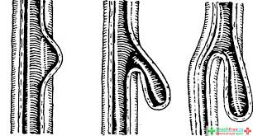
3. ESOPHAGEAL DIVERTICULA SDL
A diverticulum is an outpouching of mucosa and submucosa that protrudes through a weak portion of the musculature. Almost all are acquired and occur predominantly in adulthood. They are classified according to their:
a. Site of occurrence
Pharyngoesophageal
Midoesophangeal
Epiphrenic

Slide 15
Wall thickness
True
False
Mechanism of formation
Pulsion ( pressure from within)
Traction (occurs from the pulling of adhesions)

Slide 16
PATHOPHYSIOLOGY
The pouch traps food. The stationary mass allow the lumen, interferes with the passage of food into the stomach and may exert pressure on the trachea.
The trapped food then decomposes and may cause oesophangitis or ulceration in the mucosa.

Slide 17
Signs and symptoms
Difficulty or pain when swallowing
Belching
Regurgitation
Coughing
Foul breath odor
A gurgling sound on auscultation of the mid upper chest.

Slide 18
TYPES; Pharyngoesophageal diverticula (zenker)
Its the most common esophageal diverticulum.
It occurs between the ages of 30-50 (believed to be acquired).
It rises within the inferior pharyngeal constrictor, between the oblique fibers of the thyropharyngeus muscle and the cricopharyngeus muscle

Slide 19
Is a pulsion diverticulum
Complaints are of cervical dysplasia, effortless regurgitation of food or pills sometimes consumed hours earlier
Sometimes a gurgling sensation in the neck after swallowing is felt

Slide 21
Diagnosis and treatment
Barium swallow establishes the diagnosis
Surgery is indicated in symptomatic patients regardless of the size
It is the degree of cricopharyngeal muscle dysfunction and not the size of the diverticulum that determines the relative severity of cervical dysphagia

Slide 22
Midesophageal (traction) diverticula
Are typically associated with mediastinal granulomatous disease (TB, histoplasmosis)
They are usually small with a blunt tapered tip that points upward
These are usually an incidental finding on barium swallow
They rarely cause symptoms or require treatment
Need to be differentiated from pulsiondiverticula which can also occur in this location (associated with neuromotor esophageal dysfunction)

Slide 23
Epiphrenic (supradiaphragmatic) diverticula
Generally occur within the distal 10cm of the thoracic esophagus
These are pulsiondiverticula that arise due to esophageal motor dysfunction or mechanical distal obstruction
Many patients are asymptomatic when diagnosed
Dysphagia and regurgitation are common symptoms

Slide 24
Diagnosis and treatment
Diagnosis is easily made with barium swallow
Esophageal function studies should also be performed to rule out any motor disturbances
Lesions < 3 cm often require no treatment
Extreme symptomatic patients sometimes require surgical repair

Slide 25
MANAGEMENT
For mild symptoms treatment is a bland, soft, semisoft or semiliquid diet to facilitate passage.
Small frequent meals is also recommended.
The more severe symptoms may require surgical excision of the diverticulum

Slide 26
Nursing management
Dietary modification
Oral hygiene
Pre and post op care in case of surgical management

Slide 27
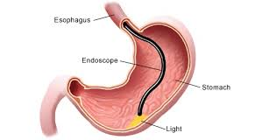
ESOPHAGOSCOPY
Indications include:
Dysphagia -foreign body impaction
Reflux –treatment
Hematemesis –GERD
Atypical chest pain
Confirmation of diagnosis e.G oral candidiasis

Slide 28
ESOPHAGOSCOPY
Contraindications:
Zenker hernia
Bleeding

Slide 29
General considerations
The esophagoscopy should be performed after barium swallow
Bacteremia during upper GI endoscopy has been well documented therefore prophylactic antibiotic treatment should be administered
Patient should be in NPO for 6-8 hours

Slide 30
Complications
The minor ones:
Lacerations of the lips or tongue
Dislodgment or fracture of teeth and possible aspiration
Major complication
Esophageal perforation

Slide 31
4. HIATUS HERNIA
Protrusion of the upper part of the stomach into the esophagus.
Types
type 1: sliding hiatal hernia (~95%). The gastro-esophageal junction (GEJ) is usually displaced >2 cm above the esophageal hiatus

Slide 32
The esophageal hiatus is often abnormally widened to 3-4 cm (the upper limit of normal is 1.5 cm).
Small, sliding hiatus hernias commonly reduce in the upright position.
The mere presence of a sliding hiatus hernia is of limited clinical significance in most cases.

Slide 33
The function of the lower esophageal sphincter and the presence of pathologic gastro-esophageal reflux are the crucial factors in producing symptoms and causing complications
type 2: paraesophagea/Rolling hiatal hernia with the gastro-esophageal junction in a normal position.
The GEJ remains in its normal location while a portion of the stomach herniates above the diaphragm

Slide 34
type 3: mixed or compound type, paraesophageal hiatal hernia with displaced gastro-esophageal junction
The mixed or compound hiatus hernia is the most common type of paraesophageal hernia.
The GEJ is displaced into the thorax with a large portion of the stomach, which is usually abnormally rotated. Large paraesophageal hernias, with most of the stomach in the thorax, increases the risk for complications such as volvulus, obstruction, and ischemia

Slide 35
The gastroesophageal junction is herniated above the diaphragm and the stomach is herniated alongside the esophagus.
type 4: mixed or compound type hiatal hernia with additional herniation of viscera. (worsening of type III)

Slide 36
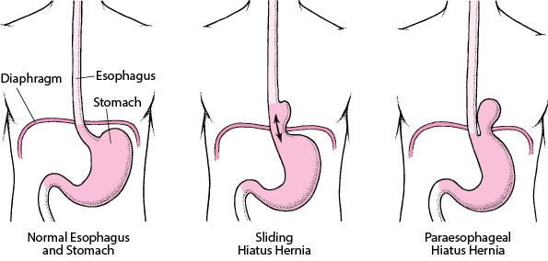

Slide 37
CAUSE
Any condition that will increase abdominal pressure e.g. Strenuous coughing, pregnancy, obesity ,valsava maneuver.
Symptoms
Usually asymptomatic but one can have heartburn
Belching
Sub sternal or epigastric pressure
Pain after eating

Slide 38
diagnosis
Esophagoscopy
Barium meal

Slide 39
Management
Small feeds
Elevate head of bed during bed time
Medication(antacid, histamine receptors, proton pump inhibitors)
Surgical repair

Slide 40
5.Gastro-oesophangeal reflux Disease
Backflow of gastric or duodenal contents into the esophagus.
Symptoms
Pyrosis, dyspepsia, dysphagia, hypersalivation, flatuelnce, nocturnal cough, wheezing, hoarseness of voice
Diagnosis
Barium swallow, endoscopy

Slide 41
Management
Health education
Diet
Medication(proton pump, histamine antagonists ,Prokinetic agents)
Surgical management
Nissen fundoplication

Slide 42
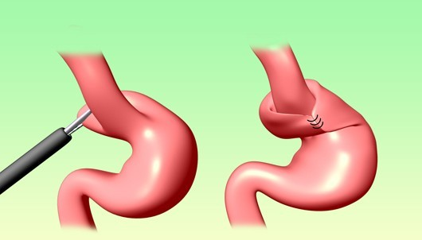
Nissen fundoplication

Slide 43
6. Cancer of the oesophagus
Occurs 3 times in men than in women
Associated with alcohol and tobacco use
Risk factors
Ingestion of hot foods
Poor oral hygiene

Slide 44
Ca esophagus contd….
Exposure to nitrosamines
Cigarette smoking
Chronic alcohol consumption
Pathophysiology
Starts as a small growth usually in the squamous layer. Tumor spreads rapidly due to lack of serosa layer.
Spread is through lymphatic and the systemic circulation.
Inner layer invasion causes ulceration, later the whole wall is invaded. There is hypertrophy of the affected cells

Slide 45
S/S
Diagnosis
Biopsy
CT chest
Endoscopic ultrasound
Management
-Surgical
-Pain
Dysphagia
Sensation of a mass in the throat
Sub sternal pain
Regurgitation of undigested food
Hiccups
Foul smell
Dyspnea
Hemorrhage

Slide 46
Post –op care
Complications
Aspiration pneumonia
Esophageal obstructions
Tracheo-esophageal fistulas
Observations
NBM
Intercostal drain management
Pain control
Antibiotics
IV fluids
Removal of stitches on the 10thday
Other nursing care per the patients needs

