Slide 1
DISORDERS OF THE STOMACH

Slide 2
1. GASTRITIS
Inflammation of the stomach mucosal surface
Pathophysiology
Reduced mucus secretion reduced
Surface protection HCL
Destroys the epithelium

Slide 3
Predisposing factors
Nsaids
Excessive alcohol consumption
Food poisoning
Cigarette smoking
Cytotoxic drugs
Ingestion of corrosive poisons, acids and alkalis
Regurgitation of bile into the stomach
Helicobacter associated gastritis
Autoimmune causes

Slide 4
Clinical manifestations
Anorexia
Abdominal discomfort
Epigastric pain
Hemorrhage
Signs of anemia

Slide 5
Management
Restrict the patient from the irritants
-If it is persistence IV fluids
-dilute the alkaline(lemon juice or vinegar) or acids( aluminium hydrochloride).
-Lavage is indicated if the corrosion is extensive
-NG feeding
-Drugs (analgesics, antacids and sedatives)
-Surgery( gastric resection or gastrojejunostomy) if there is a gangrene or perforation.
-H.Pylori kit( clarithromycin,amoxyl and esomeprazole)
Assignment-morbid obesity, gastric cancer

Slide 6
2. PEPTIC ULCER DISEASE
Erosion of the mucosa and sub mucosal lining of the GIT tract. An “ulcer” is an open sore. The word “peptic” means that the cause of the problem is due to acid. Most of the time when a gastroenterologist is referring to an “ulcer” the doctor means a peptic ulcer.
Sites
Duodenal ulcers
Gastric ulcers
Esophageal ulcer

Slide 7
Contrary to general belief, more peptic ulcers arise in the duodenum (first part of the small intestine, just after the stomach) than in the stomach.
Duodenal ulcers usually first occur between the ages of 30-50 years and are twice as common in men as in women.
Stomach (or gastric) ulcers usually occur in people older than 60 years and are more common in women.
Ulcers come when the defense mechanisms fail

Slide 8
Stomach defense mechanisms
Pre-epithelial factors:-mucus-bicarbonate-phospholipid barrier, HCL that makes environment unfriendly to most organisms
Epithelial:- layer of simple columnar cells that is hydrophobic and interconnected by tight joints with continuous, and well-coordinated cell renewal which maintains constant structural integrity of the mucosa,

Slide 9
Post-epithelial factors
continuous blood flow that delivers oxygen and nutrients with the simultaneous removal of toxic substances, an endothelial barrier that produces nitric oxide and prostacyclin to oppose the damaging effects of vasoconstrictors and inflammation in the microcirculation, and sensory innervation which helps regulate mucosal blood flow and gastric motility. These critical mechanisms exist under normal conditions to balance out injurious factors and prevent the development of ulcers and their complications.

Slide 10
Etiology
Increased gastric juices/intestinal juices
Erosion and inflammation of the mucosa
Causes
Helicobacter pylorii
Stress
Diet
Cigarette smoking
Alcohol
Nsaid
Pancreatic gastric secreting tumor

Slide 11
Pathophysiology
Whatever the etiologic factor is, the following happens:
Peptic ulcers are produced by an imbalance between the gastro-duodenal mucosal defense mechanisms and damaging forces of gastric acid and pepsin, combined with superimposed injury from environmental or immunologic agents.
The mucous membrane lining the digestive tract erodes and causes a gradual breakdown of tissue. This breakdown causes a gnawing or burning pain in the upper middle part of the belly (abdomen).

Slide 12
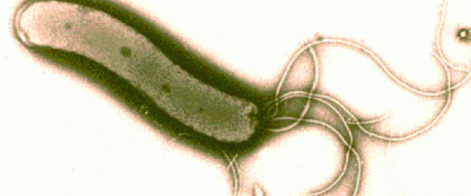
H. pylori
80% of ulcers are associated with Helicobacter pylori, a spiral-shaped bacterium that lives in the acidic stomach. Requires a little oxygen for survival
It is capable of forming biofilms and can convert from spiral to a possibly viable but nonculturable coccoid form, both likely to favor its survival and spread
Infection is usually contracted in childhood, perhaps through food, water, or close contact with an infected individual.
H. pylori associated with a 1-2% lifetime risk of stomach cancer and a less than 1% risk of gastric MALT lymphoma

Slide 13
Usually doesn't cause problems in childhood, if left untreated it can cause ulcers by:
-- infecting and inflaming the stomach and duodenal lining which weakens their defenses.
--Disturbing the mechanism which normally switches off acid and pepsin production after a meal has been digested so that more acid is produced on empty stomach

Slide 14
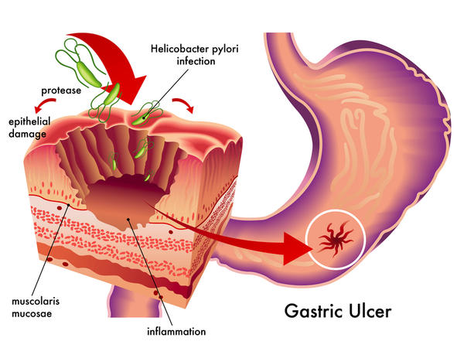

Slide 15
Stress
Stress related mechanisms: increased catecholamine release, vasoconstriction, and secretion of pro-inflammatory cytokines .
These effects are initially beneficial because they shift blood away from the GI tract and to critical organs such as the brain . However, when they persist they cause damage by breaking down gastric mucosal defenses, leading to injury and ulceration.

Slide 16
Decreased blood flow results in poor oxygen delivery and ischemic damage which have structural and chemical consequences.
Loss of the epithelial cell layer that separates the contents of the gastric lumen with the body’s interior milieu leads to increased permeability and back-diffusion of protons and pepsin which further damages the mucosa
Hypoperfusion also triggers the production of oxygen radicals and the decreased synthesis of gastro-protective prostaglandins which can lead to an aggressive inflammatory response

Slide 17
Interestingly, reperfusion injury also plays a significant role in the pathogenesis of stress ulcers. Once blood flow is restored to ischemic tissue, the sudden hyperemia brings in an influx of inflammatory cells and cytokines that result in even more cell death.
Both ischemia and reperfusion cause and worsen gastric dysmotility through the effect of cytokines on the enteric nervous system.
Poor motility aggravates the situation because the persistence of acidic material and other irritants increase the risk of ulcer formation and persistence

Slide 18
Therefore in management, we should aim at maintaining gastric motility, improving the hemodynamics, and the overall medical status of your patients to help prevent splanchnic hypoperfusion, as well as providing acid suppression, typically with a proton pump inhibitor

Slide 19
NSAIDS
Topical irritant effect on the epithelium,
Destroys the tight junctions
Suppression of gastric prostaglandin synthesis,
Reduction of gastric mucosal blood flow and interference with the repair of superficial injury.
NSAIDs acids contribute to ulcers pathogenesis and bleeding, by impairing the restitution process, interfering with hemostasis and inactivating several growth factors that are important in mucosal defense and repair.

Slide 20
Smoking
Smoking and chronic nicotine treatment stimulate gastric and HCL acid output which is more pronounced in the smokers having duodenal ulcer.
This increased gastric acid secretion is mediated through the stimulation of H2-receptor by histamine released after mast cell degranulation and due to the increase of the functional parietal cell volume or secretory capacity in smokers.
Nicotine stimulates pepsinogen secretion by increasing chief cell number or with an enhancement of their secretory capacity.

Slide 21
Long-term nicotine treatment in rats also significantly decreases total mucus neck cell population and neck-cell mucus volume.
Smoking also increases bile salt reflux rate and gastric bile salt concentration thereby increasing duodeno-gastric reflux that raises the risk of gastric ulcer in smokers.
Smoking and nicotine not only induce ulceration, but they also potentiate ulceration caused by H. pylori, alcohol, nonsteroidal anti-inflammatory drugs

Slide 22
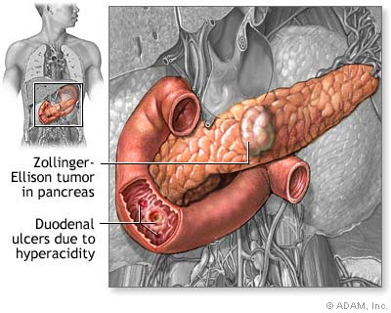
Gastrinomas (Zollinger Ellison syndrome), rare gastrin-secreting tumors, also cause multiple and difficult to heal ulcers.

Slide 23
Diet
Beverages and foods that contain caffeine can stimulate acid secretion in the stomach. This can aggravate an existing ulcer, but the stimulation of stomach acid can't be attributed solely to caffeine.

Slide 24
Alcohol(Chemical component is ethanol, a psychotropic drug)
Alcoholic beverages are typically divided into three classes—beers, wines, and spirits—and typically contain between 3% and 40% Alcohol by volume (ABV).
Beer (Alcohol content: 4%-6% ABV generally) and Wine (Alcohol content: 9%-16% ABV) are alcoholic beverages produced by fermentation. Beer is generally composed of malted barley and/or wheat and wine is made using fermented grapes. The above two have low alcohol content

Slide 25
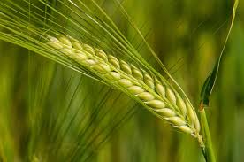
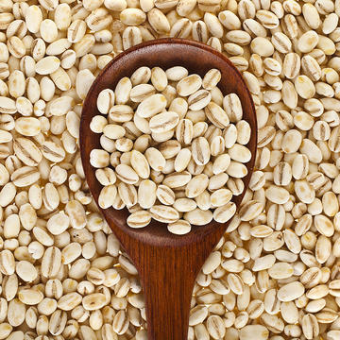
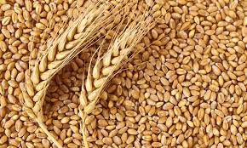
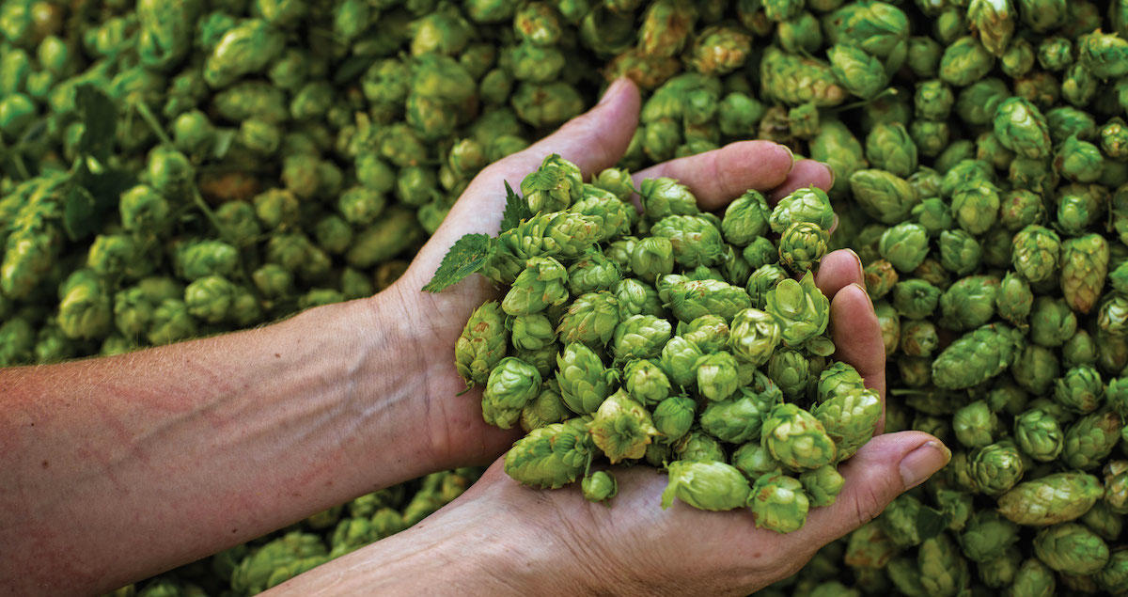
barley
wheat
hops

Slide 26
How do we end up with wheat in alcohol?
MALT is barley or other grain that has been steeped(soaked), germinated, and dried, used especially for brewing or distilling and vinegar-making
Germination makes the starch /sugars ready for fermenting
Malted barley is crushed and soaked in water. Crushing increases the surface area for sugar dissolving.
The extent of heating the barley plus the type of yeast determine the color and taste of beer
Yeast is added to ferment. Ethanol is produced

Slide 27
If more roasting is done and hops(another plant) added, alcohol is at 7 or 8% and beer labeled is strong (stout) “Export”
Lager or ale? Due to type of yeast used(Yeast is bacteria of fermenting) Lager starts fermenting beer at bottom, and spreads upwards while ale starts at top. Does better in lower temperatures910⁰c)
Lager produces better beer in terms of taste but takes longer to ferment.
Ale starts at top and spreads downwards and does better in cool temperatures

Slide 28


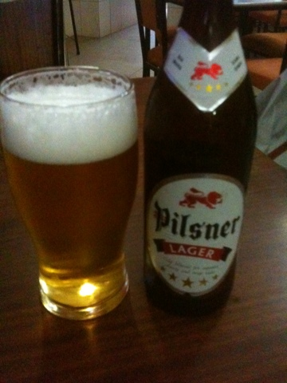

Slide 29
Champagne is just a specific variant of wine. A sparkling(carbonated) wine produced from grapes grown in the Champagne region of France following rules of secondary fermentation of the wine in the bottle to create carbonation.
Whisky, Rum, Brandy, Vodka, Tequila are all what we call 'Spirits'. Spirits (aka Liquor or Distilled beverage) are beverages prepared using distillation. Distillation is further purification and removal of any diluting components like water.
This increases the alcohol content and that's why they are also known as 'Hard Liquor',
Distilled beverages like whisky may have up to 40% ABV.

Slide 30
Soda is nothing but carbonated water. Carbonated water (also known as club soda, soda water, sparkling water, seltzer water, or fizzy water) is water into which carbon dioxide gas under pressure has been dissolved.
A cocktail is a mixed alcoholic drink/beverage that contains two or more ingredients (like a distilled spirit, soda, fruit juice, honey, herbs etc.) if at least one of them contains alcohol.
Mocktail contains fruit juices.

Slide 31
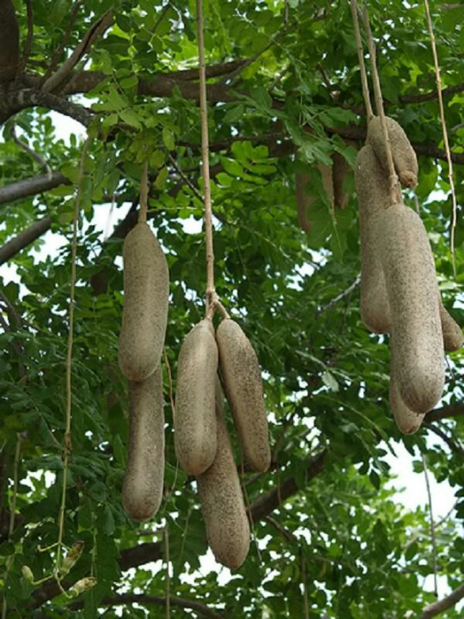
Local brews
Muratina is also known as honey beer, as it is an alcohol made from the sweet muratina fruit and is processed with water, sugar and honey. Fermentation of fruits produces more methanol than ethanol.
Busaa ale) is a home brewed cereal-based beer generally produced from the fermentation of maize, millet or sorghum.
The mean ethanol content of busaa is about 4 percent- much less than the average 34 percent for chang’aa.
Sometimes methanol is added making them toxic

Slide 32
How much to take?
Normal drinking according to CDC
Women should consume no more than one drink per day, and men should stop at two drinks per day. For these recommendations, a drink is defined as:
12 ounces of beer (1 tablespoon=0.5ounce ,15-20mls)
8 ounces of malt liquor
5 ounces of wine
1.5 ounces of 80-proof liquor such as rum, gin, vodka, or whisky
All of these drinks contain slightly more than half an ounce of pure alcohol. Acts like nicotine for ulcer formation
Alcohol reduces the amount of digestive enzymes which the pancreas produces to help us to break down the fats and carbohydrates we eat

Slide 33
What is your stand on alcohol? Prv 23:29-35
29Ni nani wapigao yowe? Ni nani wenye huzuni? Ni nani wenye ugomvi? Ni nani walalamikao?Ni nani wenye majeraha bila sababu?
Ni nani wenye macho mekundu? 30Ni wale ambao hawabanduki penye divai, wale wakaao chonjo kuonja divai iliyokolezwa.
31Usiitamani divai hata kwa wekundu wake, hata kama inametameta katika bilauri, na kushuka taratibu unapoinywa. ³²Mwishowe huuma kama nyoka; huchoma kama nyoka mwenye sumu. ³³Macho yako yataona mauzauza, moyo wako utatoa mambo yaliyopotoka. Utakuwa kama mtu alalaye katikati ya bahari kama mtu alalaye juu ya mlingoti wa meli.
³⁵Utasema, “Walinichapa, lakini sikuumia walinipiga, lakini sina habari.
Nitaamka lini? Ngoja nitafute kinywaji kingine!

Slide 34
Classification of peptic ulcers
Ulcers are named for their location within the body. Sometimes ulcers can also be diagnosed by examining the mouth and tongue of the effected patient to detect and find the type of Ulcer.
Some other type of Ulcers however will take other method for diagnoses. There are also other types of ulcers which are relatively less common and among them are Stress Ulcers, Bleeding Ulcers, esophageal ulcers and Refractory Ulcers.

Slide 35
Peptic Ulcers
Strictly, pepsin exposed ulcers are called peptic ulcers, although the term is applied to mean all esophageal, gastro, duodenal ulcers. Peptic Ulcer is the most common type in the gastrointestinal tract area. Relieved by anti acids.
Found on stomach or duodenum wall.
Pepsin and HCL, when barrier is damaged, digest epithelium.

Slide 36
Duodenal Ulcers
In duodenum.
Duodenum ulcers are usually benign however doctors may take a biopsy to make sure that they are benign.
Usually patients feel a burning sensation and heartburn feelings .Duodenum ulcers will usually begin in the starting point of the small intestine and are this type of Ulcer is much common in western societies than any other. Four less common types are following:

Slide 37
Esophageal Ulcer
Occurs in the lower end of esophagus.
H. pylori common etiology
Patients may feel a lot of pain if acid from stomach refluxes
Causes difficulty and pain in swallowing.

Slide 38
Bleeding Ulcer
Internal bleeding occurs if an ulcer is untreated.
Must be attended to fast
Refractory ulcers Simple peptic ulcers that have not healed after at least 3 months of treatment are called refractory ulcers
Stress ulcers
consist of a group of lesions and usually found in the esophagus, the stomach or the duodenum.
Common in those with other illness or are critically ill and on ventilation.

Slide 39
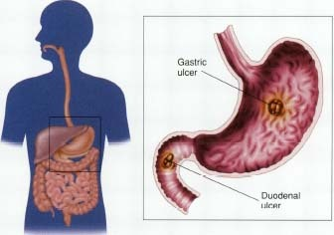
SYMPTOMS

Slide 40
Duodenal ulcers
-Age-30 to 50
-Male: female= 3:1
-Incidence-80%
-May have weight gain
-Pain-2 to 3 hrs after meals
-Nocturnal awakening
-Vomiting uncommon
-Hemorrhage less likely
-Perforation more likely
Gastric ulcers
-Usually 60 and over
-1:1
-15%
-May have weight loss
-1/2-1 hrs after meals
-No nocturnal awakening
-Vomiting common
-Hemorrhage more likely
-Perforation less likely

Slide 41
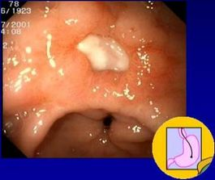
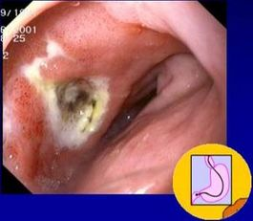
Endoscopy

Slide 42
Predisposing factors
Are age 60 or older (your stomach lining becomes more fragile with age).
Have had past experiences with ulcers and internal bleeding
Take steroid medications, such as prednisone.
Take blood thinners, such as warfarin.
Consume alcohol or use tobacco on a regular basis.
Experience certain side effects after taking NSAIDs, such as upset stomach and heartburn.
Take NSAIDs in amounts higher than

Slide 43
recommended or for long period
Stress doesn’t cause ulcers, but a contributing factor
Chronic disorders: liver disease, emphysema, R. arthritis may predispose one to ulcers
Improper diet, irregular or skipped meals
Type O blood (for duodenal ulcers)

Slide 44
COMPLICATIONS
GI bleeding is the most common complication. It occurs when the ulcer erodes one of the blood vessels.
Perforation Erosion of the gastro-intestinal wall by the ulcer leads to spillage of stomach or intestinal content into the abdominal cavity. The first sign is often sudden intense abdominal pain. Posterior wall perforation leads to pancreatitis; pain in this situation often radiates to the back.

Slide 45
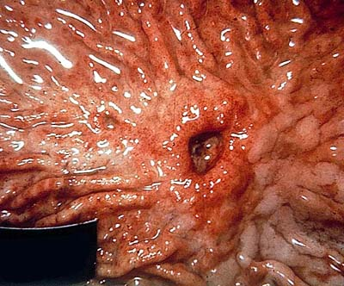

Slide 46
Penetration is when the ulcer continues into adjacent organs such as the liver and pancreas
Scar tissue Scarring and swelling due to ulcers causes narrowing in the duodenum and gastric outlet obstruction. Patient often presents with severe vomiting. Peptic ulcers can also produce scar tissue that can obstruct passage of food through the digestive tract, causing one to become full easily, to vomit and to lose weight.

Slide 47
WARNING SIGNS
vomit blood
sudden, severe pain
vomit food eaten hours or
days before
ongoing nausea or
repeated vomiting.
feel cold or clammy
feel unusually weak or
dizzy
blood in your stools
losing weight
pain doesn't go away
With medication

Slide 48
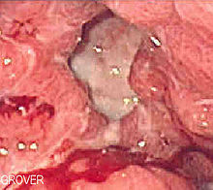
TESTS AND DIAGNOSIS CHART

Slide 49
Noninvasive
Urea Breath Test (UBT)
Blood test
Invasive
Histology
Biopsy Urease Test

Slide 50
Culture
Other tests
Stool antigen test
Endoscopy
Upper gastrointestinal (upper GI) X-ray

Slide 51
TREATMENT

Slide 52
GOALS OF TREATMENT
Lowering the amount of acid that stomach makes,
Neutralizing the acid
protecting the injured area so it can heal
It's also very important to stop smoking and drinking alcohol
Prevent complications (bleeding, perforation, penetration, obstruction)
Minimize recurrences
Reduce financial costs

Slide 53
Antibiotic medications. Combinations of antibiotics to treat H. pylori because one antibiotic alone isn't always sufficient to kill the organism.
-amoxicillin (Amoxil), clarithromycin (Biaxin) and metronidazole (Flagyl). Combination drugs that include two antibiotics together with an acid suppressor or cytoprotective agent (Helidac, Prevpac) have been designed specifically for the treatment of H. pylori infection.

Slide 54
Acid blockers. Also called histamine (H-2) blockers — reduce the amount of HCL released into GI. This relieves ulcer pain and encourages healing.
MOA: keeping histamine from reaching histamine receptors.
NB: Histamine is a substance normally present in body. When it reacts with histamine receptors, the receptors signal acid-secreting cells in stomach to release hydrochloric acid. Available by prescription or over-the-counter (OTC), acid blockers include the medications ranitidine (Zantac), famotidine (Pepcid), cimetidine (Tagamet) and nizatidine (Axid).

Slide 55
Antacids. An antacid may be taken in addition to an acid blocker or in place of one. Instead of reducing acid secretion, antacids neutralize existing stomach acid and can provide rapid pain relief.

Slide 56
Proton pump inhibitors. Reduce acid by blocking the action of these tiny pumps. These drugs include the prescription and over-the-counter medications omeprazole (Prilosec), lansoprazole (Prevacid), rabeprazole (Aciphex) and esomeprazole (Nexium). They also inhibit H. pylori.

Slide 57
Cytoprotective agents. Protect the GI mucosa.
sucralfate (Carafate) and misoprostol (Cytotec). bismuth subsalicylate (Pepto-Bismol).

Slide 58
Bowel rest: Bed rest and clear fluids with no food at all for a few days. This gives the ulcer a chance to start healing without being irritated.
Nasogastric tube: Decompression
Urgent endoscopy or surgery if indicated: Damaged, bleeding blood vessels can usually be repaired with an endoscope. The endoscope has a small heating device on the end that is used to cauterize a small wound.

Slide 59
Surgery
Vagotomy
Antrectomy
Pyloroplasty
Tying off an
artery
Other modes
Of treatment
Acupuncture
Chiropracting
Homeopathy
Herbs
Notes:
Chiroprotractor deals with the disorders of the MS and Nervous systems. Manipultes for example spinal joints that have become hypomobile due to injury etc
Using irritants to cure the dsame condition

Slide 60
LIFE STYLE AND HOME REMEDIES

Slide 61
Use of Olive Oil
Don't smoke
Limit or avoid alcohol
Less
Coffee and
Carbonated
Beverages
Avoid nonsteroidal
anti-inflammatory
drugs (NSAIDs)
Exercise
Fruits and
Vegetables
Stress Relief

Slide 62
Read and make notes on pyloric stenosis

