Slide 1
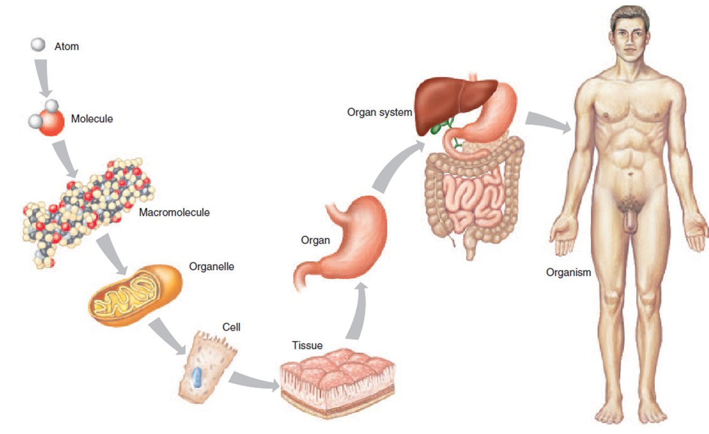
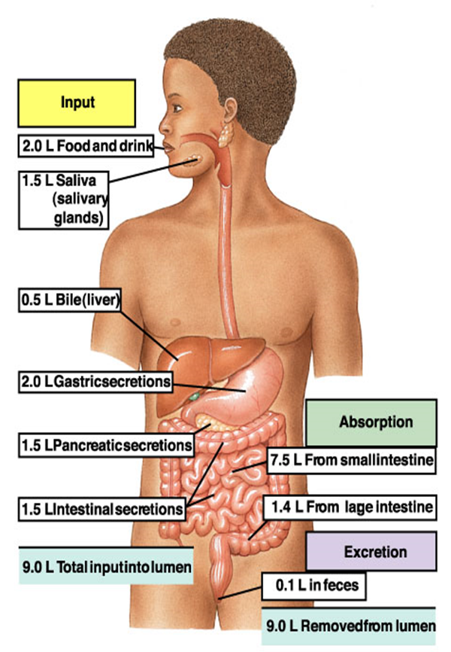
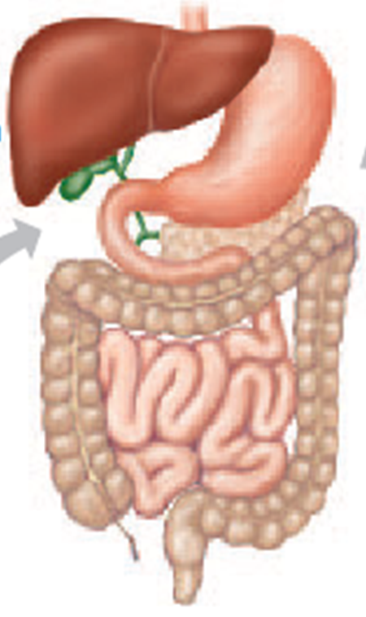
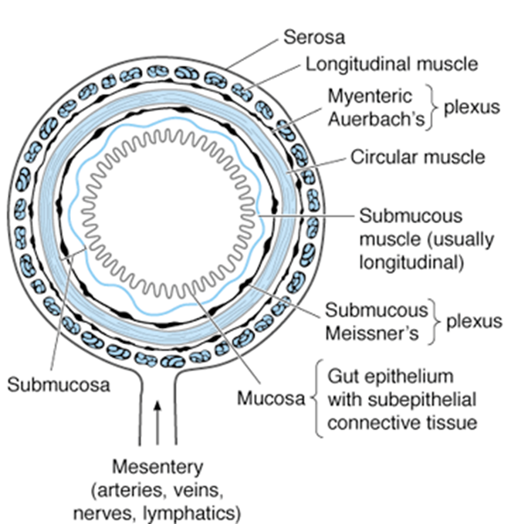
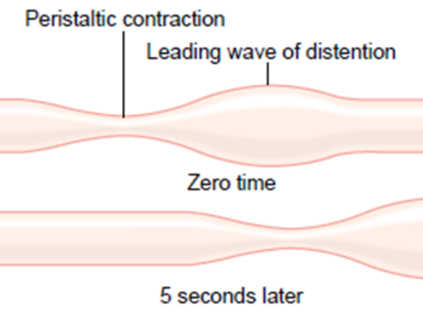
Anatomy of the
GASTROINTESTINAL SYSTEM

Slide 2
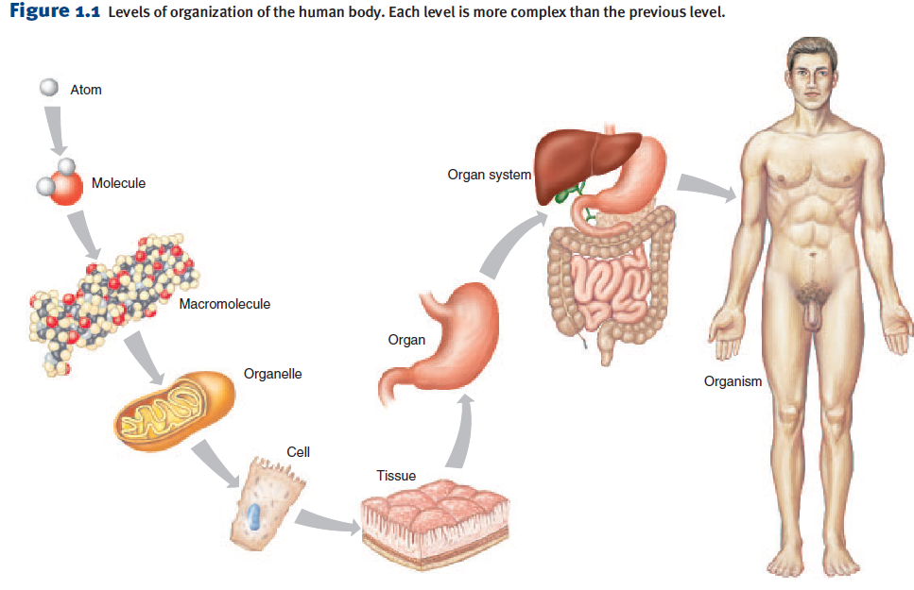
GENERAL PRINCIPLES
Get a general overview on
  Structure of GIT
  How food is
    Ingested,
    Moves down GIT,
    Digested and
    Absorbed.

Slide 3
General organization of the human body

Slide 4
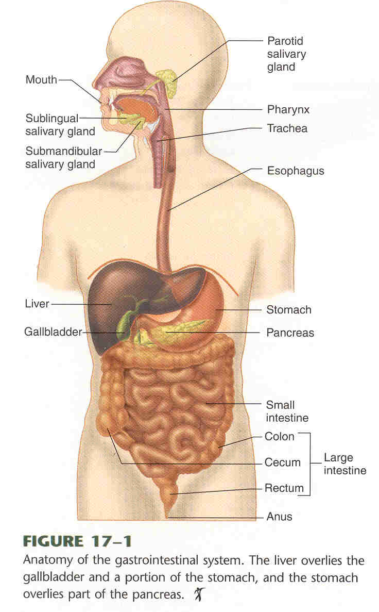
GENERAL PRINCIPLES STRUCTURE
GIT consists of 4 anatomical divisions:
  esophagus,
  stomach,
  small intestine, and
  colon or large intestine.
Accessory organs that play critical roles in digestion and absorption
  Teeth – help in breakdown
  Tongue –help in taste and swallowing
  Glands- for secretions
    Salivary
    Pancreas
    Liver.

Slide 5

STRUCTURE - GIT WALL- 4 layers
Mucosa
  Innermost layer (faces Lumen) devided into
  a.Epithelium,
    Protective barrier and the site of secretion and selective absorption( tight juction)
    Type varies from region to region depending on fuction
    At areas of likely to friction& injury its non keratinized stratified squamous (i.e in mouth, pharynx, esophagus & rectum).
    In areas of secretion and absorption its simple columnar/cuboidal
    Scattered between the cuboidal cells is exocrine (goblet cells) and endocrine (enteroendocrine cells)
  b.Lamina propria – supportive connective tissue
  c. muscularis mucosae
    a thin layer of smooth muscle

Slide 6
STRUCTURE - GIT WALL- 4 layers
Submucosa
  Strong and highly vascularized layer of connective tissue.
  Consists of collagen, elastin, glands, blood vessels and nerves/submucous plexus(autonomic)
The muscularis externa
  consists of inner circular and outer longitudinal layers (a partial oblique layer is present only in the stomach)
  Sandwiched between the muscles is another autonomic plexuses called myenteric plexuus
  Provides motility for GI tract
The external surface is serosa or adventitia, depending on its position within the body.
  Faces the blood
  Forms posterior mesentery

Slide 7
MAIN ROLE OF GIT
Provides the body with
  Water
  Electrolytes and
  Nutrients- carbohydrates, proteins, fats, vitamins

Slide 8
FUNCTIONS OF THE GI TRACT
4 major activities of GI tract
  Movement (motility)
    Propel ingested food from mouth towards rectum.
  Secretions
    Aid in digestion and absorption
  Digestion (Mechanical & chemical).
    Food broken down into absorbable molecules
  Absorption
    Nutrients, electrolytes, and water are absorbed
For the functions to be complete the following are necessary.
  Circulation of blood through the gastrointestinal organs to carry away the absorbed substances and
  Control of all these functions by local, nervous, and hormonal systems.

Slide 9
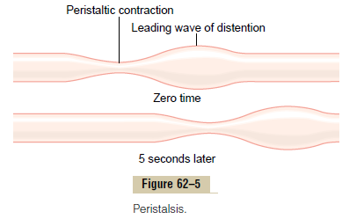
how does food move in GIT?
Movement is achieved by contraction of a type of muscle called smooth muscle
The contraction of the smooth muscle is initiated by mechanical(stretch), neural or hormonal stimuli
The stimuli leads to ca++ influx into a muscle cell.
The ca ++ influx leads contraction of smooth muscle
Contraction of one muscle spreads to others through Gap juctions hence function as a Syncytium)
Contractions helps to propel, mix, and churn the food.

Slide 10
TYPES OF SMOOTH MUSCLES.
Longitudinal Muscle:
  Thinner and less powerful
  Contraction shortens the segment of the intestine and expands the lumen
  Innervated by ENS, mainly by excitatory motor neuron
  Less gap junctions
  Ca influx from outside is important
Circular muscle:
Thicker and more powerful than longitudinal Contraction reduces the diameter of the lumen and increases its length
Innervated by ENS, both excitatory and inhibitory motor neurons
More gap junctions than in longitudinal muscle
Intracellular release of Ca is more important

Slide 11
Types of smooth muscles.
TWO types of smooth muscles exist.
-Unitary type
-Contract spontaneously in the absence of neural or hormonal influence but in response to stretch (such as in stomach and intestine)
-Cells are electrically coupled via gap junctions
Multiunit type
-Do not contract in response to stretch or without neural input (such as in esophagus & gall bladder)

Slide 12
What are the types of contractions.
Phasic contractions
Periodic contractions followed by relaxation; such as in gastric antrum, small intestine and esophagus
Tonic contractions
Maintained contraction without relaxation; such as at sphincters
  Lower esophageal sphincter
  pyloric sphincter,
  Ileocecal and
  Internal anal sphincter
Not associated with slow waves
Caused by:
  Continuous repetitive spike potential
  Hormonal effects
  Continuous entry of Ca++.

Slide 13
Types of movements in GIT
Two types of movements occur in the GIT:
propulsive(peristaltic) movements,
  Cause food to move forward along the tract at an appropriate rate to accommodate digestion and absorption.
mixing movements,
  Keep the intestinal contents thoroughly mixed at all times.

Slide 14
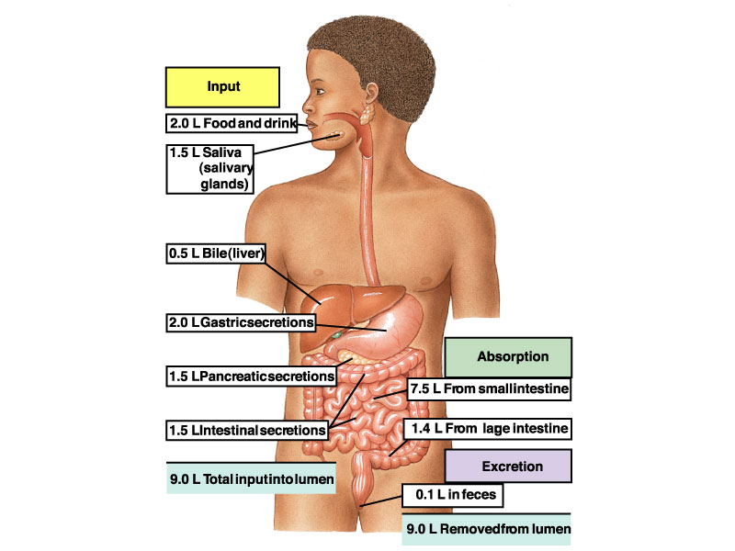
SECRETIONS OF DIGESTIVE GLANDS
Digestive glands
  Salivary gland
  Gastric
  Pancreatic
  Liver and
  intestinal glands, etc.
Secretory volume: 6~8 L/ day

Slide 15
SECRETIONS OF DIGESTIVE GLANDS
Functions of the digestive juice *
Diluting food (food osmotic pressure is similar to blood);
Changing pH value (it is suitable for enzyme digestion);
Contain enzymes that Hydrolizes food e.g amylase , proteinase, lipase,.
Contain hormones(>18 e.g gastrin,CCK, secretin) and local chemicals(e.g histamine) that regulate activities of the GIT.
Protection by mucus, antibody, a great quantity of liquid.

Slide 16
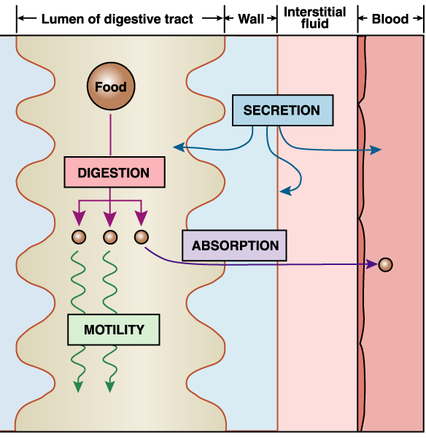
DIGESTION
Digestion occurs in the GI lumen by secreted enzymes and on surface of enterocytes by membrane-bound enzymes.
A typical meal contains carbohydrates, fat, protein, water, electrolytes, and vitamins.
Although water, electrolytes, and vitamins do not require special processing.

Slide 17
DIGESTION
The major foods on which the body lives can be classified as carbohydrates, fats, and proteins must be broken into small forms to be absorbed
Digestion of the Various Foods takes place by Hydrolysis which is breakdown of water and return of the hydrogen and hydroxyl ions from water into carbohydrates, protein or fat molecules.

Slide 18
DIGESTION
The chemistry of digestion is simple i.e
  In the case of all three major types of food the same basic process of hydrolysis is involved.
  The only difference lies in the types of enzymes required to promote the hydrolysis reactions for each type of food.
  Many of the enzymes are located in such glands as the salivary gland, glands in the stomach wall, and pancreas and are secreted into the lumen of the gut.

Slide 19
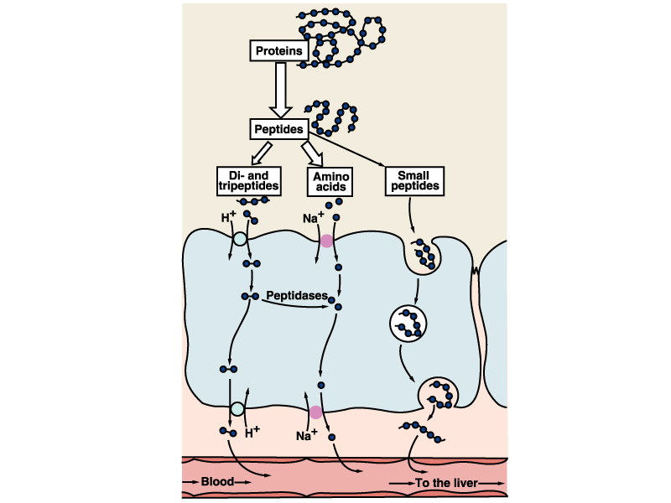
ABSORPTION
Absorption occurs by
  simple diffusion,
  facilitated diffusion,
  active transport,
  endocytosis, and
  paracellular transport

Slide 20
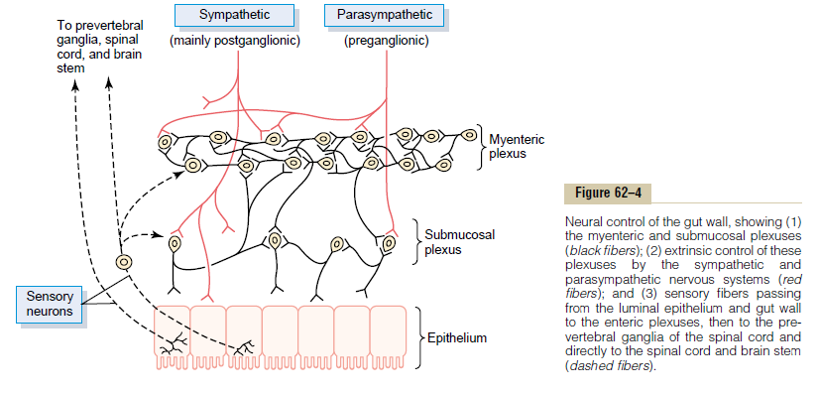
NEURAL CONTROL OF GIT
Autonomic Nervous System has an extrinsic and an intrinsic component
  Extrinsic
    Sympathetic and Parasympathetic innervation of GI tract
  Intrinsic
    Called Enteric Nervous System
    Contained within wall of GI tract
    Communicates with Extrinsic component

Slide 21
NEURAL CONTROL OF GIT
parasympathetic Nerves:
  Location in brain stem & sacral region
  Projection - preganglionic
  Neurotransmitter is Ach =excitetory)
Sympathetic nerves:
  Location thoracic & lumbar regions
  Projection - postgangionic
  Neurotransmitter= NE(neuroepinephrine) =inhibitory)
  NE increases sphincter tension
  Inactivate the motility

Slide 22
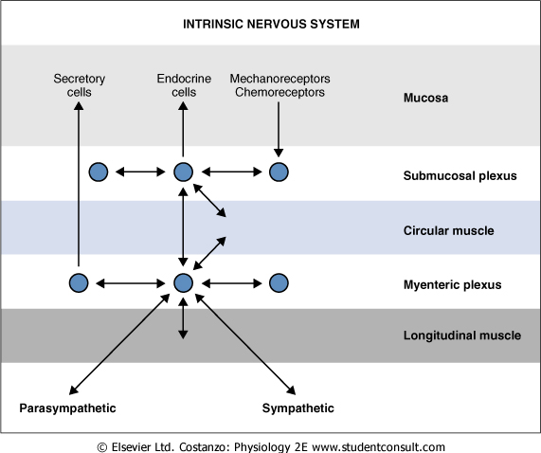
NEURAL CONTROL OF GIT – INTRINSIC(MINIBRAIN
Can direct all functions of GI in absence of extrinsic innervation
Controls contractile, secretory, and endocrine functions of GI tract
Receives input from
  Parasympathetic and sympathetic nervous systems
  Mechanoreceptors and chemoreceptors in mucosa
Sends information directly to smooth muscle, secretory, and endocrine cells

Slide 23
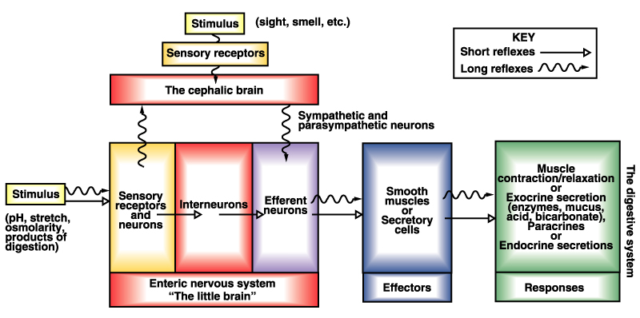
NEURAL CONTROL OF GIT – SUMMARY

Slide 24
CHEMICAL CONTROL OF GIT
Numerous peptides (short amino acid sequences) regulate GI function.
GI peptides can be divided into three classes based on their site of release and action:
  Hormones- go through blood stream,
  Paracrines – have local action.
  neurocrines.
Hormones include
  secretin,
  gastrin, cholecystokinin(CCK),
  gastrin inhibitory peptide (GIP), and
  Motilin.

Slide 25
CHEMICAL CONTROL OF GIT
Paracrines include
  somatostatin and
  histamine.
Neurocrines include
  vasoactive intestinal peptide(VIP),
  gastrin-releasing peptide(GRP), and
  enkephalins.

Slide 26
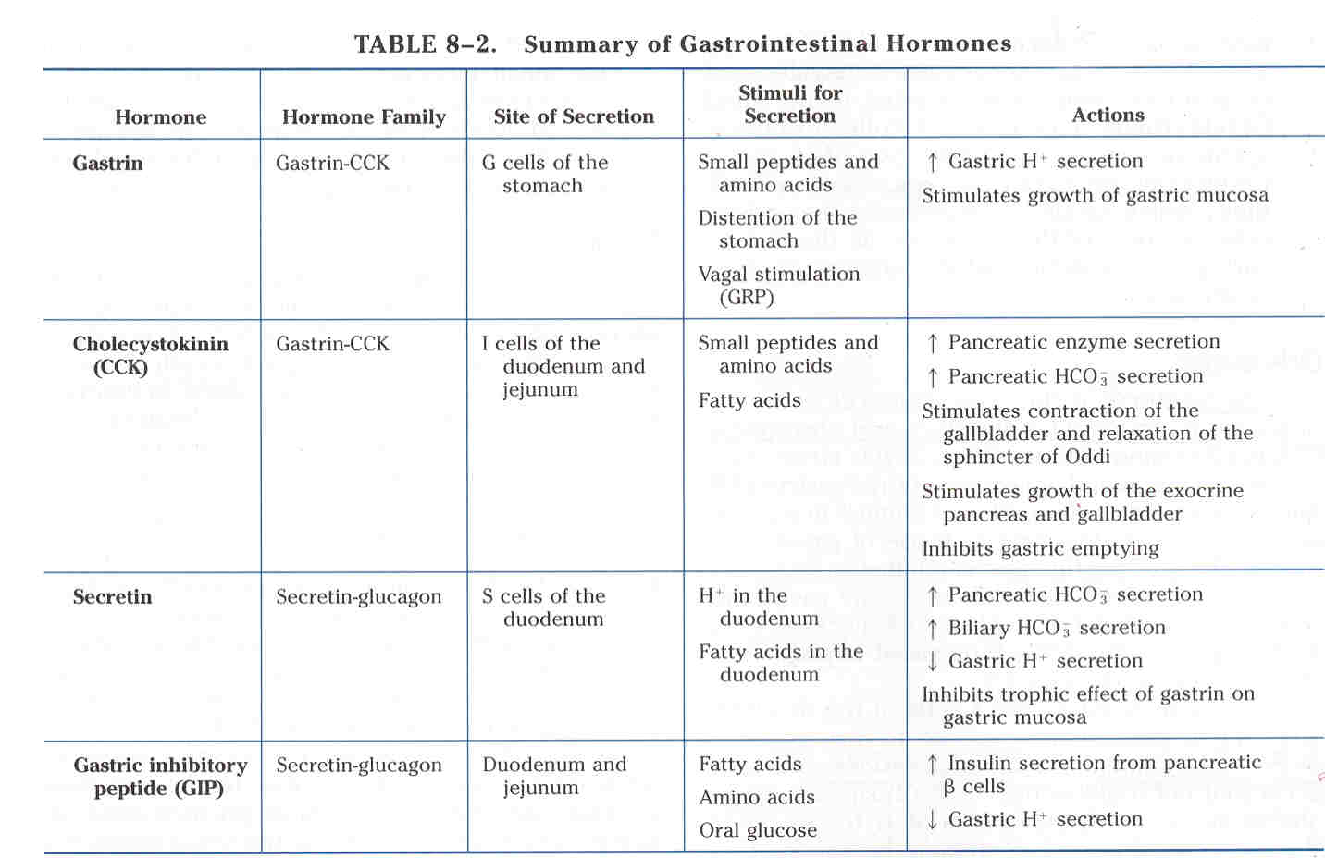

Slide 27
CHEMICAL CONTROL OF GIT
Functions of GIT hormones
  To regulate digestive gland secretion and digestive tract movement
  Trophic action .
  To modulate other hormones secretion
  Brain-gut peptide*

Slide 28
GASTROINTERSTINAL REFLEXES
3 TYPES
  Reflexes that are integrated entirely within the gut wall enteric nervous system.
  Reflexes from the gut to the prevertebral sympathetic ganglia and then back to the gastrointestinal tract.
  Reflexes from the gut to the spinal cord or brain stem and then back to the gastrointestinal tract.

Slide 29
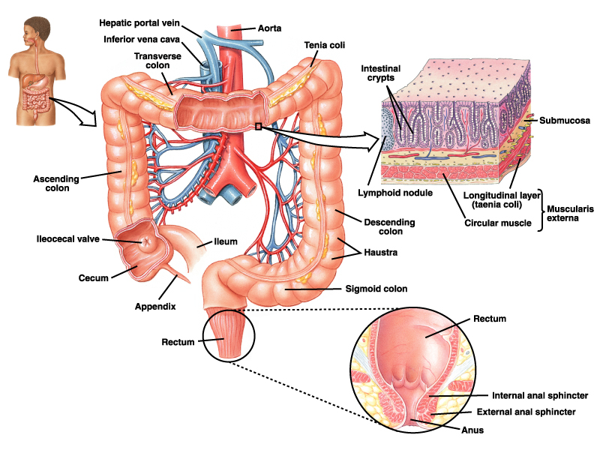
Blood supply
GI tract and accessory organs receive arterial blood from abdominal aorta
The branches from aorta to supply the organs include
  Cealiac artery
  Superior mesenteric
  Inferior mesenteric
The veins drain to Portal system
Portal system passes through a second capillary bed where phagocyte reticuloendothelial cells clean the blood of any bacteria and other particles before the blood enters the general circulation.
Most of the water-soluble, nonfat substances absorbed by the GI tract are also carried in the portal circulation to the liver.
Liver cells remove about one third to one half of all nutrients.
Fat-soluble substances absorbed by the GI tract are delivered to the circulation by the intestinal lymphatics.

Slide 30
Summary
The major function of the gastrointestinal system is to process food, and then provide nutrients to the cells of body.
The musculature of the digestive tract is mainly smooth muscle.
The digestive tract is innervated by the sympathetic, parasympathetic and enteric divisions of the autonomic nervous system.
Both motility and secretion are regulated by neural and hormonal mechanisms.

