Slide 1
Perioperative Nursing
By Ogera Dan - the DON

Slide 2
HISTORY OF THEATRE NURSING
Has developed alongside the history of surgery.
Surgery can be traced back through the history of man.
In the past, there were no theatres, no trained personnel, no anaesthesia and no equipment.
Operations were performed at home.
Problems during this time included infection, bleeding and pain.
However, with time, efforts were made to solve these problems.

Slide 3
HISTORY OF THEATRE NURSING
e.g in 17 BC, alcohol and opium were used to relieve pain by Napoleon who performed an amputation while the patient slept for 24 hours.
By 1772, Joseph Priestly discovered the use of nitrous oxide as an anesthesia,
in 1842, Dr Crawford discovered the use of ether. In 1847 James Young began to use chloroform.
In the 18th century a great breakthrough was made with the use of trilene thiopentone, clytopopaine and curare, which are muscle relaxants.
By the end of 19th century, pain relief was an integral part of surgery.

Slide 4
HISTORY OF THEATRE NURSING
In order to control haemorrhage, the ancient Greeks and Romans in the 16th century, used strings as ligatures.
Later on, the use of hot iron was introduced
This idea has been developed into the use of cautery machine to control bleeding.
By the beginning of the 20th century, many types of ligatures were available, prepared from metal, nylon, cotton,and silk

Slide 5
HISTORY OF THEATRE NURSING
The control of infection dates back to the efforts of Louis Pasteur,
Who proved that bacteria caused infections.
In 1865, Joseph Lister used carbonic acid to reduce the growth of bacteria in wounds.
In 1886 Von Bergemen introduced sterilization of dressings.

Slide 6
HISTORY OF THEATRE NURSING
The use of gloves was introduced in surgery in 1890.
The history of nursing is very much related to the history of theatre nursing.
Operating theatre nursing is a special branch of nursing.
The theatre nurse has evolved together with the development of the theatre.
He/she is a member of a bigger team, all of whom work together to provide a safe passage through the operating theatre for every patient.

Slide 7
HISTORY OF THEATRE NURSING
The theatre nurse is responsible for the success of any surgical procedure.
He/she must, therefore, be highly skilled and trained, in order to be able to ensure a successful outcome for the patient.

Slide 8
AIMS OF THE THEATRE NURSE
To prepare conscientiously by study to adapt to the changing world of medicine
To allay the fears of the patient
To integrate the patient care during their period in theatre
To become highly skilled in theatre techniques
To be able to impart knowledge to others.

Slide 9
Peri-operative nursing
Definition;
Perioperative nursing describes the wide variety of nursing functions associated with the patient’s surgical management.
Perioperative Nursing is the care of a client or patient before, during, and after an operation.
It is a specialized nursing area wherein a registered nurse works as a team member of other surgical health care professionals.

Slide 10
Perioperative nursing is used to describe the nursing care provided in the total surgical experience of the patient: preoperative, intra-operative and postoperative.
Preoperative Phase:
Extends from the time the client is admitted in the surgical unit, to the time he/she is prepared for the surgical procedure, until he is transported into the operating room.

Slide 11
b. Intra-operative Phase;
Extends from the time the client is admitted to the Operating Room, to the time of administration of anesthesia, surgical procedure is done, until he/she is transported to the Recovery Room (RR)/PACU.
c. Postoperative Phase:
Extends from the time the client is admitted to the recovery room, to the time he is transported back in to the surgical unit, discharged from the hospital, until the follow-up care.

Slide 12
PREOPERATIVE PHASE
Goals:
Assessing and correcting physiologic and psychologic problems that may increase surgical risk.
Giving the person and significant others complete learning / teaching guidelines regarding surgery.
Instructing and demonstrating exercises that will benefits the person during postoperative period.
Planning for discharge and any projected changes in lifestyle due to surgery.

Slide 13
INTRAOPERATIVE PHASE
Goal;
  Asepsis
  Homeostasis
  Safe Administration of Anesthesia
  Haemostatis

Slide 14
POSTOPERATIVE CARE
Goals:
Restore homeostasis and prevent complication
Maintain adequate cardiovascular and tissue perfusion.
Maintain adequate respiratory function.
Maintain adequate nutrition and elimination.
Maintain adequate fluid and electrolyte balance.
Maintain adequate renal function.
Promote adequate rest, comfort and safety.
Promote adequate wound healing.
Promote and maintain activity and mobility.
Provide adequate psychological support.

Slide 15
Preoperative Nursing Assessment
  Age
  Allergies
  Vital Sign Trend
  Nutritional Status
  Habits affecting tolerance to anesthesia
  Presence of Infections
  Use of drugs that are contraindicated prior to surgery
  Physiological Status
  Psychological state of the patient

Slide 16
Preoperative Nursing Assessment
Age:
  Elderly are at risk
  >65 years of age
  obtain a detailed medical history and health assessment
  assess for sensory deficits
  assess for overall functional status
  understand that there is a decreased physiological reserve
Allergies:
  assess for known drug, food and substance allergies
  assess what the reaction to the drug or substance is (is it a true allergy, hives or anaphylaxis?)
  allergies must be clearly noted on the chart, and other steps are usually taken per hospital/institutional protocol

Slide 17
Preoperative Nursing Assessment
Vital Signs Trends:
  What is normal for that patient, and are V/S in the preoperative period in line with the norms or deviating?

Slide 18
Preoperative Nursing Assessment
Nutritional Status:
  This can be a situation of deficit or excess
  assess for individuals who are prone to general nutritional deficiencies:
    Aged
    Cancer patients
    Gastrointestinal problems
    Chronic illness/Chronic steriod use
    Alcoholics/Drug Addicts
  Also assess for excess (Obesity):
    Poor wound healing because of decreased blood supply
    Hard to access surgical site
    Decreased lung capacity
    Anesthesia meds are stored in fat cells

Slide 19
Preoperative Nursing Assessment
Habits affecting tolerance to anesthesia:
  Smoking:
    alters platelet function...hypercoagulable
    reduces the amount of functional hemoglobin
      carboxyhemoglobin
    cilia in the lung are damaged, more difficult to mobilize secretions in the patient that smokes
    retards wound healing (especially because of the decreased functional hemoglobin)
  Alcoholism:
    can have impaired liver function
    B-vitamin deficiencies
  Opioid Addiction
    have a high tolerance for pain meds

Slide 20
Preoperative Nursing Assessment
Presence of Infections:
  Biggest indicator is the presence of fever above 101 degrees F (38C)
  If infection is present, likely surgery will need to be delayed because the risks to the patient are too great.
  Goal will be to find and treat the infection, and then reattempt surgery once the infection is cleared

Slide 21
Preoperative Nursing Assessment
Use of drugs that are contraindicated prior to surgery:
  Drugs like aspirin, heparin, warfarin (Coumadin) should be stopped prior to surgery
    affect bleeding time
      ASA is 2 weeks because of the permanent platelet affects
      heparin, and low molecular weight heparins are usually stopped 24 preop, unless there are problems with the liver
      warfarin is usually 7 days, but the PT/INR is rechecked either the day of or the day before the surgery to check for bleeding

Slide 22
Preoperative Nursing Assessment
Use of drugs that are contraindicated prior to surgery:
  Current use of medications,
  Over the counter agents and herbal remedies should be assessed and documented
  Some drugs/herbs can interact with the anesthesia
  Check about antihypertensives the morning of surgery
  Need to be clear about home meds (dose, frequency, timing) so that any necessary meds are in the postoperative order as per the MD
    can check with the MD if certain meds should be restarted
  Want to reinforce that if the patient is to take meds the morning of surgery, they should be taken with sips of water

Slide 23
Preoperative Nursing Assessment
Physiological Status:
  Need to ensure as a preoperative nurse that all labs, xrays, EKGs and necessary tests are done and in the chart
  Need to notify the physician if there is anything abnormal, shouldn't assume that they've already seen it
Psychological Status:
  Common behaviors are fear and anxiety
  fear = pt. knows what they are scared of
  anxiety = don't tangibly know what is scaring you

Slide 24
ROUTINE PRE OPERATIVE SCREENING TESTS
TEST
RATIONALE
CBC
RBC,Hgb,Hct are important to the oxygen carrying capacity of blood. WBC are indicator of immune function.
BLOOD GROUPING AND CROSSMATCHING
Determined in case blood transfusion is required during or after surgery.
SERUM ELECTROLYTE
To evaluate fluid and electrolyte status
PT, PTT
Measure time required for clotting to occur.
FASTING BLOOD GLUCOSE
High level may indicate undiagnosed DM

Slide 25
BUN / Creatinine
Evaluate Renal Function
ALT/AST/LDH And Bilirubin
Evaluate Liver Function
Serum Albumin And Total CHON
Evaluate Nutritional Status
Urinalysis
Determine Urine Composition
Chest Xray
Evaluate Resp.Status/ Heart Size
ECG
Identify preexisting cardiac problem

Slide 26
Preoperative Nursing Assessment
Psychological States:
Common Fears:
  Fear of death
  Fear of pain and discomfort
  Fear of mutilation or alteration in body image
  Fear of anesthesia
  Fear of disruption of life functioning or patterns
  Fear due to lack of knowledge regarding the proposed surgery
  Fear related to previous surgical expriences
  Fear due to the influence of significant others
Remember, for our patients, surgery presents a major lack of control.

Slide 27
Preoperative Nursing Assessment
Psychological States:
Preoperative fear and anxiety can lead to:
  Need for increased anesthesia
  Need for increased postoperative pain management
  Speed of recovery is decreased
Preoperative education of what to expect in clear, common english can alleviate some fear and anxiety
Remember the role of HOPE for our patients, it is often the most common coping strategy

Slide 28
Manifestation of Fears
-anxiousness
-bewilderment
-anger
-tendency to exaggerate
-sad, evasive, tearful, clinging
-inability to concentrate
-short attention span
-failure to carry out simple directions

Slide 29
Nursing Intervention to Minimize Anxiety
Explore client’s feeling
Allow client’s to speak openly about fears/concern.
Give accurate information regarding surgery (brief, direct to the point and in simple terms)
Give empathetic support
Consider the person’s religious preference and arrange for visit by a priest / minister as desired.

Slide 30
Patient Preparation for Surgery
  Operative consent
  Preoperative learning needs
  Interventions the day or evening prior to surgery
  Interventions the day of surgery

Slide 31
1. Operative Consent
This is part of the legal preparation for surgery.
Informed consent is an active, shared decision making process between the provider and recipient of care.
Purposes of informed consent:
To ensure that the client understand the nature of the treatment including the potential complications and disfigurement (explained AMD)
To indicate that the client’s decision was made without pressure.
To protect the client against unauthorized procedure.
To protect the surgeon and hospital against legal action by a client who claims that an authorized procedure was performed.

Slide 32
  Has 3 components to make it valid:
  Adequate Disclosure of:
  The diagnosis,
    Nature and purpose of the proposed treatment,
    Probability of successful outcome,
    Risks and consequences of moving forward with treatment or alternatives,
    The prognosis if treatment is not instituted, and
    If treatment is deviating from standard for their condition.

Slide 33
Essential Elements of Informed Consent
The diagnosis and explanation of the condition.
A fair explanation of the procedure to be done and used and the consequences.
A description of alternative treatment or procedure.
A description of the benefits to be expected.
The prognosis, if the recommended care, procedure is refused.

Slide 34
Informed Consent (cont):
  2. Understanding and Comprehension of above: this has to be assessed before sedating medicines can be given (minors can't give consent, severely mentally ill or severely developmentally challenged).
  3. Voluntary Consent: Can't be coerced into going through with a procedure.
  This consent can be revoked at any point leading up to a surgical procedure.

Slide 35
Operative Consent
Who can give consent?
  The patient
  Next of kin (in order of kinship)
  Can be designated with a durable power of attorney in case of medical incapacitation

Slide 36
Who has the legal responsiblity of obtaining consent?
The Physician
  The nurse is not legally required to obtain consent
  However, the nurse must make sure the consent was signed
  Nurse has a primary role as a patient advocate.
  Nurse can "witness" the consent, and sign it as such
  If the patient has questions that you can answer to clarify things, you can do that
  If the patient continues to have questions, or there is a question that they are not voluntarily giving consent, the doctor needs to come and speak with them again.
  Very important that patient is consenting voluntarily and with knowledge of the situation

Slide 37
What about emergency treatment?
A true medical emergency may override the need to obtain consent.
When medical care is needed to protect the life of an individual, the next of kin/POA (Power of Attorney) can give consent.
Also, if there is a known and available Advanced Directive with healthcare decision making instructions, that can be used to assist in justifying consent. (be sure with country legal system and institution’s policy)

Slide 38
What about emergency treatment contd…?
If the above are not available, and the doctor deems the procedure necessary for life, the doctor can chart that it was necessary, and go ahead with the procedure.
  The nurse may need to write up an incident report and state that the emergency caused a deviation in the normal policy to obtain consent on everyone

Slide 39
Pre Operative Care
Physical Preparation
Before Surgery
Correct any dietary deficiencies
Reduce an obese person’s weight
Correct fluid and electrolyte imbalances
Restore adequate blood volume with BT
Treat chronic diseases
Halt or treat any infectious process
Treat an alcoholic person with vitamin supplementation, IVF or fluids if dehydrated

Slide 40
Patient preparation:
  Preoperative learning needs
  Deep breathing (incentive spirometer),
  Coughing,
  Leg exercises,
  Ambulation
  Pain control and medications
  Cognitive control to decrease anxiety and enhance relaxation (deep breathing)
  Recovery room orientation
  Probable postoperative therapies
  Directions for the family

Slide 41
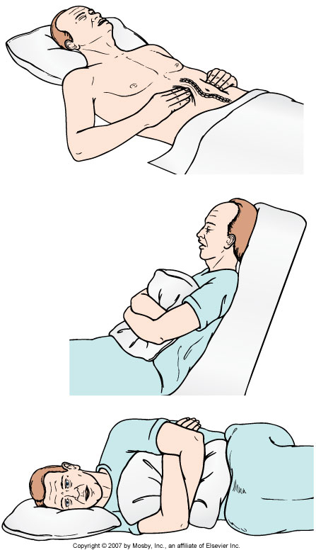
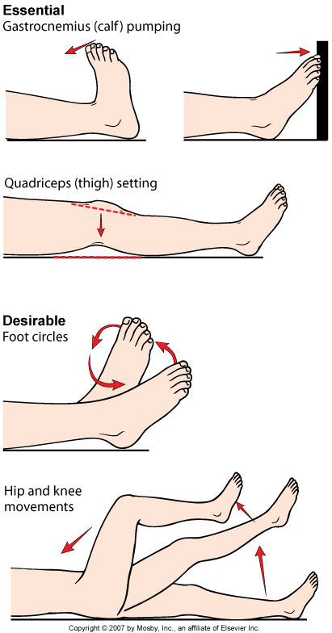

Slide 42
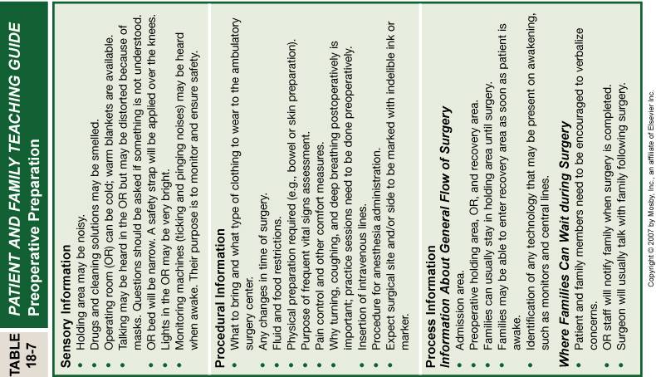

Slide 43
Patient preparation: interventions the day or evening prior to the surgery
  Diet Restrictions
    Historical guidelines to prevent aspiration were NPO after midnight the night before
    Educating the patient about the reason for NPO status may help with adherence
  Information of what to wear to the surgery
  Patient will likely need to be there 1 to 2 hours prior to scheduled procedure

Slide 44
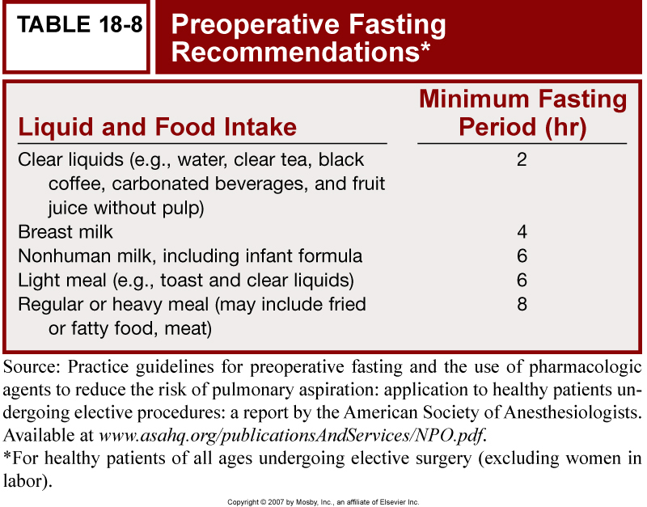

Slide 45
Patient preparation: interventions the day of surgery
This varies based on whether the person is inpatient or outpatient.
  Encourage the patient to void (empty their bladder) before they get any sedative medications
  Final preoperative teaching
  Final Assessment and communication of findings to MD
  Ensuring that all preoperative orders have been completed
  Check to chart to make sure that there is:
    A signed consent for the procedure
    Laboratory data, X ray reports, EKG
    Necessary consults
    Baseline vitals
    Nursing notes up until that point

Slide 46
Patient preparation: interventions the day of surgery
  Remove any jewelry, hair pins, clothes (except gown)
  Remove contact lens
  No dentures or partial dentures
  If the hearing aides need to be removed, please note that on the front of the chart.
    glasses or hearing aides need to be returned to the patient as soon as possible after the procedure
  No makeup or dark nail polish
  Give any preoperative medications
  Note the time the patient leaves the floor
  ID band should be placed, or checked depending on patient status, and an allergy band per institution protocol

Slide 47
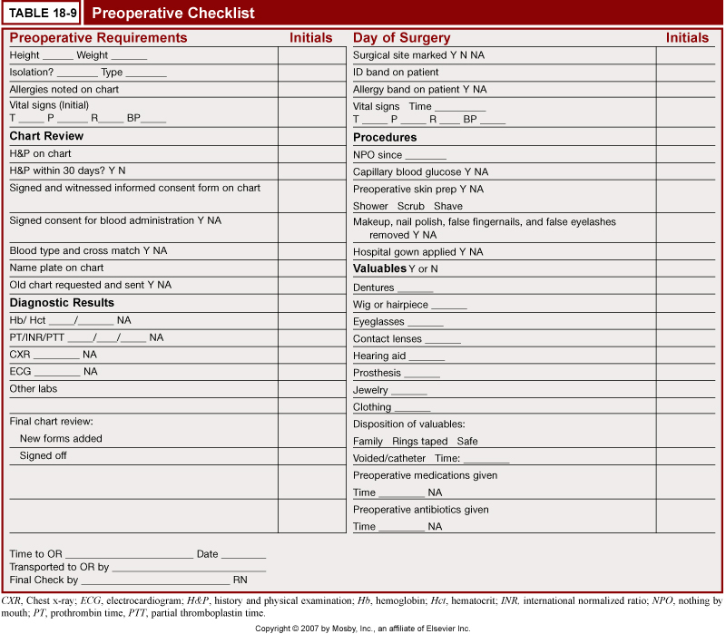
Preoperative Checklist

Slide 48
Preoperative Medications
  Benzodiazepines/Barbituates: used for their sedative and amnesic properties
  Anticholinergics: reduce secretions, and can reduce cramping
  Opioids: decrease need for intraoperative analgesics and decrease pain
  Antiemetics: decrease Nausea/Vomiting
  Antibiotics: prevent infective endocarditis, or where wound contamination is a risk (GI surgery) or where wound infection would cause significant postoperative morbidity;
    usually given IV
  Eyedrops: especially with eye surgery (lasik/laser, cataract surgery)

Slide 49
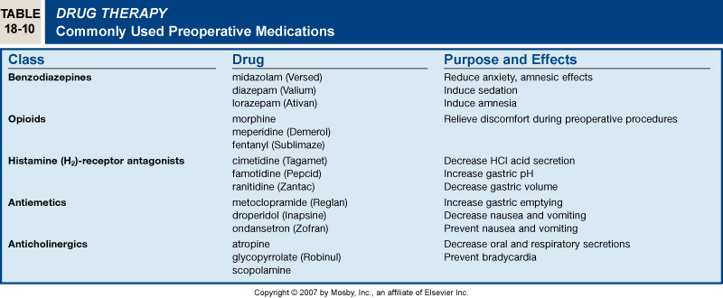
Preoperative Medications

Slide 50
INTRAOPERATIVE PHASE
Goals
Asepsis
Homeostasis
Safe Administration of Anesthesia
Hemostasis

Slide 51
Intraoperative; Operating Area
A surgical suite/setting is a controlled environment designed to minimize the spread of infectious organisms and allow a smooth flow of patients, personnel, and the instruments and equipment.
It has got three areas;
  Unrestricted Area:
  Semi-restricted Area:
  Restricted Area:

Slide 52
Surgical Setting
Unrestricted Area
Provides an entrance and exit from the surgical suite for personnel, equipment and patient
Street clothes are permitted in this area
The area provides access to communication with personnel within the suite and with personnel and patient’s families outside the suite

Slide 53
Surgical Setting contd..
2. Semi-restricted Area
Provides access to the procedure rooms and peripheral support areas within the surgical suite.
Personnel entering this area must be in proper operating room attire
Traffic control must be designed to prevent violation of this area by unauthorized persons
Peripheral support areas consists of: storage areas for clean and sterile supplies, sterilization equipment and corridors leading to procedure room

Slide 54
Surgical Setting contd..
3. Restricted Area
Includes the procedure room where surgery is performed and adjacent sub-sterile areas where the scrub sinks and autoclaves are located
Personnel working in this area must be in proper operating room attire

Slide 55
The Surgical Team
The Patient
The Anesthesiologist or Anesthetist
The Surgeon
Scrub Nurse
Circulating Nurse
RNFA ( Registered Nurse First Assistant )
Surgical Technologists

Slide 56
Surgeon
Responsibilities
Primarily responsible for the preoperative medical history and physical assessment.
Performance of the operative procedure according to the needs of the patients.
The primary decision maker regarding surgical technique to use during the procedure.
May assist with positioning and propping the patient or may delegate this task to other members of the team

Slide 57
First Assistant to the Surgeon
Responsibilities
May be a resident (MO), intern , physician’s assistant or a peri operative nurse.
Assists with retracting, hemostasis, suturing and any other tasks requested by the surgeon to facilitate speed while maintaining quality during the procedure.

Slide 58
Anesthesiologist
Responsibilities
Selects the anesthesia, administers it, intubates the client if necessary, manages technical problems related to the administration of anesthetic agents, and supervises the client’s condition throughout the surgical procedure.
A physician who specializes in the administration and monitoring of anesthesia while maintaining the overall well-being of the patient.

Slide 59
Scrub Nurse
Responsibilities
May be either a nurse or a surgical technician.
Reviews anatomy, physiology and the surgical procedures.
Assists with the preparation of the room.
Scrubs, gowns and gloves self and other members of the surgical team.
Prepares the instrument table and organizes sterile equipment for functional use.
Assists with the drapping procedure.
Passes instruments to the surgeon and assistants by anticipating their need.
Counts sponges, needles and instruments.
Monitor practices of aseptic technique in self and others.
Keeps track of irrigations used for calculations of blood loss

Slide 60
Circulating Nurse
Very defined activities during surgery:
Ensure all equipment is working properly.
Guarantees sterility of instruments and supplies.
Assists with positioning.
Monitor the room and team members for breaks in the sterile technique.
Handles specimens.
Coordinates activities with other departments, such as radiology and pathology.
Documents care provided.
Minimizes conversation and traffic within the operating room suite.

Slide 61
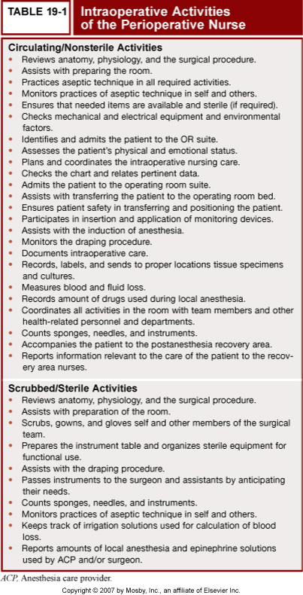

Slide 62
Other Nursing Roles
Nurse Anesthetist:
  Minimally masters prepared
  Perform many of the roles that an anesthesiology MD perform
  Manage patient pre-op. assessment, induction, maintenance, and emergence from anesthesia

Slide 63
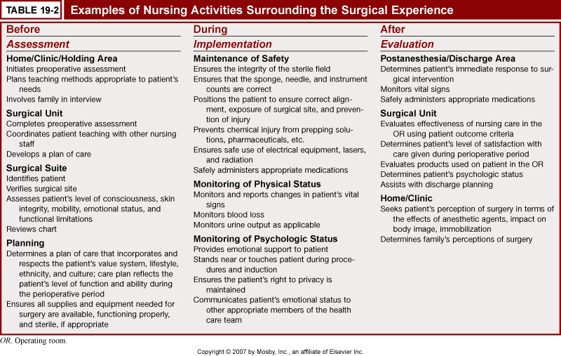

Slide 64
Environmental Safety in surgical suite
The size of the procedure room
Temperature and humidity control
Ventilation and air exchange system
Electrical Safety
Communication System

Slide 65
Environmental Safety in surgical suite contd..
a. Size of the Procedure Room
Usually rectangular or square in shape
20 x 20 x 10ft. with a minimum floor space of 360 sq. ft
Each procedure room must have the following equipment:
-Communication System
-Oxygen and vacuum outlets
-Mechanical ventilation assistance equipment
-Respiratory and Cardiac monitoring equipment
-X ray film illumination boxes
-Cardiac defibrillator
-High-efficiency particulate air filters
-Adequate room lighting
-Emergency lighting system

Slide 66
Environmental Safety in surgical suite contd..
b. Temperature and Humidity Control
The temperature in the procedure room should be maintained between 20 -24 degrees C
Humidity level between 50 -55 % at all times
c. Ventilation and Air Exchange System
Air exchange in each procedure room should be at least 25 air exchanges/ hour, and five of that should be fresh air.
A high filtration particulate filter, working at 95% efficiency.
Each procedure room should maintain positive pressure, which forces old air out of the room and prevents air from surrounding areas from entering into the procedure room

Slide 67
Environmental Safety in surgical suite contd..
d. Electrical Safety
Faulty wiring, excessive use of extension cords, poorly maintained equipment and lack of current safety measures are hazardous factors that must be constantly checked
All electrical equipment, new/used, should be routinely checked by qualified personnel.
Equipment that fails to function at 100% efficiency should be taken out of service immediately.

Slide 68
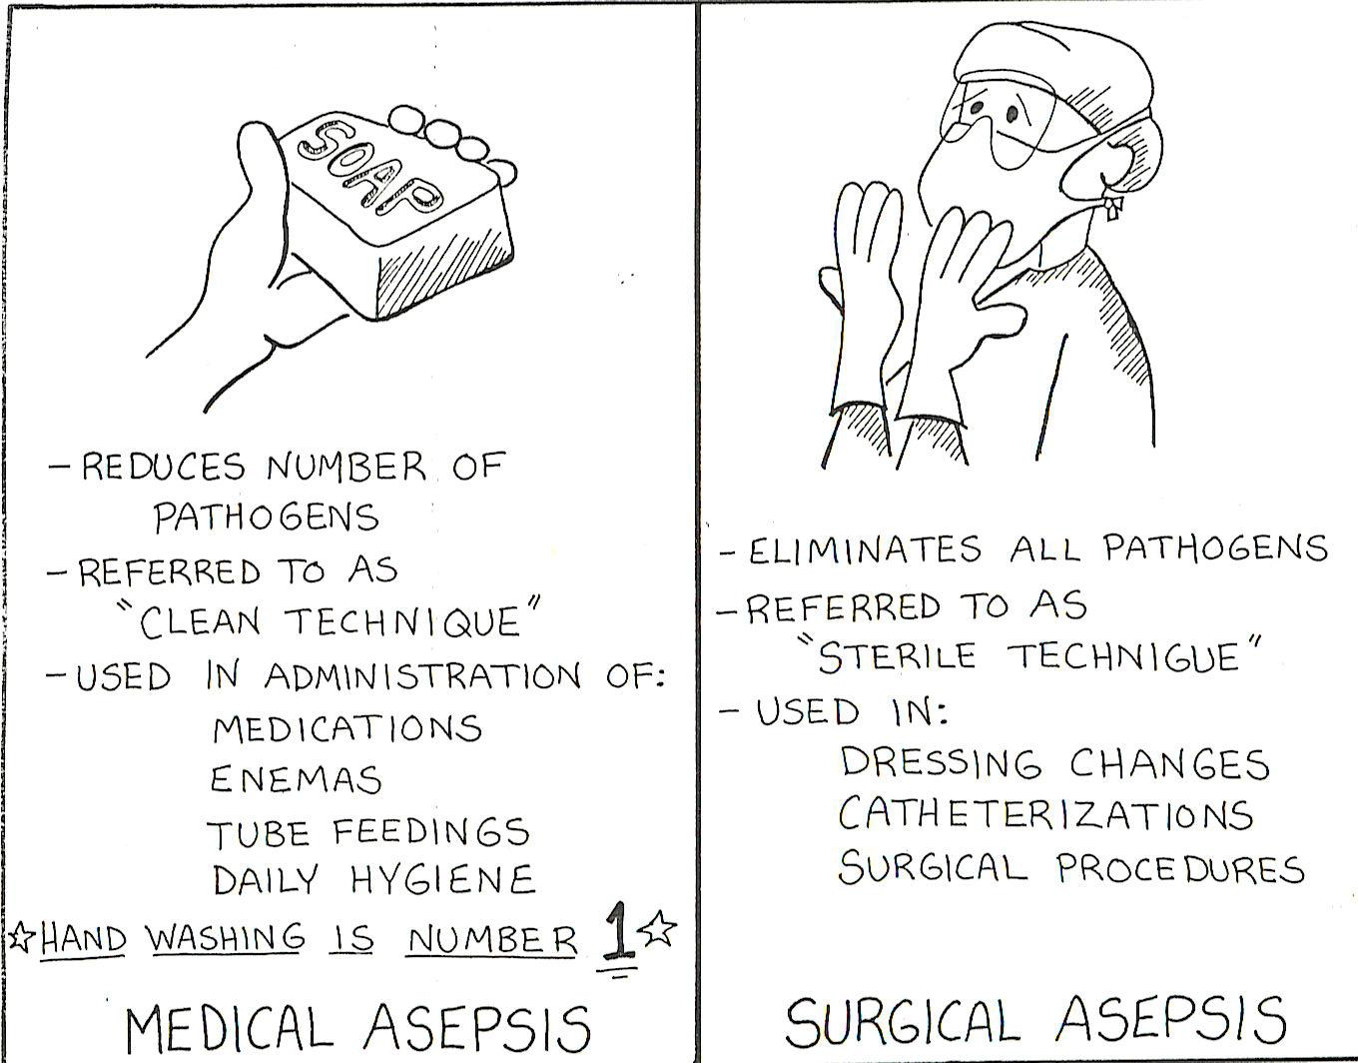
Perioperative asepsis/sterile technique
It is the creation and maintenance of a sterile field, with the patient's surgical incision at the center of the sterile field.

Slide 69
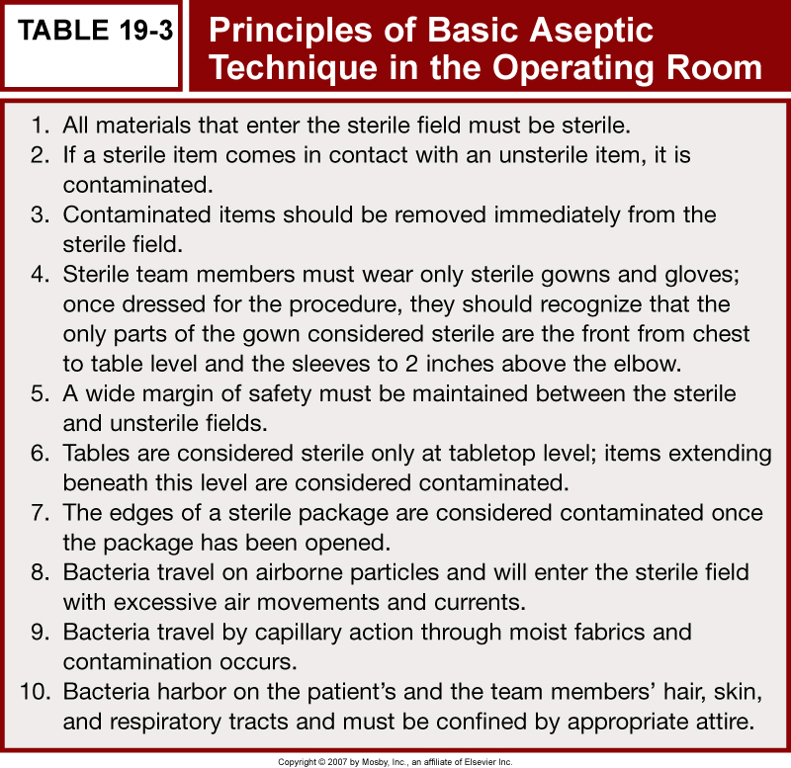

Slide 70
Proper Technique for scrubbing into a surgical field:
  Team members fingers and hands should be scrubbed first with progression to the forearm and elbows.
  The hands should be held away from the surgical attire.
  The hands should be held up once clean so that no suds or other bacteria can drift down onto the clean area
  When waterless gels are used for asepsis, hands and forearms are washed first thoroughly with soap and water, then dry before putting on the gel
  Then enter the surgical area and put on the surgical gown and gloves

Slide 71
Reasons for surgery
To cure an illness or disease by removing the diseased tissue or organs.
To visualize internal structures during diagnosis.
To obtain tissue for examination.
To prevent disease or injury.
To improve appearance.
To repair or remove traumatized tissue and structures.
To relieve symptoms or pain.

Slide 72
There are 4 Major Types of Pathologic Process Requiring Surgical Intervention; (OPET)
Obstruction – impairment to the flow of vital fluids (blood, urine, CSF, bile)
Perforation – rupture of an organ.
Erosion – wearing off of a surface or membrane.
Tumors – abnormal new growths.
Examples of pathologic process requiring surgery; Hydrocephalus (Obstruction), Burn (Erosion), Benign Prostatic Hyperplasia (Tumor), Cholelithiasis (Obstruction), Intussusceptions (Obstruction), Perforation (Ruptured Aneurysm).

Slide 73
Classifications of Surgical Procedures
There are different classifications of surgical procedures
The class can be based on:
Purpose
Urgency
Risk

Slide 74
Based on Purpose
Diagnostic. These kind of surgeries are done to determine cause of illness and/or make confirm a diagnosis. Examples includes: biopsy, exploratory laparotomy (explorelap)
2. Ablative/Curative. These kind of surgeries are performed to remove a diseased part or organ. Examples include: gastrectomy (partial or full removal of stomach), thyroidectomy, and appendectomy.

Slide 75
Based on Purpose contd….
3. Palliative. To relieve symptoms without curing the disease. These include: colostomy, debridement of necrotic tissue.
4. Re-constructive. These includes skin graft, plastic surgery, scar revisions. These are done to restore function to traumatized or malfunctioninig tissue and to improve self concept.

Slide 76
Based on Purpose contd….
5. Transplant. To replace organs or structures that are diseased or malfunctioning.
6. Constructive. To restore function in congeinital anomalies. Cleft palate repaire (palatoplasty), closure of atrial-septal defect.

Slide 77
Based on Purpose contd….
7. Exploratory. To estimate the extend of the disease or confirmation of diagnosis. Examples: Exploratory laparatomy, pelvic laparatomy.
8. Aesthetic. To improve on physical features that are within normal range. Example: breast augmentation.

Slide 78
Examples of the type of surgery according to purpose:
Pap Smear (Diagnostic),
Tonsillectomy (Curative),
Nephrocapsulectomy (Curative),
Osteoplasty (Curative/ Constructive),
Perineorrhaphy (Curative/Reconstructive),
Trachelorrhaphy (Curative/Constructive),
Skin Grafting(Curative/ Reconstructive)

Slide 79
Based on Urgency
Elective. These are kind of surgeries wherein they are pre-planned.
Delay of surgery has no ill-effects.
These can be scheduled in advance based on the client’s choice.
Examples: tonsillectomy, hernia repair, cataract extraction, mammoplasty, face lift, and cesarean section.

Slide 80
Based on Urgency contd..
2. Urgent. Surgeries that are necessary for the client’s health, usually done within 24 to 48 hours. Examples: Removal of gall bladder, amputation, colon resection, coronary artery bypass, surgical removal of tumor
3. Emergent. Surgeries that must be done immediately to preserve client’s life, body part of body function. Examples: Control of hemorrhage, perforated ulcer, intestinal obstruction, repair of trauma, tracheostomy

Slide 81
According To Degree Of Risk
Major Surgery – involves high risk / Greater Risk for Infection – it’s Extensive or Prolonged - Large amount of blood loss -Vital organ may be handled or removed
Minor Surgery - Generally not prolonged - Leads to few serious complication - Involves less risk

Slide 82
Common Terms
Perioperative Nursing:
  Includes the preoperative (before), intraoperative (during) and postoperative (after) periods.
Preoperative period:
  This is an important time to address issues that may come up during surgery (Screening)
    i.e. assess for bleeding problems, don't want to find out that someone has a bleeding problem as they exsanguinate on the operating table
  Also can teach patients and family about what to expect before, during and after a procedure
    in an emergency, we can prepare the family if the patient isn't alert

Slide 83
Types of Surgeries
  Diagnostic
  Therapeutic
  Palliative
  Preventive
  Cosmetic

Slide 84
Types of Surgeries
Diagnostic:
  Determination of the presence and or extent of the pathology
  i.e. lymph node bx, bronchoscopy, exploratory laparatomy
Therapeutic:
  Elimination or repair of the pathology
  Removal of the appendix when it's inflammed, removal of a localized cancer

Slide 85
Types of Surgeries
Palliative:
  Alleviation of symptoms without curing the underlying disease
  Rhizotomy (cutting of a nerve root) to decrease pain, colostomy placement to bypass an obstructing colon tumor
Preventative:
  Surgery to remove tissue that has the potential to become pathologic (may not already express a pathologic problem)
  Total Colectomy in patients with FAP

Slide 86
Types of Surgeries
Cosmetic:
  The surgery is preformed for aesthetic reasons
  Repair of scars from burns or injuries, minor cleft palate repairs, face lifts, breast augmentation

Slide 87
Further Descriptors of Surgery
Elective:
  Carefully planned event
  Advanced assessments are usually attained and pre-operative checks are in place
    blood draws
    physical exam
    other necessary studies
  Can be scheduled in some cases as an outpatient or in an ambulatory surgery center
Emergency:
  arises unexpectedly
  can also occur in a wide variety of settings
    ER
    OR
    Battlefield/Trauma scene
  Needed within minutes to hours
Urgent:
  delay could be detrimental
  usually within 24-48 hours

Slide 88
Types of Elective Admissions for Surgery
Ambulatory Surgery:
  Usually outside a hospital setting
  Special prescreening
  Don't use in patient's with multiple problems
Same-Day Surgery:
  Outpatient, can be in the hospital
  Go home the day of the surgery
Early Hospital Admission:
  Patient comes in early (night before or earlier)
  Usually patients with complex medical issues, and increased risk for poor surgical outcomes

Slide 89
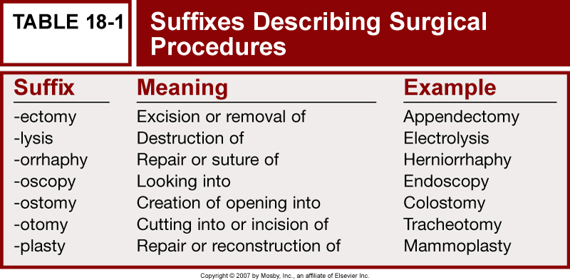

Slide 90
LEGAL ASPECTS IN THEATRE NURSING
The term ‘legal’ means; as 'required’ or 'permitted by law'.
Legal aspects in theatre nursing, refers to what the law requires us to do in the theatre before, during and after the operation.
What is the preoperative care requirement before a patient is taken for operation?
Make sure that the surgeon explains clearly to the patient what will happen to the patient during surgery.

Slide 91
PREOPERATIVE LEGAL REQUIREMENT
The surgeon should obtain an informed consent from the patient or parent/guardian/next of kin for under age or not in a position to sign (e.g. unconscious person).
The nurse ensures/confirms that the patient has signed an informed consent, after the surgeon has explained the advantages and outcomes of the operation.
Make sure that the patient observes a ‘Nil by oral’ rule.
Blood investigation: All should be within the acceptable ranges e.g. full Haemogram including HB, urea, electrolytes and creatinine.

Slide 92
Preoperative legal requirement
The patient should be counseled and reassured e.g amputation, or mastectomy.
The site to be operated on should be shaved and cleaned with warm soapy water, to reduce the bacteria on the patient’s skin. The area shaved should be larger than the incision site.
Catheterization and IV branula insertion may be necessary depending on the surgery.
Observations of vital signs, urine testing for sugars, proteins and acetone should be done.

Slide 93
PREOP. Legal requirement
The nurse should confirm that the above preoperative measures have been taken by the ward nurse in order to allow the patient in theatre.
Preparations form part of the legal requirements before surgery.
Confidentiality in nursing practice is a legal requirement.
The law gives the patient seeking medical, surgical and nursing care, rights under which they are to be managed.

Slide 94
Preoperative legal requirement
Rights: any claim that is morally just or legally granted as allowable or due to a person.
‘Legal rights of an individual during theatre nursing include:
1. Informed consent,
However, consider factors such as age, mental status and level of education before giving information
2. Obtain consent from the patient before premedication.

Slide 95
Preoperative legal requirement
3. Safety and security of the patient before, during and after operation is vested in the theatre team.
It has already been implied earlier that by signing the consent form, the patient takes some responsibility for the whole loss of life or part of their body.
However, this does not take away the responsibility of the theatre team to ensure the security of the patient's life during the operation.

Slide 96
Legal requirement
Patient should be properly prepared
Ensure that the right patient for the intended operation is taken to theatre.
The items used for the operation must be counted and recorded before, and after the operation to prevent loss of swabs, tubes, blades, forceps, abdominal packs etc.
Theatre nurses must know the ‘EXIT’ to use incase of an emergency.
Sockets in theatre should be covered during scrubbing to prevent the risks of conducting currents.

Slide 97
summary
The patient must sign an informed consent, obtained by the surgeon.
He/she must be protected from any harm, falls or eventuality, during the stay in theatre.
Patient confidentiality must be observed.
He/she must be the right patient for the intended operation.

