Slide 1
ANALGESICS

Slide 2
CONCEPT OF PAIN
Pain is unpleasant sensory or emotional experience usually associated with actual or potential tissue damage.
This may be due to injury, inflammation or cancer.
Prostaglandins (PGDs) are required for inflammation which usually accompanies pain. This kind of pain is best treated using NSAIDS.
Neuropathic pain occurs without nociceptive/afferent input.
Examples include trigeminal neuralgia and phantom limb pain.
These kinds of pain occur due to damaged neuronal tissue.
It’s a severe chronic pain which is unrelated to peripheral tissue damage.

Slide 3
NSAIDS
NON STEROIDAL ANTI INFLAMMATORY DRUGS

Slide 4
An inflammatory response involves production of potent chemical mediators that are meant to destroy pathogens and promote healing.
As the body reacts to these chemicals it produces some signs and symptoms of disease, such as swelling, pain, fever and redness.
Anti-inflammatory agents block or alter the chemical reactions associated with the inflammatory response to stop one or more of the signs and symtopms of inflammation
Several drugs are used as anti-inflammatory agents: corticosteroids, antihistamines and non-steroidal anti-inflammatory drugs (NSAIDs).

Slide 5
MECHANISM OF ACTION
Two enzymes are concerned with formation of prostaglandins
Cyclooxygenase-1( COX-1) and
Cyclooxygenase-2.(COX-2)
prostaglandin produced by COX 2 are responsible for pain and inflammation AND FROM COX 1 HAVE A PROCTECTIVE EFFECT ON THE STOMACH LINING.
most nsaids block both COX-1 and COX-2
though they relieve pain and inflammation they cause peptic ulcers

Slide 6
classification on NSAIDS
a. Propionic Acid derivatives such as fenbufen, ibuprofen, ketoprofen, naproxen and fenoprofen.
b. Salicylates and their related substances such as aspirin, diflunisal
c. Indoleacetic acid derivatives such as indomethacin, sulindac, etodolac, tolmetin, diclofenac, ketorolac
e. Oxicams such as piroxicam,tenoxicam,meloxicam
f. Pyrozolones such as azapropazone, phenylbutazone, oxyphenbutazone
g.para-aminophenol derivatives-paracetamol

Slide 7
INDICATIONS
Anti-inflammatory effect-
NSAIDS decrease prostaglandins E2 and prostacyclin decreases Vasodilation and indirectly reduces Oedema.
Analgesic effect-
They inhibit Prostaglandins synthesis which decreases sensitization of nociceptive nerve endings to inflammatory mediators. Prostaglandins sensitize nociceptors to inflammatory mediators e.g. bradykinin, serotonin by lowering their threshold of response to pain.
Headache relieve is due to decreased prostaglandin- mediated vasodilation.
Antipyretic effect-
Bacterial endotoxins cause release of pyrogenic interleukin 1 which stimulate hypothalamus to produce prostaglandin E2 which cause increase in temperature. NSAIDS such as piroxicam, naproxen, and ibuprofen prevent this by inhibiting prostaglandin synthesis

Slide 8
Other conditions.
Prevention of premature labor. They inhibit prostaglandins E2 which are involved in the physiology of labor (uterine contraction).
Cardiovascular conditions- The NSAIDS are used in the treatment of CVS conditions eg transient ischaemic attacks, angina pectoris and coronary artery bypass graft.
Due to their antiplatelet aggregation effect as thomboxane A2 is inhibited for instance by use of aspirin.
Dysmenorrhea- They inihibit prostaglandins involved in uterine contractions hence reduce dysmenorrhoea.
Rheumatoid arthritis and juvenile arthritis- NSAIDS reduce pain and inflammation in these conditions

Slide 9
General Unwanted effects of NSAIDS
Unwanted effects are usually due to inhibition of COX-1 which is found in many tissues and is involved in many body functions such as
blood clotting,
GIT protection and maintaining sodium and water in the kidneys (renal vascular auto regulation).

Slide 10
The adverse effects
Gastrointestinal effects
dyspepsia
diarrhea,
nausea,
constipation,
gastric bleeding/ ulceration due to inhibition of gastric COX1 which is responsible for synthesis of prostaglandins that normally inhibit acid production and protect the mucosa.
Selective COX-2 inhibitors have minimal GI effects. EG celecoxib

Slide 11
Skin eruptions –
rashes,
urticaria,
photosensitivity reactions.
Adverse renal effects.
These are due to inhibition of biosynthesis of prostanoids which are involved in maintenance of renal blood flow. –nephrotoxicity
-hepatoxicity
Others - - bronchospasms,
- bone marrow depression

Slide 12
NSAIDS.
Contraindications: Asthma, severe liver and/or renal disease, hypersensitivity.
Cautious use with the elderly, children, lactation, pregnancy and for patients with GI, cardiac and/or bleeding disorders.
Nursing considerations: Monitor blood, renal and hepatic function. Baseline hearing and eye exams are recommended so that changes can be identified.
Toxicity may be signaled with tinnitus and/or blurred vision.

Slide 13
ANALGESICS.
CLASSIFICATION OF opioids
Narcotic - other names: opiods or opiates
    morphine
    codeine
    heroine
    pethidine),
    fentanyl
    methadone
    diamorphin
    pentazocine
    tramadol.

Slide 14
MECHANISM OF ACTION OF NARCOTICS/OPIODS
inhibit transmission of pain impulses.
Brain and spinal cord produce their own pain killers known as endorphins, enkephalins and dynorphins in response to pain.
These are natural chemicals that resemble morphine and act as highly effective pain relievers for a short period.
Therefore, they are less effective for treating chronic pain.
They relieve pain by acting on pain receptors which are also acted upon by opiates.
These receptors include Kappa, delta, sigma and mu receptors.
Stimulation of receptors inhibit transmission of pain impulses and perception of pain is suppressed.

Slide 15
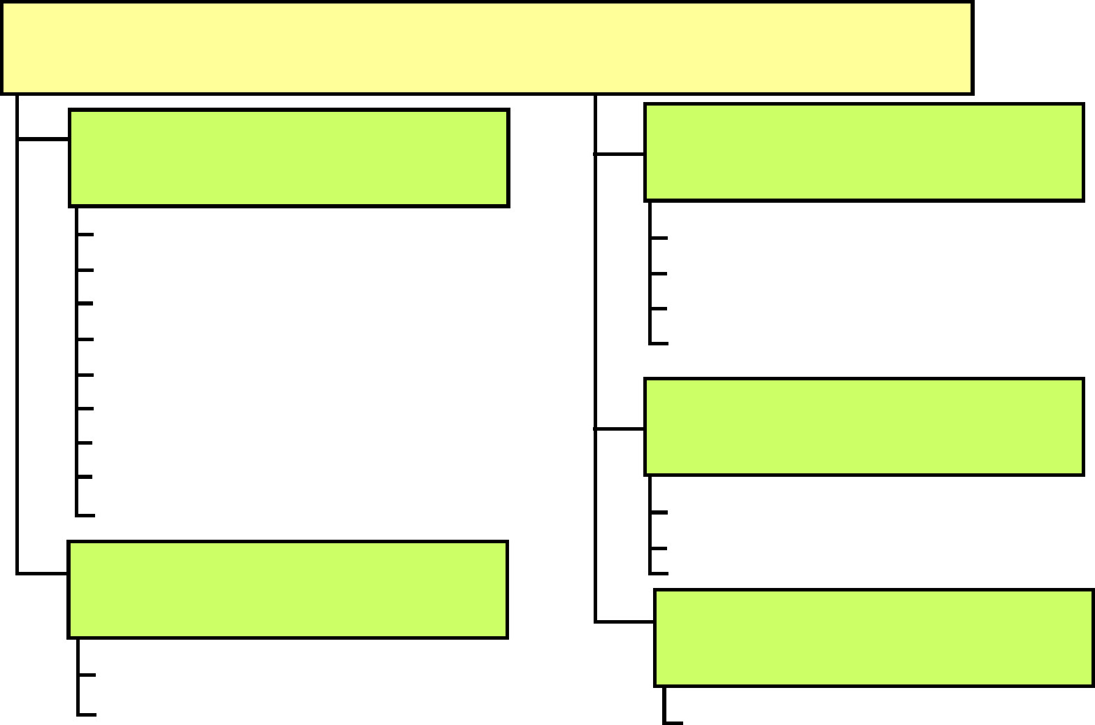
Summary of opioid analgesic and antagonists
CLASSIFICATION OF OPIOID ANALGESICS
Strong agonists
Mixed agonist-antagonists and partial agonists
Alfentanil
Fentanyl
Heroin
Meperidine
Methadone
Morphine
Oxycodone
Remifentanil
Sufentanil
Buprenorphine
Butorphanol
Nalbuphine
Pentazocine
Antagonists
Nalmefene
Naloxone
Naltrexone
Moderate/low agonists
Other analgesics
Codeine
Propoxyphene
T ramadol
(according to Lippincott´s
Pharmacology, 4th ed., 2009)

Slide 16
Indications
Analgesia: effective in treatment of pain.
sleep-inducing drugs.
Relief of cough: Suppression of the cough reflex, codeine
or dextromethorphan are more widely used.
Acute pulmonary edema: IV morphine relieves dyspnea caused
by pulmonary edema
Application in anesthesia
Premedication (sedative, anxiolytic, analgesic properties),
Intraoperatively

Slide 17
  morphine
  Opiates e.g. Actions: Depression of the pain impulse transmission at the level of the spinal cord
  Uses: Moderate to severe pain
  Adverse Reactions and Side Effects: GI (constipation, nausea, vomiting, anorexia, cramps), sedation, respiratory depression, circulatory depression and increased intracranial pressure

Slide 18
Contraindications and Caution to opiods
Upper airway obstruction
bronchial asthma,
Hypersensitivity
addiction.
pregnancy and lactaction
Also in diarrhea caused by poisons as depression of GI activity would lead to further absorption
, in biliary surgery and abdominal surgical anastomoses because of GI depression.
head injury
delirium tremors
alcoholism
liver and renal dysfunctions
respiratory and heart disease.
Nursing considerations: Monitor respiratory, urinary and mental status, level of consciousness. An antiemetic can be used for nausea and vomiting.

Slide 19
Adverse Effects
respiratory depression
orthostatic hypotension
nausea, vomiting
Diarrhea
miosis- aaaaaaaalladdict to morphine have pin-point pupils
constipation and biliary spasms.
Others include dependence,
dizziness
hallucinations,
light-headedness
urinary retention,
low libido and sweating

Slide 20
SALICYLATES
E.g. aspirin
Actions: Antipyretic (inhibits the heat regulation center in the hypothalamus), anti-inflammatory (inhibits prostaglandin), analgesic (inhibits prostaglandin).
Has an antiplatelet effect by inhibiting the production of thromboxane which binds platelets together to create a patch over damaged walls of blood vessels.

Slide 21
Cont’d
Uses: Mild to moderate pain, inflammation (arthritis), fever, used long term at low doses to prevent heart attacks, strokes and blood clot formation in patients at high risk of developing blood clots.
SEs: GIT ulcers, stomach bleeding, tinnitus $vertigo in high doses
CI: allergy, hemophilia and other bleeding disorders
Caution in people with peptic ulcers
Toxicity-metabolic acidosis,dehydration,hyperthermia,collapse coma and death in high doses
NO SPECIFIC ANTIDOTE

Slide 22
Salicylates
Contraindications: Frequently occurring hypersensitivity. Contraindicated with a vitamin K deficiency, GI bleeding, a bleeding disorder. Caution with hepatic and renal failure, anemia .
Nursing considerations:
Monitor renal and hepatic function, blood. Observe for signs of hepatotoxicity (clay colored stool, dark urine, diarrhea, yellow sclera and skin, itching, fever, abdominal pain) and ototoxicity (ringing or roaring in the ears, tinnitus)

Slide 23
Paracetamol/acetaminophen
Pharmacodynamics
It is similar to aspirin in efficacy but has weak inhibitory effect on cyclo-oxygenase, hence it has no demonstrable anti-inflammatory effect.
It inhibits prostagladins in the brain and not peripherally.
Metabolism takes place in the liver with a half life of 2 hours.
It undergoes extensive liver metabolism through glucuronidation to produce a toxic metabolite called N-acetyl-P-benzoquinone imine
exretion takes place through the renal system.

Slide 24
Indications
pain
pyrexia
tension headache
post-operative pain,
post immunization pyrexia
dysmenorrhea
myalgias,
neuralgias
pos-partum pain.

Slide 25
advantages over aspirin
It has no blood coagulation and antiplatelet effects
does not irritate the GIT hence it is preferably used by the elderly and lastly,
it is not associated with Reyes syndrome, hence it is appropriate for use by children and elderly.
Reyes syndrome- condition characterized by rapid liver degeneration and encephalitis in children treated with aspirin
Antidote in overdose- acetyl cysteine
Contraindication and cautions
It is contraindicated in hepatic or renal impairment.

Slide 26
WHO Guidelines on the Hierarchical use of Analgesics
Mild pain: Non-narcotic analgesics such as NSAIDs or paracetamol
Moderate: Narcotics of low efficacy e.g. codeine, dextropropoxyphen, pentazocin or combined therapy of NSAIDs plus a low efficacy opiod.
Severe pain: High efficacy opiods e.g. morphine, pethidine, diamorphine and if there is tissue injury you need to include NSAIDs in the therapy.
Overwhelming pain: High efficacy opiods plus sedatives or anxiolytics e.g. diazepam or phenothiazides e.g. chlorpromazine

Slide 27
note
NSAIDs are also available for topical use on skin for relief of symptoms caused by soft tissue trauma e.g.
diclofenac
Ibuprofen
piroxicam
oxyphenbutazone .
They occur in form of gels, cream, ointments etc

