Slide 1
CANCER CHEMOTHERAPY

Slide 2
Cancer occurs when normal cells become transformed by chemicals, viruses, or unknown agents and thereby become resistant to normal regulation of cell division and other cellular processes.
Cancer occurs when normal cells become cancerous and show the following characteristics:
Uncontrolled proliferation; metastasis i.e. tending to spread; de-differentiation and loss of function i.e. loss of distinct characreristics, hence inability to perform their function; invasiveness i.e. they they tend to invade the surrounding cells

Slide 3
Chemotherapy targets dividing cells, hence normal cells of ovary, testes, hair follicles, endometrium and other sites of fast cell division are usually affected.
Drugs may target specific cancer cells by means of receptors e.g. antiestrogens can target estrogen receptors and cause death of cancer cells that depend on estrogen
These drugs are usually used for treating cancers of the reproductive system because these cancers are dependent on these sex hormones.

Slide 4
Causes of cancer
Environmental exposure
Ionizations
Viruses

Slide 5
Chemo
Chemotherapy is presently used in three main clinical settings:
(1) Primary induction chemotherapy refers to chemotherapy administered as the primary treatment in patients who present with advanced cancer for which no alternative treatment exists. This has been the main approach in treating patients with advanced metastatic disease, and in most cases, the goals of therapy are to relieve tumor-related symptoms, improve overall quality of life, and prolong time to tumor progression.
(2) neoadjuvant treatment for patients who present with localized disease, for whom local forms of therapy such as surgery or radiation, or both, are inadequate by themselves,
(3) adjuvant treatment to local methods of treatment, including surgery, radiation therapy, or both

Slide 6
classification of cytotoxic agents
The is based on: chemical properties and origin of the drug or on the site in the cell cycle where the drug acts.
This second classification is based on the site in the cell cycle where the drugs act is preferred and it is the one we shall use.
These drugs portray dose limiting toxicity i.e. unwanted effects that limit the dose that can be used.
They have a very narrow therapeutic index.

Slide 7
Cytotoxic drugs
The drugs kill the dividing cells ad are therefore not only toxic to cancer cells but to healthy dividing cells.
Grouped to:
Alkylating agents
Cytotoxic antibiotics
Antimetabolites
Topoimerase 1 and 2 inhibitors

Slide 8
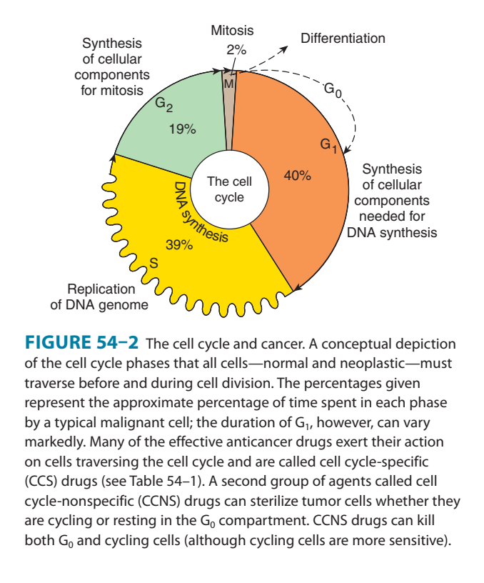
Cell cycle
G1 phase. Period of protein synthesis and intense metabolic changes to prepare the cell for division. At a certain point - the restriction point where cells remain restricted their entire life and if the cell is committed to division and moves into the S phase.
S phase. Short stage and concerned with DNA and RNA synthesis. Period of great metabolic activity. DNA synthesis replicates the genetic material. Each chromosome now consists of two sister chromatids.
G2 phase. Metabolic changes assemble the cytoplasmic materials necessary for mitosis and cytokinesis.
Mitotic phase. A nuclear division (mitosis) followed by a cell division (cytokinesis). Each daughter cell has full complement of DNA exactly the same as the parent cell.
The period between mitotic divisions - that is, G1, S and G2 - is known as interphase.
A proportion of cells in a cancer are in a resting phase called G0 phase and at this stage, they are not dividing making them very resistant to chemo

Slide 9
Alkaylating Agents
Agents that directly attack DNA
MOA-Inhibit DNA synthesis and function. Alkylation of guanine can result in miscoding through abnormal base pairing with thymine or in depurination by excision of guanine residues
Examples of drugs in this class include: altretamine, busulfan, carboplatin and cisplatin, carmustine and lomustine, chlorambucil, cyclosphosphamide, dacarbazine, ifosfamide, mechlorethamine, melphalan, mitoxantrone and thiotepa
INDICATION-Breast ca, ovarian, non Hodgins, lymphoma, leukemia, neuroblastoma.
S/E, The adverse effects usually associated with alkylating agents are generally dose-related and occur primarily in rapidly growing tissues such as bone marrow, gastrointestinal tract, and reproductive system. alopecia, Bone marrow suppression leading to leukopenia, thrombocytopenia , stomatitis
Nausea and vomiting can be a serious issue with a number of these agents.
alkylating agents are mutagenic and have immunosuppresive activity

Slide 10
Cyclophosphamide – oral or IV, effects delayed for a week plus,
S/E- BM suppression alopecia.
It causes severe cystitis due to a metabolite known as acrolein- increase fluid intake to 4l and administer MESNA to bind and neutralize it.
Chlorambucil- orally for long period of times
Melphan- powerful depressant of white blood cells
Lomustine- orally as a single dose and should not be repeated for 4 to 6 wks
Estramustine- contraindicated in PUD, liver and heart disease

Slide 11
Toxicity
bone marrow suppression increases with these drugs
Alopecia
Hemorrhagic cystitis
As a class, alkylating agents are carcinogenic in nature, and there is an increased risk of secondary malignancies, especially acute myelogenous leukemia.

Slide 12
Contra indications
The drugs are contraindicated in any known allergy, pregnancy and lactation.
Caution is taken in bone marrow depression, renal and hepatic dysfunctions and GI ulceration.

Slide 13
Cytotoxic/Antitumor Antibiotics
Antitumor Antibiotics/Agents that Block DNA or Protein Synthesis
MOA
They interfere or prevent RNA formation which is used as a template for protein synthesis.
It does this by binding highly to DNA and preventing reading of the genes.
Examples include dactinomycin, bleomycin, epirubicin, doxorubucin, daunorubicin and idarubicin.

Slide 14
Examples
Doxorubicin- binds to DNA itself preventing both DNA and RNA synthesis by inhibiting the action of enzyme topoimerase II that allows DNA to be reproduced
The commonly used chemo
Instilled directly to the bladder or IV for 3 weeks.
Depresses bone marrow after 2 weeks.
Toxic to the heart muscles and requires ECG monitoring
Bleomycin- does not depress bone marrow,
Injected weekly and a spike of fevers may follow after injection
Epirubicin is less cardiotoxic

Slide 15
Indications
Lymphocytic leukemia in children
choriocarcinoma
wilm’s tumor
and sarcomas

Slide 16
Antimetabolites
Resemble substances used by cells for their metabolic process. They then become incorporated in the cells and because they cannot be metabolized they normally cause cells to die.
Higher doses inhibit normal cell production particularly bone marrow.
Many resemble purines and pyrimidines which are the building blocks for DNA. They become incorporated to the growing strand f the DNA and stop the process.

Slide 17
Examples
Methotrexate- prescribed with folic acid as a supplement – folinic acid residue. Causes liver damage and mouth ulceration. Used in RA and psoriasis as an immune suppressant.
Mertacaptopurine- indicated for leukemia
Fluorouracil- given as and IV infusion or bolus for most GIT tumors
Cytarabine-
Fludarabine
Cladribinee
Gemcitabine

Slide 18
Mitotic Inhibitors
Examples include etoposide and teniposide, vinblastine, paclitaxel. vincristine, vindesine and vinorelbine
MOA -impaires mitosis making it phase specific drug
Indications
Small cell lung carcinoma, ovarian carcinoma, testicular tumors, lymphomas, leukemia and neuroblastoma
Contraindication and cautions
bone marrow depression, allergy, hepatic and renal dysfunction, and GI ulceration

Slide 19
Vinblastine causes leucopenia
Used in rx of lymphomas
Vincristine- damages peripheral nerves causeing numbness, tingling, abdominal distension and constipation.
Vinorelbine- breast cancer when others have failed
Paclitaxel- inhibit cell division in the G2 and M phase
Used in ovarian and breast cancer
Paclitaxel causes hypersensitivity reactions- administer with steroids and antihistamine before infusion

Slide 20
Unwanted effects
Bone marrow suppression,
alopecia,
immunosuppression,
nausea/vomiting
, hyperuricemia,
mucositis,
parethesias,
jaw pain,
ataxia and muscle wasting

Slide 21
Sex hormones and hormone antagonists
Estrogens ie diethylstilbestrol
Was used to treat prostate cancers
Ocassionaly uses in postmenopausal women to treat breast cancers
S/E causes sodium retention, oedema, gynecomastia, impotence in men, bine pain and hypercalcemia
Ethinylestradiol – occassionaly used for breast cancer

Slide 22
Hormone antagonists
Tamoxifen- used to treat breast cancer
Mild effects, bone pain, flushing, and increased risk of endometrial cancer.
Contraindicated in breastfeeding and planned pregnancy.
Toremifene – treat hormone dependent metastatic breast cancer I npostmenopausal women.

Slide 23
Immunotherapy
Corticosteroids
Interferons and interleukins
Predinisolone- causes tumor regression
Useful as part of palliative care in end stage malignancy asn it lifts the patient’s mood and appetite
Ciclosporin0 immunosuppressant
Interferons – suppress viral growth and used in leukemia
Interleukinss- aldesleukin- extremely toxic to organs

Slide 25
Mechanism of anticancer drug resistance
Increased capability of the cancer cells to repair DNA.
Decreased permeability of the cell to the drug.
Decreased transportation of the drug to the receptor site.
Increased production of glutathione which inactivates the agent through conjugation.
Increased glutathione S-transferase activity which catalyses conjugation/metabolism of the drug.
Increased synthesis of dihydrofalate reductase

Slide 26
Hormonal/Tissue-Specific Anticancer Agents
examples of these drugs include;
anastrazole,
bicalutamide,
estramustine,
exemestine,
flutamide,
gosereline,
letrozole,
tamoxifen,
nilutamide,
testolactone,
toremifene, triptorelin and leuprolide

Slide 27
MOA
These drugs are receptor-site specific or hormone-specific to block the stimulation of growing cancer cells that are sensitive to these hormones.
Indications
Breast cancer in post menopausal women, prostate cancers, endometriosis and precocious puberty
Adverse effects
Menopausal-associated effects like hot flashes, vaginal spotting, vaginal dryness, mood swings and depression.
Other effects include bone marrow depression, GI toxicity and hepatic dysfunction. Without estrogen activity hypercalcemia results

Slide 28
Cisplastin
Is a platinum analogue
Used in testicular cancers
Diuresis is essential when the drug is given to prevent kidney damage
Damages hearing therefore test hearing regulary
Vomiting is troublesome here. Always have antiemetics handy

Slide 29
Combination of Anti-cancer Drugs
reasons:
1. Combination of drugs acting by different mechanisms reduces the chances of development of drug resistance. Cancer cells develop resistance just like microbials. Some may develop multiresistant drug pumps which make them resist many drugs.
2. Selecting agents that produce different patterns of toxicity and thereby reduce the damage directed at any one organ system.
3. Combining of anticancer agents that act at different stages of the cell cycle allows for more tumor cells to be killed.

Slide 30
REGIME DRUGS INCLUDED DISEASE
ABVD Dorobucin (Adriamycin) Hodgkin’s disease
Bleomyan (Blenoxane)
Vinblastine (Velban)
CHOP Cyclophosphamide
Dororubicin Non-Hodgkin’s Lymphomas
Oncovin
Prednisone
CHF Cyclophospanide
Methotrexate Breast caranoma
Fluorouracil
POMP Prednisone
Viuashre (oncovin) Acute lymphocytic leukemia
Methotrexate
Mercaptoporine

Slide 31
Cancer of the reproductive system is sensitive to hormones and hormone modulators.
Cancer of the breast, ovaries, prostate, and cervix get their growth stimulated by these sex hormones.
The tumors have specific receptors for these hormones which when stimulated stimulate their growth.
Antineoplastic agents block the receptor sites, block release of gonadotropic hormones, in breast or prosate cancer.
Others may block androgen receptor sites directly and are useful in the treatment of advanced prostate cancer.

Slide 32
Contraindications and caution
They are contraindicated in pregnancy and lactation. Caution should be taken in bone marrow suppression, hepatic, renal dysfunctions and GI ulceration

Slide 33
Unwanted effects
The drugs are non -selective and attack the dividing tissues. They cause bone marrow suppression, damage to epithelial cells, nausea, stomatitis and damage to hair follicles leading to alopaecia
Drug interactions
Bone marrow suppressants and radiation accelerates the effects on bone marrow suppression. Immunosuppression drugs increase the risk of generalized viral infections.
Live virus vaccines put patients at risk of role of getting the disease

Slide 34
COMMON COMBINATION USED
ABVD -Dorobucin (Adriamycin) Hodgkin’s disease
Bleomyan (Blenoxane) Vinblastine (Velban
INDICATION- Hodgkin’s disease
CHOP Cyclophosphamide ,Dororubicin,Oncovin
Prednisone
INDICATION- Non-Hodgkin’s Lymphomas
CHF Cyclophospanide ,MethotrexateFluorouracil
INDICATION- Breast caranoma
POMP Prednisone ,Viuashre (oncovin) Methotrexate
Mercaptoporine
INDICATION- Acute lymphocytic leukemia

Slide 35
Drugs used as Adjunct Therapy in Cancer Treatment
These drugs are used in cancer patients either to relieve symptoms of the disease or to ease the adverse effects of drugs. Some examples incude:
Allopuriunol
Chemotherapy destroys cells that release breakdown products e.g. uric acid which can damage the kidneys if allowed to accumulate. Allopurinol inhibits formation of uric acid.
2. Analgesics
Narcotic analgesics are used to relieve severe pain which usually accompanies the disease.

Slide 36
CT
Anti – emetics
Nausea and vomiting are very common side effects of cytotoxic drugs. It might be severe to lead to electrolyte imbalance.
Usually Phenothiazides are used as they have a strong antiemetic effect.
4. Drugs for control of direct drug toxicity
Examples include ifosfamide and cyclophosphamide produce toxic substances that can cause bladder damage.Mesna binds to metabolites of these drugs. Dextrazoxane prevents heart damage by doxorubicin.
5. Drugs for control of hypercalcemia
Etidronate, pamidronate and gallium nitrate block overproduction of calcium

Slide 37
Nursing considerations
Oral – no restriction
IM or IV – use a pump with nurses with special training
IV bolus- training
Never use brachial vein for vesicant
Use cannula number 22-24
Vescicant drugs should be given into a fast running infusion over atleast 5 minutes.
For vescicant drug extravasation
The needle should be left in situ and infusion stopped and as much as possible, the needle then is removed.
Ice packs should be applied to the area
Cool the area for the next 24 hours and hydrocortisone cream applied twice daily
Monitor the area after 24 hours

Slide 38
LONGTERM RISKS
Second malignancy
Gonadal damage
teratogens

