Slide 1
OPERATION THEATRE LAYOUT

Slide 2
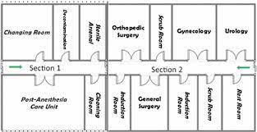

Slide 3
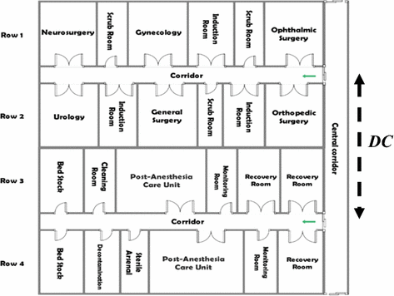

Slide 4
LAYOUT OF AN OPERATING THEATRE
Is a block of building with a series of rooms leading off a corridor.
With self-closing doors, which separate it from the main hospital.
The doors reduce unnecessary movement to and from theatre.

Slide 5
A theatre should be built in a central place possibly near an intensive care unit, accident/emergency department
The surgical wards and other special wards, for example, renal unit and burns unit.

Slide 6
Layout of operating theatre
All these units should be in relation to each other, but construction should be separate and independent from all traffic and air movement within the hospital.
A theatre unit is self contained with changing rooms, shower rooms, toilets, anaesthetic room,
operating room, recovery room; at least four beds, sluice room, linen room and sterilizing room.

Slide 7
LAYOUT cont’d
Inside, the walls, floor and roof are built with labour saving materials for hygiene purposes.
It has artificial ventilators, efficient artificial lights and emergency systems for use during power failure.

Slide 8
The theatre furnishings and fittings are made of stainless materials for quick and thorough cleaning.
All the trolleys are fitted with non-electricity conducting rubbers to minimize the risk of electric conduction.

Slide 9
Layout of theatre
Washable paint, smooth walls, and round corners.
Ceiling may be used for mounting operation light and other electrosurgical units.
Walls must be fitted with outlet of oxygen and other medical gases, vacuum and electric outlets.
Floor: Terrazzo material, smooth without cracks, curved at the wall for easy cleaning, nonslip surface for to prevent injury to staff.

Slide 10
Layout of theatre
Windows: clear glass view windows to prevent frequent opening and closing.
Lighting : white fluorescent – they cast minimum shadow, should be evenly distributed in the room.
Overhead operating light, provides near daylight without shadow and minimum heat
Ventilation : mechanical ventilation which ensures clean and filtered air supply
Positive air pressure flows; forces air out of the room.
Temperature and humidity; maintained at 20 to 25 degrees Celsius.

Slide 11
Unrestricted area
An area of the building that is not defined as semi-restricted or restricted.
This area includes a central control point for designated personnel to monitor the entrance of patients, personnel, and materials into the semi-restricted areas.

Slide 12
This area may include staff rooms, offices, waiting rooms, the preoperative admission area,and PACU
Public access to the area may be limited based on the facility's policy and procedures.

Slide 13
Semi-restricted area:
The peripheral support areas of the surgical suite.
The area may include storage areas for equipment and clean and sterile supplies;
work areas for processing instruments; sterilization processing room(s); scrub sink areas; corridors leading from the unrestricted area to the restricted areas of the surgical suite;

Slide 14
and the entrances to locker rooms, preoperative admission area, the PACU, and sterile processing.
This area is entered directly from the unrestricted area past a nurse’s station or from other areas.
Personnel in the semi-restricted area should wear surgical attire and cover all head and facial hair.
Access to the semi-restricted area should be limited to authorized personnel and patients accompanied by authorized personnel.

Slide 15
Restricted area: A designated space contained within the semi-restricted area and accessible only through a semi-restricted area.
The restricted area includes the operating and other rooms in which surgical or other invasive procedures are performed.
Personnel in the restricted areas should wear surgical attire and cover head and facial hair.

Slide 16
Masks should be worn when the wearer is in the presence of open sterile supplies or persons who are completing or have completed a surgical hand scrub.
Only authorized personnel and patients accompanied by authorized personnel should be admitted to this area.

Slide 17
Personal protective equipment (PPE)
Specialized equipment or clothing for eyes, face, head, body,
and extremities; protective clothing; respiratory devices; and protective shields and barriers designed to protect the worker from injury
or exposure to a patient’s blood, tissue, or body fluids.

Slide 18
Used by health care workers and others whenever necessary to protect themselves from the hazards of processes or environments,
chemical hazards, or mechanical irritants encountered in a manner capable of causing injury or impairment in the function of any part of the body,
through absorption, inhalation, or physical contact.

Slide 19
END
THANKS

