Slide 1
INTERVIEWING AND THE HEALTH HISTORY

Slide 2
APPROACH TO THE MEDICAL INTERVIEW
Taking time for self-reflection
Be open and respectful to individual differences.
It is a continuous processes in professional development.

Slide 3
Approach to the medical interview cont’d…
2. Reviewing the chart
Help clinician gathers information and plans what areas to explore.
Important aspects – age, gender, address, health insurance, medications, allergies, vitals etc.

Slide 4
Approach to the medical interview cont’d…
3. Setting goals for the interview
Students – goal is to take a history and physical examination for write-up to submit to lecturer.
clinician – review waiting patients, fill in org or insurance forms and test hypothesis
Important – balance provider-centered goals and patient centered goals

Slide 5
Approach to the medical interview cont’d…
4. Reviewing your clinical behavior and appearance.
As you watch the pt he/she will watch you too.
Be calm and unhurried
Personal appearace of clinician should be good.
Postures, gestures, eye contact, tone of voice all convey the extent of your interest, attention, acceptance and understanding.
Avoid actions that potray disapproval, embarassment, impatience or boredom, - these block communication as do stereotypes and belittling pts.

Slide 6
Approach to the medical interview cont’d…
5. Adjusting the environment
Privacy and confidentiality is important
Good seating arrangement

Slide 7
Approach to the medical interview cont’d…
6. Taking notes
Write notes bt do not let note-taking or writing forms destruct you from the patient
Maintain good eye contact and whenever the patient is talking about sensitive or disturbing material put your pen down and listen

Slide 8
THE SEQUENCE OF THE INTERVIEW
- Throughout the sequence, clinician must always be attuned to pts feelings, help, pt express themselves, respond to their concerns and validate significances

Slide 9
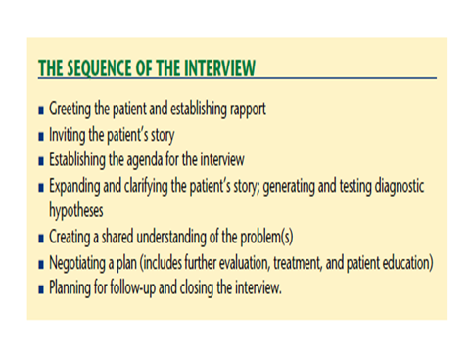

Slide 10
The sequence of the interview cont’d…
Greeting the patient and establishing rapport
Shapes the foundation for relationship
Greet patient, call patient by name and if possible shake hands
Use patients name in communication
Use formal titles and not granny, auntie etc
Good seating arrangement- be near pts with no objects between clinician and patient.

Slide 11
The sequence of the interview cont’d…
2. Invite the patients story
Ask open-ended questions and avoid YES/NO questions.
Ex. What brings you here today? How can I help you?
Follow pts leads – verbal and non-verbal cues
Avoid interrupting unless very necessary

Slide 12
The sequence of the interview cont’d…
3. Establish agenda
Due to time limitations – focus interview on pts most pressing issue.

Slide 13
The sequence of the interview cont’d…
4. Expanding and clarifying the patients story
Attributes of symptoms
OLD CART (Onset, location, duration, character, aggrevating/alleviating factors, radiation and timing)
OPQRST (Onset, palliating/provoking factors, quality, radiation, site and timeing).

Slide 14
The sequence of the interview cont’d…
5. Creating and testing diagnostic hypothesis
-Dx and DfDx

Slide 15
The sequence of the interview cont’d…
6. Create a shared understanding of the problem.
Many factors may shape this experience including prior personnal experience or family health which may affect outlook/coping.
Ex sore throat
Pt- concerned about the pain and diff in swallowing
Clinician – concerned about if it is a streptoccocal infection or some other microorganism
Create shared expectations.

Slide 16
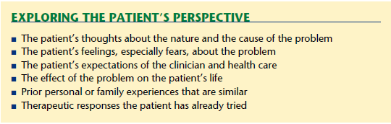
Create a shared understanding of the problem cont’d…

Slide 17
The sequence of the interview cont’d…
7. Negotiate plan
8. Planning for follow-up and closing
Before gathering paper to leave – tell pts we need to top now.
Inform them of an appropriate return date

Slide 18
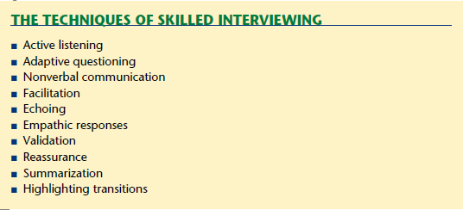
Facilitating the Patient’s Story: The Techniques of Skilled Interviewing

Slide 19
BUILDING A THERAPEUTIC RELATIONSHIP
Active listening
Attend to what the pt is communicating
be aware of pts emotional state
using verbal and non-verbal skills to encourage the speaker to continue

Slide 20
Building a therapeutic relationship cont’d…
2. Guided questioning: options for expanding and clarifying the patients story.
Moving form open-ended to forcused question
Questioning that ellicit a graded response Ex. You get breathless after how many flight of stairs
Ask one question at a time not do you have tb, pn, uti, ulcers etc.
Offering multiple choices without bias where need be Ex. Is the pain burning, sharp, dull, bounding or something else?

Slide 21
Building a therapeutic relationship cont’d…
Guided questioning: options for expanding and clarifying the
patients story cont’d…
e. Clarifying what pt means
Clarify ambigous or unclear associations
f. Continuers
Use positive gestures, or words to encourage pt to go on
Ex. Leaning forward, eye contact, using phrases like mmmh or go on or im listening

Slide 22
Building a therapeutic relationship cont’d…
Guided questioning: options for expanding and
clarifying the patients story cont’d…
g. Echoing
- Simple repetition of pts words
Ex.
Pt; pain got worse and continued to spread
Clinician: spread?
Pt: yes blah blah blah and it fills like im going to die
clinician: going to die?
Pt; yes blah blah blah

Slide 23
Building a therapeutic relationship cont’d…
3. None verbal communication
4.Empathetic responses
Nb: to empathize with your pts you must first identify pts feeling
5. Vallidation
Ex. “Yes being in an accident is scary.” “it normal to feel ….”
6. Reassure
-first step to effective reassurance is to simply identify and acknowledge feelings
- Avoid – Don’t worry, you will be okay if you are not sure.

Slide 24
Building a therapeutic relationship cont’d…
7. Partnering
Make it explicit, your desire to work with them and you are there for them.
8. Summarization
-Ex. You said you had a cough for the last 3days and that its especially bad at night and its productive. You have not had fever or SOB

Slide 25
Building a therapeutic relationship cont’d…
9. Transitions
- Always inform pt you are moving to the next phase of assessment and procedures/what is required of pt.
Ex “ Now I’d like to ask questions about you health.”
“ Now I would like to examine you.”
10. Empowering the pt
- Empowering pt to take care of themselves and encourage them.

Slide 26
Adapting Interviewing Techniques to Specific Situations
The silent patient.
The talkative patient
The anxious patient
The crying patient
The confusing patient
The angry and disruptive patient
The patient with language barrier
The patient with hearing problem
The patient with reading problems
The patient with impaired vision
The patient with limited intelligence
The poor historian
The patient with personal problems

Slide 27
ADAPTING TO SPECIAL SITUATIONS
The silent patient
Depression and dementia in pts?
Response to your questioning if you are too fast, pt disapproval of something you did or failed to recognize ex. Pain
ASK
You seem very quiet. Have I done something to offend you.

Slide 28
Adapting to special situations cont’d…
2. Confusing pt
“ pt says fingernails feel to heavy.”
“my stomach knots up like a smak.”
????? Mental/Neurological disorder

Slide 29
Adapting to special situations cont’d…
3. Patient with altered capacity
- Got surrogate, informant or decision maker to assist with the history.

Slide 30
Adapting to special situations cont’d…
4. The talkative patient
Give pt free ran for about 5 to 10 min to talk and listen keenly.
Focus on what seems to be important/pts problem to pts and show interest by asking questions in those areas
Interrupt only if necessary bt be courteous
A brief summary by clinician may help change subject and validate concerns

Slide 31
Adapting to special situations cont’d…
5. The crying patient
It signals strong emotions – saddness/anger/frustation.
Crying is therapeutic – offer a tissue and wait for the patient to recover or hold pts hand gently or allow pt to cry on you shoulder.
“ comments like im glad you let that out my help in some cases.”

Slide 32
Adapting to special situations cont’d…
6. Angry and disruptive patient
Accept the angry feelings for the patient.
Allow them to express such emotion without getting angry in return.
Validate if need be –
“ I understand you feel frustrated by the long wait but im following you case and will update on the same shortly.”
If disruptive – alert security, stay calm, appear accepting and avoid being confrontational.

Slide 33
Adapting to special situations cont’d…
7. Pts with language barrier
8. Pt with low literacy
Simplify information and avoid orders like 1x3
9. The patient with impaired hearing

Slide 34
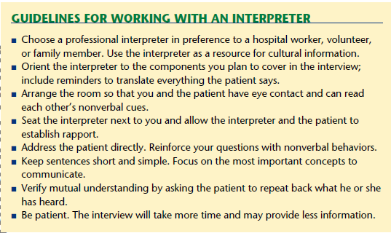

Slide 35
Adapting to special situations cont’d…
10. The patient with impaired vision
Shake hands – establish contact and explain who you are and why you are there.
Orient patient to the room if unfamiliar
If the pts uses glasses allow them to wear them during the interview.

Slide 36
Adapting to special situations cont’d…
11. Patient with limited intelligence
Transit to MSE ie pt my have mental retardation
Family and caregiver assist with history
12. The patient with personnal problems
-Ex. Pts asks you if he/she should quite stressful job.
-Explore approaches pts has considered and relate to pros and cons, who else they have discussed with and what support they have available. Ultimately it should be their choice to make.

Slide 37
Special Aspects of Interviewing
Cultural competence
The drug and alcohol
The sexual history
Domestic and physical violence
The mental heallth history
Death and the dying patient (phases of grieving- Denial and isolation, Anger, Bargaining, Depression or sadness and finally Acceptance).
Sexuality in the clinician – patient relationship
Ethical considerations

Slide 38
Special Aspects of Interviewing cont’d…
Single most important rule is to be non-judgemental
Explain why you need to know certain information- doing so makes the patient less apprehensive
Use specific language – ex. Penis, vagina and not “ private parts.”
Choose words that the patient understands. “By intercourse, I mean when a man inserts his penis into a woman’s vagina.”
Find opening questions for sensitive topics and learn the specific kinds of data needed for your assessments

Slide 39
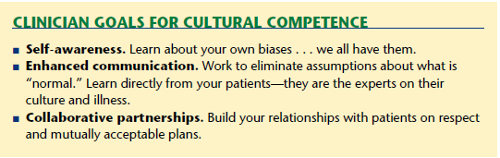
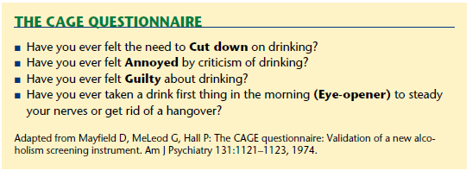

Slide 40
Interviewing Patients of Different Ages
Assignment

Slide 41

REFERENCES
BATES TEXT BOOK OF PHYSICAL EXAMINATION AND HISTORY TAKING.
FUNDAMENTALS OF NURSING
FUNDAMENTALS OF NURSING, STANDARDS AND PRACTICE

Slide 42

THANK YOU

