Slide 1
INTRODUCTION TO NUTRITION
LEARNING OBJECTIVES:
Define nutrition, nutrient, diet, essential diet, balanced diet and calories.
Identify the classes of nutrients , their characteristics and functions.
Describe the 4 characteristics of nutritious diet.

Slide 2
Definitions of terms
Nutrition- a science that studies nutrients and other substances in food and how these nutrients relates to health and diseases.
Nutrients- the nourishing substances in food that provide energy and promote the growth and maintenance of our body.
Diet – is the selection of food eaten by individual.
Balanced diet- appropriate amounts of all nutrients in correct proportion to meet body Requirements.
Essential diet- substance that cannot be made by our body and therefore must be included in our diet.

Slide 3
Cont’
Calories- a measure of the energy in food, specifically the energy yielding nutrients.
Macronutrients- nutrients required in large amounts, e.g. proteins, fats and carbohydrates.
Micronutrients- nutrients required in small amounts, e.g minerals and vitamins.

Slide 4
BALANCED DIET
A balanced diet contains all nutrients required for health in appropriate proportions, and is normally achieved by eating a variety of foods.
Food groups serves as a general guide to chose a balance diet.
It also provides information as to which of the different foodstuffs can be substitute for one that may be temporarily unavailable.
A proper combination of fruits, vegetables, grains and dairy product will undoubtedly ensure a balanced diet.

Slide 5
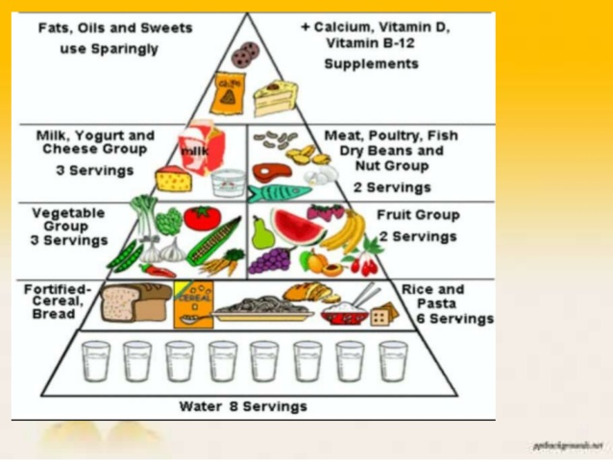
Food pyramid

Slide 6
Food groups
Five food groups:
Bread group: grains(wheat,rice,corn etc), starchy vegetables, beans. These have starch, iron and vitamin B.
Vegetables group: have vitamin and minerals
Fruit group: rich in vitamins
Milk group: rich in high quality protein, calcium and riboflavin
Meat group: meat , poultry, fish, egg, beans and nuts
Oil and sweats: must be used sparingly.

Slide 7
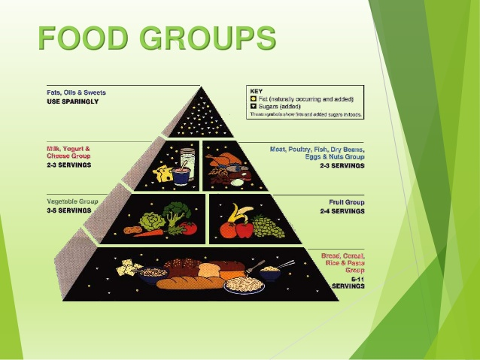
Cont’

Slide 8
characteristics of nutritious diet.
Provide appropriate amount of energy and adequate amounts of water.
Contains appropriate amount of energy and adequate amounts of water.
Should be adequate and wholesome
Contains adequate amounts of all the necessary nutrients required for healthy growth and activity.

Slide 9
classifications
based on chemical nature nutrients are classified into six classes.
Carbohydrates
Lipids
Proteins
Minerals
Vitamins
Water
Dietary fiber

Slide 10
CARBOHYDRATES
They are mainly sugars and starches found in variety of foods e.g sugar, jam, cereals, bread etc
They consist of carbon, hydrogen and oxygen
Should constitute 55-60% of total caloric intake.
They are classified according to the complexity of the chemical substances from which they are formed.
Monosaccharides
These are, chemically the simplest form in which a carbohydrates can exist. E.g fructose and galactose

Slide 11
Cont’
Disaccharides
These consist of two monosaccharide molecule chemically combined e.g sucrose, maltose and lactose.
Polysaccharides
These consist of complex molecules made up of large members of monosaccharide's in chemical combination e.g starches, glycogen, cellulose and dextrin

Slide 12
Functions of carbohydrates
It is the chief source of energy (60-70%) total energy
Required for the oxidation of fats.
Synthesis of pentose's for DNA, RNA synthesis.

Slide 13
proteins
Proteins are amino acid joined together by peptide linkage
amino acids are composed of the elements carbon, hydrogen, oxygen and nitrogen. Some contains minerals such as iron, copper, zinc, iodine, sulphur and phosphate.
They are divided into essential and non-essential
Essential amino acids cannot be synthesized in the body there for must be included in our diet
Non essential amino acids can be synthesized in our body

Slide 14
Cont’
Diet should contain 20% calorie from proteins
One gram protein gives 4 calories
Daily average requirement for a man is approximately 60g per day

Slide 15
Functions of proteins
Growth and repair off body cells and tissues
Synthesis of enzymes, plasma proteins, antibodies and some hormones.
Provision of energy. (secondary function)

Slide 16
FATS
Can be either saturated or unsaturated
Saturated- solid at room temperature e,g ghee, butter, coconut oil: this is bad for our health
Unsaturated- liquid at room temperature, omega 3 fatty acid good for our health
They are good source of energy due to high caloric value 9 cal/g

Slide 17
Functions of fats
Provision of the most concentrated source of chemical energy and heat
Support of some organs, e.g kidneys
Transport and storage of the fat soluble vitamins A,D,E,K
Formation of steroid hormones from cholesterol
Storage of energy as fat in adipose tissue under the skin and mesentery
Insulation-as a subcutaneous layer it reduces heat loss through the skin.

Slide 18
vitamins
They are chemical compounds, required in very small quantities, which are essential for normal metabolism and health.
They can be found in a wide range of foods
Can be either fat soluble : A,D,E,K
Water soluble vitamins : B complex and C
FAT SOLUBLE
Bile is needed for absorption of these vitamins from the small intestine.

Slide 19
Cont’
Vitamin A
Found in such foods as cream, egg yolk, liver, fish oil, cheese and butter. Vegetables, fruits and carrots.
Functions
Cell growth and differentiation
Generation of the light sensitive pigment rhodopsin in the retina
Promotion of immunity and defense against infection
Promotion of growth e.g in bones

Slide 20
Cont’
Vitamin D
Found mainly in animal fats such as eggs, butter, cheese and fish.
Main function regulates calcium and phosphate metabolism
Deficiency causes rickets in children and osteomalacia in adults.
Vitamin E
Found in nuts, eggs, yolk, wheat, whole cereal, milk and butter.
Function : an antioxidant, which means that it protects body membranes from being destroyed in oxidative reactions.

Slide 21
Cont’
Deficiency is rare, seen only in premature babies and conditions associated with impaired fat absorption e.g cystic fibrosis.
Vitamin K
Source liver, some vegetable oils and leafy green vegetables
It is synthesized in the large intestine by microbes and significant amounts are absorbed.
Required by liver for the liver for the production of prothrombin and factors VII, IX, and X all essential for the clotting of blood.
Deficiency therefore prevents normal blood coagulation

Slide 22
Water soluble vitamins
Vitamin B complex
A group of water-soluble vitamins that promote activity of enzymes involved in the chemical breakdown (catabolism) of nutrients to release energy.
Vitamin B1(thiamin)
Source nuts, yeast, egg yolk, liver, legumes, meat and cereals.
Essential for the complete aerobic release of energy from carbohydrate. And nervous system function.
Deficiency causes beriberi

Slide 23
Cont’
Vitamin B2 (riboflavin)
Source: yeast , green vegetables, milk, liver, eggs, cheese and fish
Concerned with carbohydrates and proteins metabolism, especially in the eyes and skin.
Deficiency leads to cracking of the skin, commonly around the mouth and inflammation of the tongue.
Vitamin B3 (niacin)
This is found in liver, cheese, yeast, whole cereals, eggs, fish and nuts
It is aids with energy- releasing reactions in the cells

Slide 24
Cont’
In fats metabolism it inhibits the production of cholesterol and assists in fat breakdown .
Deficiency causes pellagra
Vitamin B6 (pyridoxine)
Source: egg yolk, pea, beans, soya beans, yeast, meat and daily liver.
Is associated with amino acids metabolism, including synthesis of non essential amino acids and molecules such as haem and nucleic acids

Slide 25
Cont’
Vitamin B12 (cobalamin)
Found in liver, meat, eggs, milk and fermented liquors
Essential for DNA synthesis, and formation and maintenance of myelin .
Deficiency leads to megaloblastic anaemia and causes irreversible damage such as peripheral neuropathy and sub acute spinal cord degeneration.

Slide 26
Cont’
Folic acid (folate)
Found in green vegetables , yeast, liver and kidney
It is also synthesized by bacteria in the large intestines
Essential for DNA synthesis
Deficiency leads to megalobstic anaemia.
Vitamin C
Source: oranges, grapefruit and lemons
Essential for protein metabolism and acts as antioxidant.
Deficiency leads to scurvy.

Slide 27
Minerals, trace elements and water
Inorganic elements found in food that are essential to life processes
Those required in small quantities are known as trace elements or trace minerals. E.g iron, iodine, zinc, copper, cobalt, selenium and fluoride.
The main elements include: calcium, phosphate, sodium, potassium, iron and iodine.
calcium
Helps in proper bone formation, cells signaling, blood clot formation and muscles contraction.

Slide 28
Cont’
Sources: dairy products, green leafy vegetables, bean and fish
Deficiency leads to osteoporosis, muscle cramps
Iron
Source liver, kidney, beef, egg yolk, etc
Essential for formation of hemoglobin in red blood cells
It is also necessary for oxidation of carbohydrates and synthesis of some hormones and neurotransmitters
Deficiency causes anaemia

Slide 29
cont’
Phosphate
Source: cheese, oatmeal, liver and kidney.
It is associated with calcium and vitamin D in hardening bones and teeth.
Sodium
Source : fish, meat, eggs, milk, most processed foods and also added during cooking or as table salt.
Involved in muscle contraction, transmission of nerve impulses along axons and water and electrolytes balance.

Slide 30
Cont’
Potassium
Found widely distributed in all foods, especially fruit and vegetables
The most commonly intracellular cation
Involved in muscles contraction, transmission of nerve impulses and maintenance of water and electrolyte balance.
Iodine
Found in salt, fish and vegetables grown in soil containing iodine
It is essential for the formation of thyroxine and triiodothronine

Slide 31
water
Water is the most a abundant constituent of the human body, it makes up about 55% in women and 60% in men.
Functions of water.
Provision of the most internal environment required by all living cells
Moistening of food for swallowing
Regulation of body temperature
Dilution of waste products and poisonous substances in the body
Providing the medium for the excretion of waste products
Transport of substances round and to and from the body cells.

Slide 32
Non-starch polysaccharide (dietary fibre)
It is the indigestible part of the diet and consists of bran, cellulose and other polysaccharides found in fruit and vegetables
Functions
Provides bulk to the diet and helps to satisfy the appetite.
Stimulates peristalsis, which prevents constipation
Prevents some git disorders
Attracts water, increasing bulk and softness of faeces.
Increases frequency of defecation, preventing constipation.

Slide 33
specific dietary requirements
Certain groups of people may require a diet different from the principles outlined above.
Pregnant and lactating women have higher energy requirements to support the growing baby and milk production.
Menstruating women need more iron in their diets to compensate blood loss.
Babies and children have higher energy requirements because of growth and higher metabolic rates.
In some gastrointestinal disorders e.g coeliac disease.

Slide 34
REFERENCE
Text book of Biochemistry by Sathyanarayana
Text book of Anatomy and Physiology by Ross and Wilson
Emedicine.mediscape.com

Slide 35


